Slide 1








Management of Assaultive Behavior (MAB)
Workplace Violence Prevention Course...
M1 Basic MAB - Book Two:
Lesson 8 - The Avenues of Approach
GET STARTED
www.MABPRO.com

Slide 2


M1 Basic MAB: Book Two - Student Guide
www.MABPRO.com

Slide 3


Topics...
1.
2.
3.
4.
The Avenues of Approach
Team Positioning
The Acuity of Approach
Space to Think
www.MABPRO.com

Slide 4
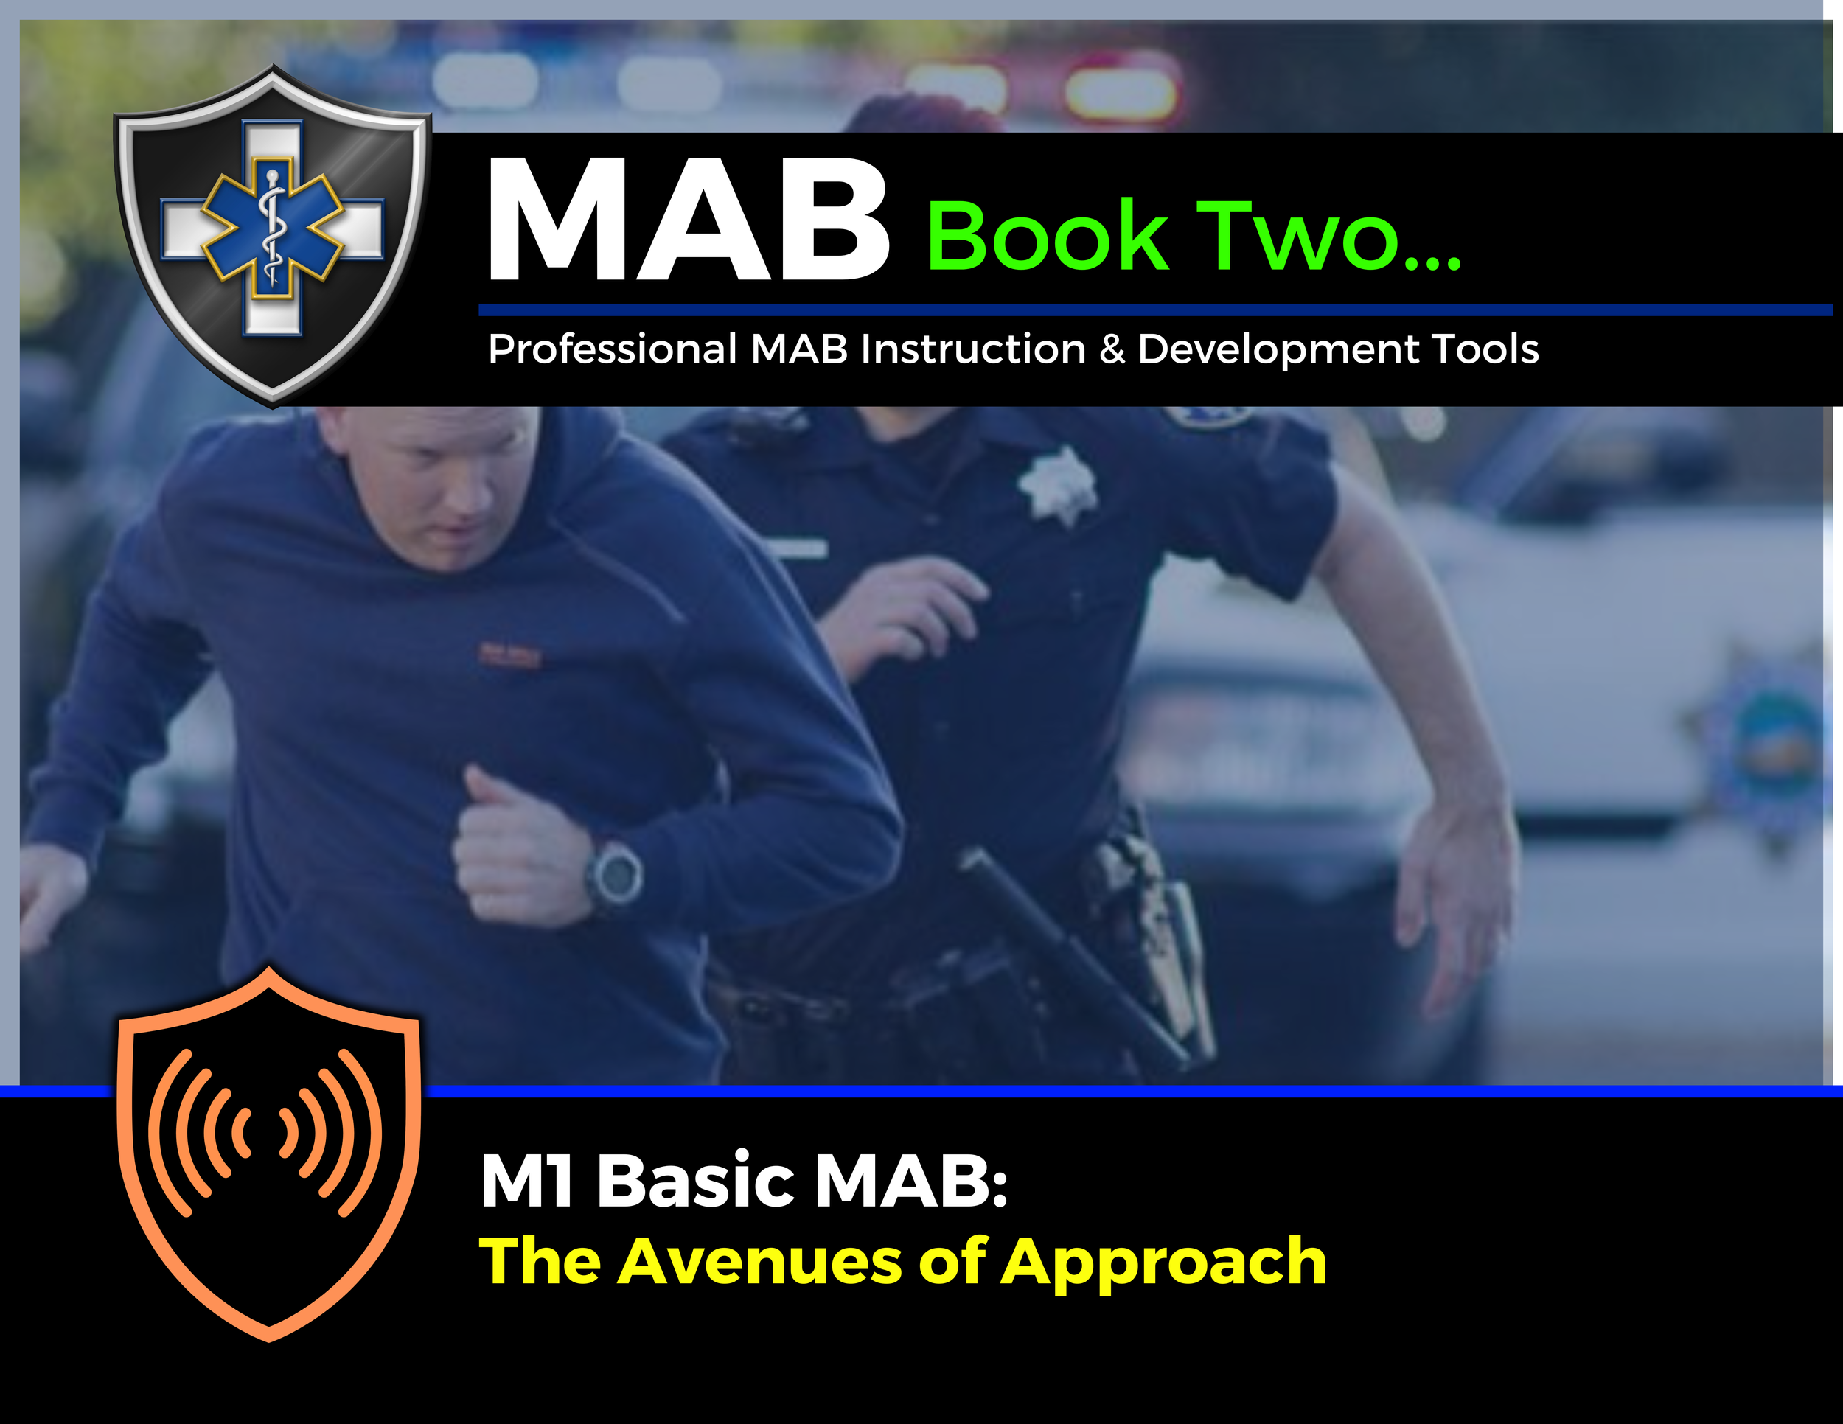

Topic Handouts
www.MABPRO.com

Slide 5

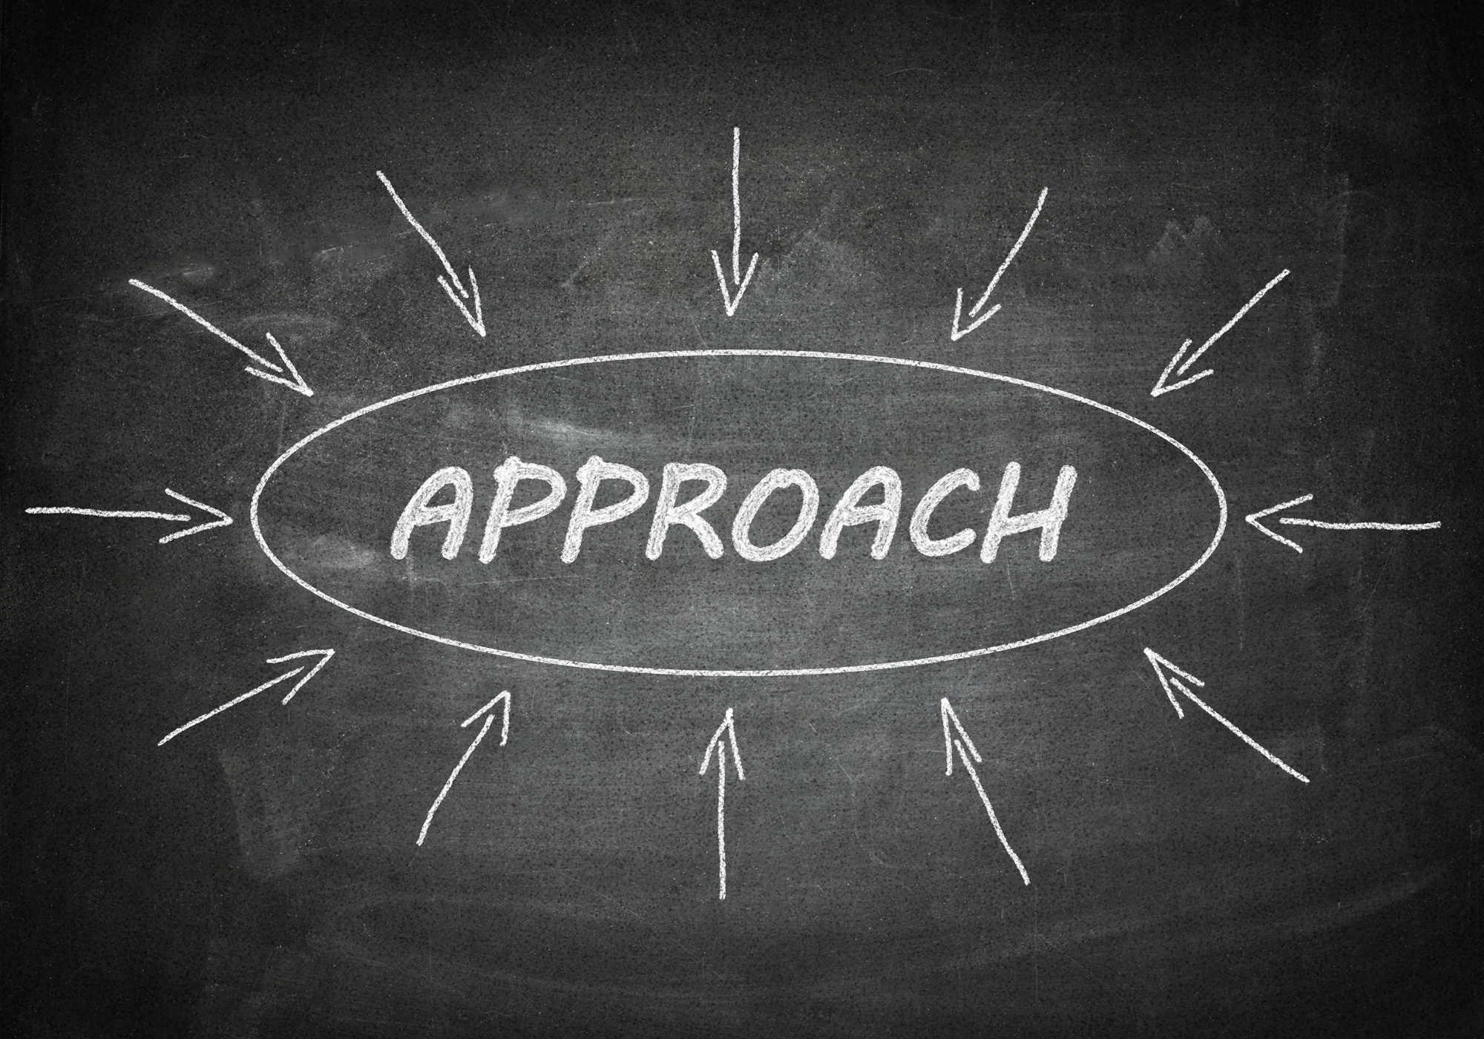
Avenues of Approach...
When we are called to respond to crisis situations it's important for our team members to mindful of their Avenues of Approach.
Our efforts to hurry and help those in crisis sometimes can turn an accidental blind eye towards the acuity that we can bring to the situation as we approach it...
This next topic will walk us through some of the positives and negatives of response team approaches....
www.MABPRO.com

Slide 6

How much acuity do we bring on approach?
  The term avenues of approach refers to the method and manner that a responder team presents when they approach a patient in crisis.
  How much does the acuity increase when a team rushes in to assess and respond to a crisis?
  Consider how your approach and occupation of the environment can impact the situation.
  Adjusting the level of acuity your response brings into the location is key.
www.MABPRO.com

Slide 7

How much acuity do we bring on approach?
  Try to be aware of the following:
  Where they stand about relative to the crisis, accidently crowding or surrounding an escalated individual.
  Are Responders blocking the only exit or doorway?
  How many staff talk simultaneously? When multiple responders are involved, designate one person as the primary communicator. Having too many people speak at once can confuse or overwhelm the patient, escalating tensions.
www.MABPRO.com

Slide 8
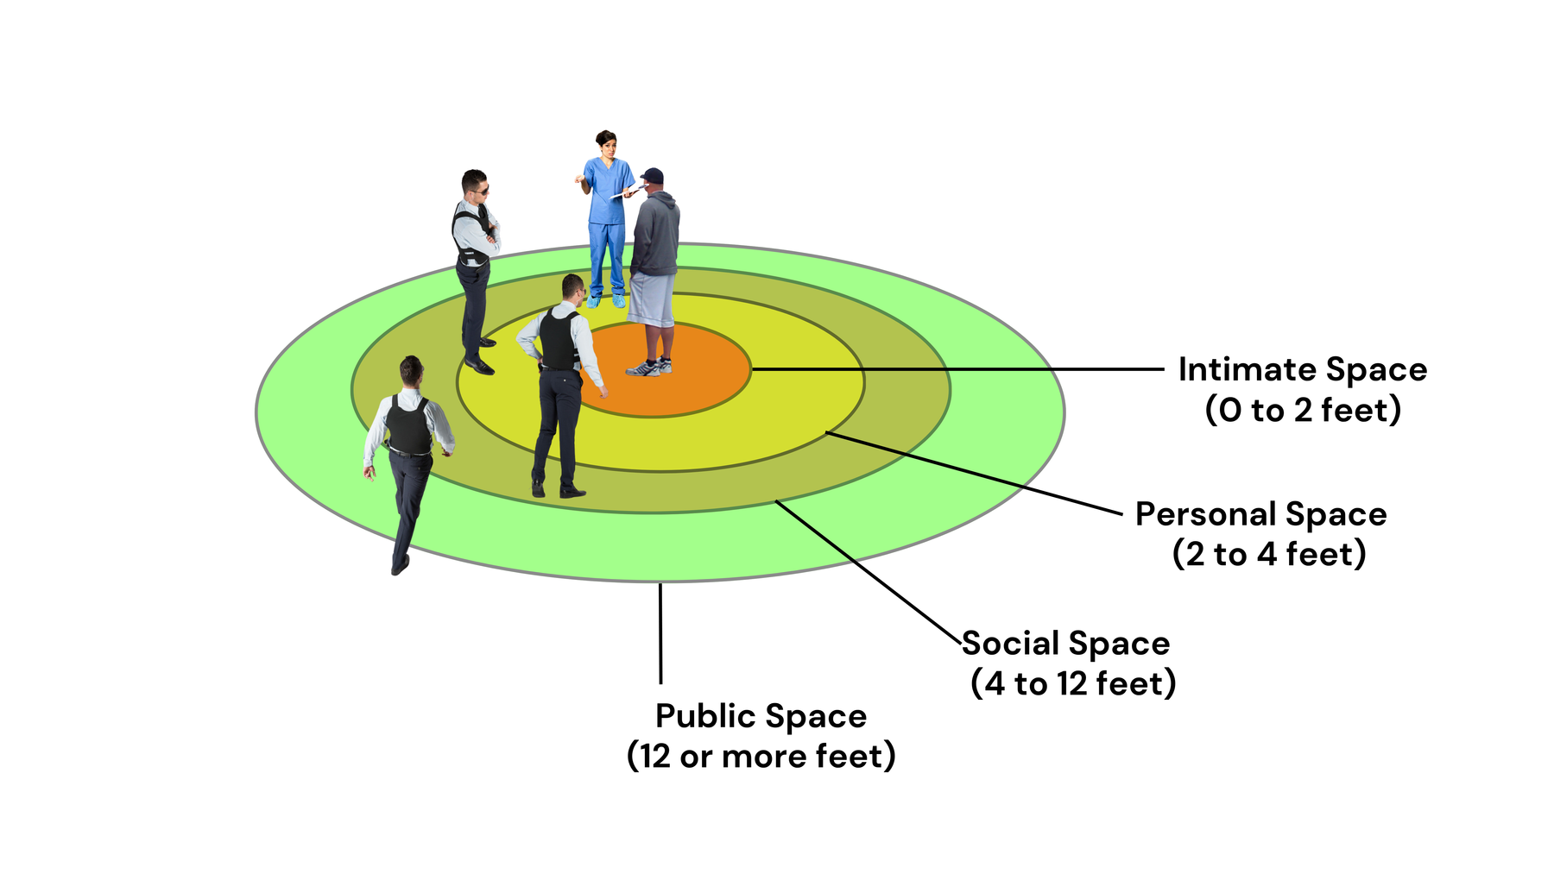
Team Crowding...
Team Crowding - The CRT Team or solo responders instinctively closing on the space in front of the patient or client. Be mindful to not crowd the individual if the variables do not require it
www.MABPRO.com

Slide 9
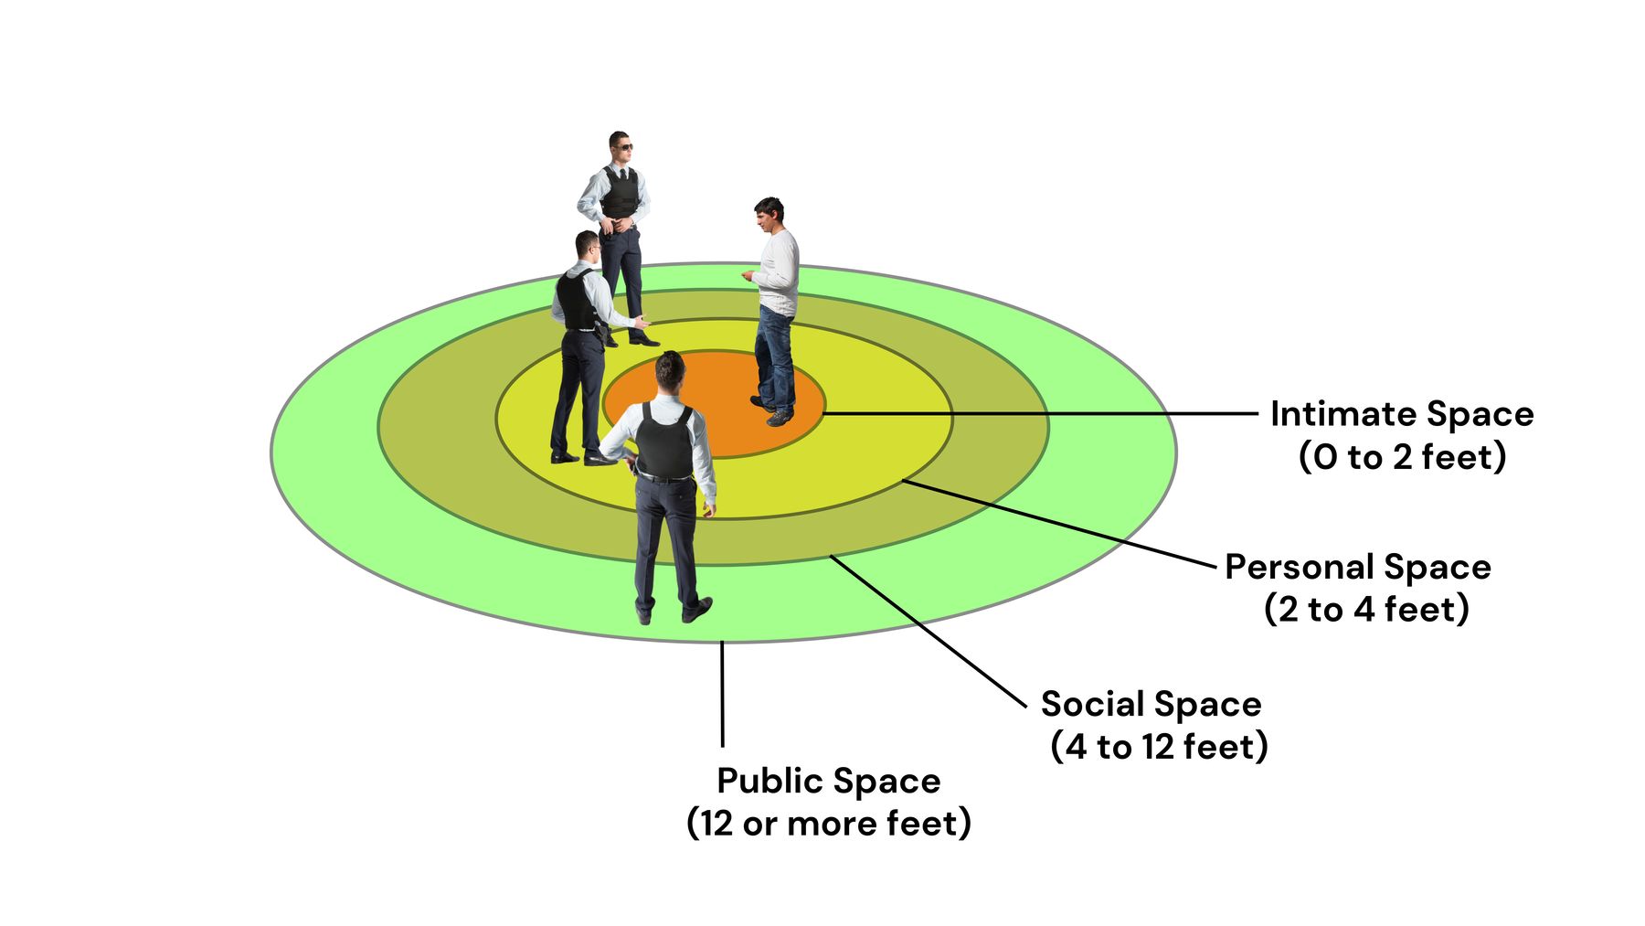
Questionable Team Intent...
Team Intent- The CRT Team, or solo responder, approaches in a manner that leads the individual to question the intent of the team
  Try to not let the team frustration enter into team alignment.
  Be mindful of your facial expressions
  Avoid rushing up toward the client
www.MABPRO.com

Slide 10
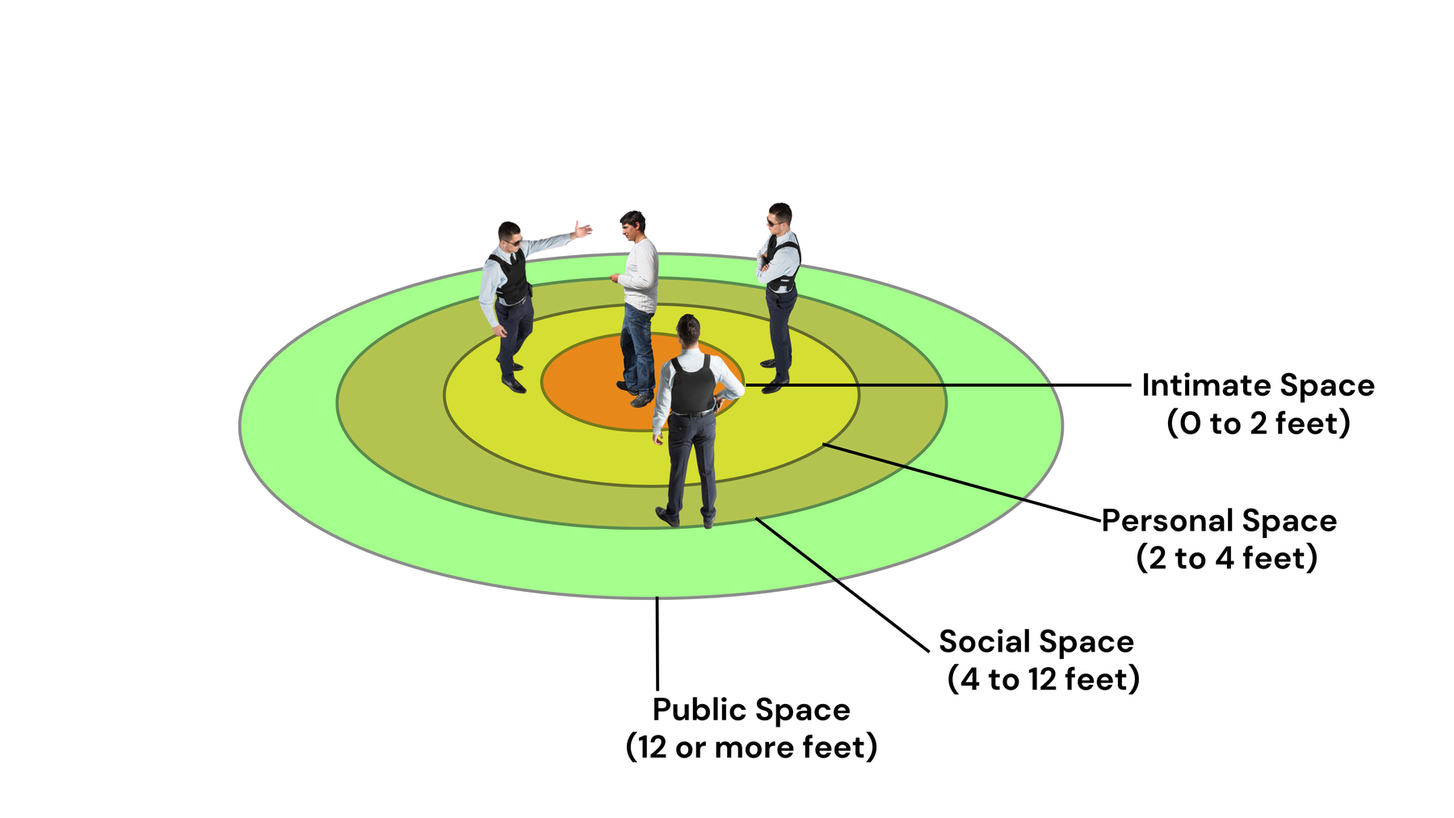
Team Stacking...
Team Stacking - The CRT Team approach closes in on the patient from 2-3 sides.
  This Sometimes occurs when team members arrive at the crisis situation from different locations team stacking occurs.
www.MABPRO.com

Slide 11
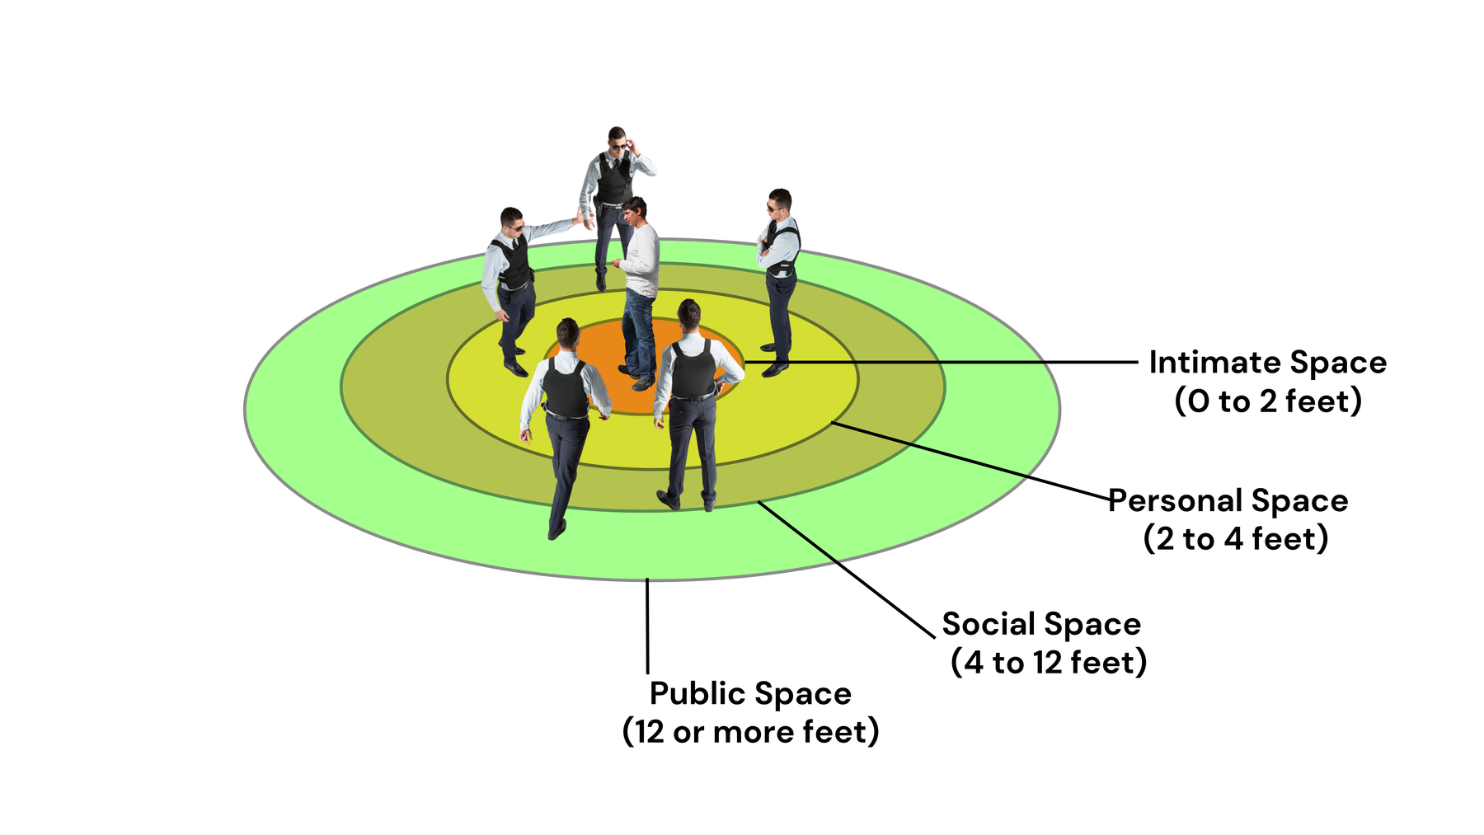
Team Trapping...
Team Trapping - The CRT Team approach surrounds the patient from all sides
  Threat levels climb when a patient feels trapped or surrounded.
www.MABPRO.com

Slide 12
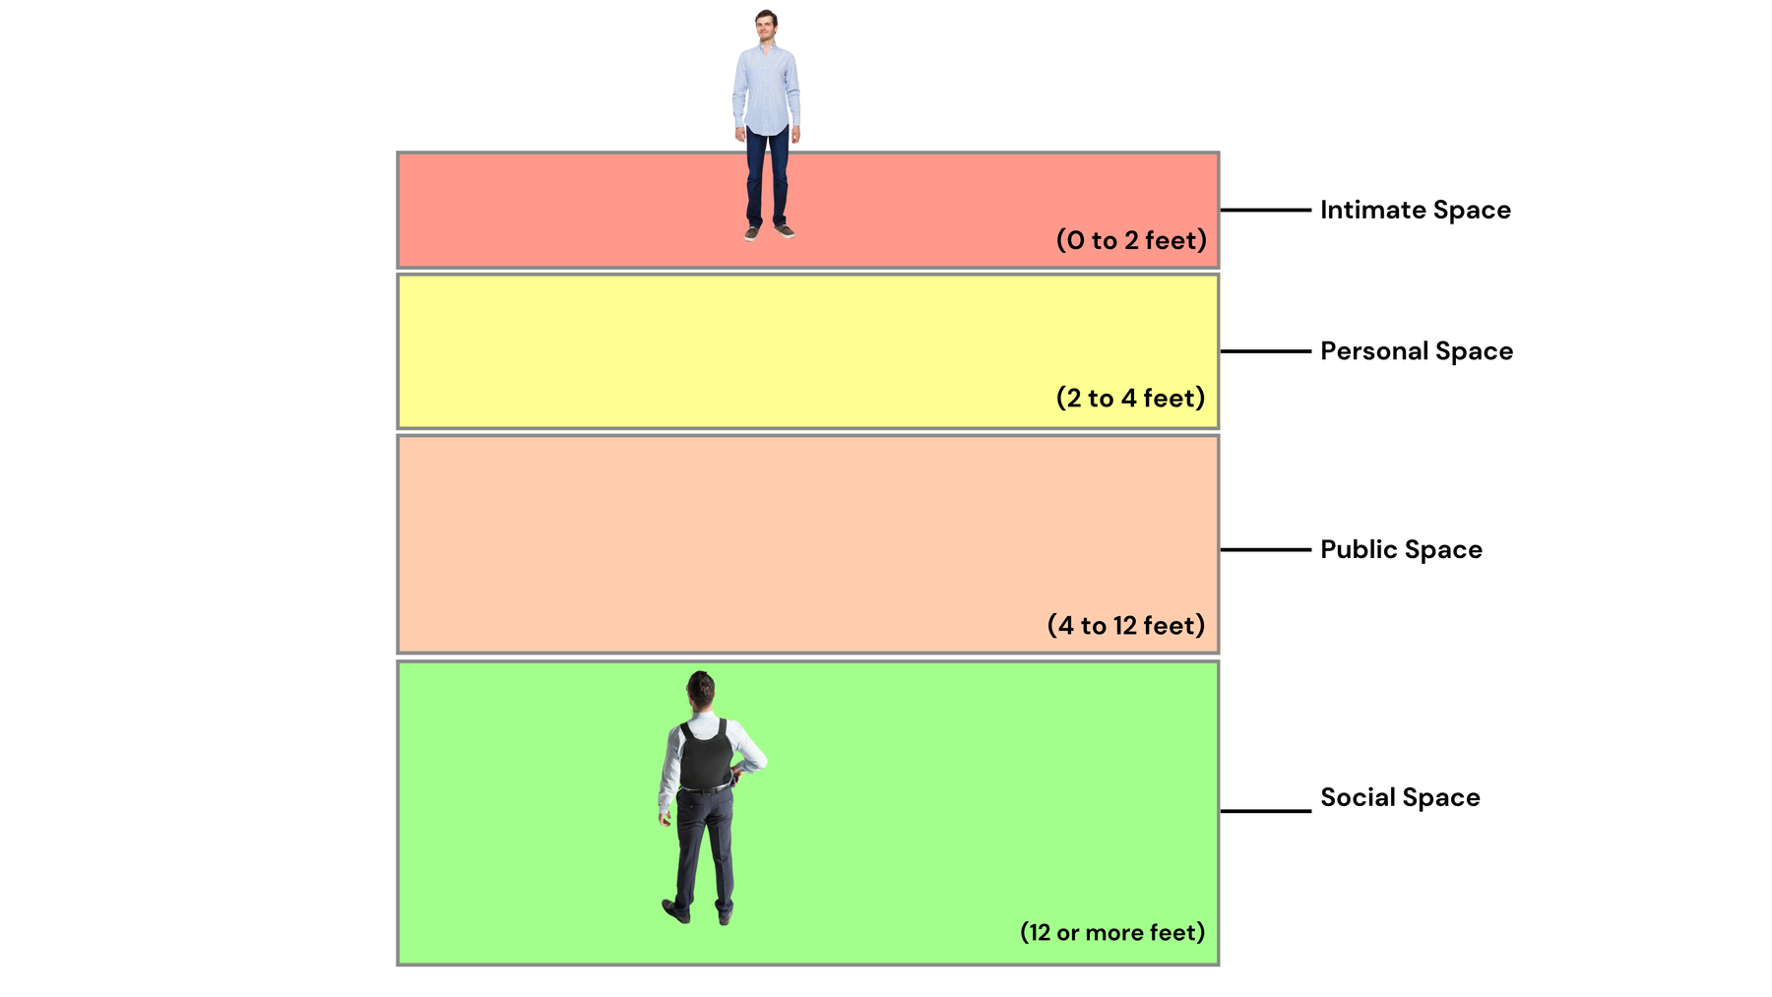
Monitoring the Avenues of Approach...
Monitoring the method and manner of avenues of approach in crisis response is essential because how a responder enters a space—physically and psychologically—can either escalate or de-escalate the situation.
The “avenue of approach” refers to the path a responder takes toward an individual in crisis, and the method and manner describe how that approach is executed: posture, pacing, angle, proximity, and presence.
These elements are deeply tied to proxemics and nonverbal communication, and they shape the emotional tone of the interaction before a single word is spoken.
www.MABPRO.com

Slide 13
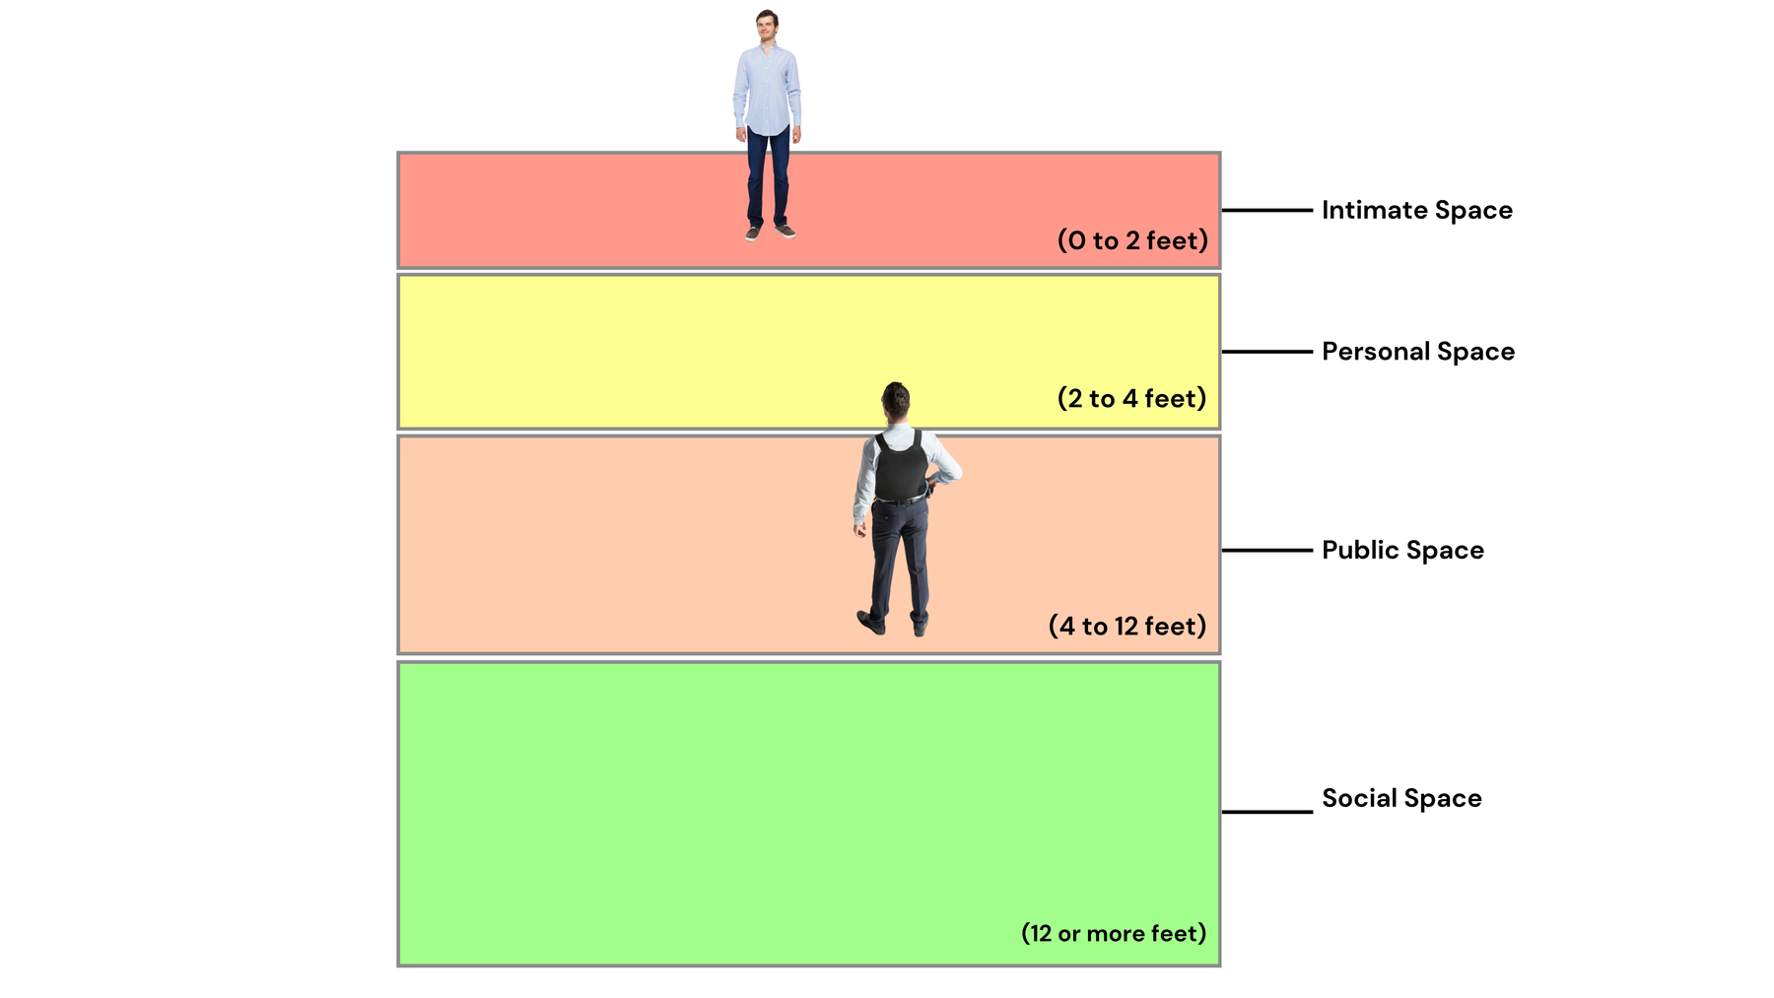
Monitoring the Avenues of Approach...
A direct, fast, or head-on approach may feel threatening or confrontational, especially to someone in a heightened emotional state or with a trauma history. In contrast, a slow, angled, and respectful approach signals calm, control, and empathy.
Monitoring these factors allows responders to adjust in real time—reading cues like flinching, withdrawal, or defensive posture—and respond with sensitivity.
It also supports situational awareness, giving the responder time and space to assess risk, observe body language, and maintain safe boundaries.
www.MABPRO.com

Slide 14
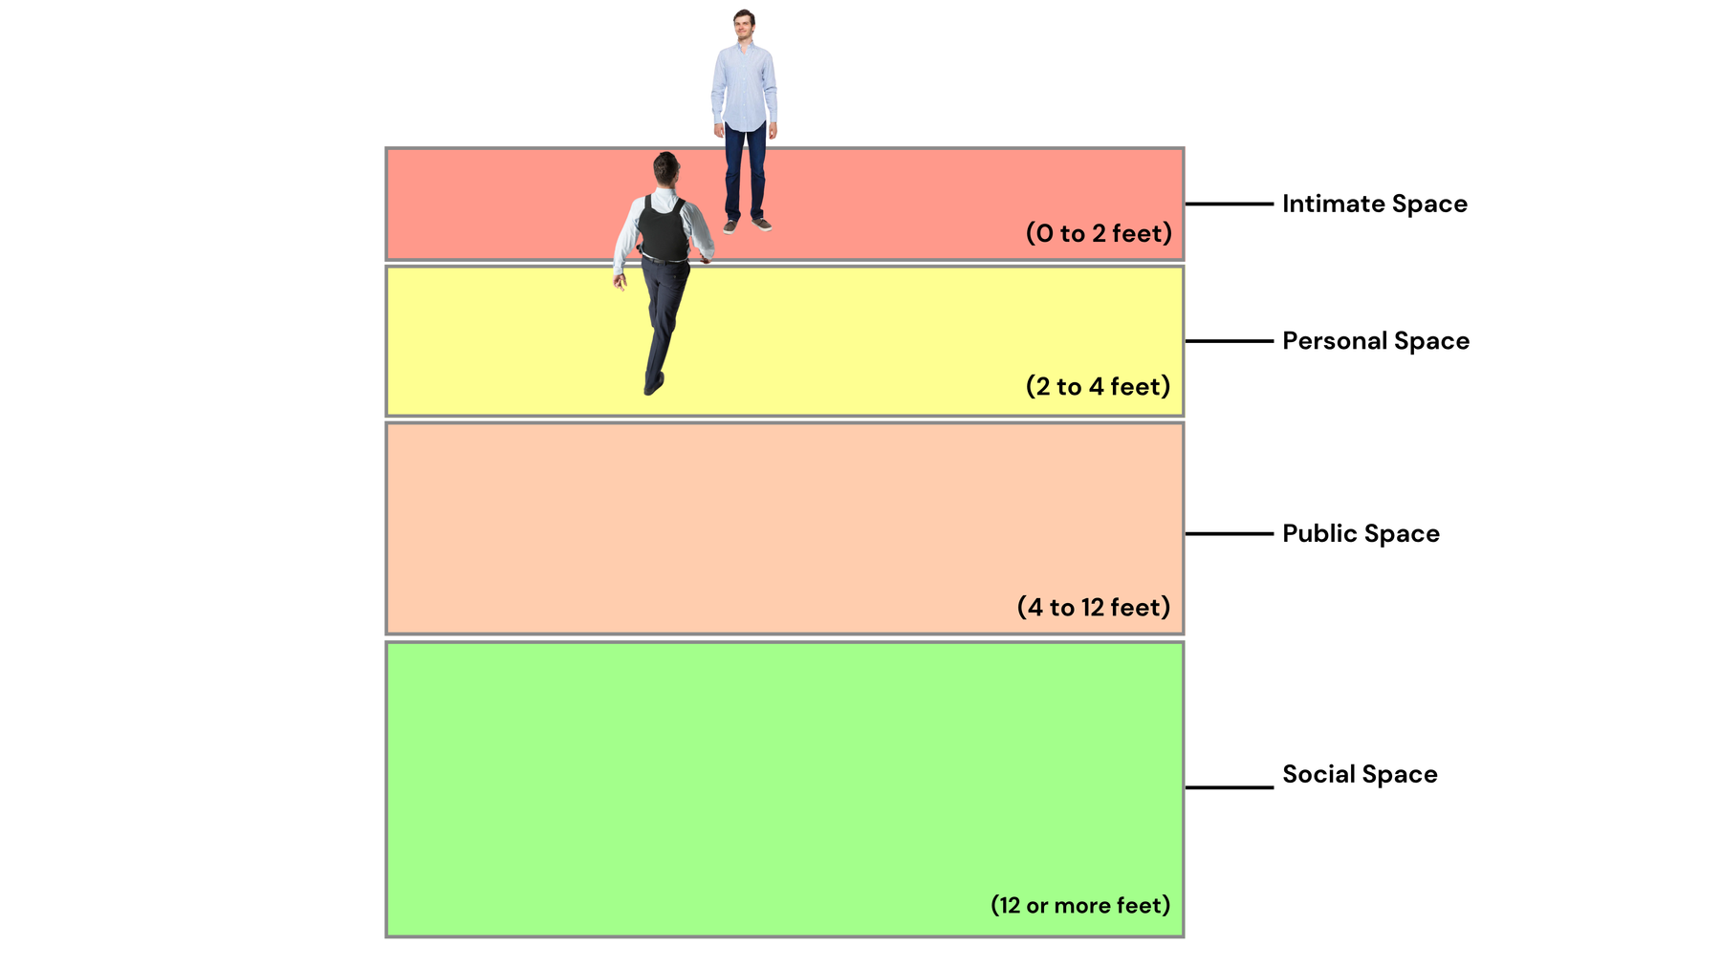
Monitoring the Avenues of Approach...
In trauma-informed crisis response, the goal is not just to reach the individual, but to do so in a way that preserves dignity, minimizes triggers, and fosters psychological safety.
By consciously managing the method and manner of approach, responders communicate respect, reduce perceived threat, and lay the groundwork for trust and cooperation.
This is especially critical in MAB training, where spatial dynamics and emotional regulation are central to effective intervention...
www.MABPRO.com

Slide 15
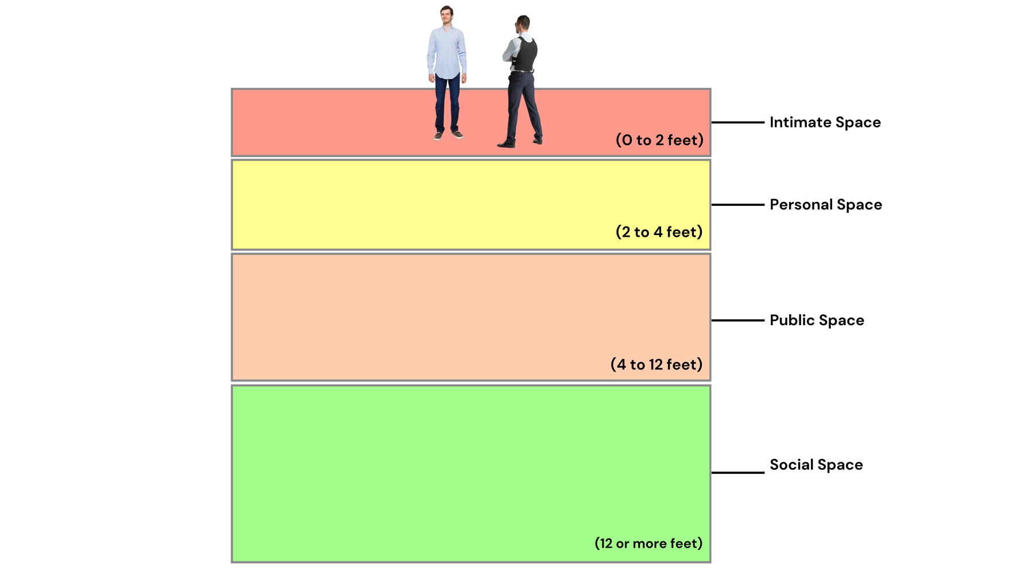
Our goal is to maximize communication...
The primary goal of crisis negotiation is to resolve high-stakes, emotionally charged situations peacefully, with a strong emphasis on preserving life and minimizing harm.
Our professional utilization of the avenues of approach helps us to maximize the our communication efforts towards conflict resolution.
www.MABPRO.com

Slide 16
Space to think...
“Having a clear mind and a clear space allows you to think and act with purpose.”
- Erika Oppenheimer
www.MABPRO.com

Slide 17
Management of Assaultive Behavior (MAB)
Workplace Violence Prevention Course...
Thank You!
www.MABPRO.com

