Slide 1








Management of Assaultive Behavior (MAB)
Workplace Violence Prevention Course...
M1 Basic MAB - Book Two: Lesson 7- Supporting Safe Boundaries
GET STARTED
www.MABPRO.com

Slide 2

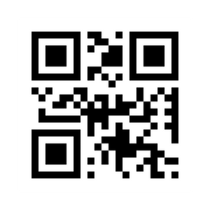
M1 Basic MAB: Book Two - Student Guide
www.MABPRO.com

Slide 3
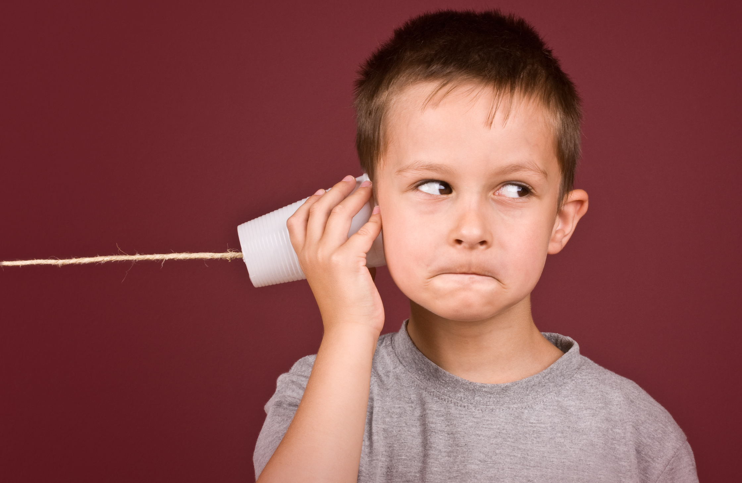

Topics...
1.
2.
Supporting Safe Boundaries
Trying to Confirm Permission
www.MABPRO.com

Slide 4
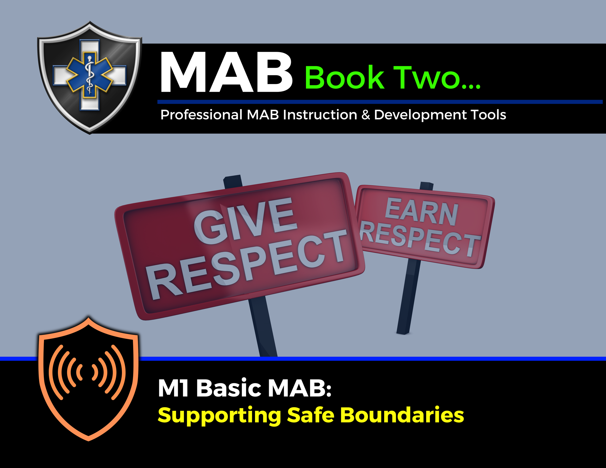

Topic Handouts
www.MABPRO.com

Slide 5


Supporting Safe Boundaries...
Now that we understand how proxemic influence is measured we need to also understand the application of safe boundaries.
While Proxemic influence is understood and intuitively measured by most, safe boundaries are learned and reinforced by individual life experiences.
A safe boundary can be set at any of the Proxemic Intervals, or it can encompass all of them. It is the level the patient feels most comfortable that determines the safe boundary.
www.MABPRO.com

Slide 6
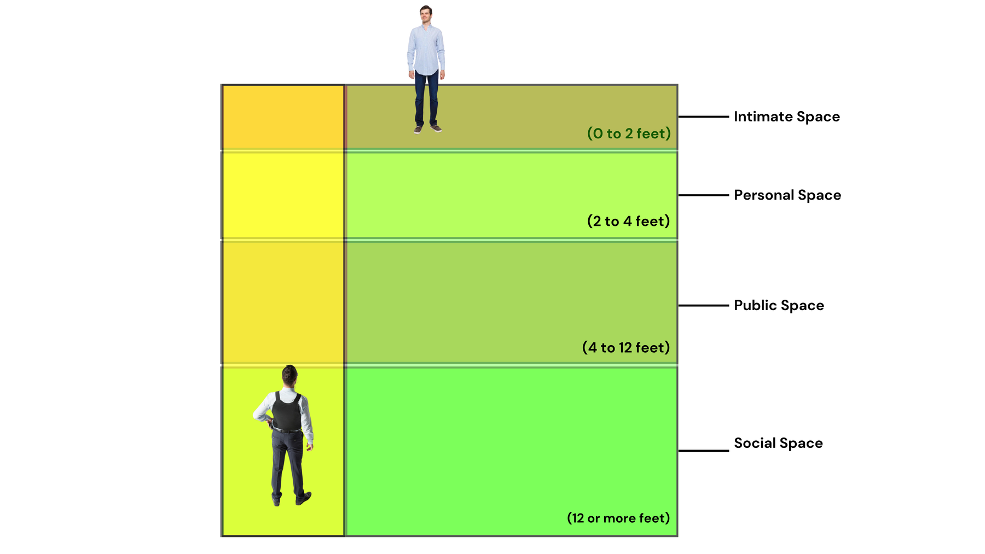
Sometimes where we stand influences the intuitive space where people can feel less encumbered by our presence...
In the diagram the responder is purposefully leaving open the proxemic influence to provides distance and intuitive comfort to the individual in conflict.
www.MABPRO.com

Slide 7
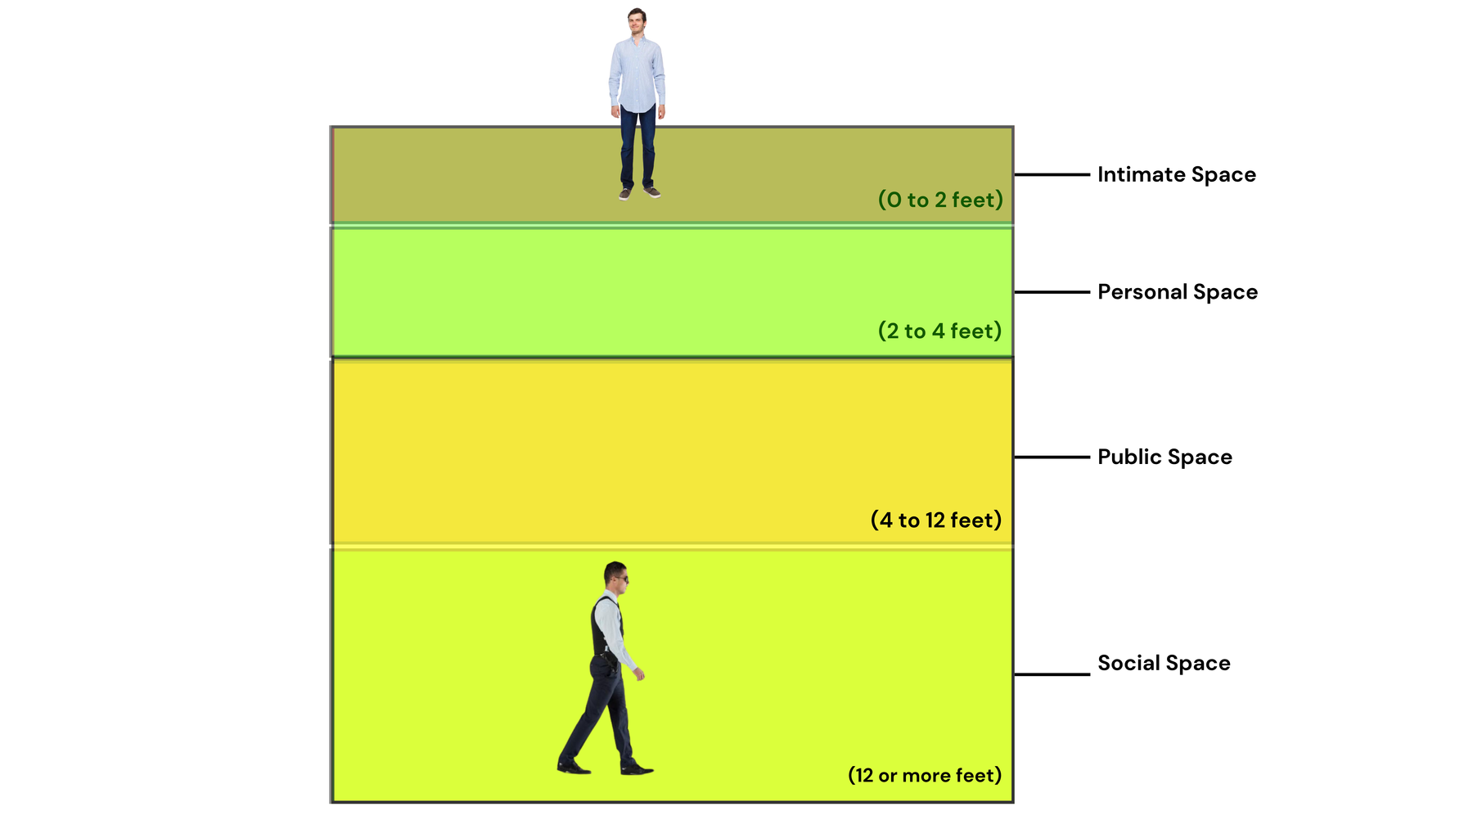
Understand the impact that your movement can have on communication...
In the diagram the responder is moving to reposition to create more of a influential proxemic footprint.
Be careful, and be aware of potential negative messages that movement can present.
www.MABPRO.com

Slide 8

Do we have permission?
Confirming the patient's permission to advance closer is the one thing that ties all of the proxemic intervals together and supports the development of Safe Boundaries.
Your ability to read the variables and process the levels and types of communication will help you trust but verify the approach is safe and is seen as help.
www.MABPRO.com

Slide 9
Trying to confirm permission...
“There are no perfect methods for instantly knowing the Safe Boundaries of another, we do our best to move in a measured way to communicate intent and receive permission to approach...”
www.MABPRO.com

Slide 10
Management of Assaultive Behavior (MAB)
Workplace Violence Prevention Course...
Thank You!
www.MABPRO.com

