Slide 1








Management of Assaultive Behavior (MAB)
Workplace Violence Prevention Course...
M1 Basic MAB - Book Two: Lesson 6 - Understanding Proxemics
GET STARTED
www.MABPRO.com

Slide 2


M1 Basic MAB: Book Two - Student Guide
www.MABPRO.com

Slide 3
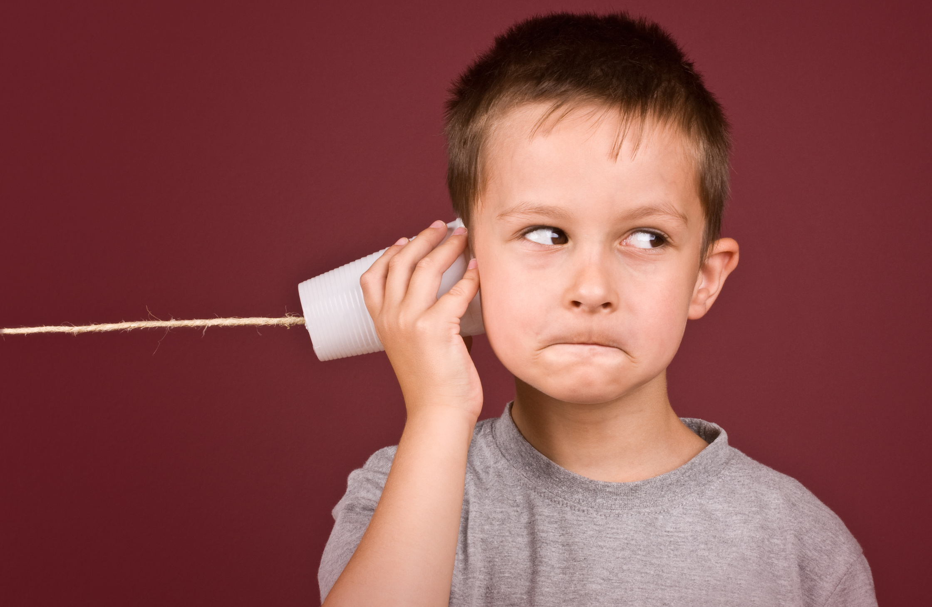

Topics...
1.
2.
3.
4.
Understanding Proxemics
Why Proxemics Matters in Crisis Response
Proxemics & Situational Awarensss
How to Better Utilize Proxemics
www.MABPRO.com

Slide 4
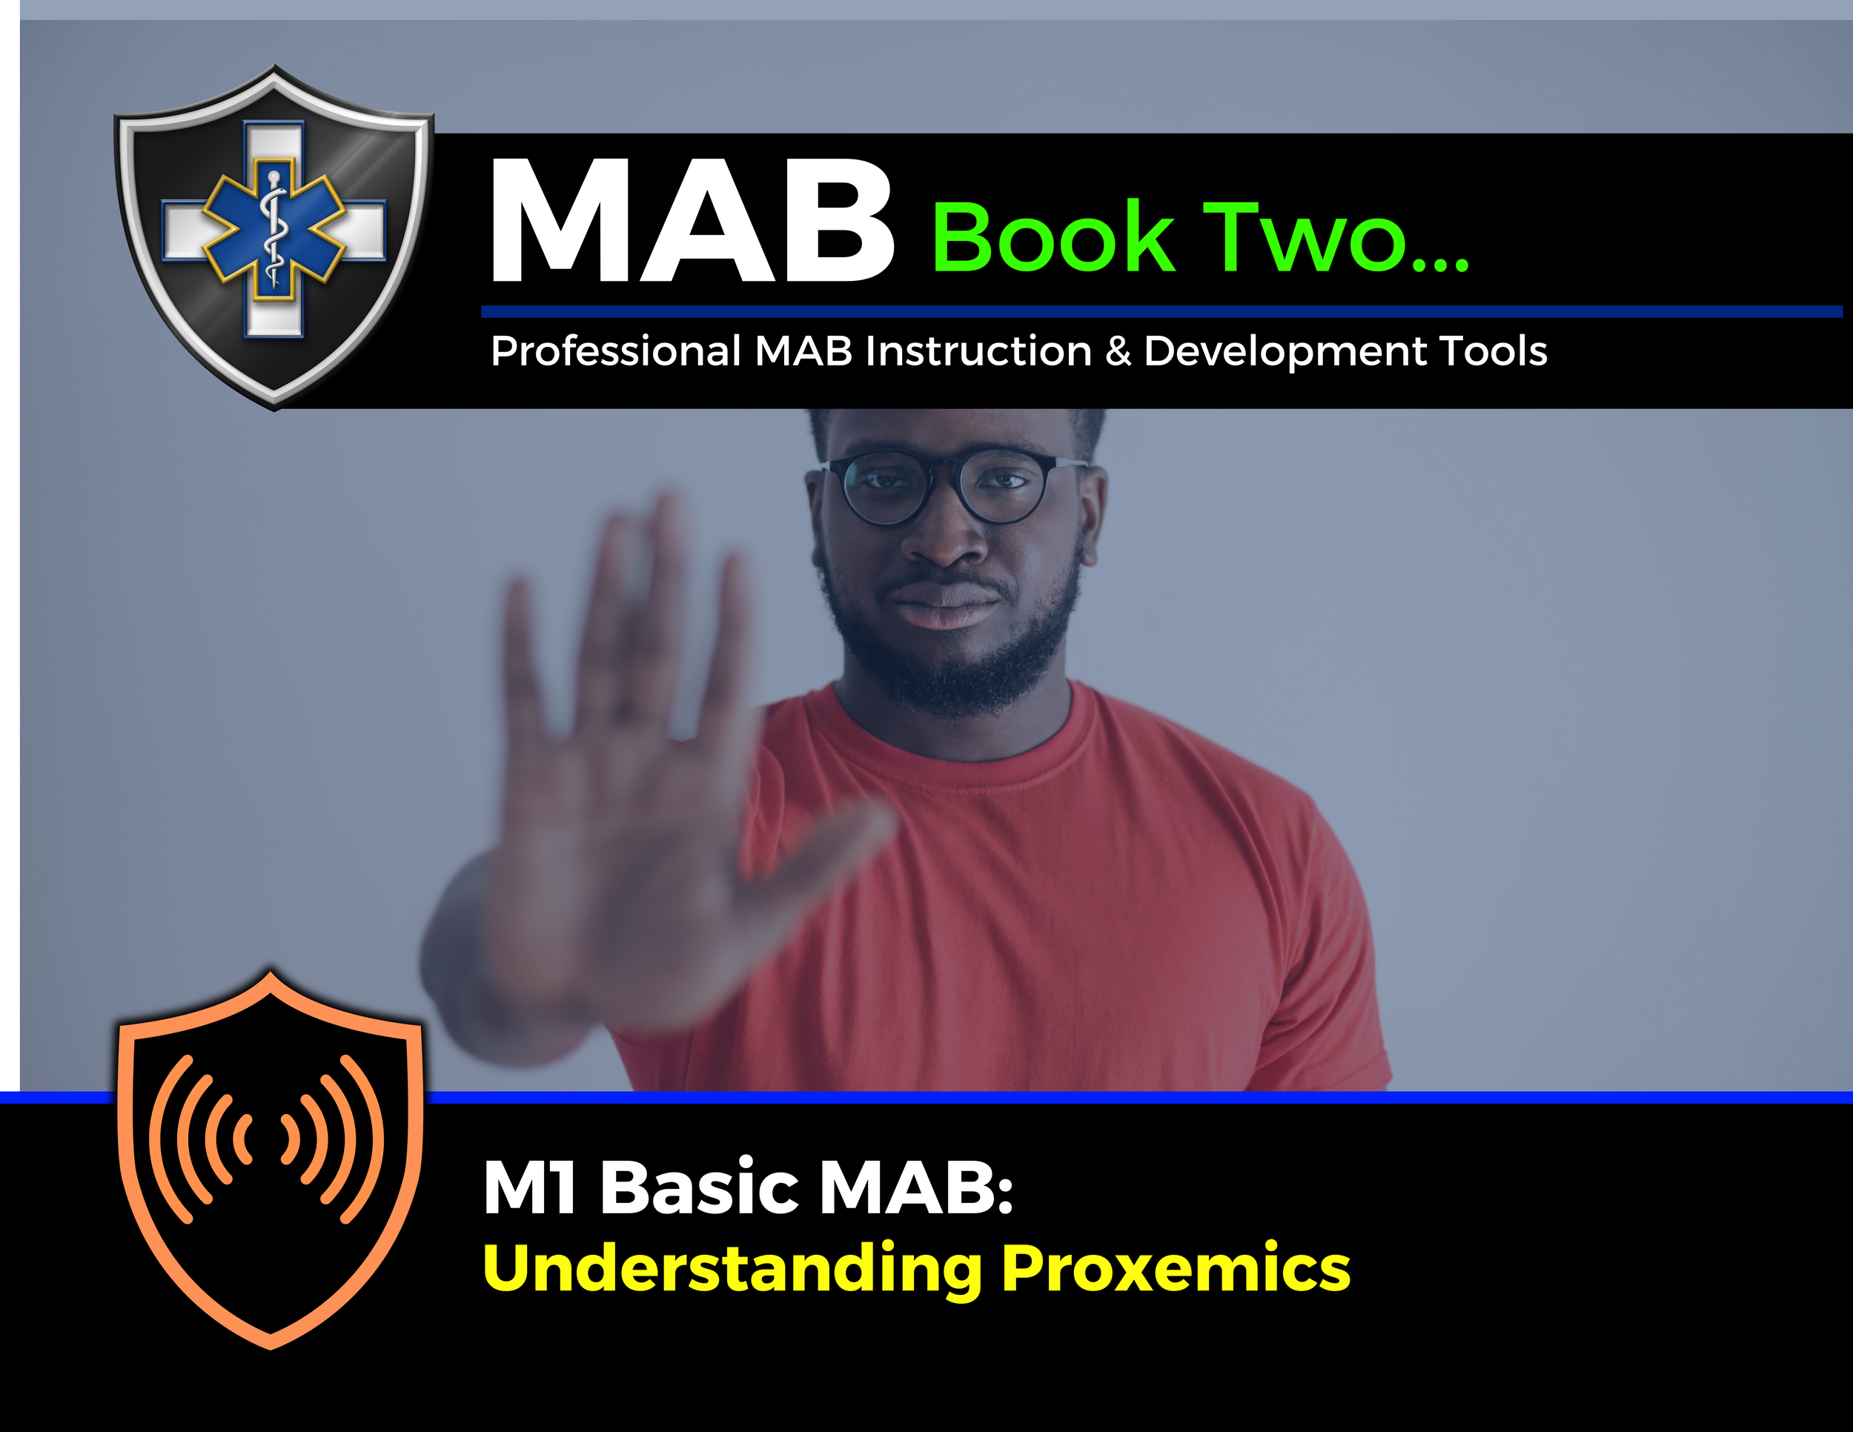

Topic Handouts
www.MABPRO.com

Slide 5


Understanding Proxemics...
Welcome to today's lesson on Proxemics. The MAB definition of proxemics is how we influence space by how we occupy space.
This crucial skill set helps provide the distance needed to help see and read crisis variables when responding to workplace violence.
Now, lets begin...
www.MABPRO.com

Slide 6
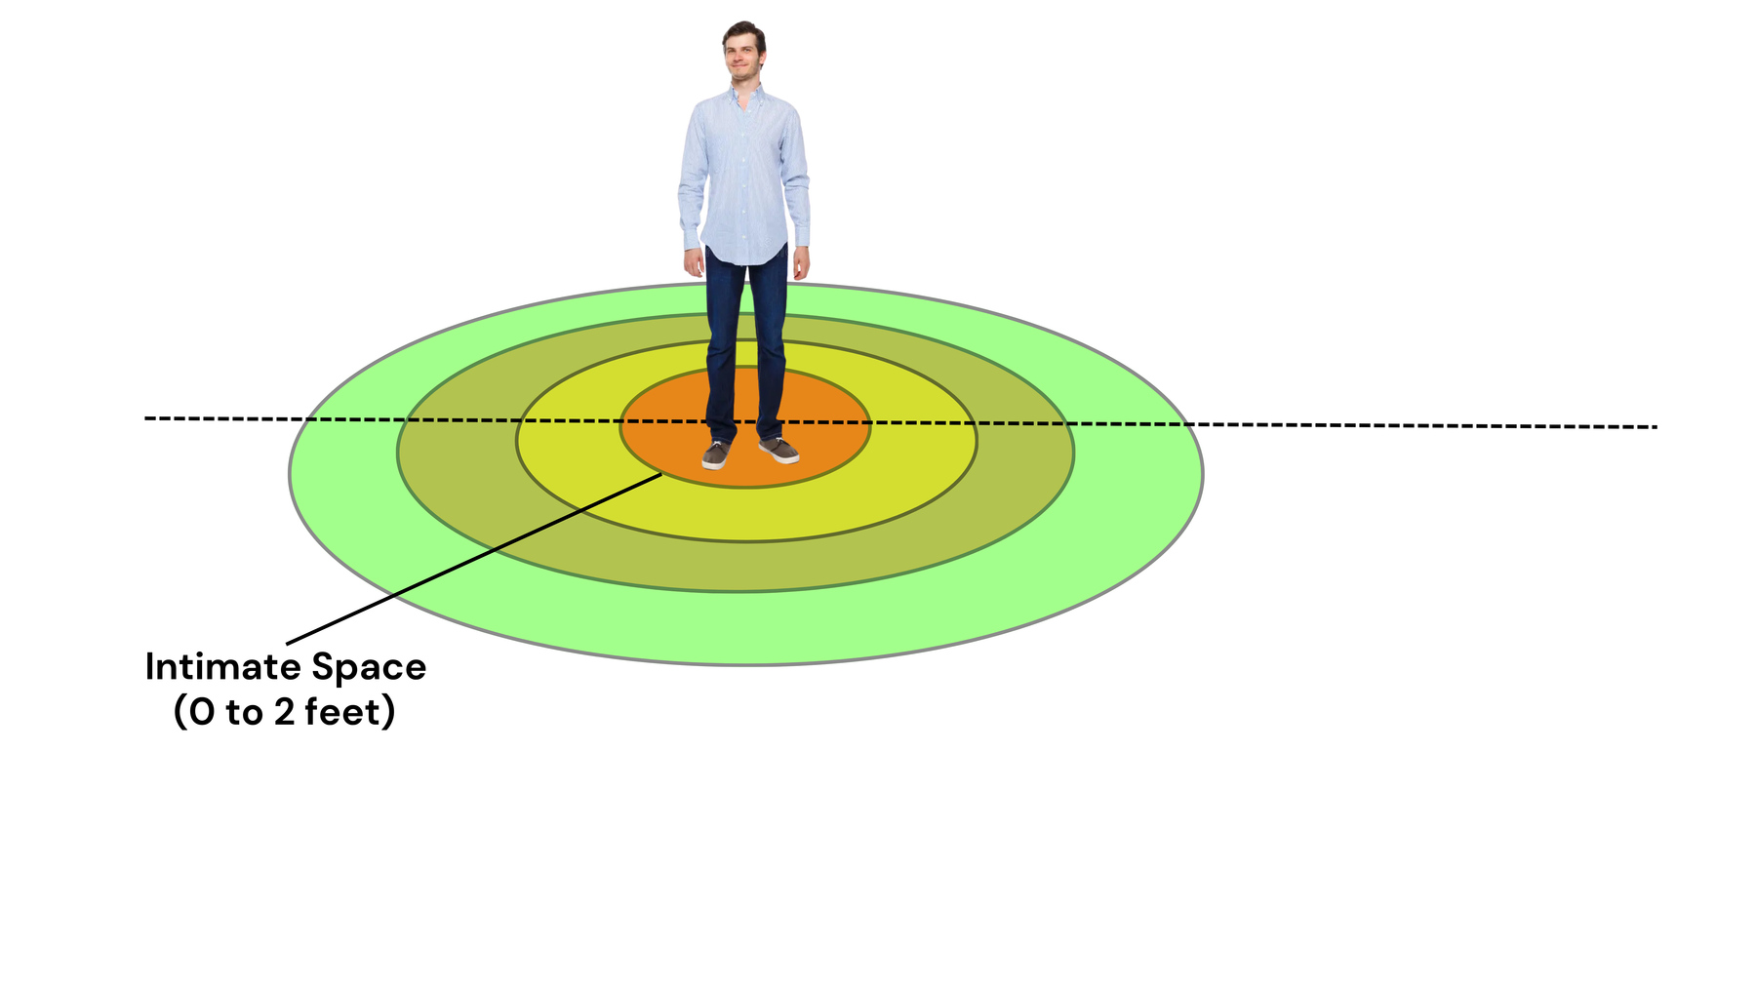
Intimate Space...
There are four basic levels of measured proxemic influence.
The first influential measurement starts with intimate space, usually representing 0 to 2 feet away from the patient, the zone reserved for close relationships.
For those who work in the healthcare field, this is the space we enter when providing direct patient care, like administering a vaccine. It's vital to be aware of this boundary and respect it to build trust.
www.MABPRO.com

Slide 7
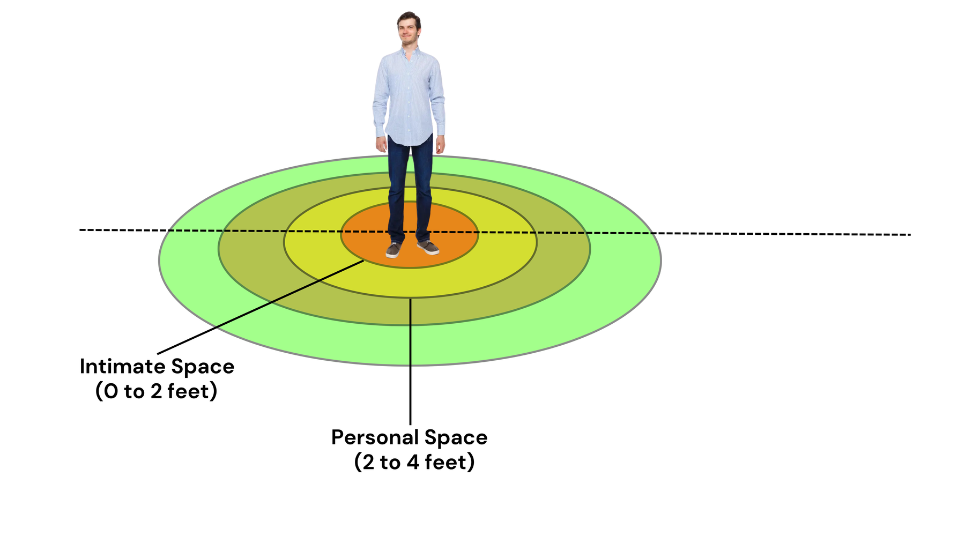
Personal Space...
Next is personal space, measured 2 to 4 feet from the patient, the comfortable distance for interactions with friends and family.
In a healthcare setting, this might be the distance you maintain when discussing a patient's care plan with their loved ones. Maintaining this space helps foster open communication.
www.MABPRO.com

Slide 8
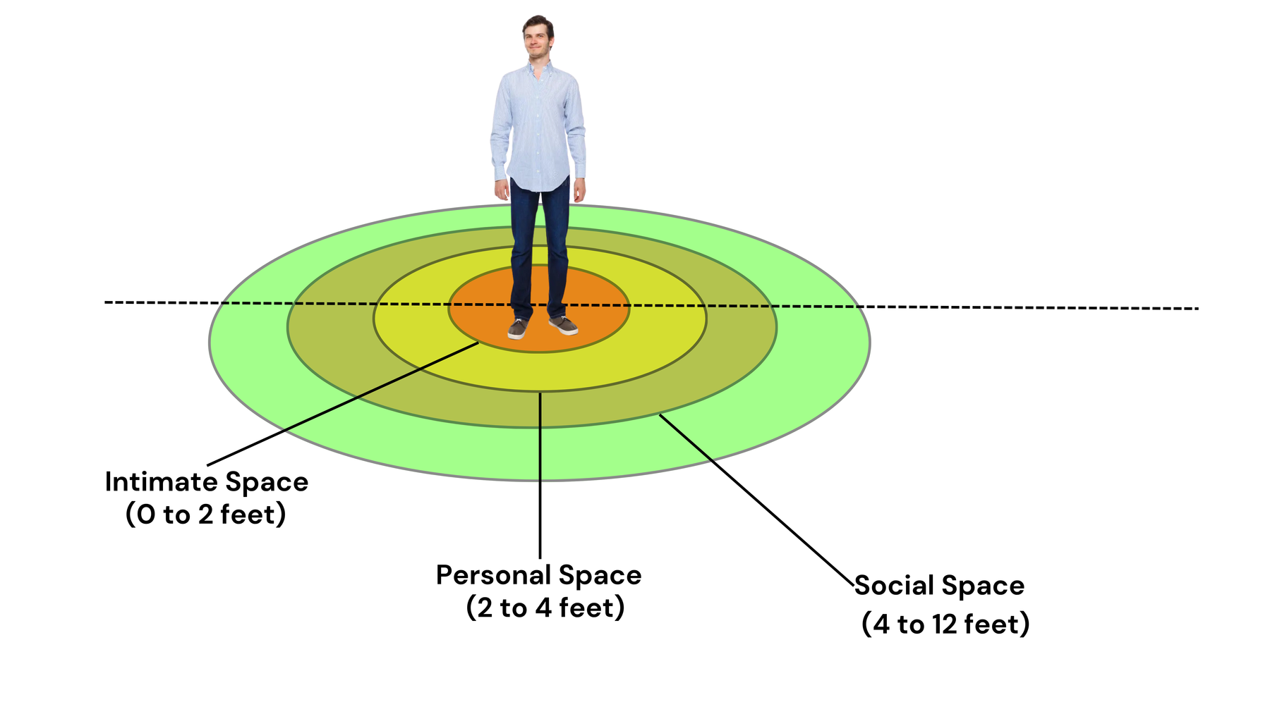
Social Space...
Now, let's consider social space, measured 4 to 12 feet from the patient, the distance we keep with acquaintances.
Think of interactions in a shared workspace or during a team meeting. Being mindful of this distance to promote a professional and comfortable environment.
www.MABPRO.com

Slide 9
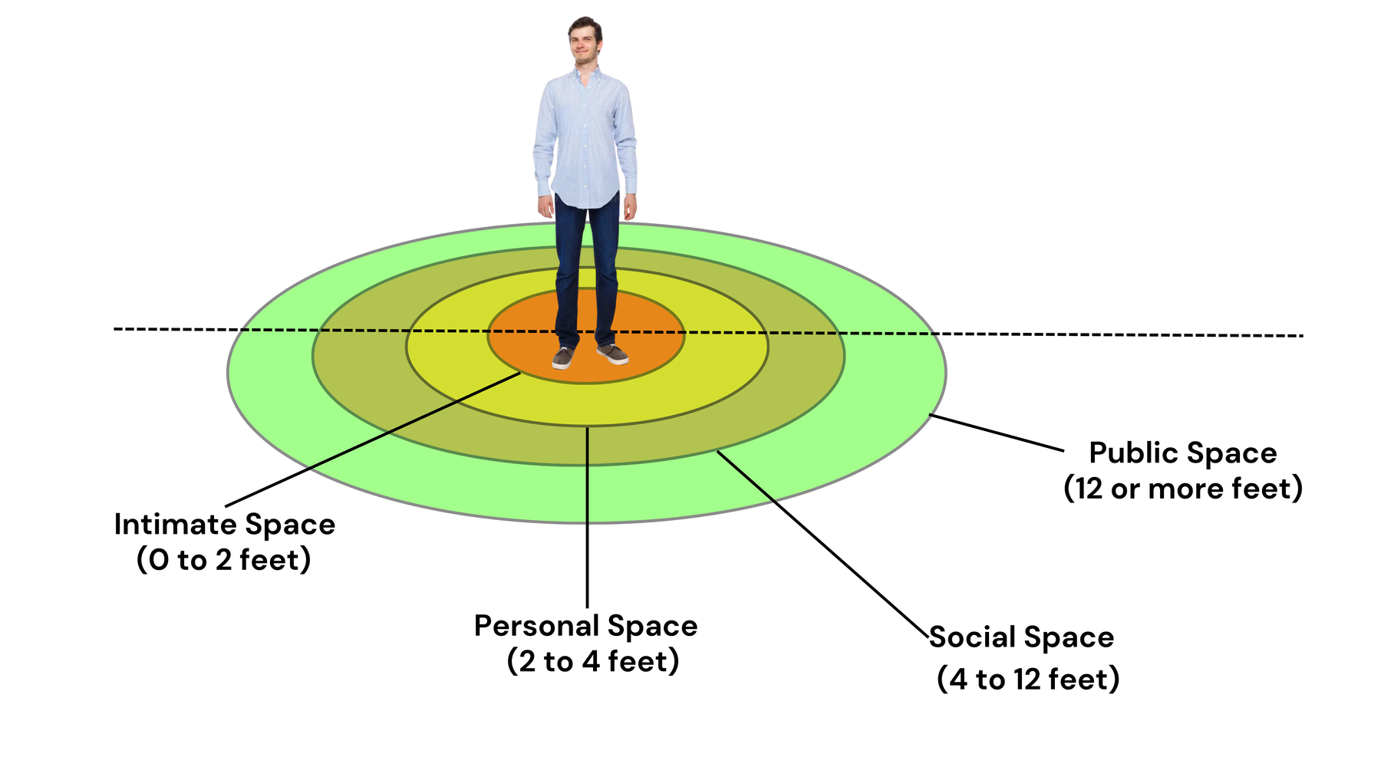
Public Space...
Finally, we have public space, measured 12 feet or more away from the patient, used for public speaking or addressing a large group.
This is the distance we maintain when giving presentations or addressing a crowd. Understanding this distance helps project confidence and maintain control.
www.MABPRO.com

Slide 10

Why does Proxemics Matter in
Crisis Response?
Proxemics is a concept that becomes critical when responding to workplace violence, behavioral escalations, or emotionally charged interactions. The physical distance between individuals, the angle of approach, and the responder’s body orientation can either escalate or de-escalate a situation.
FOR INSTANCE...
Standing too close or directly in front of someone in distress may feel threatening, while maintaining a respectful buffer zone and positioning oneself at a slight angle can reduce perceived aggression and foster psychological safety.

Slide 11
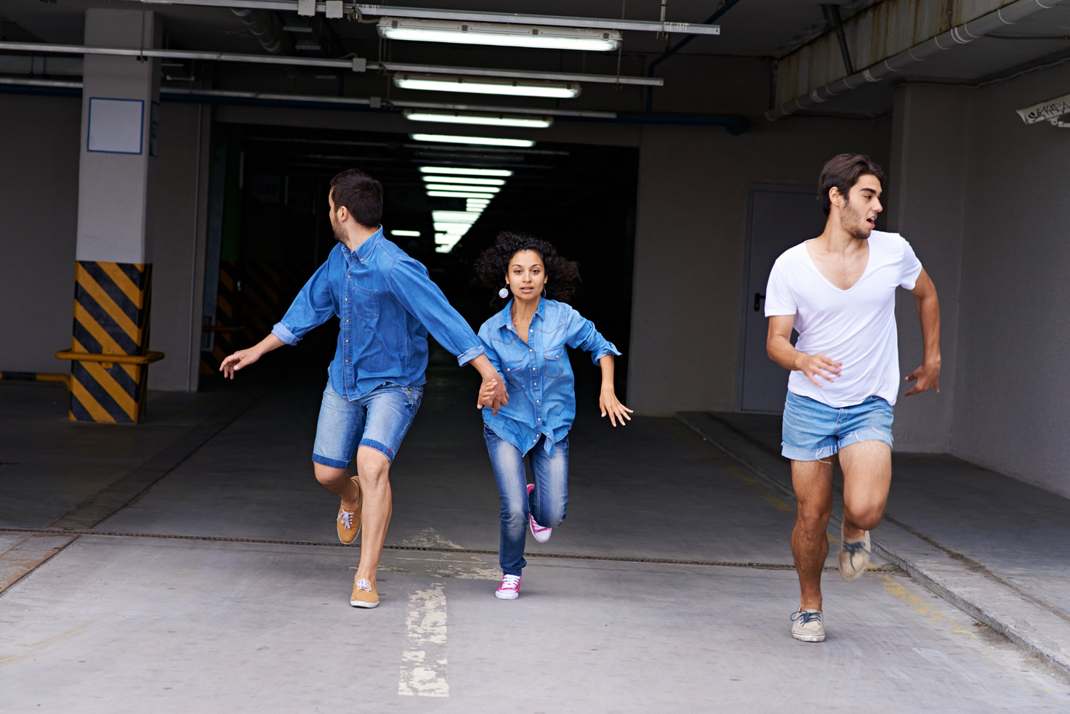
Proxemics and Situational Awareness...
Proxemics also enhances situational awareness. By keeping appropriate distance, responders can better observe nonverbal cues—such as clenched fists, shifting posture, or signs of withdrawal—that signal potential escalation. This spatial awareness allows for quicker, more informed decisions and helps responders maintain control without resorting to force.
n trauma-informed care, proxemics is especially vital because it respects personal boundaries and minimizes triggers. Ultimately, mastering proxemics allows crisis responders to communicate calm, authority, and empathy—without saying a word.

Slide 12
How to Better Utilize Proxemics...
  To better use proxemics in crisis response, you need to treat space as a strategic tool—one that shapes perception, regulates emotion, and enhances safety.
  Proxemics isn’t just about distance; it’s about how your presence influences the environment and the people within it.

Slide 13
Here’s how to refine your use of proxemics for maximum impact:
Maintain a safe buffer zone Keep enough distance to observe body language and react if needed, but not so far that you appear disengaged. This balance helps you stay alert while signaling respect for personal space.
Use angled positioning Standing at a slight angle rather than head-on reduces perceived threat and creates a more collaborative dynamic. It also allows for smoother movement and clearer exits if needed.
Control your pacing and movement Move slowly and predictably. Sudden gestures or abrupt shifts can trigger anxiety or defensive reactions. Your movement should feel intentional and calming.
www.MABPRO.com

Slide 14
Here’s how to refine your use of proxemics for maximum impact:
Respect cultural and trauma-informed boundaries Different individuals and communities have varying comfort levels with proximity. Always err on the side of caution and adjust based on cues like flinching, withdrawal, or eye aversion.
Use space to de-escalate Step back if someone becomes agitated. Giving space can reduce pressure and allow the person to regulate themselves. Conversely, stepping forward too quickly can escalate tension.
Orient yourself for visibility and accessibility Position yourself where you can be seen and heard clearly, without crowding. This is especially important in group settings or when guiding someone through a stressful environment.
www.MABPRO.com

Slide 15

Developing Rapport through Proxemics:
Developing rapport through proxemics means using space intentionally to foster trust, emotional safety, and connection—especially in crisis response settings where verbal communication may be strained or ineffective.
To build rapport, responders can begin by maintaining a respectful buffer zone that honors personal boundaries while still signaling presence and support.

Slide 16
Proxemics...
“Proxemics is defined as how we influence space by how we occupy space, and when used skillfully, it becomes a silent but powerful tool for building relational bridges”
www.MABPRO.com

Slide 17
Management of Assaultive Behavior (MAB)
Workplace Violence Prevention Course...
Thank You!
www.MABPRO.com

