Slide 1








Management of Assaultive Behavior (MAB)
Workplace Violence Prevention Course...
M1 Basic MAB - Book Two: Lesson 4 - Visual Communication
GET STARTED
www.MABPRO.com

Slide 2

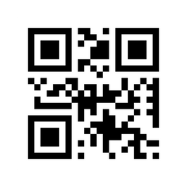
M1 Basic MAB: Book Two - Student Guide
www.MABPRO.com

Slide 3
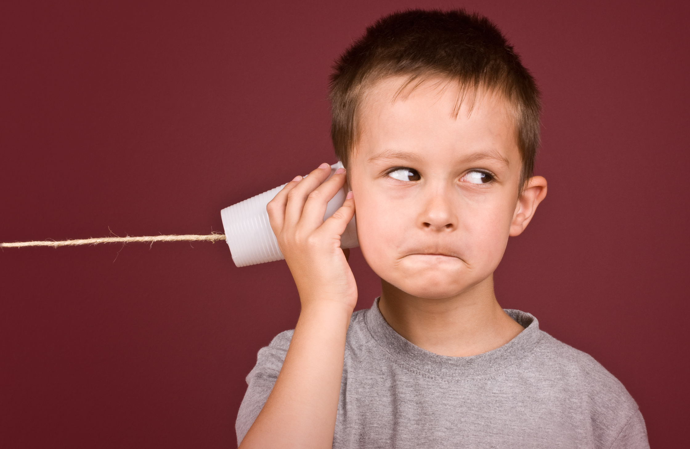

Topics...
1.
2.
3.
Visual Communication
Non-Verbal Forms of Communication
Tips on Utilizing Non-Verbal Communication
www.MABPRO.com

Slide 4
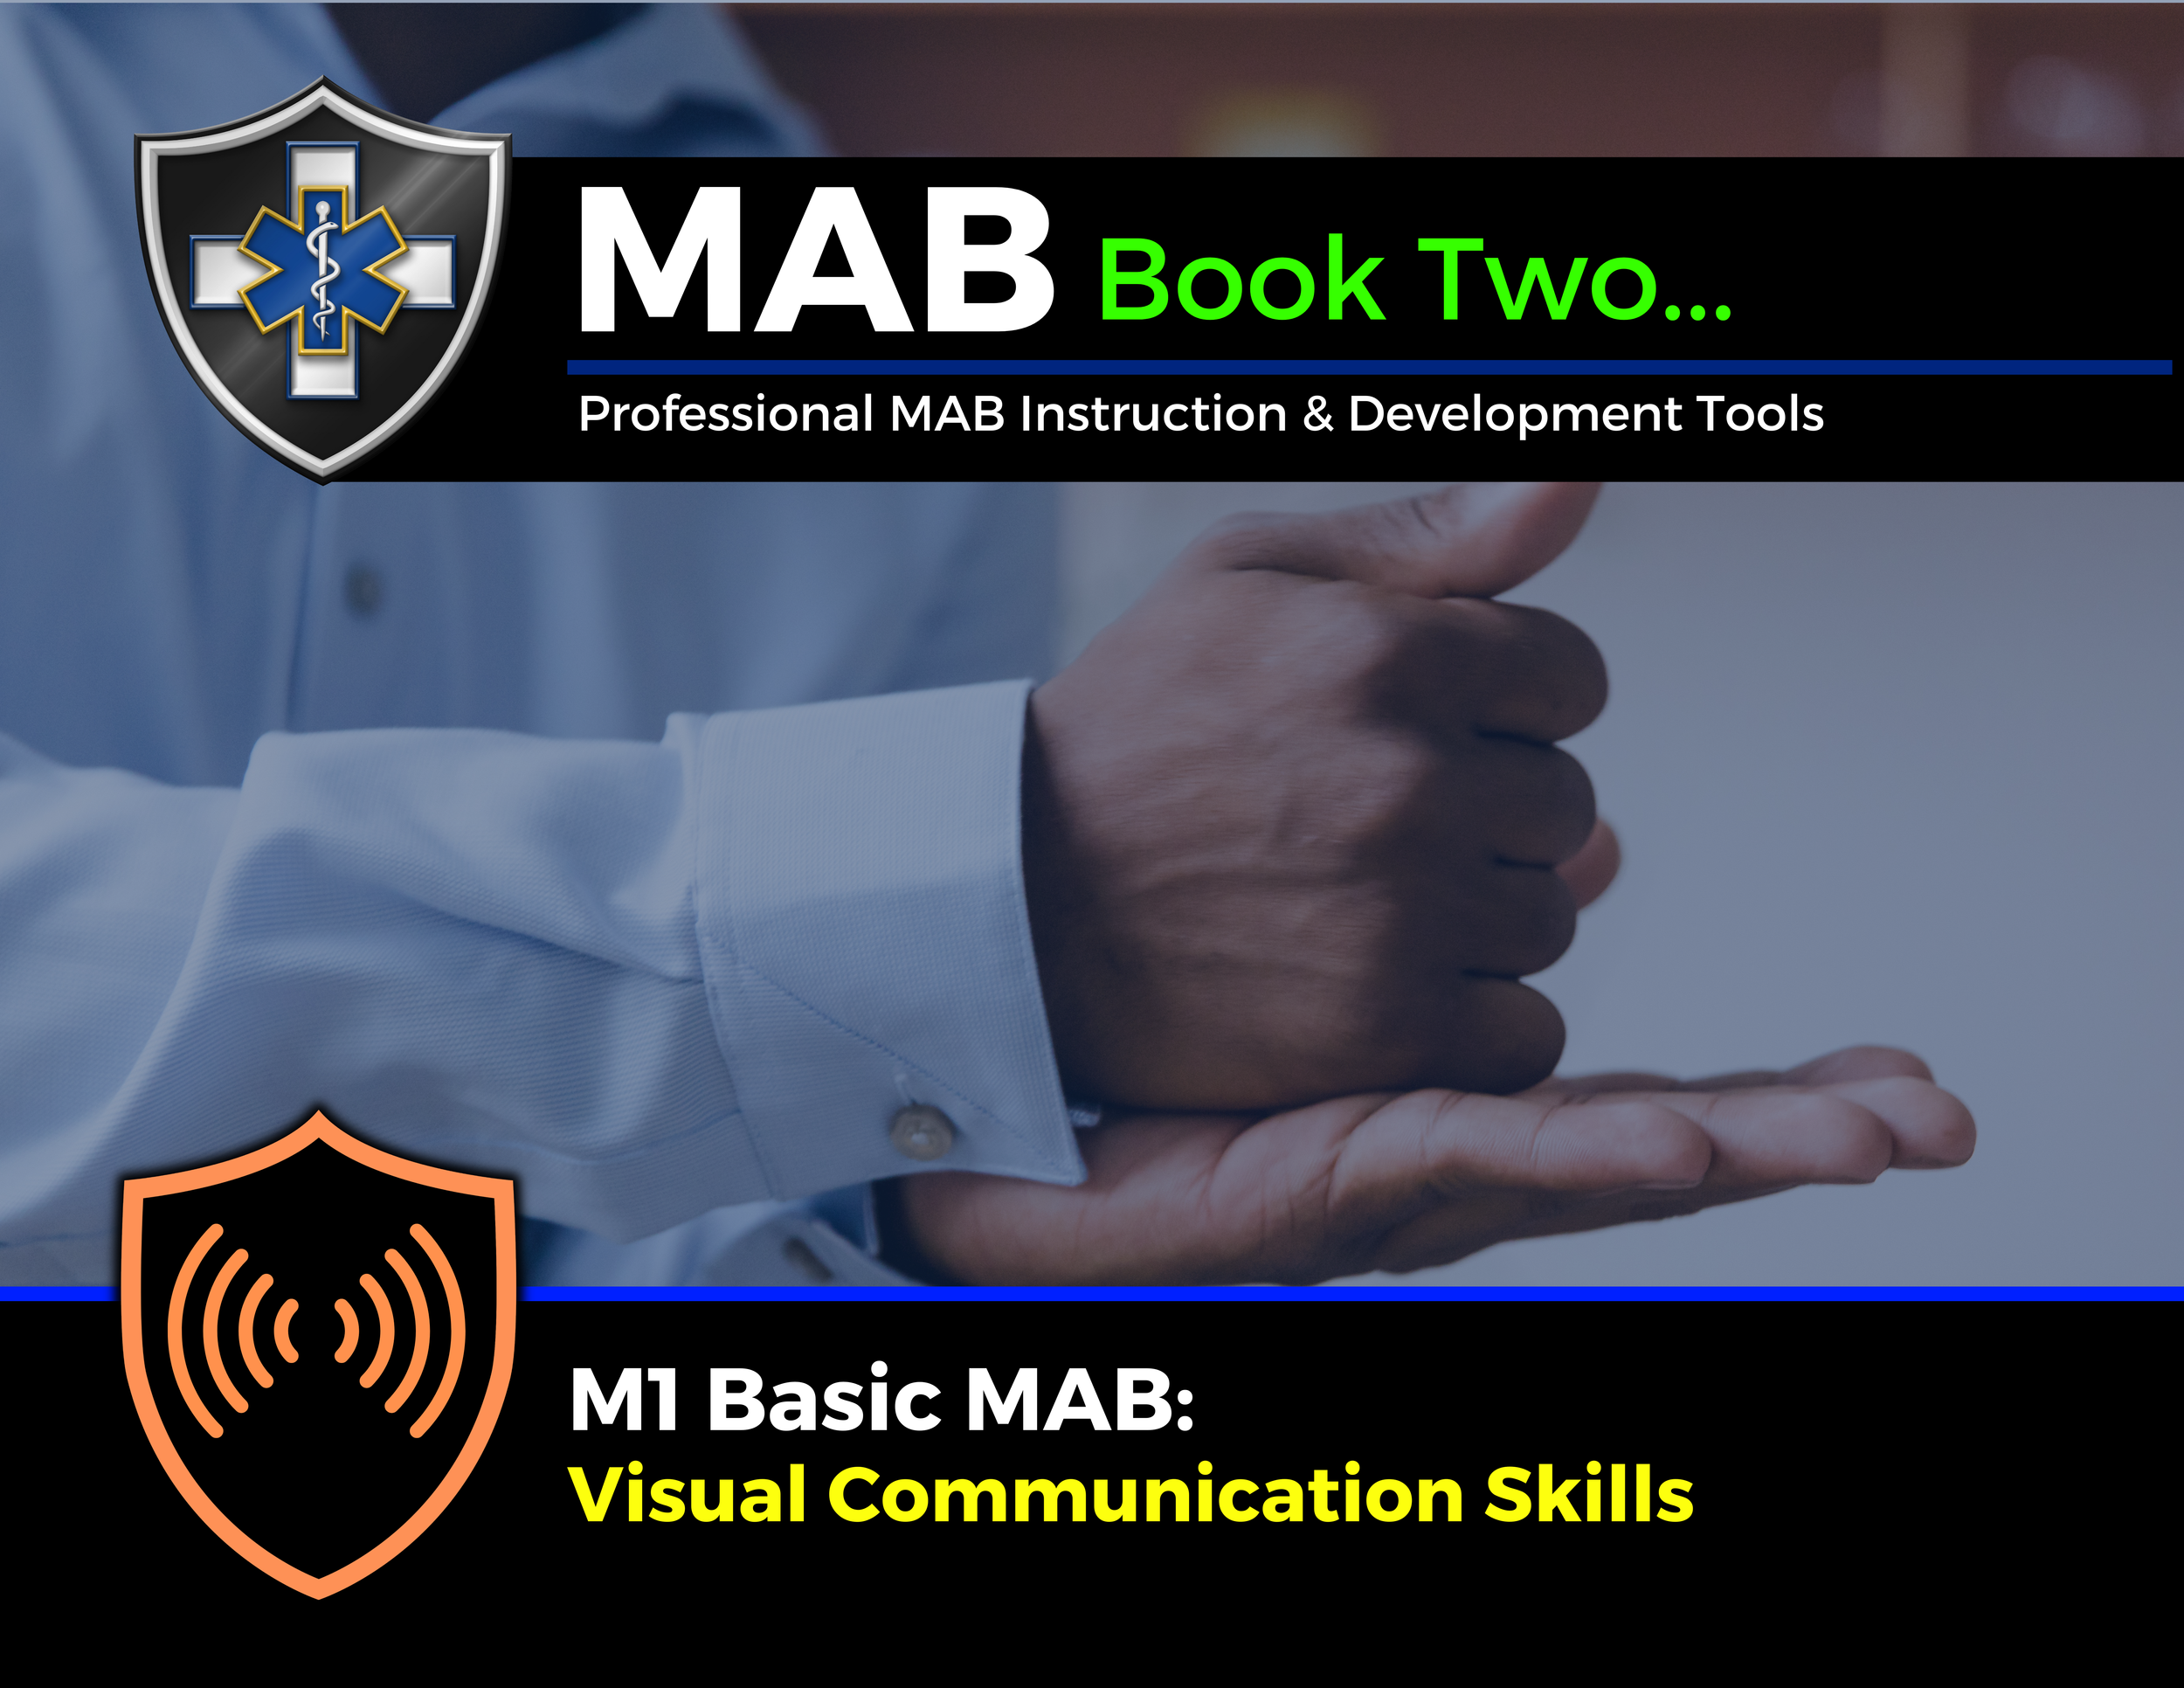

Topic Handouts
www.MABPRO.com

Slide 5

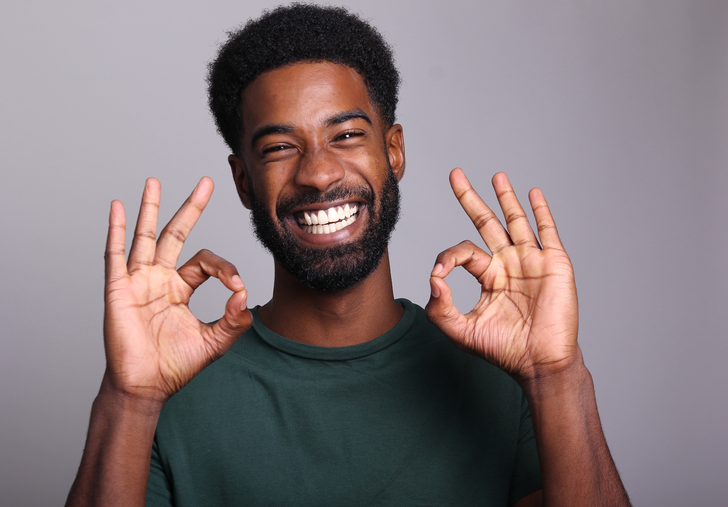
Visual Communication Skills...
People use visual communication in conversation to enhance understanding, reinforce messages, and express emotions. In this lesson we will review the many types of visual communication and learn how to use them positively in a negotiation.
There are many forms of non-verbal communication. Here are a few. We often use Facial Expressions...Facial expressions are responsible for a considerable proportion of nonverbal communication...
www.MABPRO.com

Slide 6
Nonverbal forms of Communication...
Nonverbal communication is the silent powerhouse behind how we express ourselves—often saying more than words ever could. Here are the key types, each with its own unique role in shaping perception and connection:
Facial Expressions The most universal form—smiles, frowns, raised eyebrows, all
convey emotion instantly.
Gestures Movements like waving, pointing, or thumbs-up, that add
emphasis or replace words.
Paralinguistics Vocal elements such as tone, pitch, volume, and inflection that
shape how words are received.
Body Language & Posture How we sit, stand, and move communicates confidence,
openness, or defensiveness.
Proxemics (Personal Space) The physical distance we maintain—intimate, personal,
social, or public zones.
www.MABPRO.com

Slide 7
Nonverbal forms of Communication...
Nonverbal communication is the silent powerhouse behind how we express ourselves—often saying more than words ever could. Here are the key types, each with its own unique role in shaping perception and connection:
Eye Contact (Oculesics) Signals attention, trust, aggression, or avoid an
depending on context and culture.
Haptics (Touch) Touch conveys warmth, dominance, or comfort—think handshakes,
hugs, or pats on the back.
Appearance Clothing, grooming, and style choices send messages about
identity, professionalism, and mood
www.MABPRO.com

Slide 8
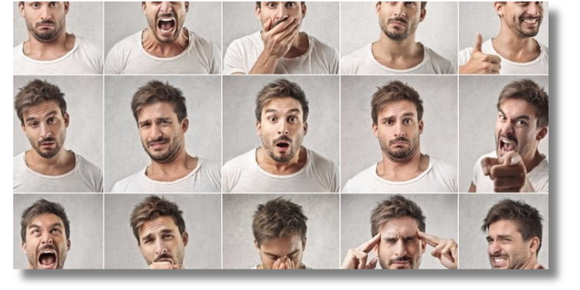
Facial Expressions...
Defining:
Facial expressions play a crucial role in communication, conveying emotions and intentions without words.
Examples:
Smiles show happiness, friendliness, or agreement...
Raised Eyebrows can Indicate surprise or curiosity.
Nodding with a Soft Expression can signal understanding or encouragement.

Slide 9
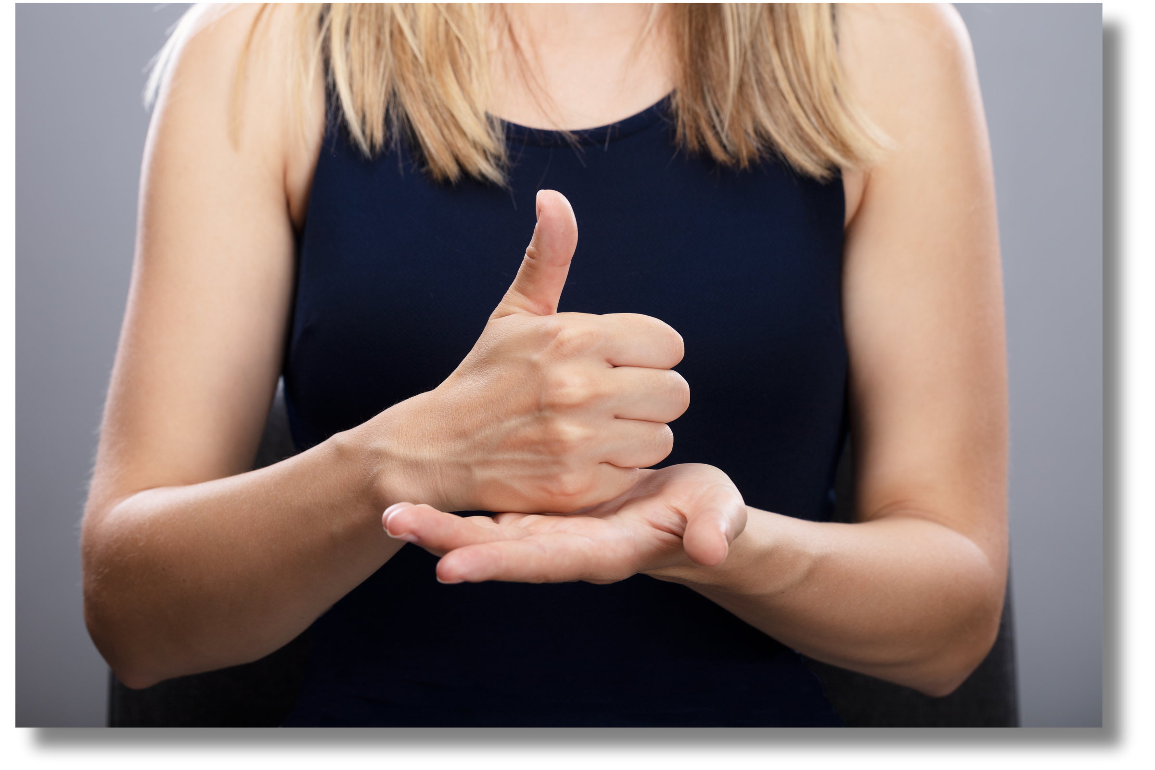
Gestures...
Defining:
Gestures are a powerful form of non-verbal communication that help convey emotions, reinforce spoken words, and enhance understanding.
Examples:
Open palms help to show honesty and openness.
Clenched fists can indicate determination or frustration.
Hands on heart can express sincerity or deep emotion.

Slide 10

Body Language...
Defining:
Body language and posture play a crucial role in communication, often conveying emotions and intentions without words.
Creating an Open vs. Closed Posture
Open posture – Standing or sitting with uncrossed arms and a relaxed stance signals approachability and willingness to engage.
Closed posture – Crossed arms or legs may indicate defensiveness, discomfort, or disinterest.

Slide 11

Eye Gaze...
Defining:
Eye Gaze = People utilize eye gaze to determine if someone is being honest.
Examples:
Wide eyes: Can show surprise, fear, or excitement
Direct, steady gaze: Often associated with confidence or
dominance.
Looking down or away: May signal submission, nervousness, or deference.

Slide 12
Non-verbal forms of Communication can be very effective; they can also derail the intent of the negotiation. Here are some tips on Non-Verbal Communication...
Avoid slouching.
www.MABPRO.com

Slide 13
Non-verbal forms of Communication can be very effective; they can also derail the intent of the negotiation. Here are some tips on Non-Verbal Communication...
Avoid slouching.
Steer clear of smiles or laughter when messages
are serious.
www.MABPRO.com

Slide 14
Non-verbal forms of Communication can be very effective; they can also derail the intent of the negotiation. Here are some tips on Non-Verbal Communication...
Avoid slouching.
Steer clear of smiles or laughter when messages
are serious.
Display some animation with your hands and facial expressions to project a dynamic presence.
www.MABPRO.com

Slide 15
Non-verbal forms of Communication can be very effective; they can also derail the intent of the negotiation. Here are some tips on Non-Verbal Communication...
Avoid slouching.
Steer clear of smiles or laughter when messages
are serious.
Display some animation with your hands and facial expressions to project a dynamic presence.ggggg
A nod to demonstrate understanding
www.MABPRO.com

Slide 16
Non-verbal forms of Communication can be very effective; they can also derail the intent of the negotiation. Here are some tips on Non-Verbal Communication...
Rotate eye contact with various speakers in group settings or networking situations.
www.MABPRO.com

Slide 17
Non-verbal forms of Communication can be very effective; they can also derail the intent of the negotiation. Here are some tips on Non-Verbal Communication...
Rotate eye contact with various speakers in group settings or networking situations.
Stay calm even when you’re nervous.
www.MABPRO.com

Slide 18
Non-verbal forms of Communication can be very effective; they can also derail the intent of the negotiation. Here are some tips on Non-Verbal Communication...
Rotate eye contact with various speakers in group settings or networking situations.
Stay calm even when you’re nervous.
Steer clear of monotone delivery
www.MABPRO.com

Slide 19
Non-verbal forms of Communication can be very effective; they can also derail the intent of the negotiation. Here are some tips on Non-Verbal Communication...
Rotate eye contact with various speakers in group settings or networking situations.
Stay calm even when you’re nervous.
Steer clear of monotone delivery
Wait until the person is done talking to respond.
www.MABPRO.com

Slide 20
Management of Assaultive Behavior (MAB)
Workplace Violence Prevention Course...
Thank You!
www.MABPRO.com

