Slide 1








Management of Assaultive Behavior (MAB)
Workplace Violence Prevention Course...
M1 Basic MAB - Book Two: Lesson 3 - Verbal Communication Skills
GET STARTED
www.MABPRO.com

Slide 2

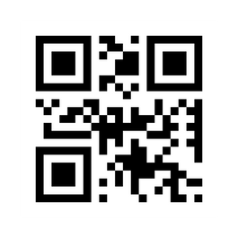
M1 Basic MAB: Book Two - Student Guide
www.MABPRO.com

Slide 3
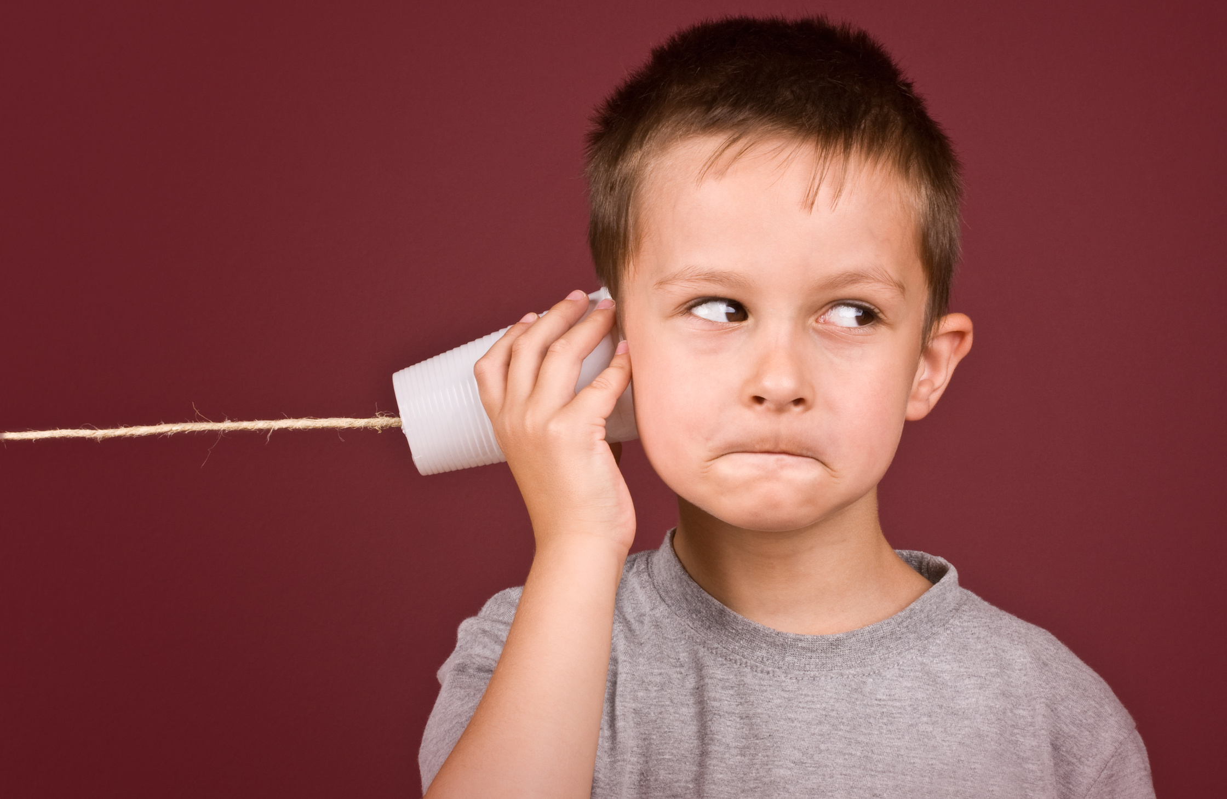

Topics...
1.
2.
3.
4.
5.
Verbal Communication Skills
Core Eleemnts for Effective Communication
55/38/7 Rule of Communication
Trigger Words
Persuasive Things to Say
www.MABPRO.com

Slide 4
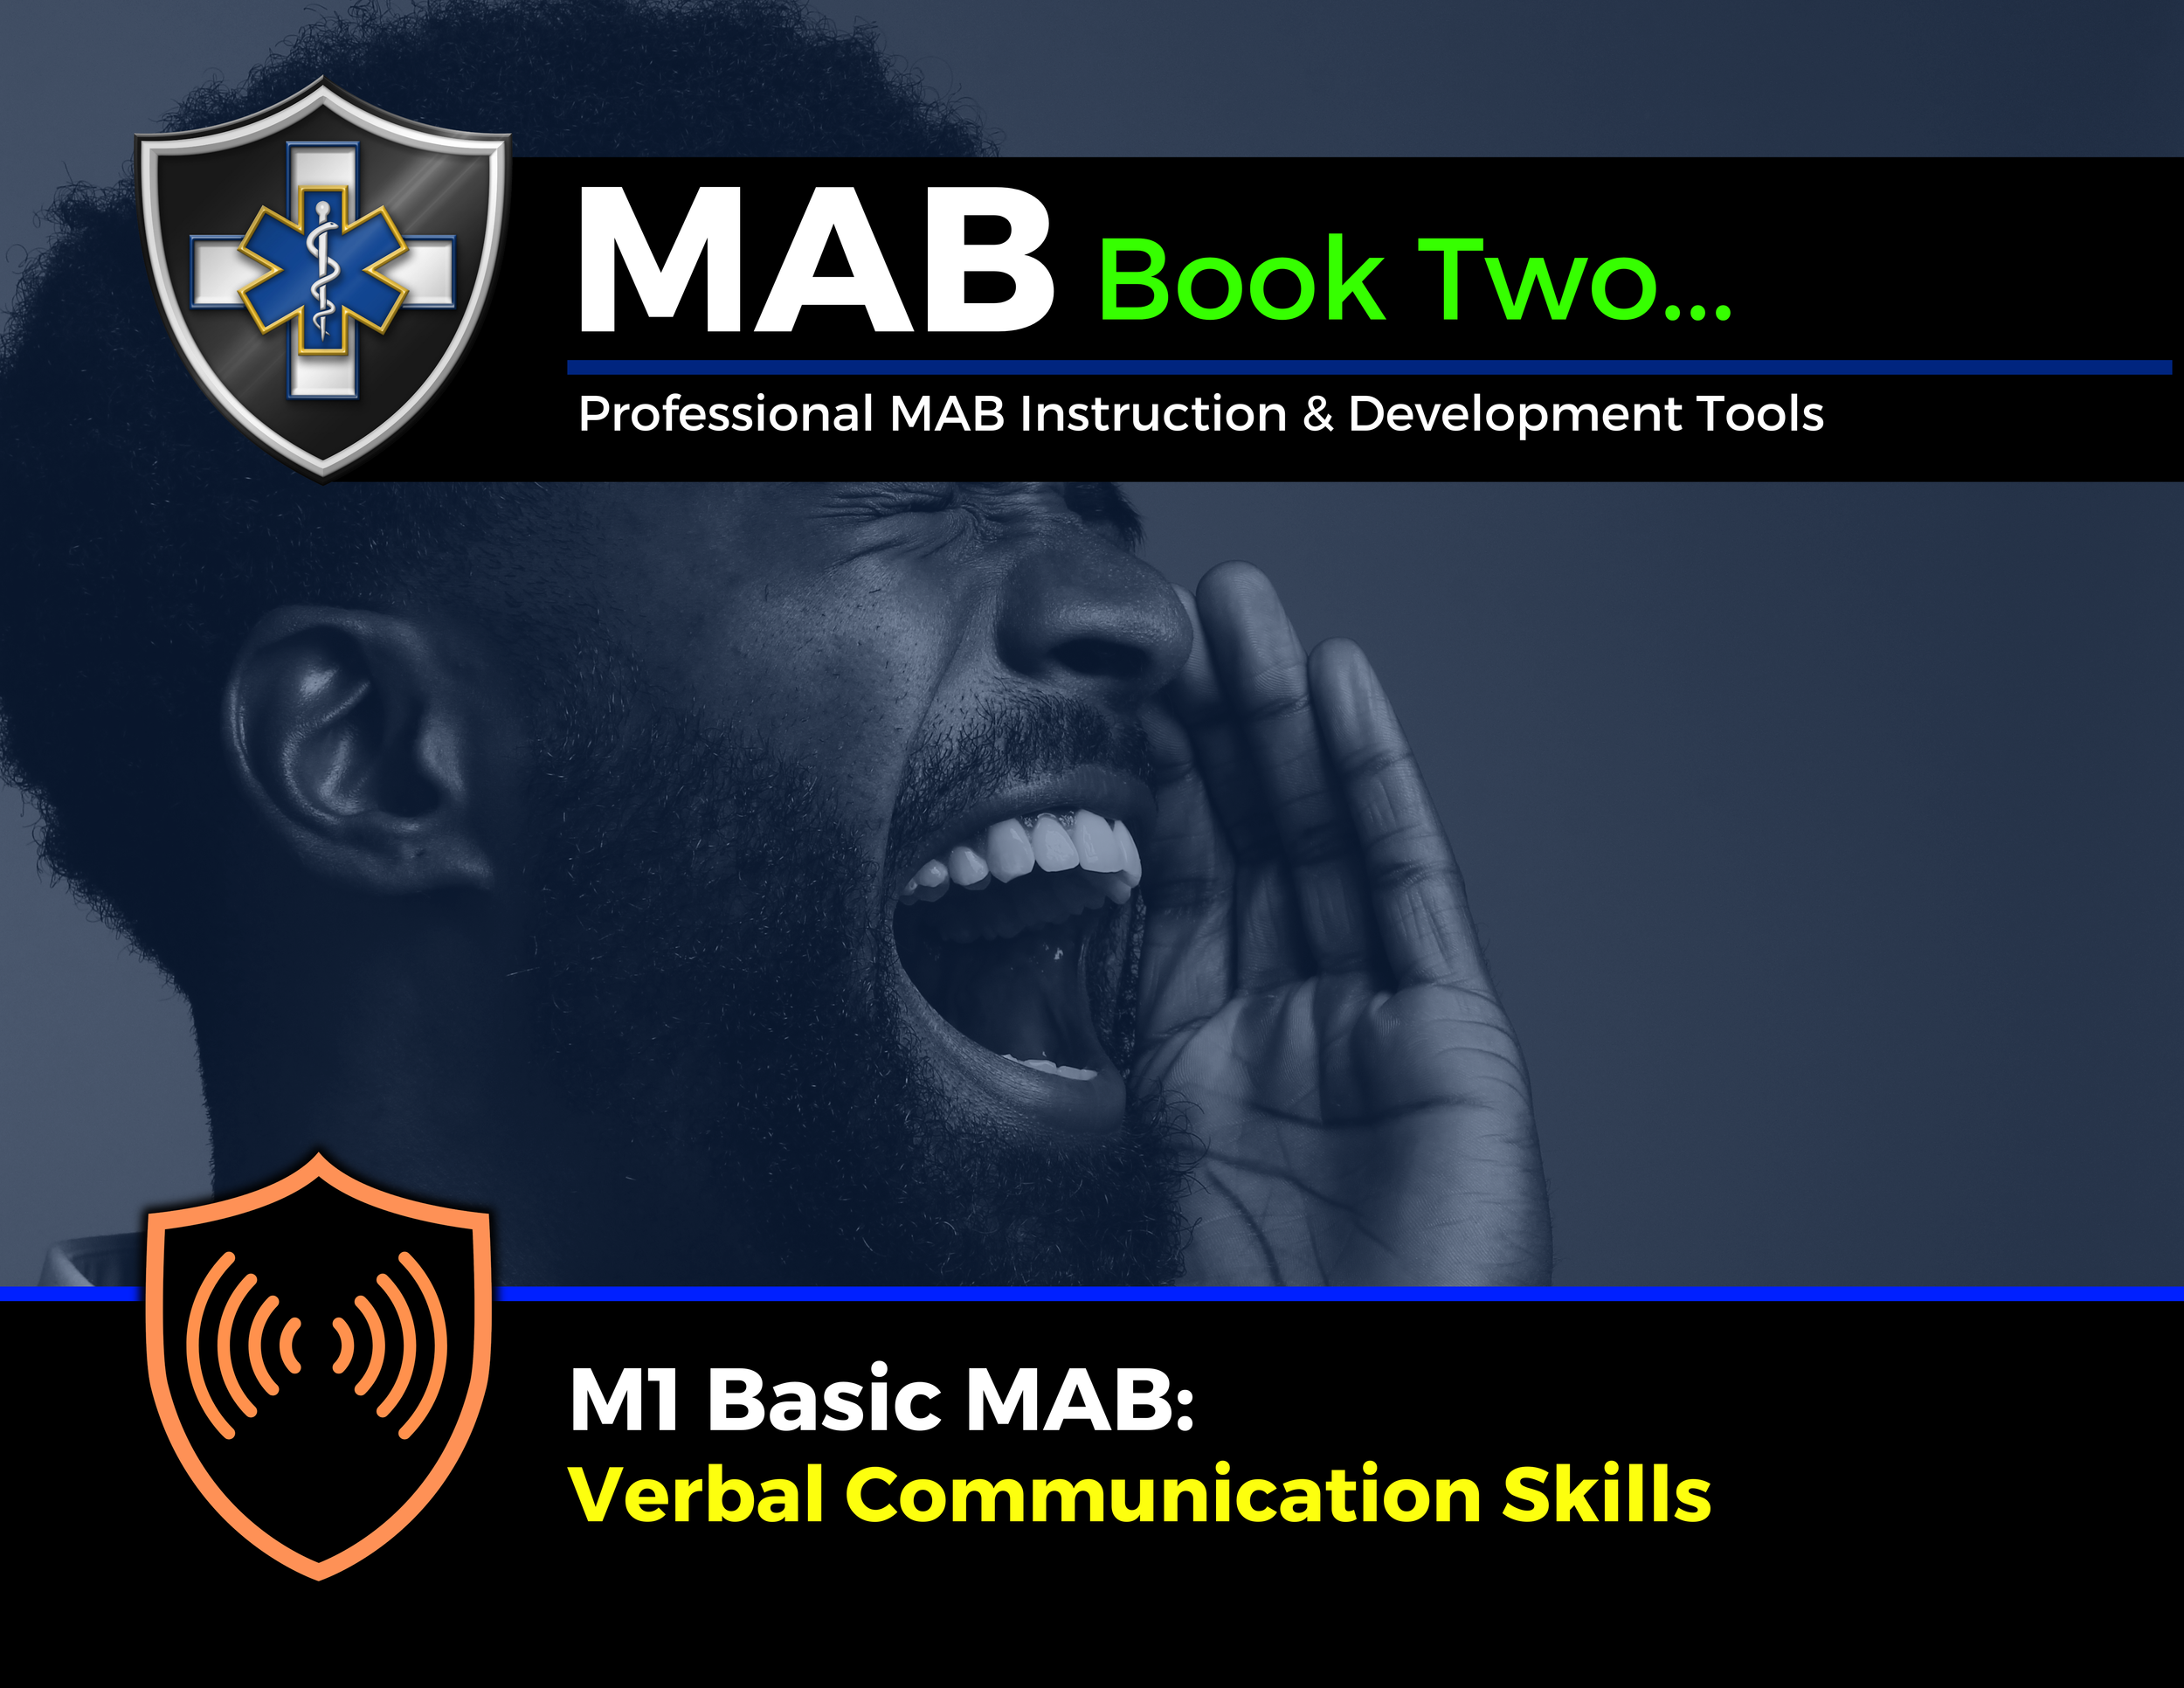

Topic Handouts
www.MABPRO.com

Slide 5


Verbal Communication Skills...
Effective verbal communication is essential for building strong relationships, resolving conflicts, and conveying ideas clearly. In this module we will be review some of the best strategies towards positive verbal communication..
www.MABPRO.com

Slide 6
Good communication starts with the practice of
clarity & conciseness...
  Try and use simple, direct language.
  Take a moment to organize your thoughts before speaking.
  Try to not use filler words like “um” or “like.”
  As you seek a calmer response, try to use a professional tone & delivery.
  Adjust your tone to match the message.
  Speak at a steady pace with confidence.
  Use pauses effectively to emphasize key points.
  Use courteous phrases like “please” and “thank you.”
  Avoid overly emotional or aggressive language.
  Stay neutral and objective, especially in sensitive discussions.
www.MABPRO.com

Slide 7
The Core Elements of Effective Verbal Communication:
Clarity & Conciseness:
Nonverbal Cues:
  What it means: Expressing your message in a straightforward, easy-to-understand way without unnecessary jargon or filler.
  Why it matters: People tune out when messages are vague or long-winded. Clear communication saves time and prevents misunderstandings.
  Example: Instead of saying, “We might want to consider possibly adjusting the timeline,” say, “Let’s move the deadline to Friday.
  What it means: Body language, facial expressions, eye contact, posture, and gestures that accompany your words.
  Why it matters: Nonverbal signals often speak louder than words and can reinforce—or contradict—your message.
  Example: Maintaining eye contact while speaking shows confidence and sincerity; crossed arms may signal defensiveness.
www.MABPRO.com

Slide 8
The Core Elements of Effective Verbal Communication:
Tone & Delivery:
Adaptability:
  What it means: The emotional quality of your voice—how you say something, not just what you say.
  Why it matters: Tone can convey confidence, empathy, urgency, or frustration. It shapes how your message is received.
  Example: A calm, reassuring tone during a crisis can de-escalate tension, while a firm tone in a meeting can assert leadership.
  What it means: Adjusting your communication style based on your audience, setting, and situation.
  Why it matters: Different contexts require different approaches. Flexibility ensures your message resonates.
  Example: You might use formal language in a boardroom, but a more relaxed tone in a team huddle.
www.MABPRO.com

Slide 9
The 55/38/7 Rule of Communication...
Percentage
of Impact
55%
38%
7%
Communication
Component
Body Language
Tone of Voice
Words
(Content)
Description
Facial expressions, posture, gestures—nonverbal cues that shape perception.
Vocal elements like pitch, volume, and emotion.
The actual spoken words.
“How you say what you say and when you say it defines the message!”
www.MABPRO.com

Slide 10

Trigger Words...
  Now Let's turn our attention to trigger words as well as persuasive things we can say to help navigate negotiations...
  Trigger words are specific words or phrases that evoke strong emotional or psychological responses in people. These can be positive or negative, depending on the context and the individual's personal experiences.
  During personal interactions, words like "failure" or "rejection" might trigger self-doubt, whereas words like "achievement" or "success" can be motivating...
www.MABPRO.com

Slide 11

Trigger Words...
  Trigger words tend to shut down communication and escalate conflict.
  Minimizing trigger words is crucial for effective communication. It fosters understanding and builds stronger relationships. This is true in both personal and professional settings.
  Persuasive language, conversely, aims to influence positively. It encourages agreement and action. It does so by appealing to logic and emotion.
www.MABPRO.com

Slide 12
The Core Elements of Effective Verbal Communication:
Some Potentially Triggering Phrases:
Some Potentially Triggering Words:
  No
  Later
  seriously
  OMG
  Stop it!
  Why?
  Easy!
  Relax!
  Stupid
  Nope!
  Forget it
  Never
  Chaos
  Failure
  Negligence
  Don’t
  Ignored warnings
  They caused this
  You should have…
  Out of control
  You Always...
  Calm Down!
  You need to...
  What is now?
  That’s not my job
  Because I said so!
www.MABPRO.com

Slide 13
The Core Elements of Effective Verbal Communication:
Persuasive language is all about influencing thoughts, emotions, and actions in a way that encourages agreement or cooperation. Here are a few persuasive statements to use:
  How can we fix this?
  What do you suggest?
  Let's take a step back.
  I respect your feelings.
  We can figure this out.
  I hear you.
  I see why this matters to you.
  I appreciate your perspective.
  We understand this is difficult
  Your concerns are valid
  We’re here to support you
  Let’s take this one step at a time
  We’re reviewing what happened
  We’re focused on solutions
  Let’s work together to move forward
www.MABPRO.com

Slide 14
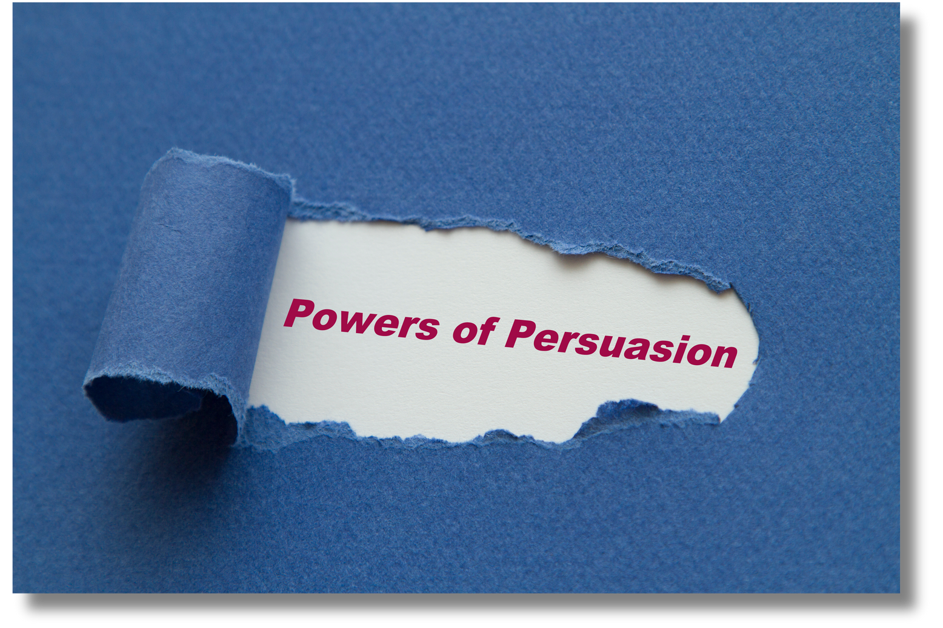
True persuasion isn’t about tricking people, it’s about...
  Building credibility
  Fostering trust
  Offering value
  Respecting autonomy
“It’s the difference between 'convincing' and 'coercing.”
www.MABPRO.com

Slide 15

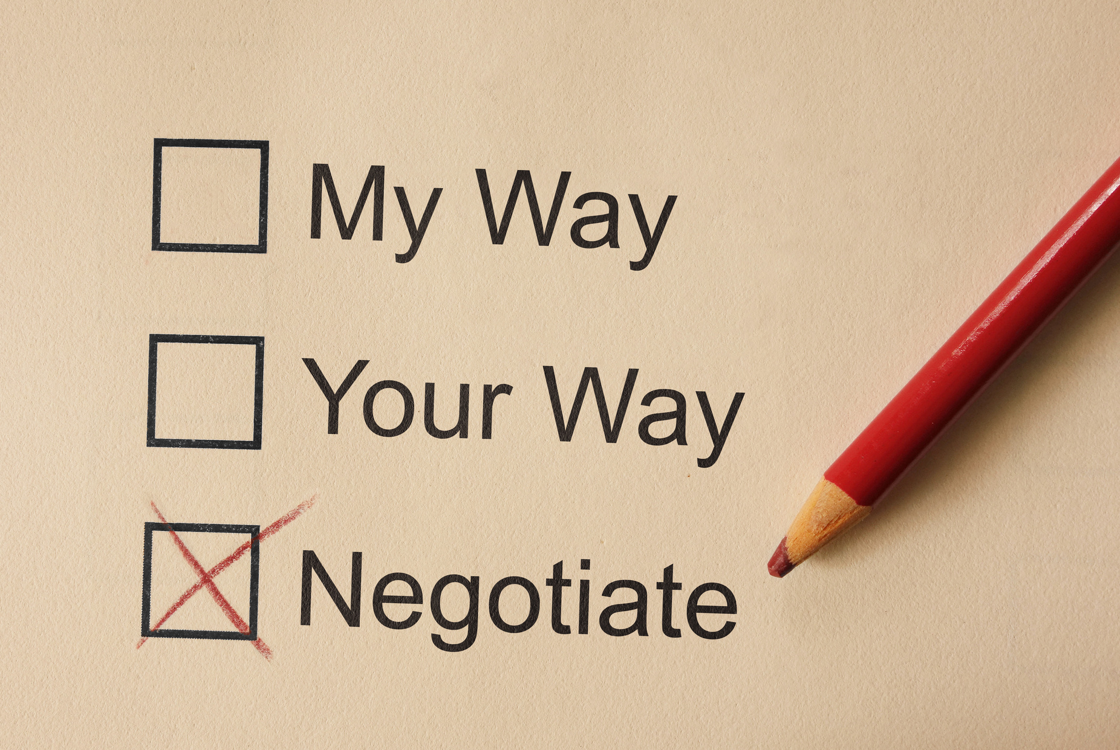

Slide 16
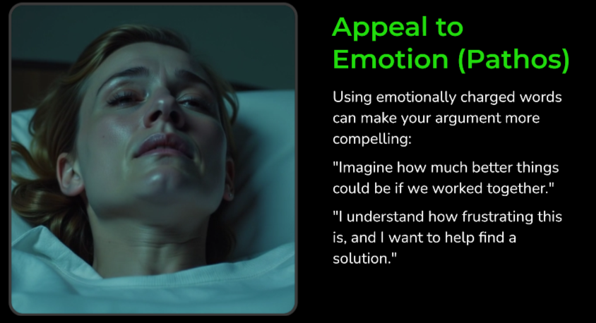


Slide 17



Slide 18



Slide 19



Slide 20
Management of Assaultive Behavior (MAB)
Workplace Violence Prevention Course...
Thank You!
www.MABPRO.com

