Slide 1








Management of Assaultive Behavior (MAB)
Workplace Violence Prevention Course...
M1 Basic MAB - Book Two: Lesson 2 - Active Listening
GET STARTED
www.MABPRO.com

Slide 2


M1 Basic MAB: Book Two - Student Guide
www.MABPRO.com

Slide 3
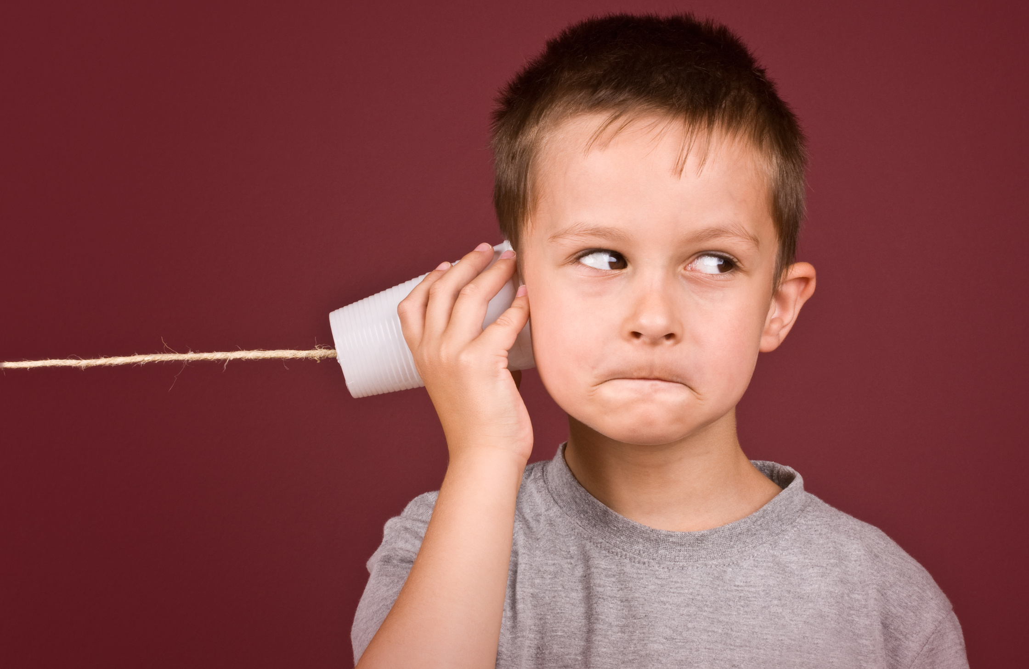

Topics...
1.
2.
3.
4.
Active Listening
Bad Listening Habits
Good Listening Habits
Active Listening & Passive Listening
www.MABPRO.com

Slide 4
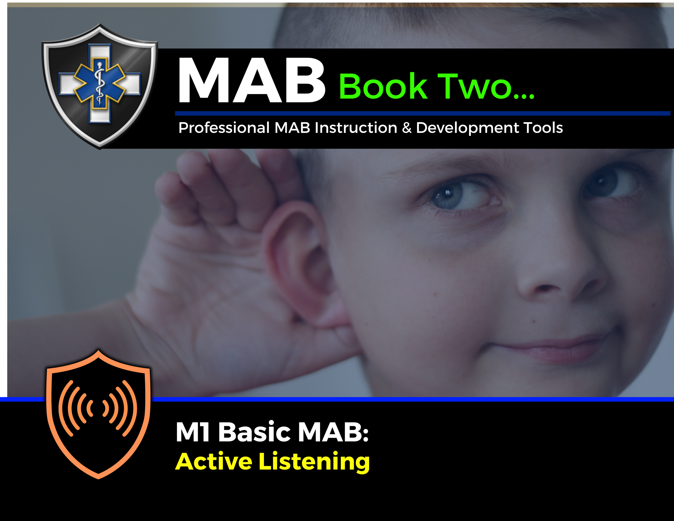

Topic Handouts
www.MABPRO.com

Slide 5


Active Listening...
To become an influencing part of any negotiation, you have to actively engage the needs and concerns of the individual in conflict.
When we practice Active Listening, we are fully concentrating on what is being said rather than just passively ‘hearing’ the speaker’s message...
www.MABPRO.com

Slide 6
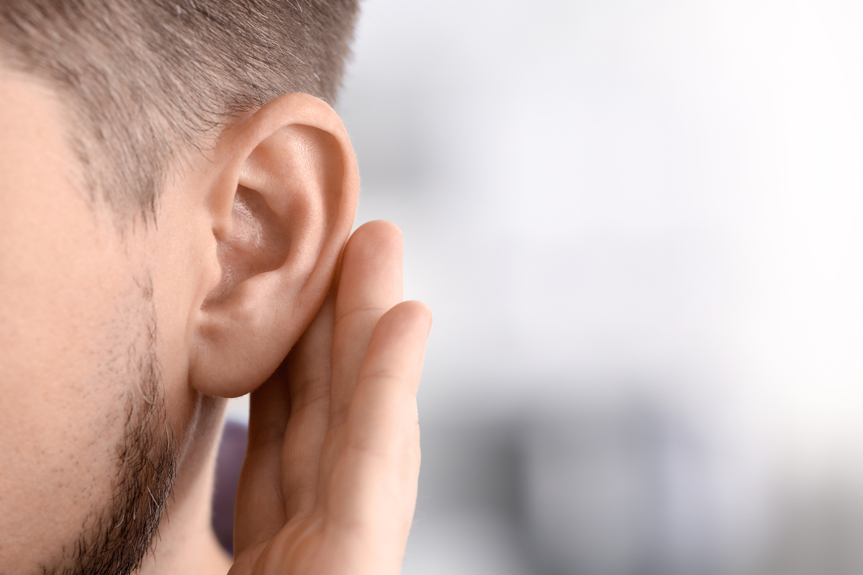
Active Listening...
It is helpful when active listening to show that you are listening by providing feedback. By doing so, conversations become more productive.
It also helps build trust and understanding. Active listening requires effort and skill. It's more than just being quiet while someone speaks. It's about truly understanding their perspective.
www.MABPRO.com

Slide 7

When listening try to avoid these bad listening habits...
1. Showing a lack of interest in the subject,
2. Focusing on the person, not on the content.
3. Interrupting,
4. Focusing on the detail, missing the big picture,
5. Force-fitting their ideas into your mental models,
6. Daydreaming,
7. Letting emotions block the subject.
www.MABPRO.com

Slide 8

When listening, try to develop these good habits...
Active listening is a communication skill that involves entirely focusing, understanding, and responding thoughtfully to someone who is speaking. It’s not just about hearing the words they are saying, but truly engaging with their message.
1. Pay Attention
2. Show you are listening
3. Provide Feedback
4. Defer Judgment
5. Respond Appropriately
6. Reflecting on what you heard
7. Exhibiting positive body language
www.MABPRO.com

Slide 9
Active Listening and Passive Listening...
Active listening is a communication skill that involves entirely focusing, understanding, and responding thoughtfully to someone who is speaking. It’s not just about hearing the words they are saying, but truly engaging with their message.
Active Listening: Involves fully concentrating on the speaker, processing their message, and responding thoughtfully. It includes maintaining eye contact, nodding, paraphrasing, and asking relevant questions to show genuine interest and comprehension...
Passive Listening: In contrast, is a more disengaged approach. The listener hears the words but doesn’t fully process or respond to them. They may appear indifferent, distracted, or simply not invested in the conversation...
www.MABPRO.com

Slide 10
Actively try to avoid Passive Listening...
Active listening strengthens relationships, enhances communication, and fosters mutual respect, whereas passive listening can lead to misunderstandings and missed opportunities for connection.
www.MABPRO.com

Slide 11
Management of Assaultive Behavior (MAB)
Workplace Violence Prevention Course...
Thank You!
www.MABPRO.com

