Slide 1








Management of Assaultive Behavior (MAB)
Workplace Violence Prevention Course...
M1 Basic MAB - Book Two: Lesson 1 - MTAC Fundamentals
GET STARTED
www.MABPRO.com

Slide 2


M1 Basic MAB: Book Two - Student Guide
www.MABPRO.com

Slide 3
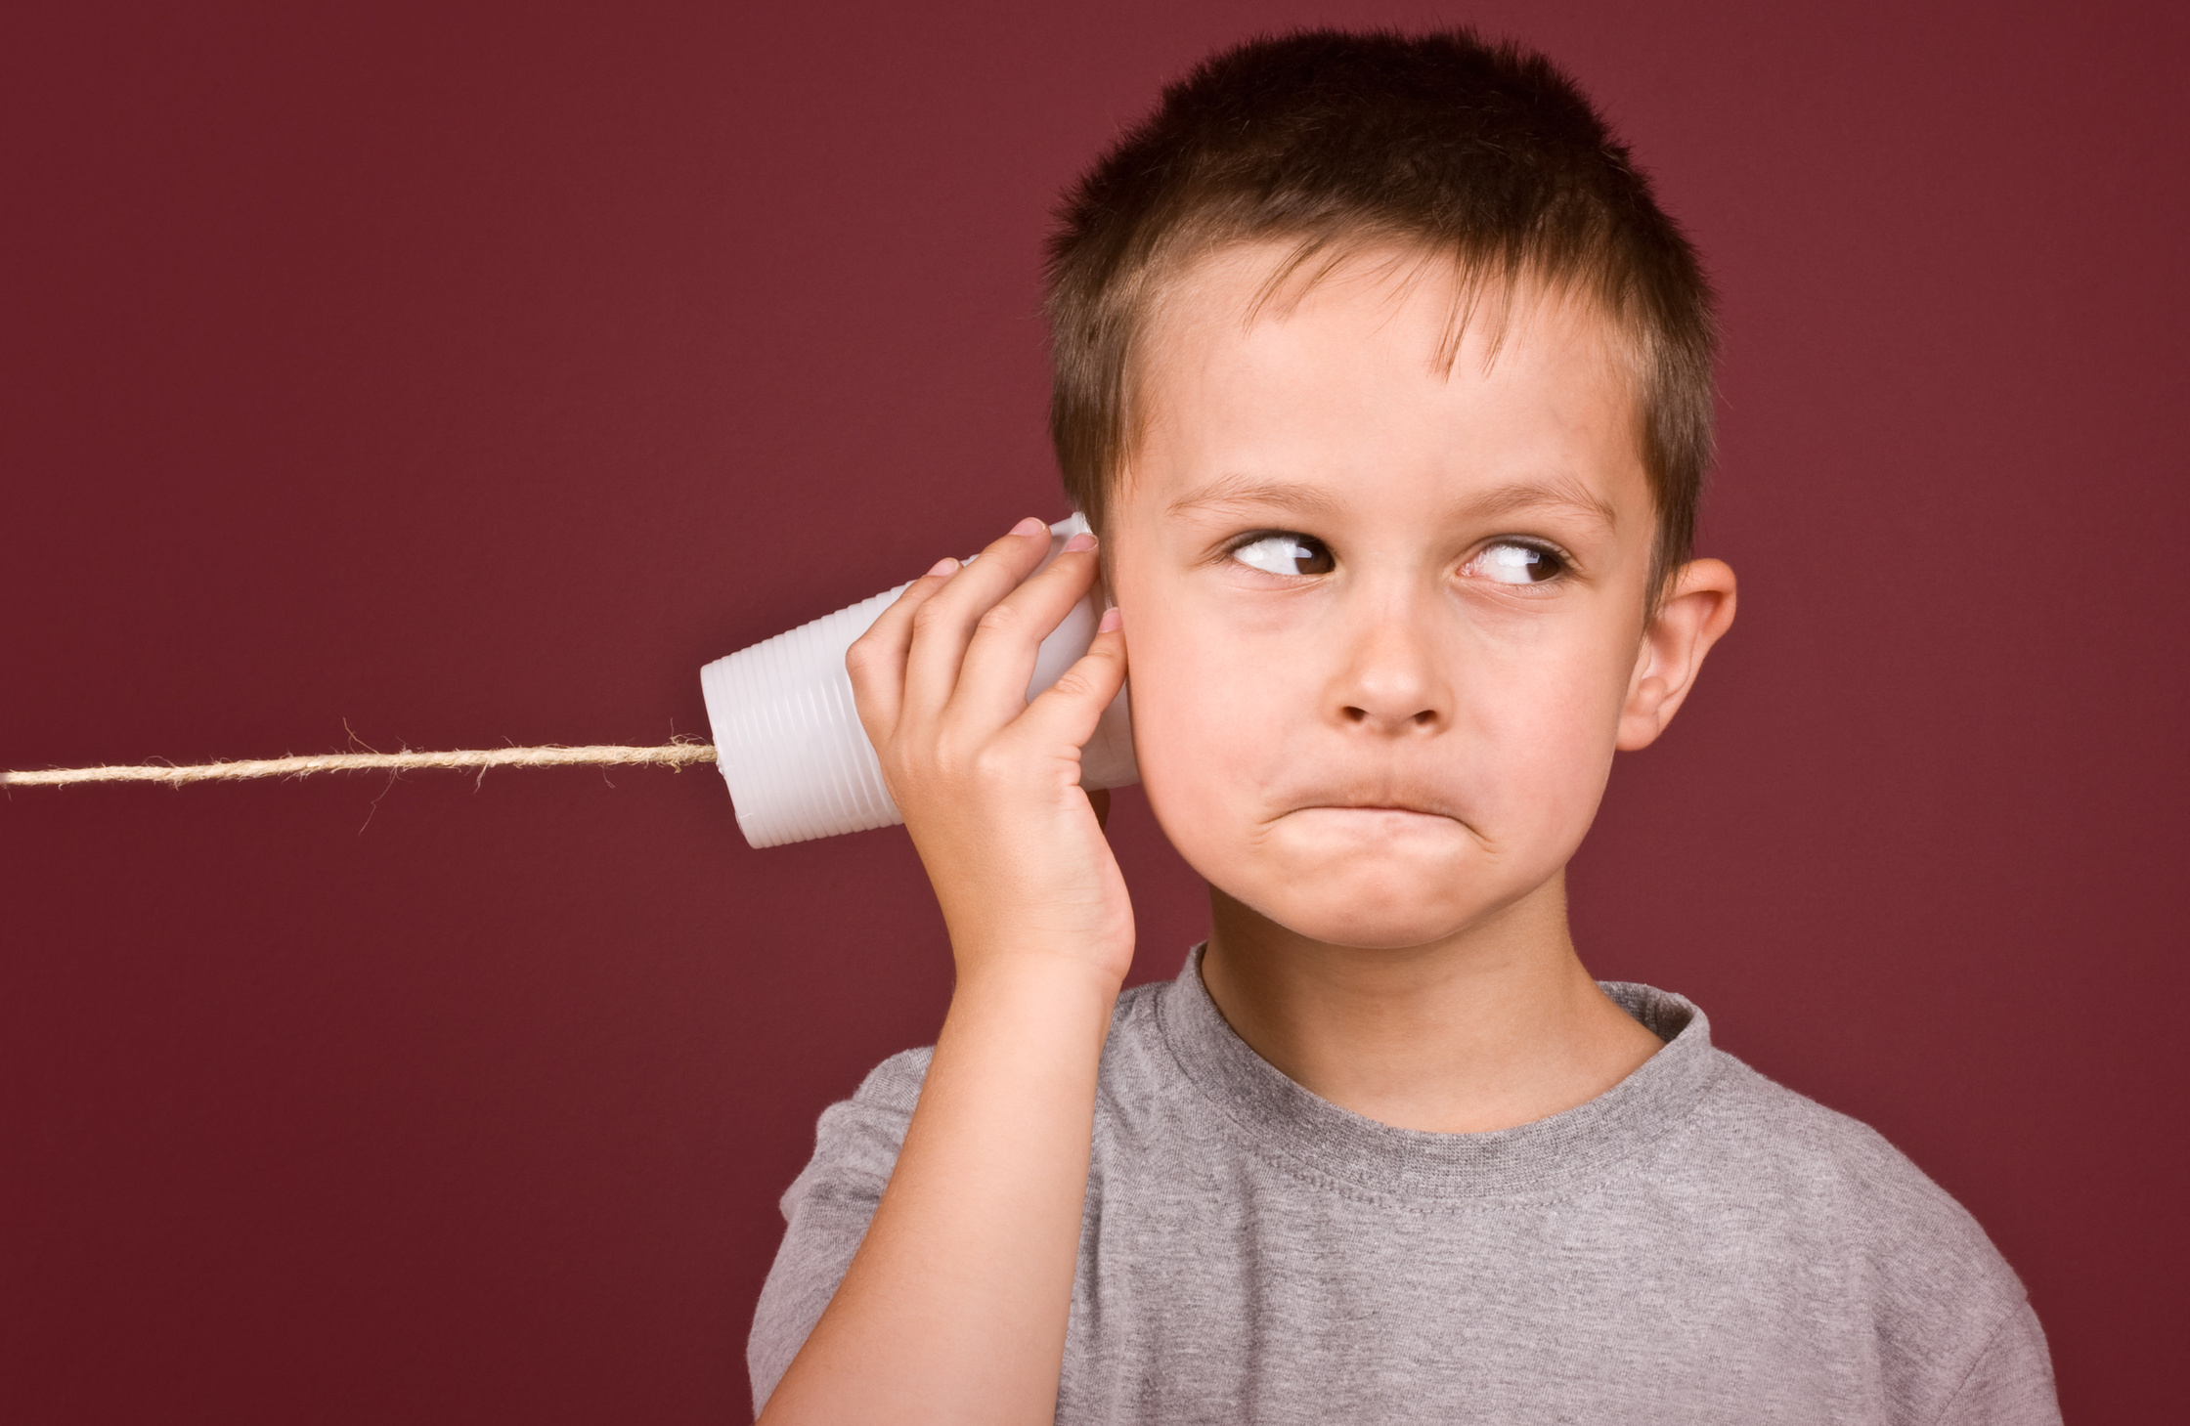

Topics...
1.
2.
3.
4.
5.
MTAC Fundamentals
Types of Communication
Responder Communication Principles
Tips to Utilize Frameing
The Professional Communicator
www.MABPRO.com

Slide 4
Topics...
1.
2.
3.
Delivering the Expectation
The Perils of Reactionary Thinking
Ways to Foster Critical Thinkning
www.MABPRO.com

Slide 5
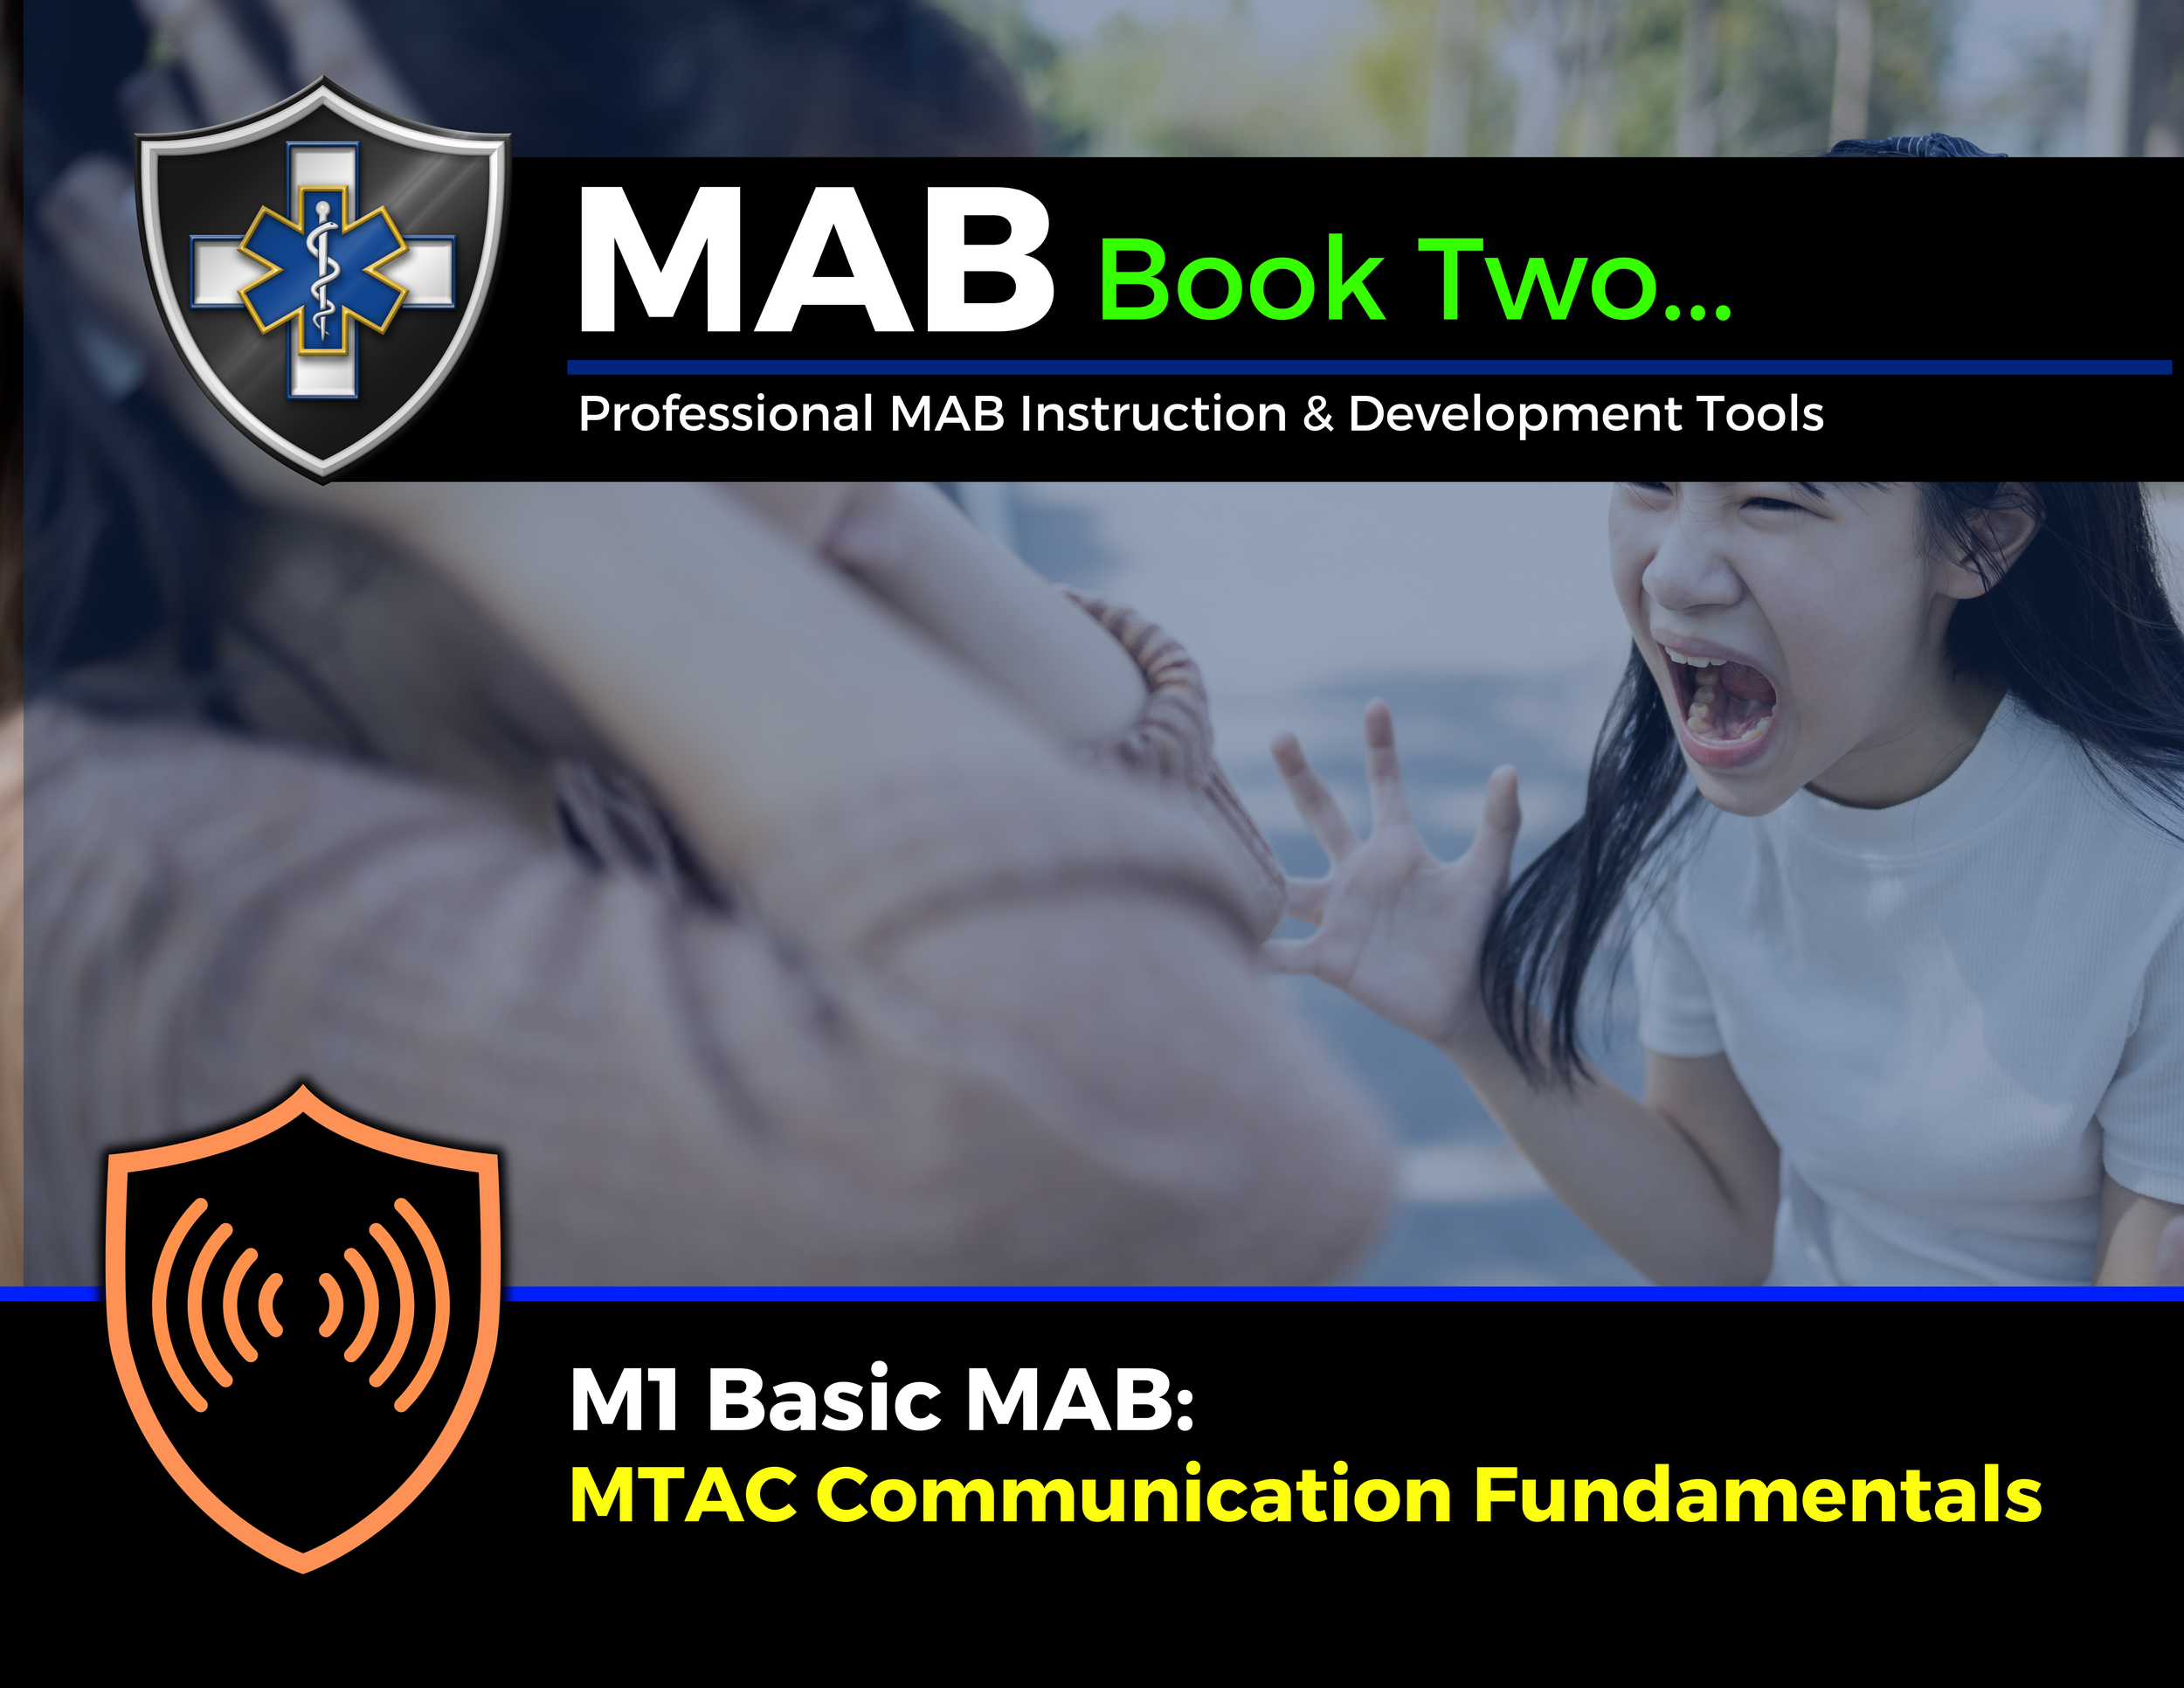

Topic Handouts
www.MABPRO.com

Slide 6

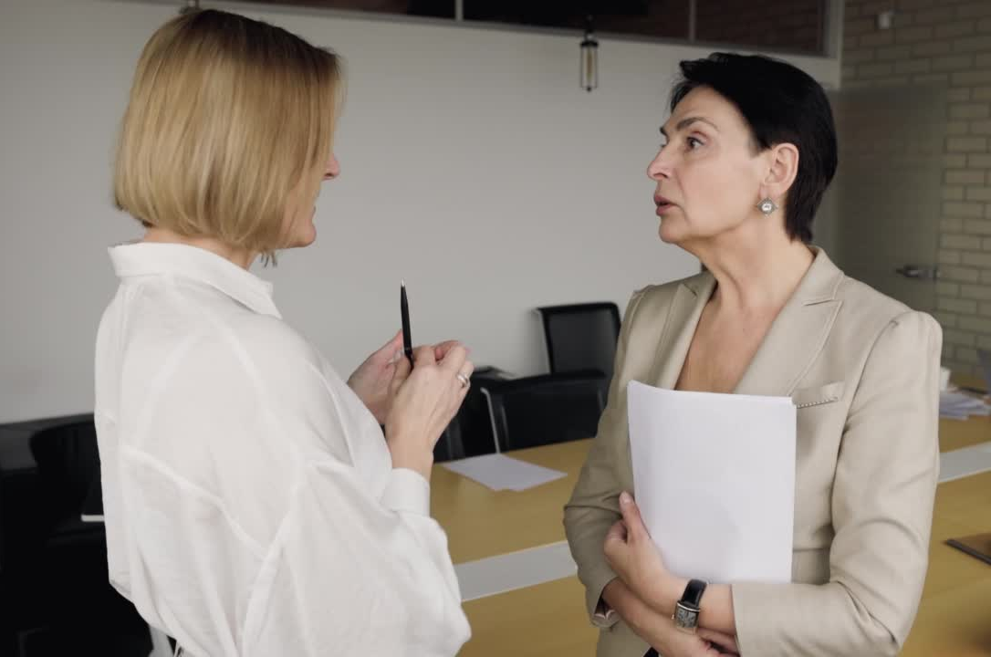
MTAC Fundamentals...
This lesson is on the MAB Fundamentals of Tactically Advanced Communication (MTAC). Here we will learn the keys to effective communication to help us become effective in conflict resolution...
Communication involves more than just speaking and listening. It includes nonverbal cues, active listening, and clarity in expressing ideas. Mastering these basics can help you avoid misunderstandings and foster a positive work environment.
www.MABPRO.com

Slide 7
Some of the Benefits of Advanced Communication Skills Include the following...
Increased General Safety
Increased Levels of Responder Professionalism.
Decreased Customer complaints
Reduction in liability.
An Increase in Individual and Team morale/ confidence.
Reduction in workplace stress levels.
Increased awareness and development of Professional Crisis Response Traits.
Communication isn’t just a skill—it’s a lifeline. Whether you're navigating crisis scenarios, or leading a team through high-stress environments, strong communication unlocks clarity, connection, and control.
www.MABPRO.com

Slide 8

What is the foundation of basic Communication?
  Communication is a TWO-WAY process.
  Communication is both the SENDING and RECEIVING of messages.
www.MABPRO.com

Slide 9



Let’s take a look at the differing types of communication....
Auditory -
Visual -
Kinesthetic -
Auditory - Hearing, Speaking, or Auditory Language.
Visual - Seeing, visualizing, visual messages, or body language.
Kinesthetic - Physical Elements of communication

Slide 10
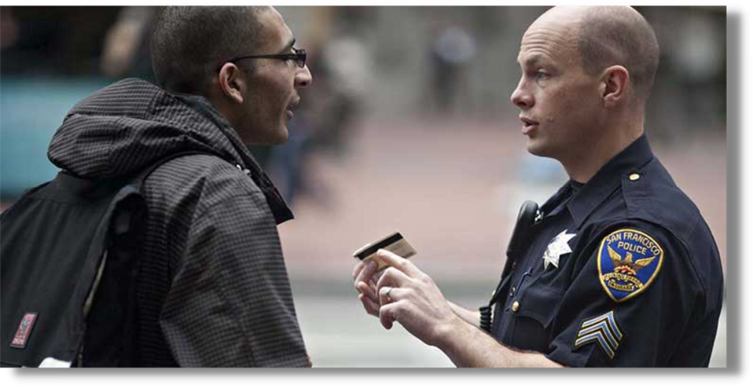
The Goal of Professional Communication...
The Goal of the Professional is to encourage the development of Voluntary Cooperation, Collaboration, or Compliance.
Always mindful of the desire to avoid using force and to provide support in the least restrictive manner available to the Responder.
www.MABPRO.com

Slide 11

The MTAC Responder Communication Principles...
When following the the MTAC Responder Communication Principles..., it is important to focus on how we deliver the messages we send...
www.MABPRO.com

Slide 12

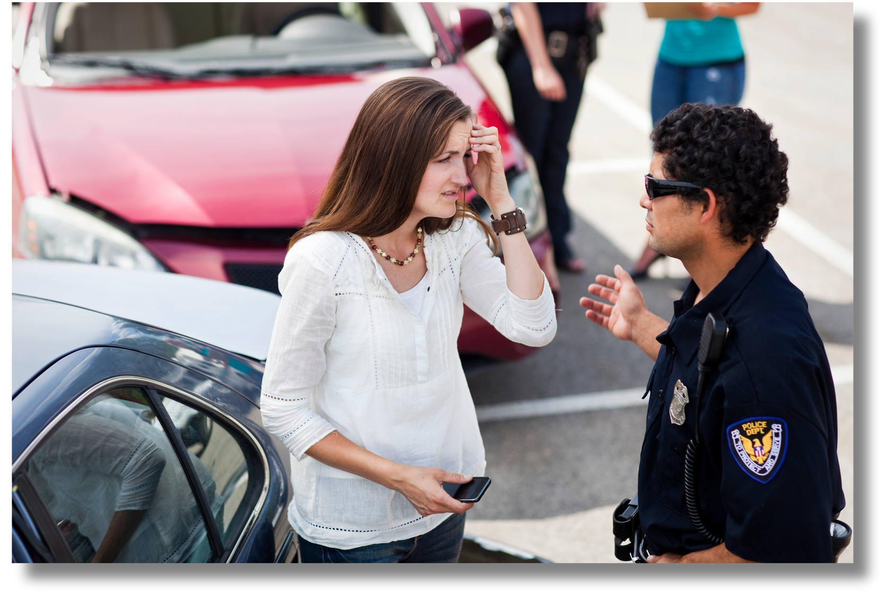
Respond, don’t React:
Responders and the teams they lead need to seek alternatives to reacting to threats and start responding to the developing situation.
www.MABPRO.com

Slide 13

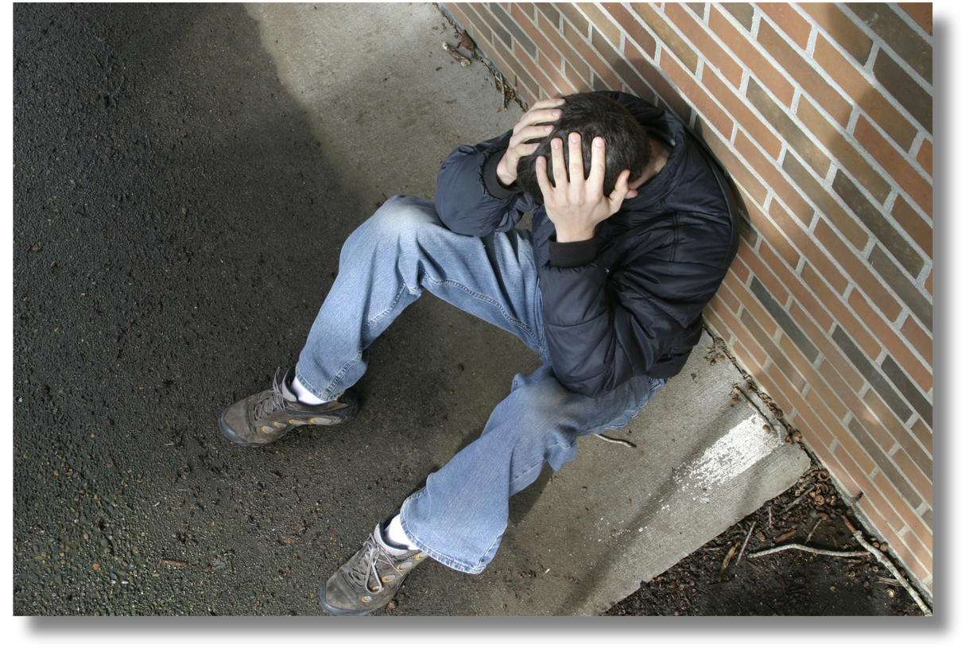
Keep Communication Moving:
Often, the decision to use force is based on the verbal interactions we maintain with the person in crisis.
These interactions help define the level of imminent danger to oneself and/or others.
Keeping this communication
exchange in motion increases our ability to de-escalate and to precisely respond to a dangerous crisis.
www.MABPRO.com

Slide 14

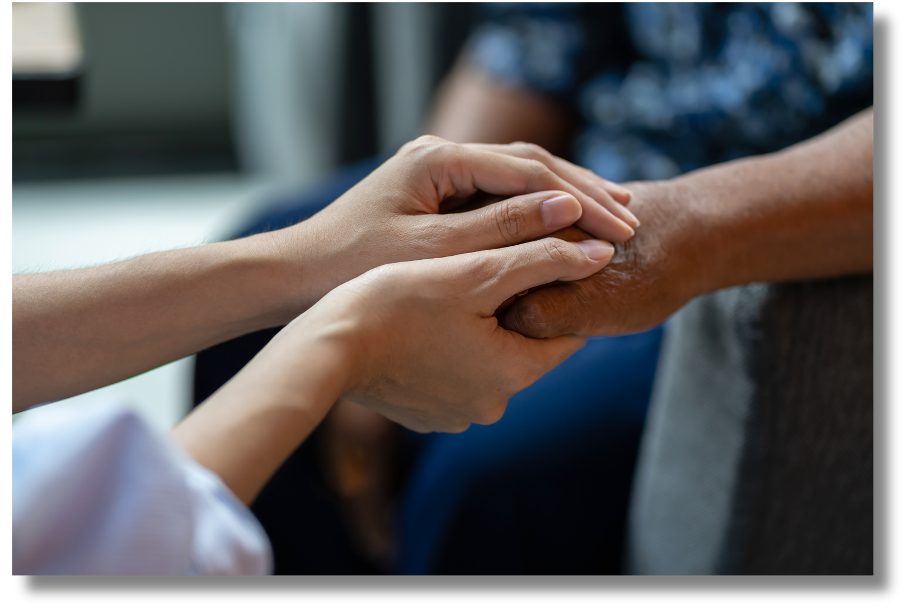
Recognize the benefits of differences:
Differences—whether cultural, linguistic,
psychological, or experiential—can actually be a powerful asset in crisis response.
www.MABPRO.com

Slide 15


Acknowledge the effort
Acknowledge the effort and the intent of the messages being sent. Acknowledging effort means recognizing the time, energy, and intention someone puts into communication - even if the outcome isn’t perfect. It’s about saying, “I see you, and you
matter.”
www.MABPRO.com

Slide 16


Don’t be afraid
Don’t be afraid to explore different approaches. Trying different approaches to communication is one of the most effective ways to build stronger connections, resolve misunderstandings, and adapt to diverse people and situations.
www.MABPRO.com

Slide 17


Try to be more empathetic
Try to be more empathetic and less sympathetic, helps us understand others' emotions, leading to deeper, more meaningful approach. Empathy builds trust and reduces conflict in personal and professional settings.
www.MABPRO.com

Slide 18


Seek to find and use Positive Reinforcement.
Positive reinforcement in crisis situations isn’t just helpful—it can be transformative. When emotions run high and escalate, the strategic use of encouragement and affirmation can shift the entire dynamic.
www.MABPRO.com

Slide 19
Tips in utilizing Framing during Crisis Communication...
Framing isn’t just about logistics—it’s about language, tone, and intention. A well-framed response says: “You’re not alone. You’re not broken. You’re supported.”
Framing a behavioral crisis response effectively means creating a structured, compassionate, and person-centered approach that prioritizes safety, dignity, and recovery. Here's how professionals and organizations typically frame these responses
  Do not hurry the client...
  Break a task into small parts...
  Use visual cues to communicate...
  Provide slow, brief, straightforward instructions...
  Use direct, consistent communication...
  Focus on the individual's needs, preferences, and strengths.
  Avoid punitive or coercive measures; instead, empower the person in crisis.
www.MABPRO.com

Slide 20
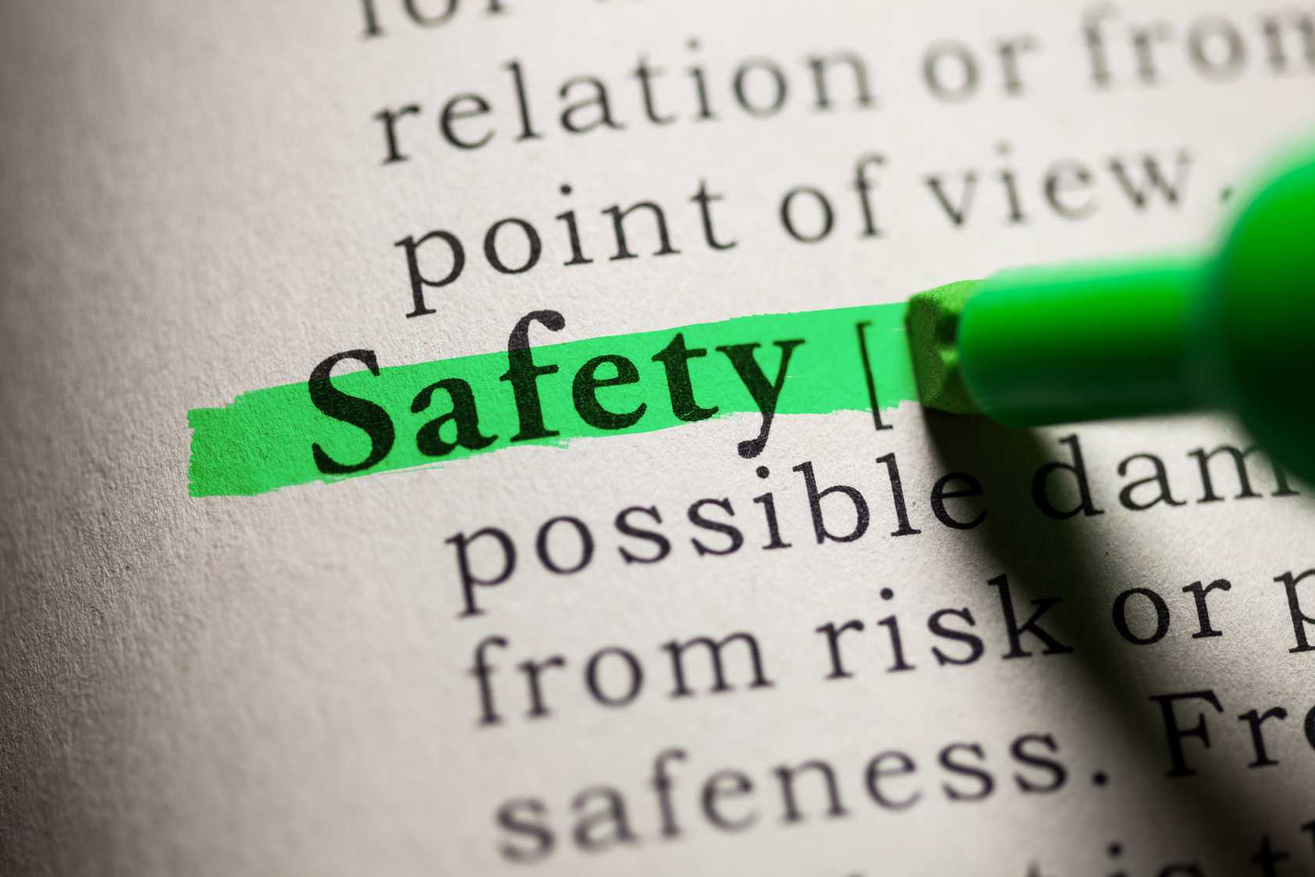
Tips in utilizing Framing during Crisis Communication...
  Recognize that many behavioral crises stem from trauma.
  Try to foster responses that avoid re-traumatization and promote psychological safety.
  De-escalation First
  Use calming techniques, active listening, and non-threatening body language.
  Reinforce positive behaviors and offer choices to restore a sense of control.
  Where possible, use a team approach...
www.MABPRO.com

Slide 21
Set the Mirrored Expectation, This is the way...
“If you want to see peace, you need to be peace...the individual in crisis is depending on you to mirror calm, speak confidence and hope, and that you are to help.”
www.MABPRO.com

Slide 22

The Traits of a Professional Communicator...
As we develop our problem-solving skills, we recognize the traits of a well cultivated thinker. We seek to not just solve the immediacy of the situation, but to understand the depth and the cause and effect of the variables. Prevention of the next occurrence is often in the details of the current situation...it's good practice to...
  Raise vital questions and identify problems.
  Gather and assess relevant information and think open-mindedly within alternative systems of thought.
  As a professional communicator, we spend honest effort on ensuring we are sending messages appropriately...
  To understand another person, we must be willing to be influenced. When we are open, we allow people to release their fixed positions and consider alternatives...
www.MABPRO.com

Slide 23

The Traits of a Professional Communicator...
Being a professional communicator means more than just speaking clearly—it’s about cultivating trust, clarity, and connection across diverse contexts.
  When we seek to understand, it allows us to act from a position of knowledge, and by trying to understand, we gain influence in the relationship.
  Use Positive Language. Try to avoid language that is negative in its connotation.
  Avoid using “But,” “Can’t,” or “Don’t.” This negates the first part of the statement and brings confusion to communication.
  As we respond, can we correct mistakes with a supportive tone?
www.MABPRO.com

Slide 24
Delivering the Expectation...
Professional communicators are the ones who turn words into results.”
www.MABPRO.com

Slide 25

The Perils of Reactionary Thinking...
Sometimes we can be caught off guard and slip into reactionary thinking. Problem-solving through reactionary thinking can be very difficult, as emotions can override logic.
Reactionary Thinking may feel instinctive and protective in the moment—but it often undermines clarity, connection, and long-term outcomes.
As we respond under pressure with trauma-informed care and situational awareness, understanding and preventing the perils of reactionary thinking is essential in shaping resilient, reflective pathways towards resolution.
www.MABPRO.com

Slide 26

Let's review some of the contributors towards reactive thinking:
Reactionary thinking, while often instinctive in high-stress situations, poses significant risks to effective communication, decision-making, and emotional regulation. It bypasses the brain’s reflective processes, leading to impulsive responses driven by fear, bias, or urgency.
  Reactive thinking is crisis-based thinking, coming up with solutions after problems develop.
  A reactive thinker often spends too much of his time fighting fires.
  Crisis-driven reactive thinking may be more prone to feeling stressed.
  Circumstances easily blindside a reactive thinker.
www.MABPRO.com

Slide 27
Reactive Thinking verses Critical Thinking...
As we navigate conflicts away from reactionary thinking, we should seek ways to help foster critical thinking in the dialog. Critical thinking as a mindset is essential to the negotiation process. It helps to steer response away from reactive thinking and helps to mitigate the elements of escalation....
Reactive thinking can not see past limited options, has a tendency to focus on the threat versus the resolution, and has a difficult time creating a plan of approach.
Critical thinking creates options, determines methods for effective communication, and can recognize and prioritize the developments of crisis variables.
www.MABPRO.com

Slide 28
As we seek to foster critical thinking, we should also be mindful of potential obstacles to critical thinking...such as....
  Reliance on authority or someone else.
  Rigid thinking
  Cultural conditioning.
  Frame of reference.
  Hasty Moral Judgment.
  Resistance to change.
  Emotional Related Dysfunction...
  Favoring information that supports existing beliefs while ignoring contradictory evidence.
  Prioritizing harmony over truth. Individuals suppress dissenting views to align with the group.
  Viewing situations only through a personal lens, ignoring others’ perspectives.
  Taking things for granted without evidence. Assumptions can derail analysis and lead to misjudgments.
www.MABPRO.com

Slide 29
Here are a few ways to help foster critical thinking...
  Listen and expect an answer to your message
  Use open-ended questions like “What else could be true?” or “What assumptions are we making?”
  Critical thinking is essential for sound judgment, especially in high-stakes environments like behavioral safety and crisis response. But it’s not automatic—it’s a skill that can be blocked by subtle and powerful obstacles.
  Use role modeling to demonstrate the correct behavioral response
  Develop well-received “Why” questions.
  Set a narrative for cause and effect.
  Thinking out loud
  Compare similar situations
  Verbalize Examples
www.MABPRO.com

Slide 30
You decide what must be addressed...
“Not everything that counts can be counted, and not everything that can be counted counts.”
~ William Bruce Cameron
www.MABPRO.com

Slide 31
Management of Assaultive Behavior (MAB)
Workplace Violence Prevention Course...
Thank You!
www.MABPRO.com

