Slide 1








Management of Assaultive Behavior (MAB)
Workplace Violence Prevention Course...
M1 Basic MAB - Book Three: Lesson 5 - The MAB Assault Cycle
GET STARTED
www.MABPRO.com

Slide 2


M1 Basic MAB: Book Three - Student Guide
www.MABPRO.com

Slide 3


Topics...
1.
2.
3.
4.
The MAB Crisis Intervention Scale
Response Considerations
Threat Considerations
The Assault Cycle
www.MABPRO.com

Slide 4
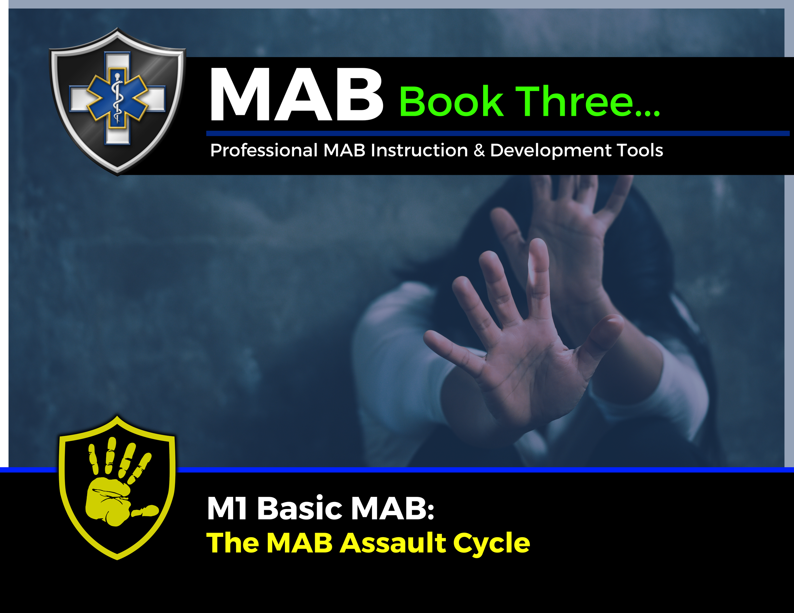

Topic Handouts
www.MABPRO.com

Slide 5


The MAB Crisis Intervention Scale ( The Assault Cycle)...
In this lesson, we will seek an understanding of the assault cycle, a critical component of our Workplace Violence Prevention Program. This model helps us recognize and potentially de-escalate situations before they escalate.
The assault cycle is rooted in the idea that everyone has a baseline behavior. By understanding this baseline, we can identify deviations that might signal the beginning of a potential crisis.
We approach crisis situations through our experience and training, considering and evaluating the variables.
www.MABPRO.com

Slide 6
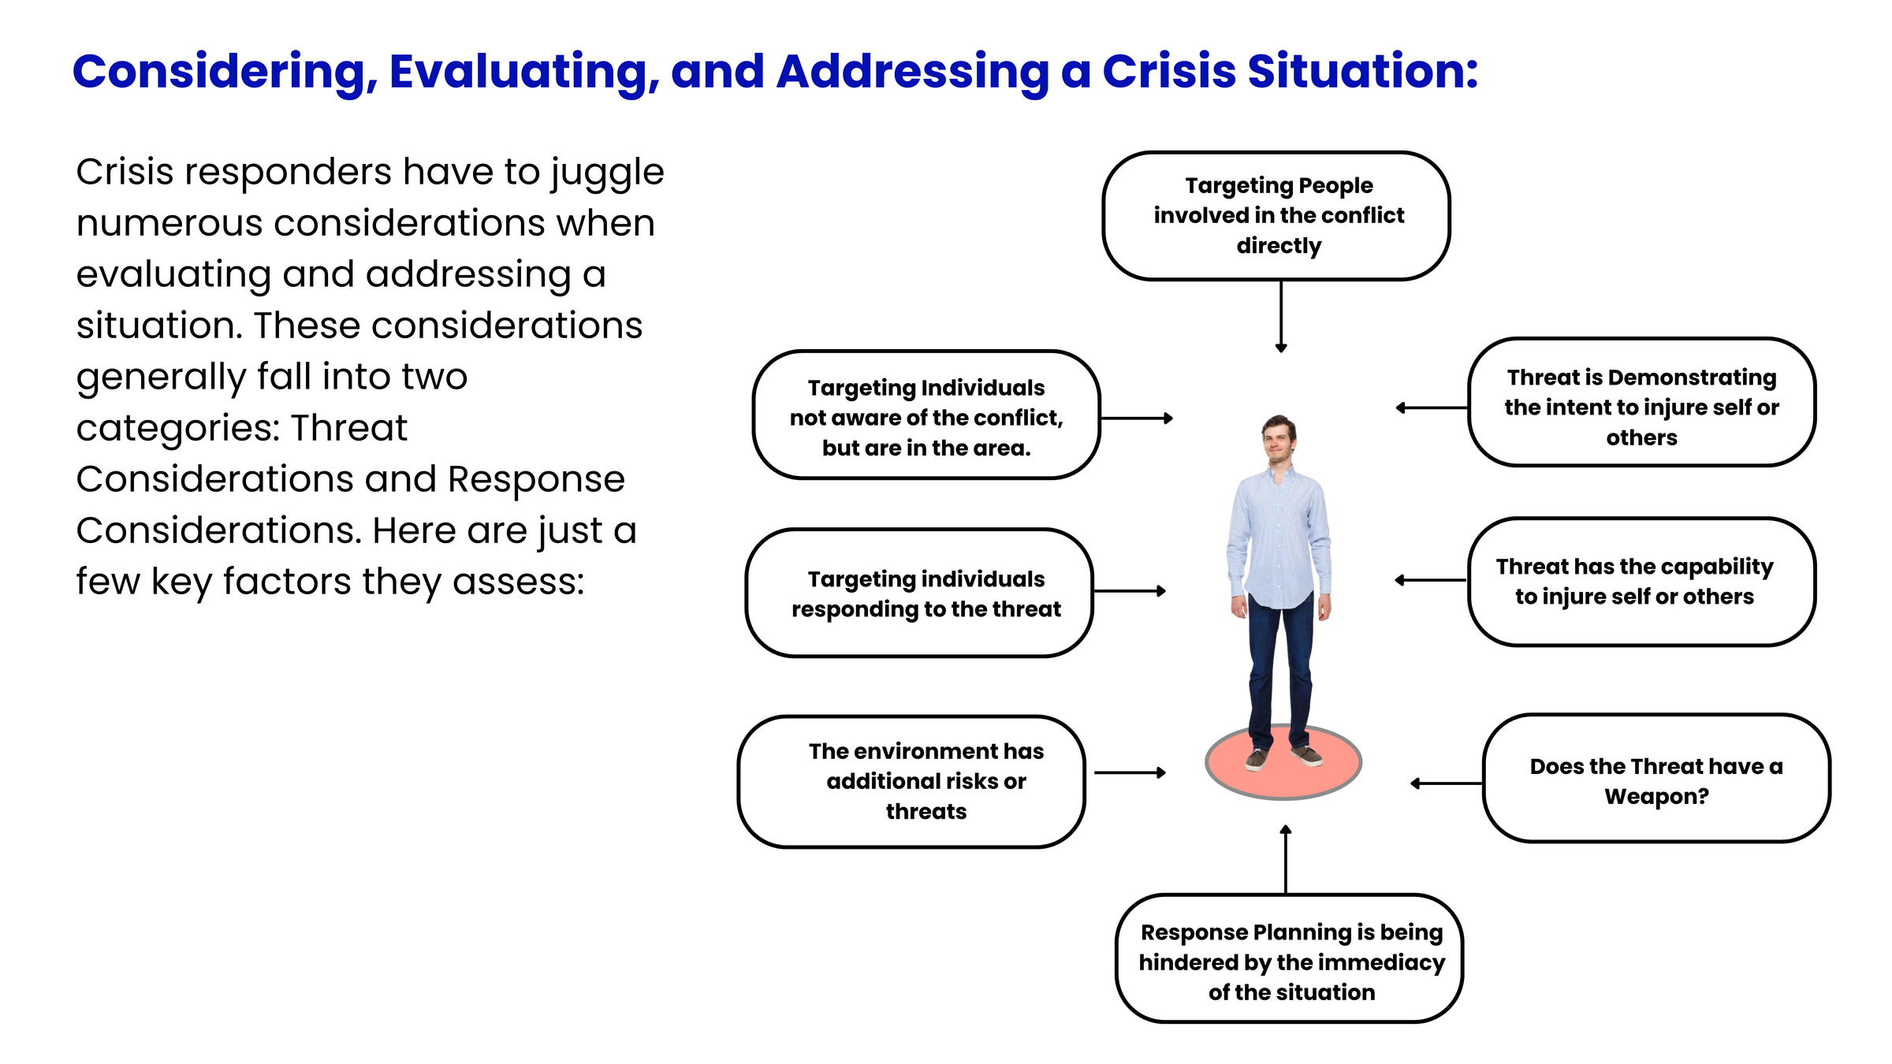
Considering, Evaluating, and Addressing a Crisis Situation:
Crisis responders have to juggle numerous considerations when evaluating and addressing a situation. These considerations generally fall into two categories: Threat Considerations and Response Considerations.
As we evaluate the crisis variables, we begin to define and identify the threat, which helps us determine how to respond. All of this is happening very rapidly as the responder seeks to calm and de-escalate the situation.
www.MABPRO.com

Slide 7
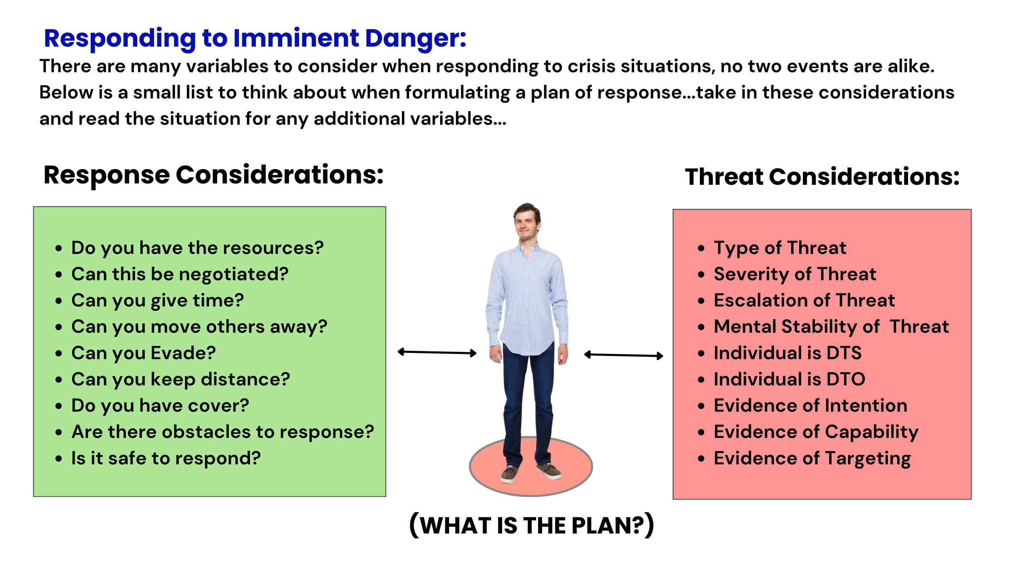
Defining Imminent Danger:
There are many variables to consider when responding to crisis situations; no two events are alike. Below is a small list to consider when formulating a response plan. Take these into account and read the situation for any additional variables.
www.MABPRO.com

Slide 8

The MAB Crisis Intervention Scale ( The Assault Cycle)...
Understanding the assault cycle is a valuable tool in crisis response. It helps us evaluate and consider how to help, identify existing threat levels, & in developing a way forward.
Understanding the assault cycle is like having a map through the storm. It helps crisis responders recognize where someone is emotionally and behaviorally, so they can intervene with the right tools at the right time.
“Remember...No two events are alike,
find the variables!”
www.MABPRO.com

Slide 9
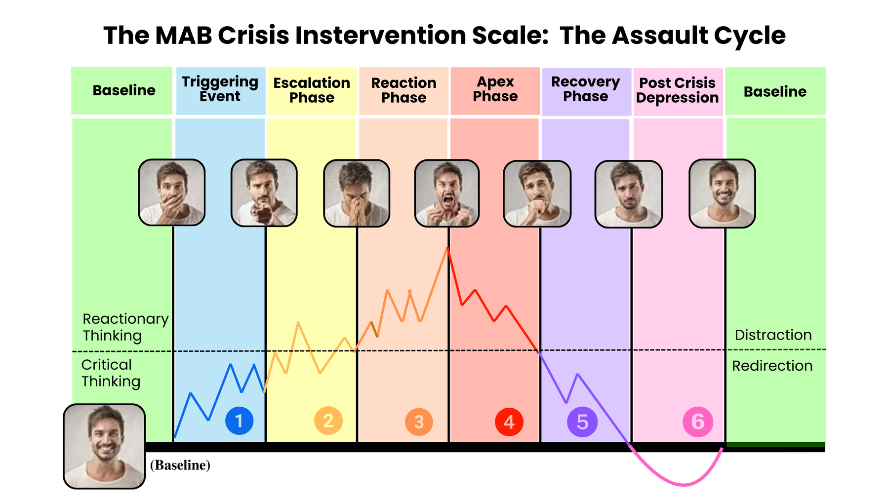
What is it?
The assault cycle is a behavioral model that helps crisis responders understand and anticipate aggressive or violent behavior.
It breaks down the progression of aggression into five distinct phases, each with its own emotional and behavioral markers.
Recognizing these phases allows for timely intervention and safer outcomes.
www.MABPRO.com

Slide 10
  Predictability in chaos. The cycle outlines five observable phases—Triggering, Escalation, Crisis, Recovery, and Post-Crisis Depression. Knowing these helps responders spot early warning signs and act before aggression peaks
  Enhances safety by identifying where someone is in the cycle, allowing responders to tailor their approach and reduce risk for themselves, the individual in crisis, and bystanders.
  Improves communication. Understanding the emotional state tied to each phase allows for more empathetic, effective dialogue. For example, during escalation, setting calm boundaries is more useful than reasoning or confrontation.
Why It Matters in Crisis Response:
www.MABPRO.com

Slide 11
Why It Matters in Crisis Response: (cont.)
  Supports de-escalation strategies. The cycle helps responders choose the right tools—whether it’s grounding techniques, verbal redirection, or offering space—based on the person’s current phase.
  Builds team coordination. In institutional settings like hospitals or schools, the cycle helps teams stay aligned in their response, reducing confusion and conflicting messages.
  Facilitates post-crisis reflection. After the crisis, the model encourages reflection and support during the Post-Crisis Depression phase, which is often overlooked but critical for healing and preventing recurrence.
“In short, the assault cycle transforms unpredictable behavior into something understandable—and that’s a game-changer in crisis work.”
www.MABPRO.com

Slide 12
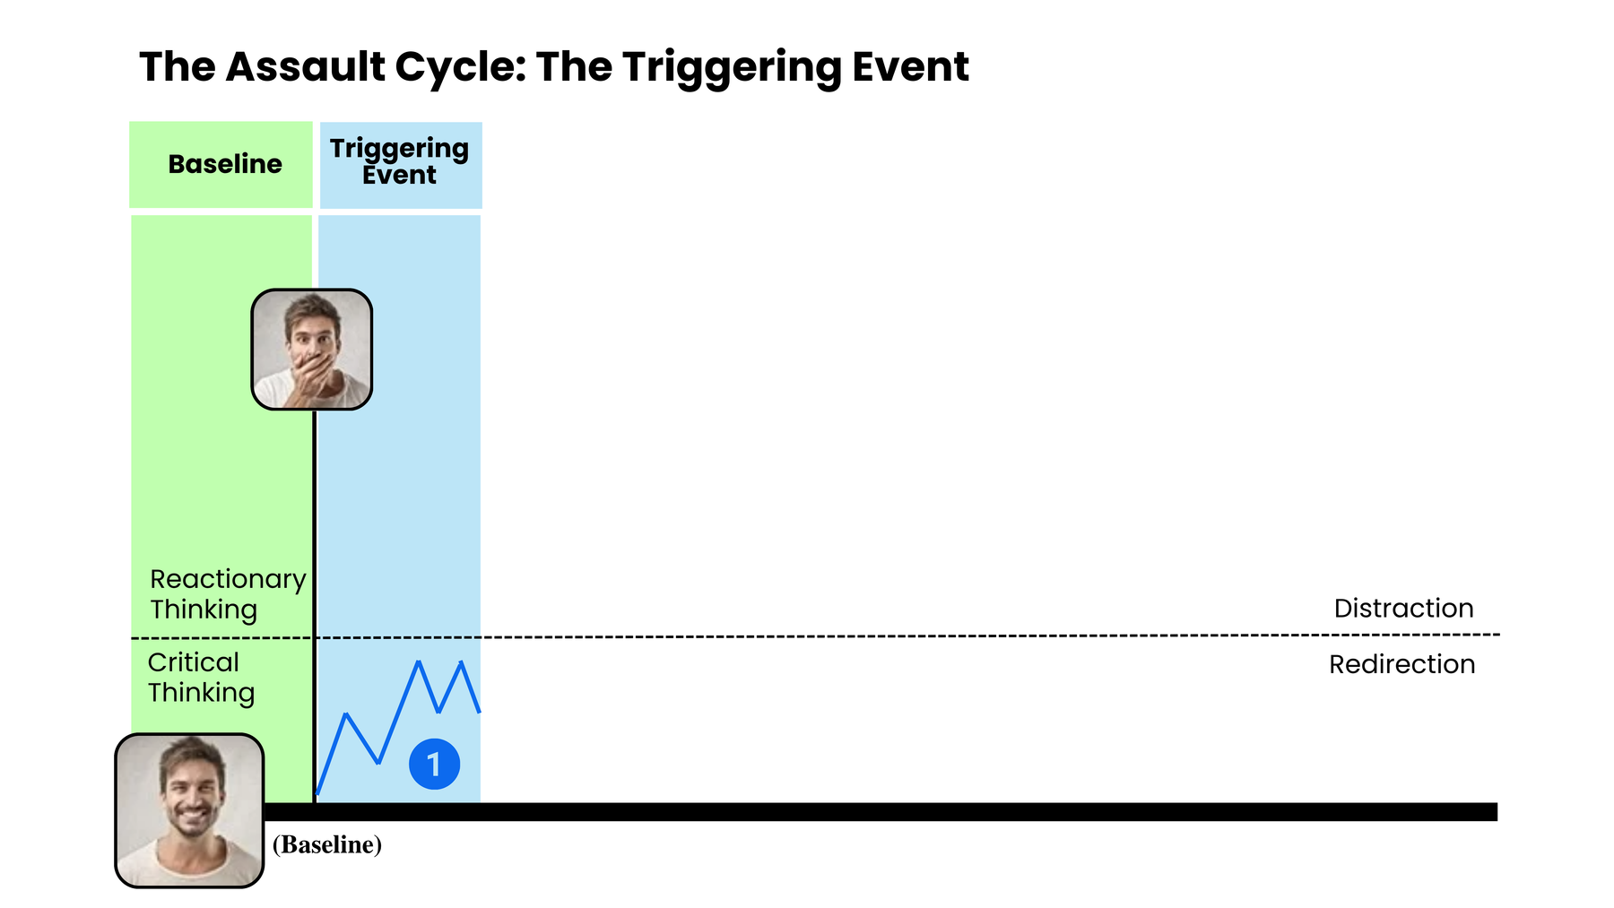
The Assault Cycle: The Triggering Event...
The assault cycle begins with the Triggering Phase, which is set in motion by an event the individual perceives as threatening, frustrating, or deeply upsetting—even if others wouldn’t see it that way.
  It's a change in behavior where the individual perceives a significant threat – emotionally, mentally, or physically. This perception sets off a chain reaction.
  The Body's physiological systems begin preparation to meet and deal with the threat.
www.MABPRO.com

Slide 13
Triggers typically fall into two categories:
  Fear-Inducing Events: These make the person feel unsafe or at risk of losing something important. Examples include being yelled at, sudden changes, and perceived abandonment.
  Frustrating Circumstances These make the person feel powerless or unheard. Examples include unmet needs, blocked goals, and feeling ignored or disrespected.
www.MABPRO.com

Slide 14
Why Triggers Matter:
  They activate the fight-or-flight response, flooding the body with stress hormones.
  The person may begin to show signs of agitation, anxiety, or withdrawal.
  If not addressed early, the cycle can escalate toward aggression or violence.
“Understanding what triggers someone—and how they interpret those events—is key to early intervention. It’s not just about what happened, but how it was experienced.”
www.MABPRO.com

Slide 15
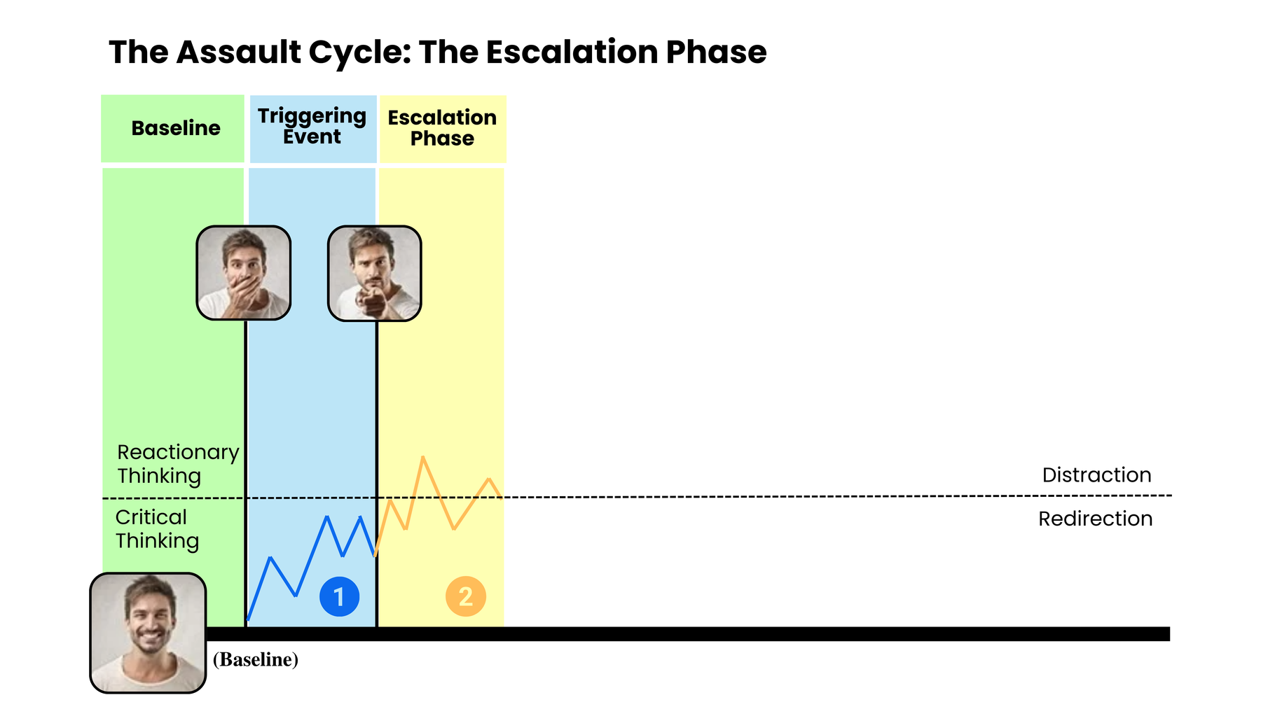
The Escalation Phase...
The Escalation Phase is the second stage of the assault cycle, and it’s where tension and agitation begin to build—both emotionally and physically.
Think of it as the moment when the internal storm gathers force but hasn’t yet broken.
www.MABPRO.com

Slide 16
  Physiological arousal increases: Heart rate rises, breathing quickens, muscles tense. The body is preparing for a possible “fight.”
  Behavior becomes more confrontational: The person may raise their voice, use aggressive language, or challenge authority.
  Cognitive narrowing: Rational thinking starts to fade. The person may misinterpret neutral actions as threats.
  Control begins to slip: They may taunt, threaten, or lash out verbally—but haven’t yet reached physical aggression.
What Happens During Escalation?
www.MABPRO.com

Slide 17

Elements of fear response begin to affect the body...
  Fear triggers a cascade of physiological responses.
  Our bodies react, impacting everything from our vision and motor skills to our heart rate and cognitive processing.
www.MABPRO.com

Slide 18
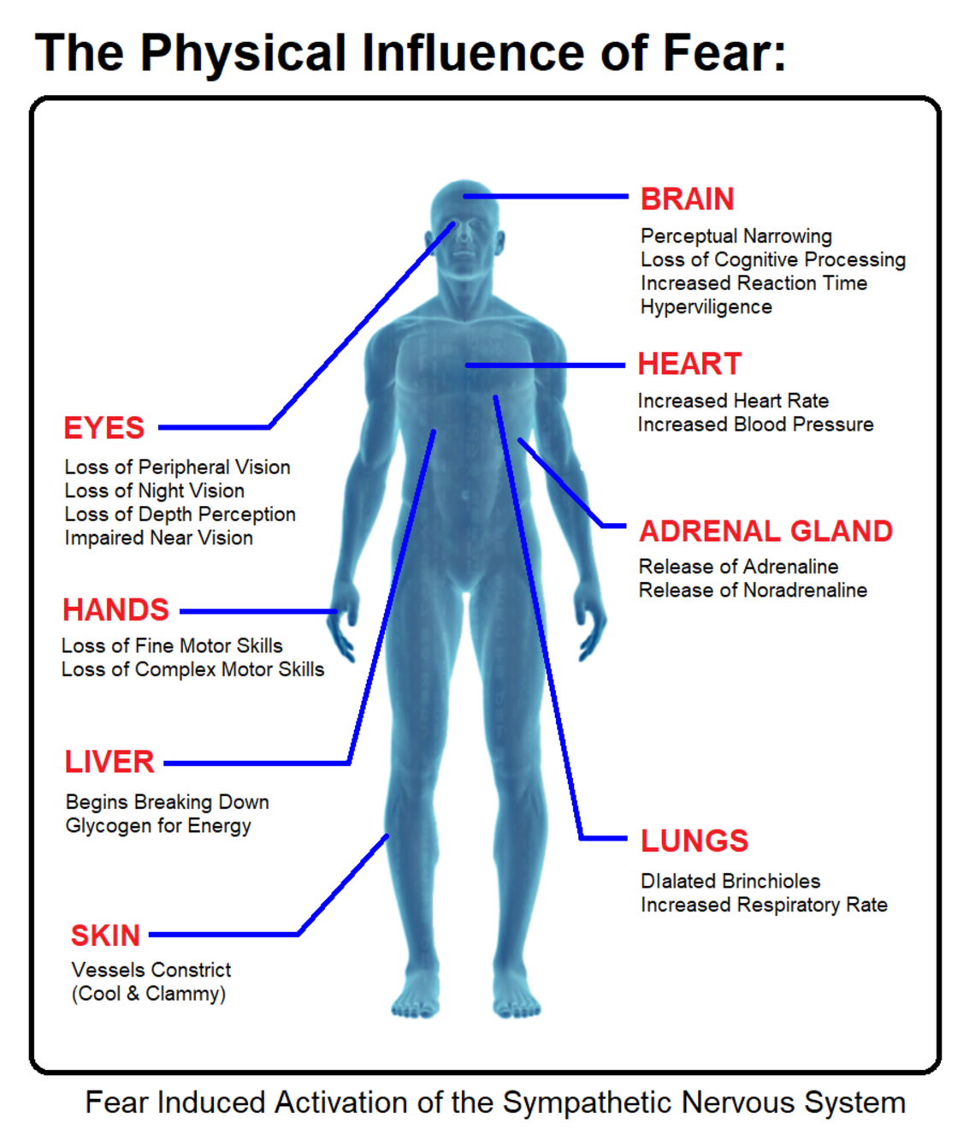
Key Physiological Responses Triggered by Fear:
  Increased heart rate and blood pressure. To pump more oxygen and nutrients to muscles, the body prepares itself to run or fight.
  Rapid breathing (hyperventilation) supplies more oxygen to the bloodstream and helps fuel quick reactions.
  Dilated pupils enhance vision to better detect threats in the environment.
  Muscle tension: Muscles tighten and prepare for action—this can lead to trembling or clenched fists.
  Sweating helps cool the body and improve grip (think clammy hands).
  Goosebumps (piloerection) is A leftover evolutionary trait that makes animals appear larger when threatened.
  Redirected blood flow: Blood is shunted away from the skin and digestive system toward vital organs and muscles
www.MABPRO.com

Slide 19
Key Physiological Responses Triggered by Fear:
  Redirected blood flow: Blood is shunted away from the skin and digestive system toward vital organs and muscles
  Release of stress hormones, Adrenaline (epinephrine) and noradrenaline, floods the system, increasing alertness and energy.
  Spiked blood glucose levels provide a quick energy source for muscles in case of physical exertion.
  Suppressed digestion and immune response. Non-essential systems are temporarily downregulated to conserve energy for survival.
“These changes happen in seconds, often before you're consciously aware of the fear.”
www.MABPRO.com

Slide 20
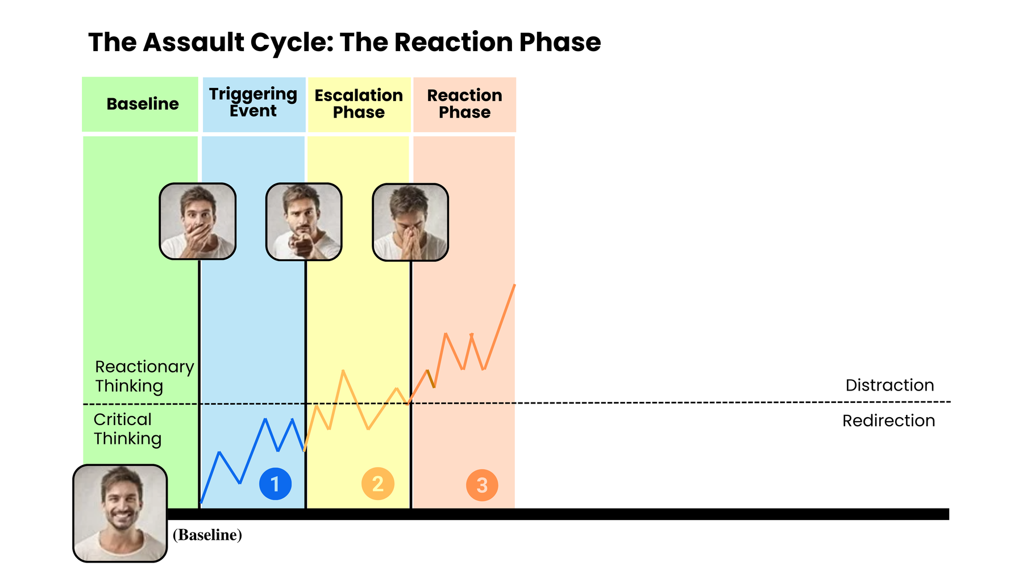
The Reaction Phase...
  The Reaction Phase is a crucial opportunity. When coping skills are exhausted, individuals often seek help and are more receptive to being redirected away from the crisis.
  Our pre-existing relationship with the individual is vital during this phase. A strong, positive connection can significantly improve the chances of successful redirection.
www.MABPRO.com

Slide 21
  When people in crisis reach out for help, it’s often a brave and vulnerable act—a signal that their internal coping systems are overwhelmed and they need connection, support, or intervention. Whether the crisis involves mental health, trauma, substance use, or emotional distress, that moment of reaching out is a critical turning point.
  It’s a chance to interrupt the assault cycle before it reaches crisis.
  It builds trust and connection, which are protective factors against long-term harm.
  It can be the first step toward healing, especially if the person has felt isolated or misunderstood.
Why this moment is so important...
www.MABPRO.com

Slide 22
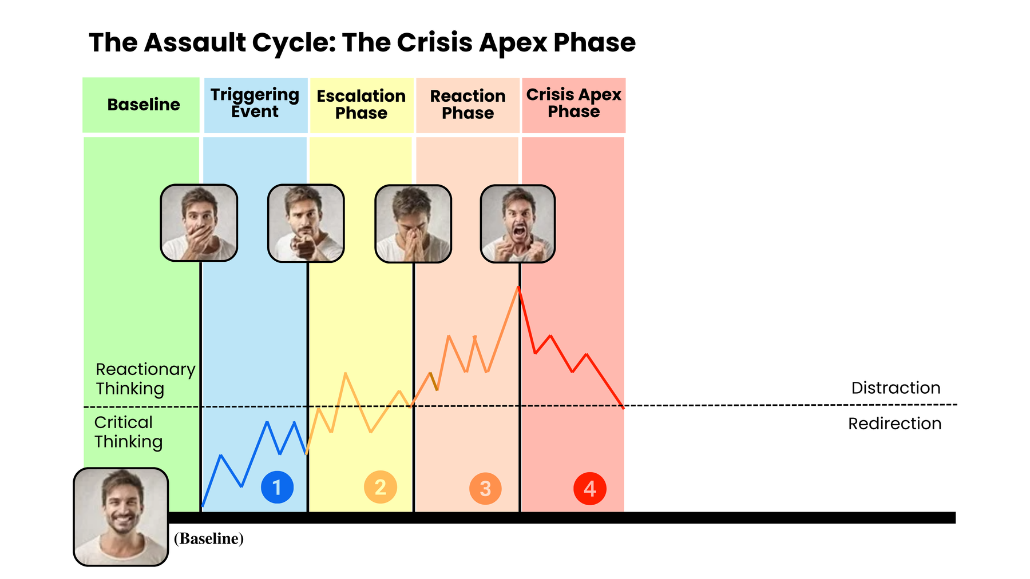
During the Crisis Apex...
  During the Crisis Apex, survival instincts take over. It's essential to communicate with simple, direct, and non-provoking statements.
  Recognizing when you're approaching the crisis point is key. If possible, create distance. The individual is experiencing heightened physical, emotional, and psychological arousal.
  Control over aggressive impulses decreases, and direct aggression is a possibility.
www.MABPRO.com

Slide 23
During the Crisis Apex...(Cont.)
  The aggressor erupts into violent acts against the perceived threat.
  The behavioral pattern explodes into one or more physical assaults on the perceived source of the threat. The individual will threaten injury, hit, kick, or throw objects at people, among other actions. An individual cannot sustain this level of energy forever
  The acuity proved too much to bear is offloaded in a vented manner (violence, property destruction, & possible self-harm).
www.MABPRO.com

Slide 24
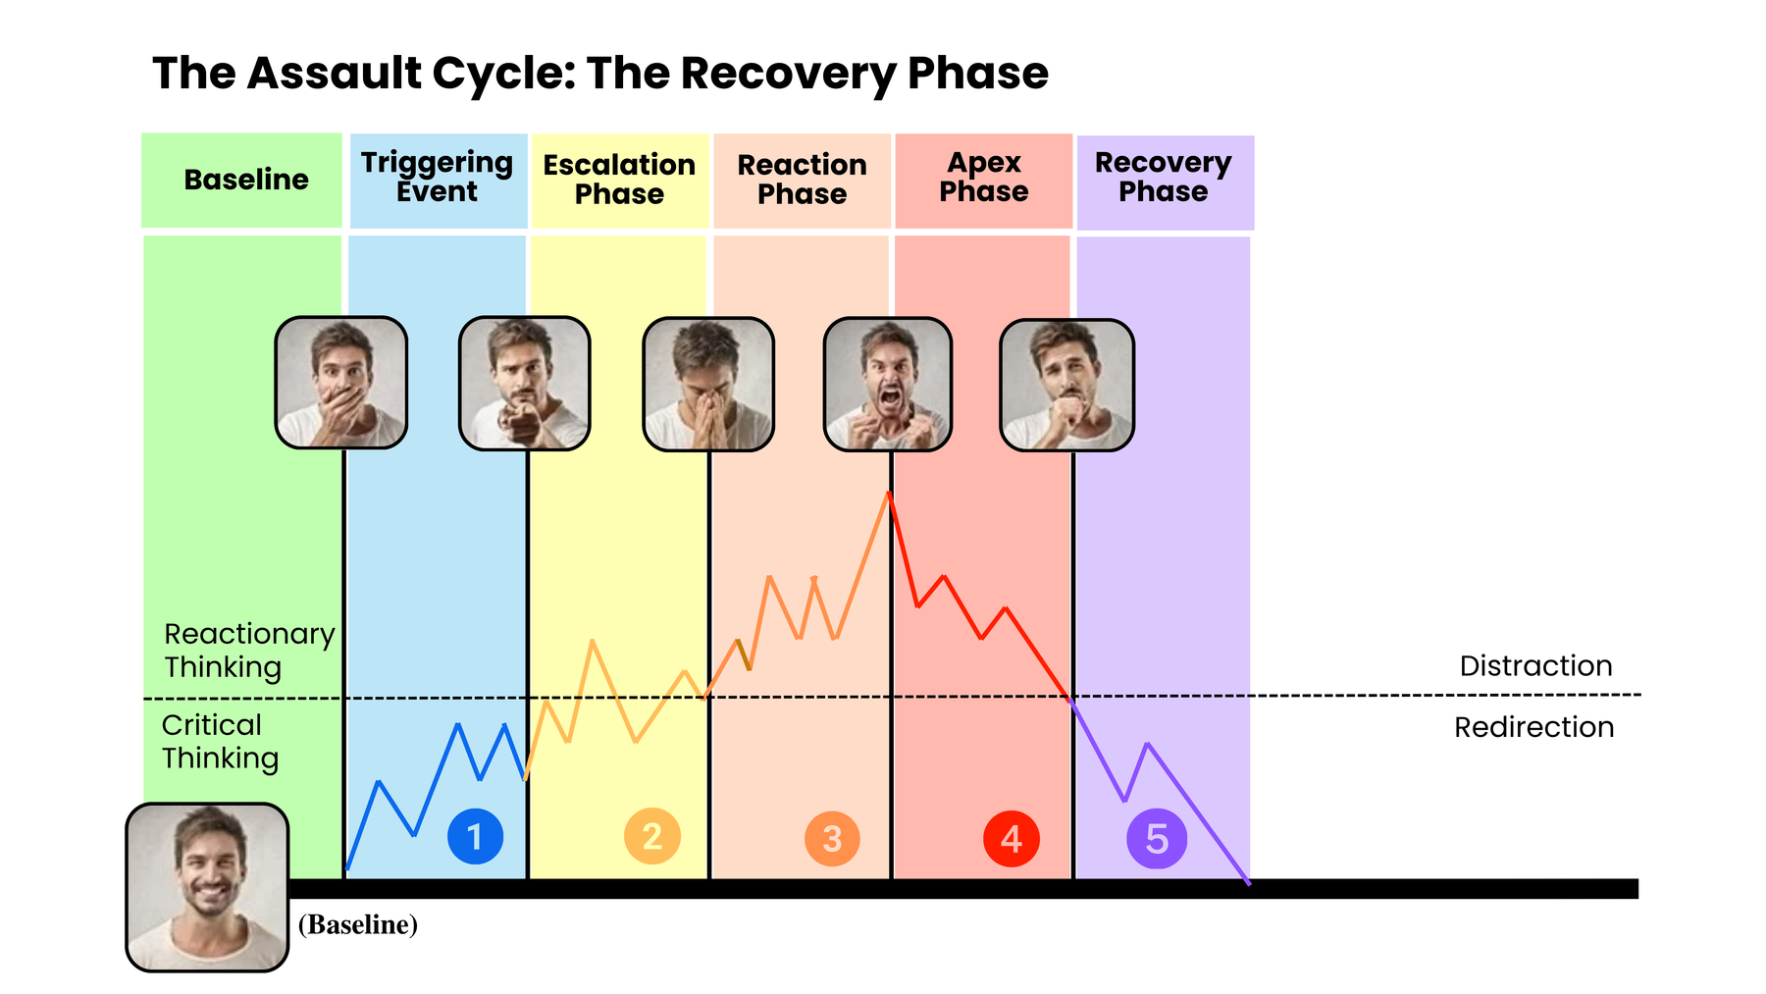
In the Recovery Phase...
  In the Recovery Phase, the Patient slowly returns to their baseline behavior. The service user’s heightened state of physical and psychological arousal can remain a threat for up to ninety minutes due to the level of adrenaline in the bloodstream.
  The aggressor’s body relaxes, and the mind decreases its vigilance. The confrontation appears to be over, even if temporarily.
www.MABPRO.com

Slide 25
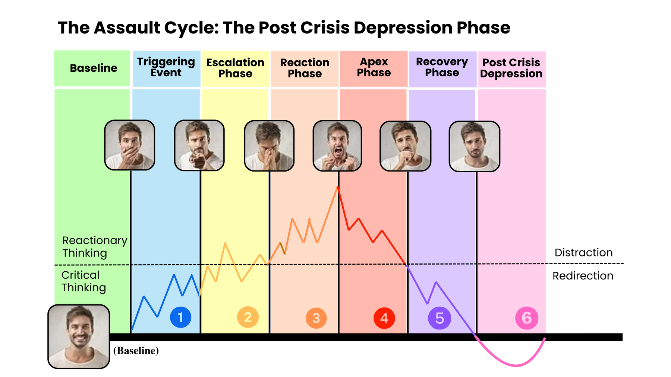
The Post-Crisis Depression Phase...
  The Post-Crisis Depression Phase often sees the individual dip below their baseline.
  After reaching normal physiological levels, the body enters a short period in which the heart rate slips below average to regain balance (homeostasis).
  They may experience feelings of guilt, regret, and emotional depression as they process what occurred.
www.MABPRO.com

Slide 26
The Post-Crisis Depression Phase...(Cont.)
  Finally, once some action has been taken to resolve the crisis phase, the body begins to recover from the extreme stress and energy expenditure. However, the adrenaline does not leave the bloodstream all at once, so the level of arousal tapers off until normal limits are reached.
  Quality of judgment returns to normal levels as reasoning replaces the survival response.
www.MABPRO.com

Slide 27
The Post-Crisis Depression Phase...(Cont.)
  Understanding the MAB Crisis Intervention Scale helps us to meet the patient where they are.
  The depth of each phase is unique to the individual's coping capability; some are quick to trigger & some are slow to escalate.
www.MABPRO.com

Slide 29
Management of Assaultive Behavior (MAB)
Workplace Violence Prevention Course...
Thank You!
www.MABPRO.com

