Slide 1








Management of Assaultive Behavior (MAB)
Workplace Violence Prevention Course...
M1 Basic MAB - Book Three: Lesson 4 - Fundamental Reasons Why People Lose Control
GET STARTED
www.MABPRO.com

Slide 2


M1 Basic MAB: Book Three - Student Guide
www.MABPRO.com

Slide 3


Topics...
1.
2.
3.
4.
The Fundamental Reasons Why People Lose Control
A Choice we Make...
2 Fundamental Reasons
We are Always Communicating
www.MABPRO.com

Slide 4
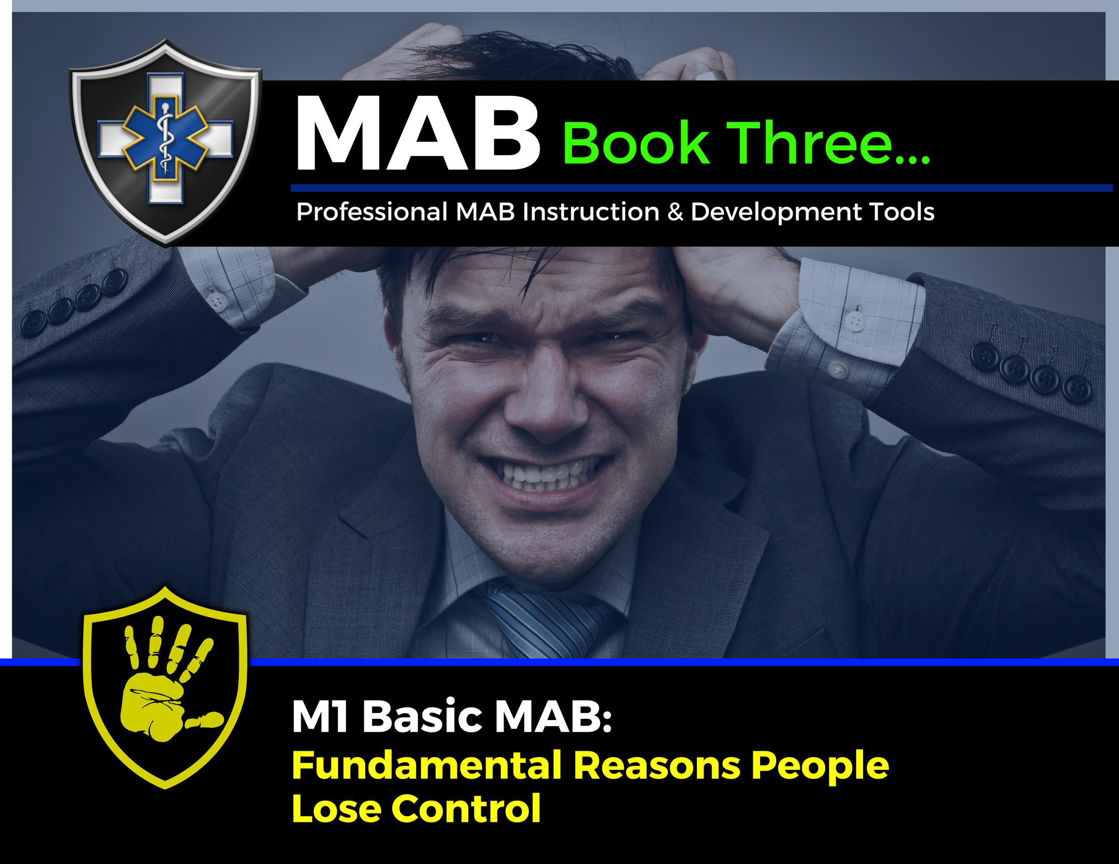

Topic Handouts
www.MABPRO.com

Slide 5


The fundamental reasons why people lose control...
Welcome to this training on the two fundamental reasons why people lose control. Here we will learn how to recognize what is leading the escalation moments of conflict...
www.MABPRO.com

Slide 6

Losing Control - When Anger Becomes Rage:
Anger isn’t always destructive. Like all other emotions, anger serves a purpose. However, a very fine line divides managed anger from rage.
It is this second, more negative facet that we will discuss below: this is when we reveal the darkest side of ourselves. In this sense, when we get angry, we exhibit a voluntary reaction – and as such, an avoidable one – in response to extreme provocation.
www.MABPRO.com

Slide 7

Losing Control - When Anger Becomes Rage:
Anger becomes negative when it becomes toxic due to a lack of control we can exercise over it.
When you stop having control and give this over to anger, the problems start: this feeling invades us and clouds our reason.
www.MABPRO.com

Slide 8
A choice we make...
“Anybody can become angry — that is easy, but to be angry with the right person and to the right degree and at the right time and for the right purpose, and in the right way — that is not within everybody's power and is not easy.”
- Aristotle
www.MABPRO.com

Slide 9
The Many Reasons We Give for Losing Control...
There are numerous reasons why people lose control...
  The staff member looks like someone the client hates or fears
  The client is being held against their will and wants to leave.
  The client does not want to leave or be discharged from the facility.
  The client is experiencing psychosis, hallucinations, or delusions.
  Demand for compliance.
  Making unreasonable demands of clients.
  Sarcasm during interactions between staff and clients.
  Rude and hostile treatment of clients.
www.MABPRO.com

Slide 10
There are so many sparks that lead to rage...
The list of reasons people lose control can be vast and unique. What concerns some does not concern all. There are even more examples like...
  Rude and hostile treatment of clients.
  Failure to provide confidentiality.
  Touching or getting too close to clients who have physical issues
  Individual or group punishments, especially in public.
  Giving double messages, Inconsistencies, and violations of the established routines.
  Favoritism.
www.MABPRO.com

Slide 11
The list continues...
How do we help redirect or distract from conflict when there are so many reasons a person can be upset?
  Being too punitive or parental with clients.
  Arguing with a client.
  Interrupting while a client speaks.
  Failing to be attentive to the client while they are speaking.
  Poorly timed confrontations.
  The lack of respect or rejection of the client.
www.MABPRO.com

Slide 12
It can seem like a list with no end....
The reality of knowing why people lose control can be tricky. Because each person is unique, and the variables they are coping with are unique, as such, we risk never seeing the end of the list of reasons why someone loses control.
Patients don’t always come into care environments with detailed histories, and we often meet them for the very first time. We sometimes find ourselves supporting someone in crisis, despite knowing nothing about them.
When this happens, we must adjust our response to read the information presented in real-time and plan action that best supports the crisis.
www.MABPRO.com

Slide 13



What if we could break it down into 2 fundamental reasons people lose control?
Communication...
They cannot communicate effectively or develop the coping skills necessary for the communication process. Alternatively, they have learned poorly and behave in the only way they know to get attention or achieve their desires.
Symptom of their illness...
Drunk, on drugs, psychotic, low functioning, autistic, reaction to medications, dementia...something having to do with illness that would cause them to become aggressive or strike out because of it.
www.MABPRO.com

Slide 14

We are Always Communicating...
  Communication is often at the root of the conflict and the end result of success.
  Communication is irreversible.
  Communication is as much nonverbal as verbal.
  Communication is a step-by-step process.
  Effective Communication must be thought through.
  The most common obstacle to the success of any work is the need for more communication.
www.MABPRO.com

Slide 15
Management of Assaultive Behavior (MAB)
Workplace Violence Prevention Course...
Thank You!
www.MABPRO.com

