Slide 1








Management of Assaultive Behavior (MAB)
Workplace Violence Prevention Course...
M1 Basic MAB - Book Three: Lesson 3 - Conflict Resolution Mistakes to Avoid
GET STARTED
www.MABPRO.com

Slide 2

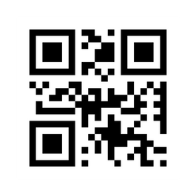
M1 Basic MAB: Book Three - Student Guide
www.MABPRO.com

Slide 3


Topics...
1.
Conflict Resolution Mistakes to AVOID
www.MABPRO.com

Slide 4
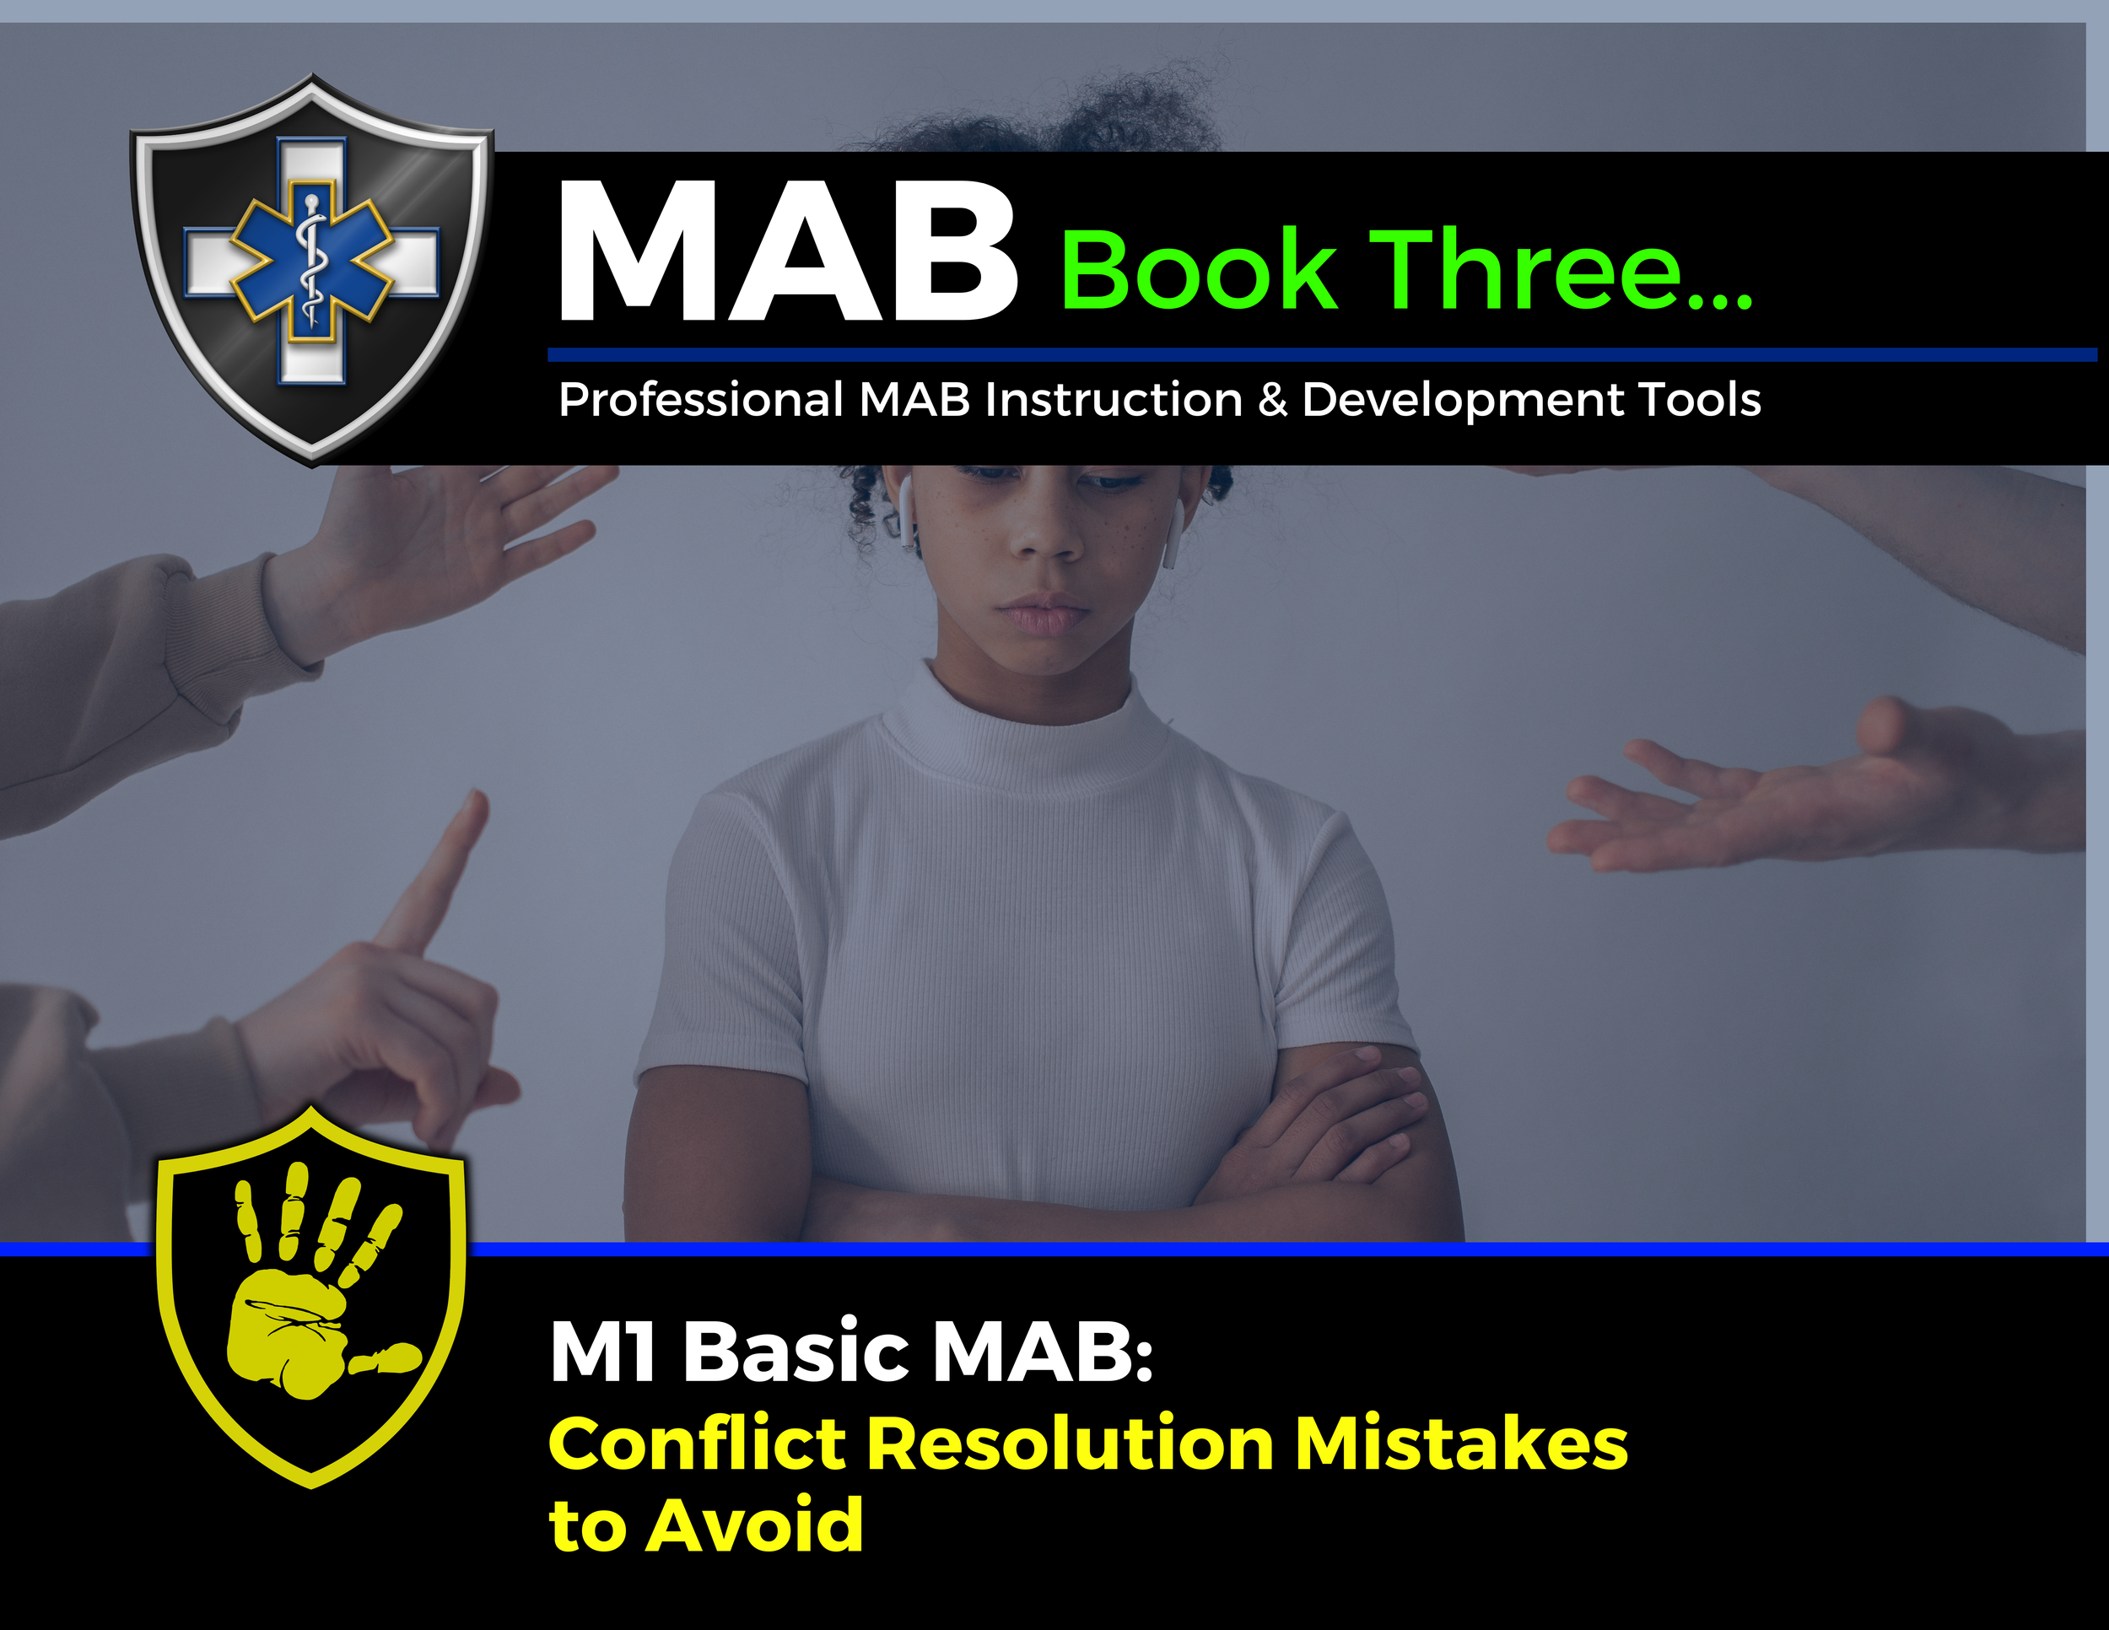

Topic Handouts
www.MABPRO.com

Slide 5


Conflict resolution mistakes to AVOID...
Welcome. In this module, we will review some common conflict resolution mistakes and discuss how to avoid them.
Conflict resolution mistakes can turn a manageable disagreement into a full-blown breakdown in trust, communication, and collaboration. Whether in personal relationships, workplaces, or crisis situations, effective communication is crucial.
Missteps in resolving conflict can intensify tension, damage relationships, and shut down progress.
www.MABPRO.com

Slide 6




Conflict resolution mistakes to AVOID...
Avoiding Conflict
Avoid Being Defensive
Avoid Overgeneralization.
Utilizing Overgeneralizations can increase the drama when you’re resolving an argument.
Avoid starting sentences with “you always” and “you never,” as in, “You always come home late!” or “You never do what I want to do!”
Some people avoid discussing building frustrations calmly and respectfully, waiting to say anything until they’re ready to explode. This may seem less stressful, but it usually causes more stress to both parties. It’s much healthier to address and resolve conflict.
Defensive people steadfastly deny any wrongdoing and work hard to avoid looking at the possibility that they could be contributing to a problem.
This creates long-term problems for people who don’t feel listened to and unresolved conflicts continue to grow

Slide 7



Conflict resolution mistakes to AVOID...
Avoid the "Need" to be Right
Avoid Psychoanalyzing.
Avoid Interrupting
The need to be “right” can prolong and intensify conflicts.
It’s damaging to decide that there’s a “right” and a “wrong” way to look at things.
Look for a compromise or agree to disagree, and remember that there’s not always a “right” or a “wrong” and that two points of view can be valid.
Try not to “Psychoanalyze” or Mind-Read.
“Psychoanalyzing” the other person is something to avoid in a conflict. This creates hostility and misunderstandings.
Don't assume information. Where possible, always try to trust but verify.
This signals disrespect and shuts down dialogue. It prevents you from hearing the full story and escalates frustration.

Slide 8



Conflict resolution mistakes to AVOID...
Avoid Forgetting to Listen
Avoid Using sarcasm
Failing to validate emotions
This prevents you from seeing their viewpoint and makes your partner less likely to see yours.
You can not effectively speak and listen at the same time. Actively listen to the views and points others are trying to make.
Ignoring or minimizing someone’s feelings—especially in crisis—can make them feel dismissed or unsafe.
Validation doesn’t mean agreement; it means acknowledgment.
These tactics undermine trust and clarity. They may feel like indirect expressions of emotion, but they often confuse or provoke the other person.

Slide 9


Conflict resolution mistakes to AVOID...
Avoid Rushing the Resolution
Trying to “fix” things too quickly can feel dismissive. Some conflicts require time, space, and layered negotiation. Pacing matters.
We resolve at the pace that they can cope...

Slide 10
We eventually learn...
“Peace is not the absence of conflict, but the ability to cope with it.”
- Mahatma Gandhi
www.MABPRO.com

Slide 11
Management of Assaultive Behavior (MAB)
Workplace Violence Prevention Course...
Thank You!
www.MABPRO.com

