Slide 1

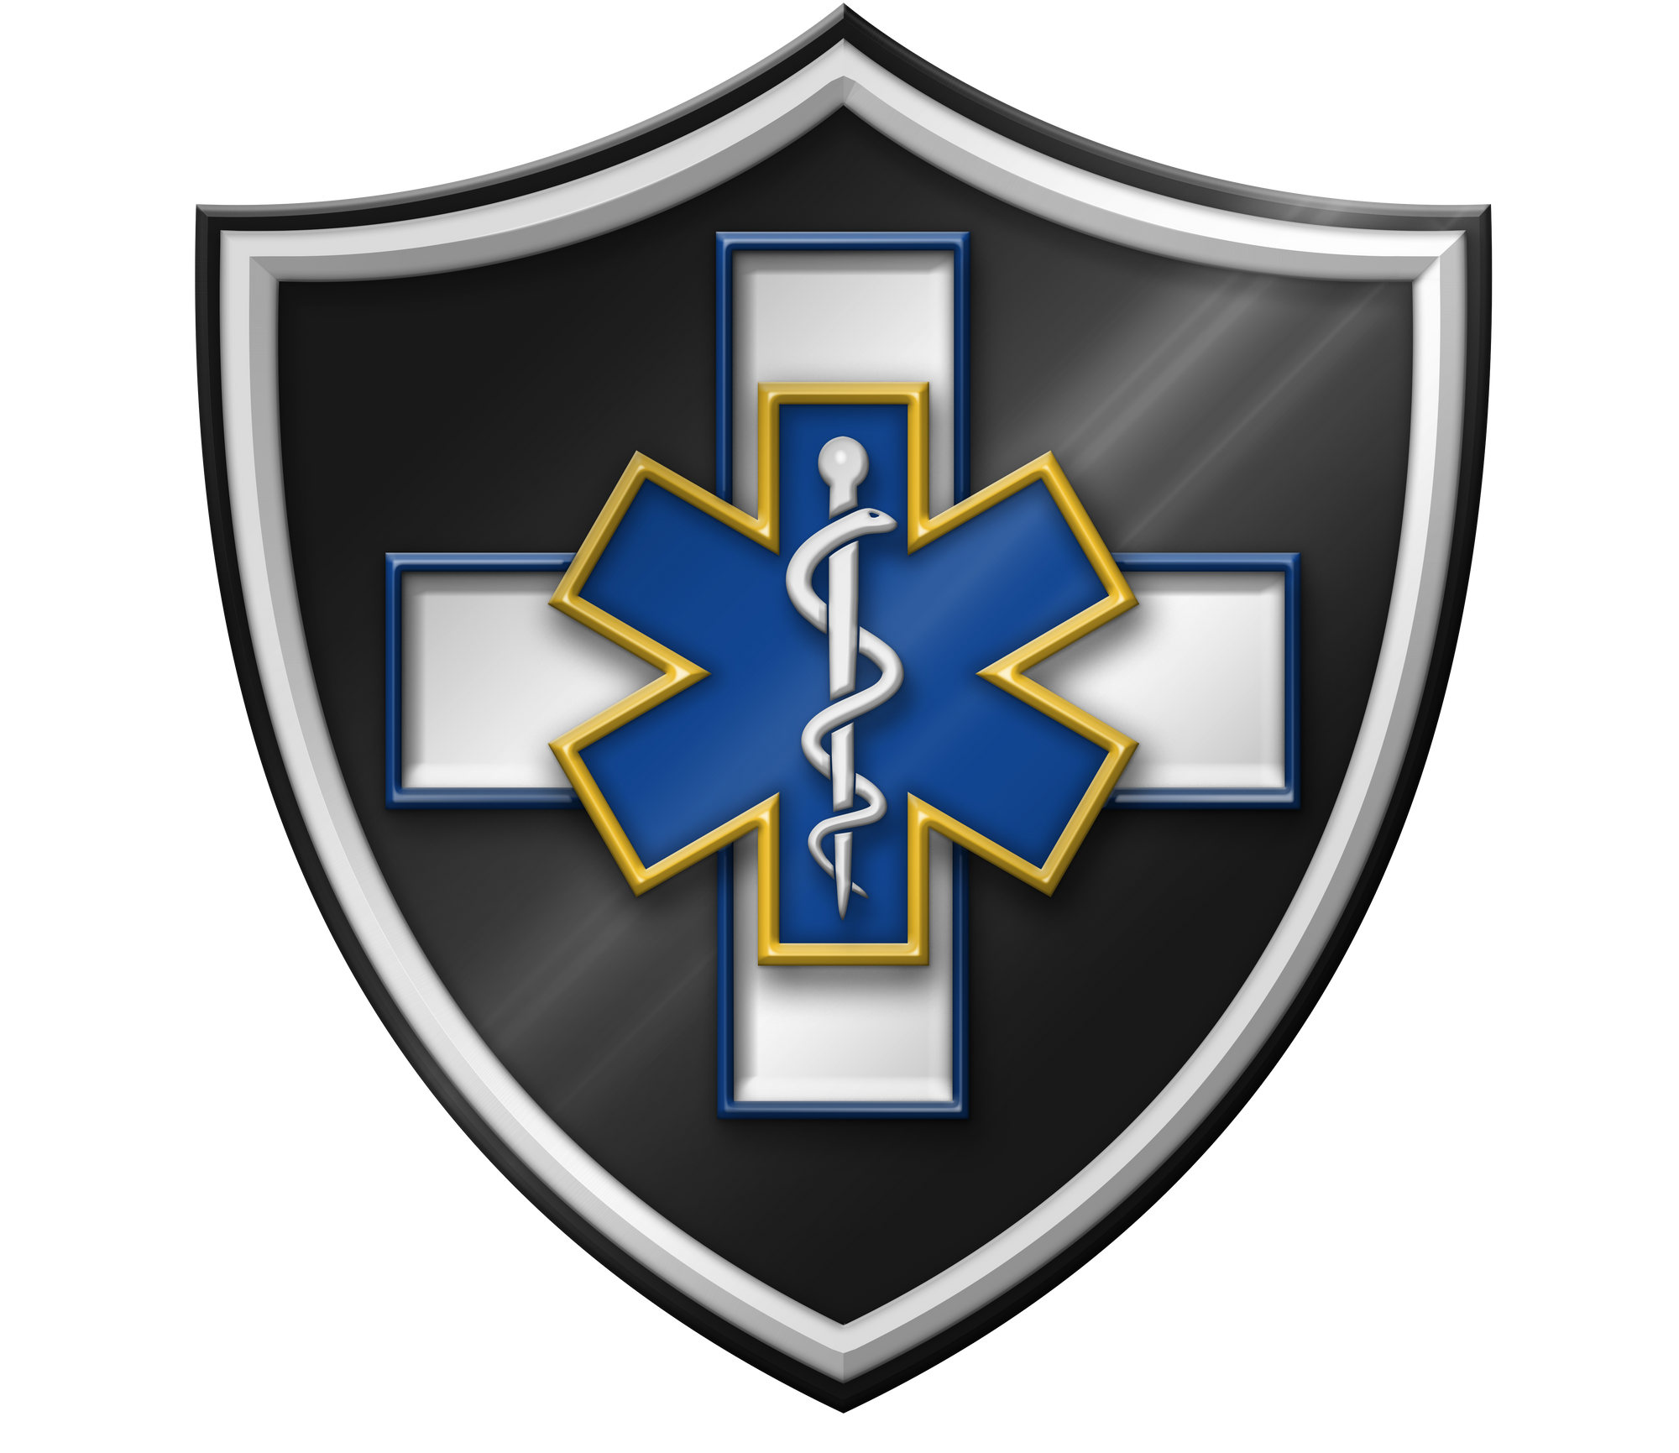






Management of Assaultive Behavior (MAB)
Workplace Violence Prevention Course...
M1 Basic MAB - Book Three: Lesson 2 - The Team Dynamic in WPV Prevention
GET STARTED
www.MABPRO.com

Slide 2

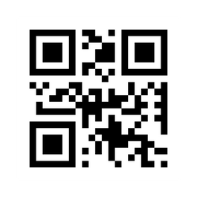
M1 Basic MAB: Book Three - Student Guide
www.MABPRO.com

Slide 3


Topics...
1.
2.
3.
4.
Team Dynamics in Workplace Violence Prevention
Understanding Team Impact
The Value of Team Work
One of the Most Powerful Tools in Crisis Negotiation
www.MABPRO.com

Slide 4
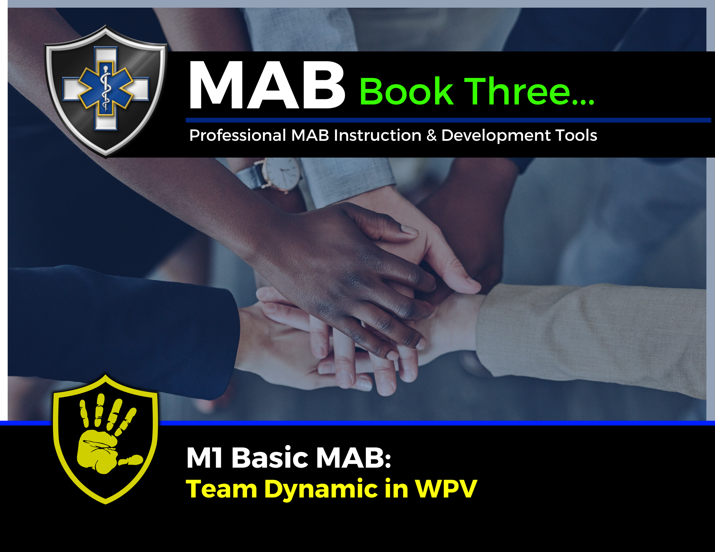

Topic Handouts
www.MABPRO.com

Slide 5

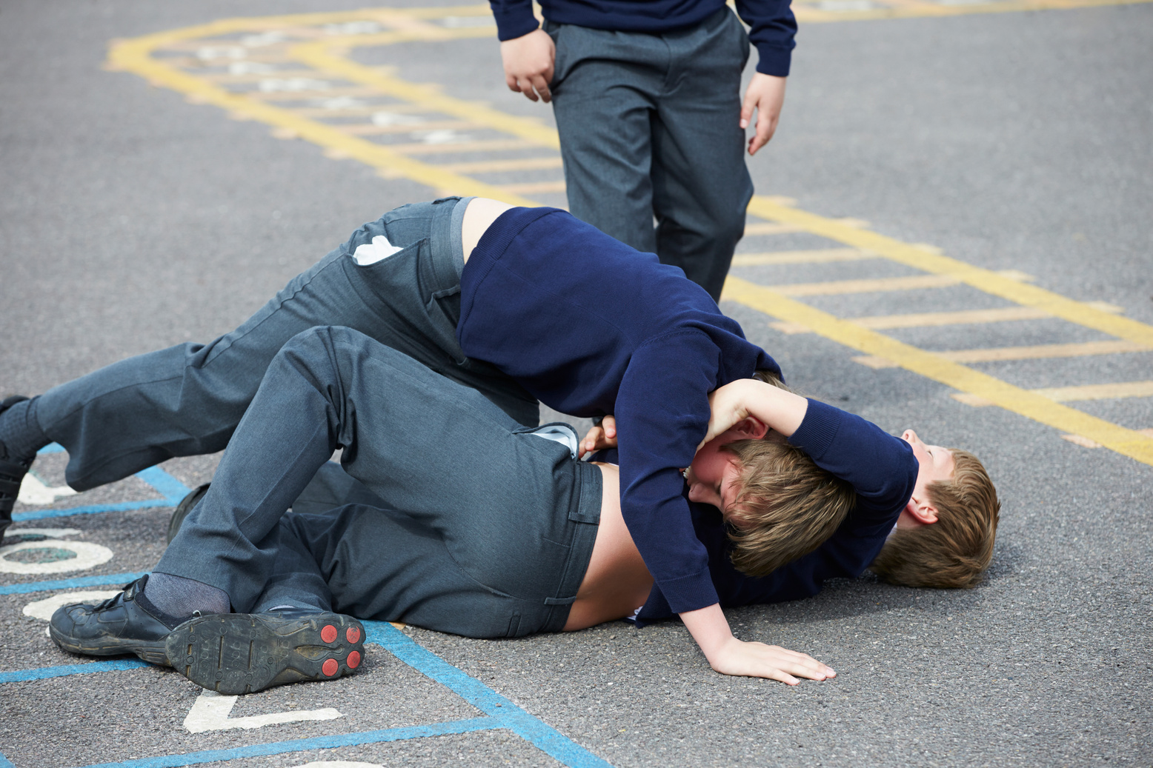
Team Dynamics in WPV Prevention...
In this Lesson, we will review how to develop and maintain a positive team dynamic. One thing is for certain: the care professions need the contributions of every team member to meet the needs of our patients. The following skills help us to continuously improve our responder teams.
www.MABPRO.com

Slide 6



To truly understand our team dynamic, we need
to consider a few key elements...
We need to build strong working relationships both internally and with other stakeholders to support our environment and mission.
Fosters trust and collaboration among team members.
Improves communication, reducing misunderstandings during high-pressure situations.
Encourages mutual support, which is vital for responder well-being.
Strengthens team cohesion, leading to more effective and unified responses
Each member must have a deep understanding of the Crisis Support Team's mission.
It ensures that:
Everyone is aligned on the purpose and goals of the team.
Decisions and actions are guided by a shared set of values and objectives.
Communication is clear and consistent, both internally and with those seeking support.
Trust and accountability are strengthened within the team and with the community they serve.
We must recognize and leverage the diverse personalities within the team.
Different strengths: Some team members may excel in calming others, while others are great at problem-solving or logistics.
Broader perspectives: Diverse personalities bring varied viewpoints, which can lead to more creative and effective solutions.
Better communication: Understanding personality differences helps tailor communication styles for better collaborations.
www.MABPRO.com

Slide 7

Adjusting to meet the need...
One of the challenges is that strategies that work for one group may not work for another.
Flexibility in approach is key in understanding the strengths and weaknesses of the individuals on the team.
Strong leadership seeks to encourage the strengths and train up the weaknesses of the team. Everyone has a role to play in successful responder teams.
www.MABPRO.com

Slide 8
It’s why we are there...
“The phrase “The Patient is ALWAYS on the team!” highlights a vital philosophy in crisis response and healthcare: the individual receiving care is not just a subject of treatment, but an active and valued member of the support team.”
www.MABPRO.com

Slide 9

The value of teamwork in crisis response...
When team members feel valued, their morale and confidence increase, leading to greater commitment.
Proactive teams experience less conflict, and leaders who recognize and enhance individual strengths foster a cohesive environment.
www.MABPRO.com

Slide 10

The value of teamwork in crisis response...
Leadership reinforces the importance of making each team member feel valued.
When a team member feels valued by the Captain and other team members, their morale and confidence go up!
www.MABPRO.com

Slide 11
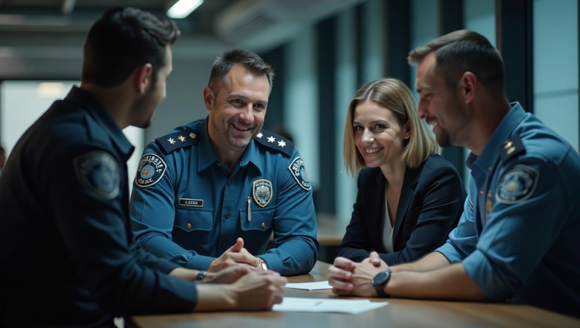
The value of teamwork in crisis response...
Leaders who understand and leverage the strengths of their team members enable cohesive functioning.
Creating an environment where employees can thrive without conflict requires a continuous focus on improving the group dynamic.
www.MABPRO.com

Slide 12
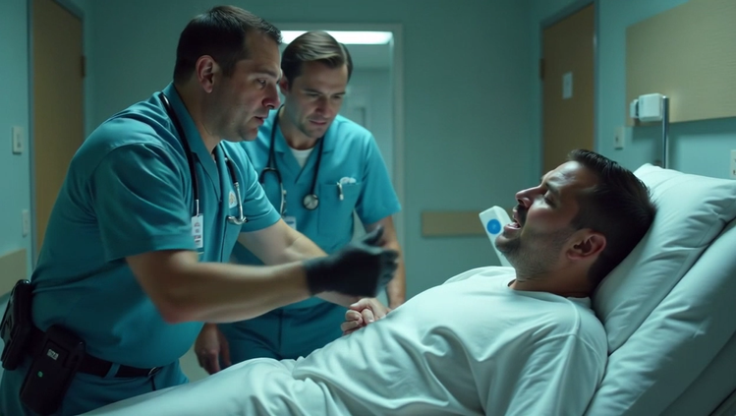
The value of teamwork in crisis response...
To develop better team response traits, we must be technically competent, remember our work ethic supports those we serve, and maintain flexibility.
We also need to support conflict management through patience, enhance team dynamics, develop problem-solving skills, and maintain loyalty to patient rights.
www.MABPRO.com

Slide 13
One of the most powerful tools in crisis negotiation:
“One of the most powerful tools in crisis negotiation: creating psychological safety through inclusion. When someone in crisis feels like they’re part of a team, they’re more likely to trust, cooperate, and move toward resolution. Good negotiators don’t just talk to someone in crisis—they talk with them, as allies.”
www.MABPRO.com

Slide 14
Management of Assaultive Behavior (MAB)
Workplace Violence Prevention Course...
Thank You!
www.MABPRO.com

