Slide 1








Management of Assaultive Behavior (MAB)
Workplace Violence Prevention Course...
M1 Basic MAB - Book Three: Lesson 1 - Negotiation for Success
GET STARTED
www.MABPRO.com

Slide 2

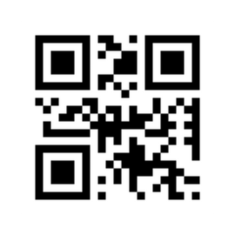
M1 Basic MAB: Book Three - Student Guide
www.MABPRO.com

Slide 3


Topics...
1.
2.
3.
4.
5.
Negotiation for Success
The MAB Levels of Response
A Mandate to Respond
The Triad of Negotiation
The Win-Win
www.MABPRO.com

Slide 4
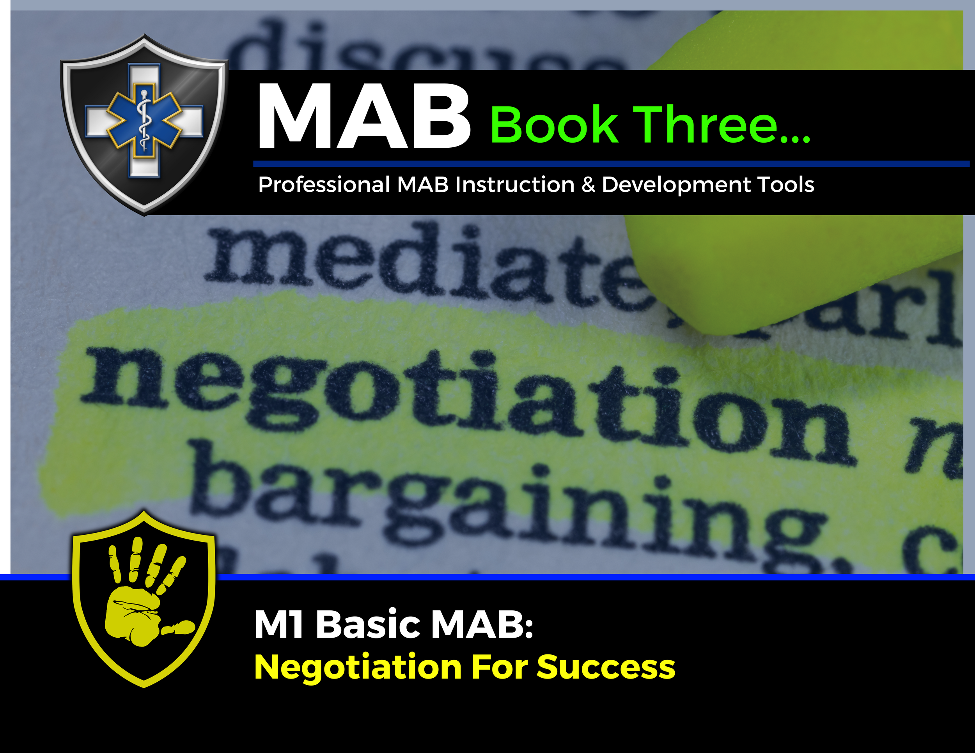

Topic Handouts
www.MABPRO.com

Slide 5


Negotiation for Success...
Welcome. In this training, we will go over the process for negotiating for success. Understanding the basic principles of negotiation will help the responder navigate and compromise to reach an agreement that avoids argument and dispute...
Negotiation is a method by which people settle differences. It is a process by which a compromise or agreement is reached while avoiding argument and dispute.
The principles of fairness, mutual benefit, and relationship maintenance are key to a successful outcome.
We pair our efforts to negotiate with the least restrictive response. The concept of "least restrictive" in crisis response is all about balancing safety with autonomy. It’s a guiding principle that encourages responders to use the minimum level of intervention necessary to stabilize a person in crisis—while preserving their dignity, freedom, and rights.
www.MABPRO.com

Slide 6
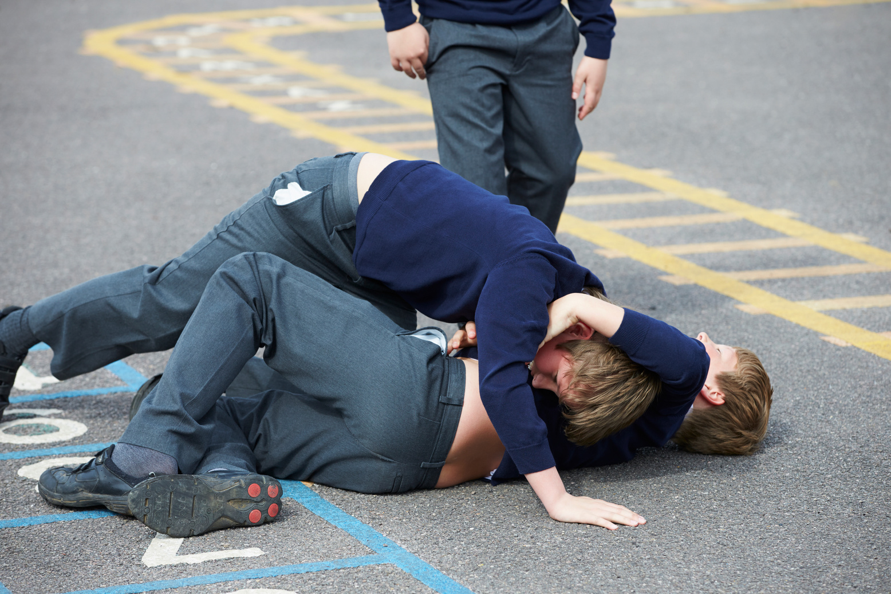
Always alert throughout the Negotiation Process...
When you are negotiating, always keep in mind the level of escalation, the potential for greater risk or danger, & a keen understanding of when additional safety resources are to be needed.
Don’t be caught off guard by encapsulating the wrong perspective or by being blindsided by the volatile capabilities of a person in crisis.
A sucker punch always comes from the angle you are not paying attention to and are least prepared for. An accidental trigger word can fuel escalation, and ultimately, we must be mindful that reality does not always care to support our best intentions.
www.MABPRO.com

Slide 7
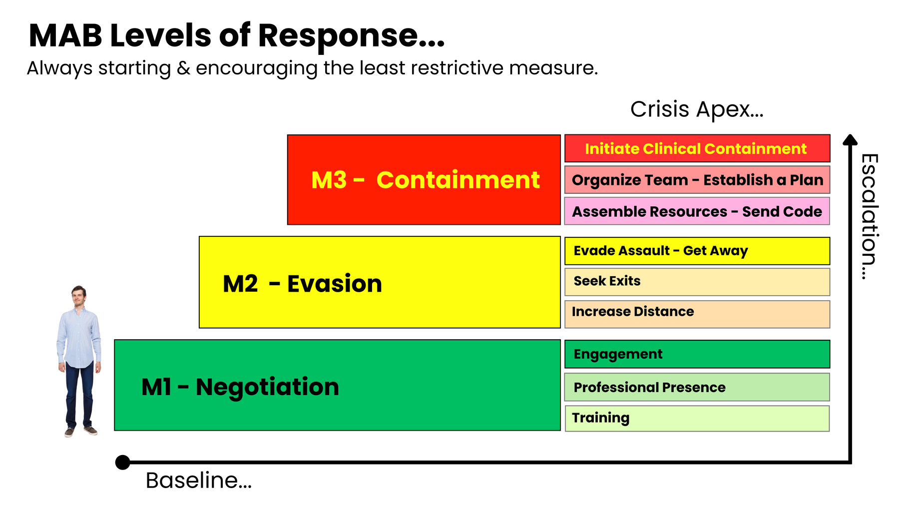
Training at the level of acuity is resourced...
The level of acuity, combined with the observable risk of imminent danger, defines the response & resources needed.
As the situation escalates, so does the need for more resources.
The negotiation process utilizes many of the skills outlined in the M1 Basic MAB course.
On occasion, conflict moments can become difficult to navigate, leading to escalation. If the Individual in conflict attacks the responder, then an elevation of response to evade is used to seek help. The M2 Advanced MAB course instructs singular maneuvers to help the responder evade the assault and get away.
There are those agencies that are required by mandate to secure violent individuals through clinical containment. This high level of acuity demands a large amount of resources trained in the ability to mitigate harm. Crisis Response Teams are trained through M3 Clinical MAB to help coordinate this team approach.

Slide 8
Understanding your mandate...
Understanding your mandate to respond in crisis situations means recognizing the responsibility, authority, and ethical framework that guides your actions as a trained professional.
In MAB (Managing Aggressive Behavior) training, this mandate is rooted in the principle of least restrictive intervention—you are empowered to act, but obligated to do so in a way that prioritizes safety, dignity, and autonomy.
Each Student is required to know their mandate at the facilities where they work. Some facilities will only authorize M1 or M2 level MAB response and draw the line at clinical containment. Facility polices should provide guidance on employee mandates.
A mandate is what you are required to do; your modality (MAB) is how you do it.

Slide 9
The Choice to Respond...
“A mandate is what you are required to do; your modality (MAB) is how you do it.”
www.MABPRO.com

Slide 10

Defining Negotiation...
Negotiation - Negotiation is part logic, part empathy, and part strategy. In Negotiation, you’re dealing with a whirlwind of impulses, curiosity, and boundary-testing. But yes, even in crisis you can negotiate… if you redefine what negotiation means....
www.MABPRO.com

Slide 11



The 3 Dynamics of Beginning a Negotiation help identify the path and set measurements for conflict resolution.
Try to understand as much about the Individual or Situation you are faced with:
Although you may have just met this patient and do not know them well, you can take a proactive approach to preparation by learning in advance about the diagnoses your patients may encounter, available demographics, histrionic dynamics, current presenting information, or observable conditions.
Try to understand your reaction to the individual or situation you are faced with.
Being self-aware during those crisis moments helps you to minimize the influence of your own emotions as you seek to help someone stabilize their own.
Try to understand how to attempt to solve the issue you are faced with.
Developing and consistently assessing that inward plan of approach is a crucial element of negotiation. Know what you are going to say before you say it. Develop a plan of procedure that is safe and utilizes the resources available in a responsive and measured manner.
www.MABPRO.com

Slide 12
Don’t lose focus...
"Adjust the plan if necessary, but stay committed to the goal."
www.MABPRO.com

Slide 13
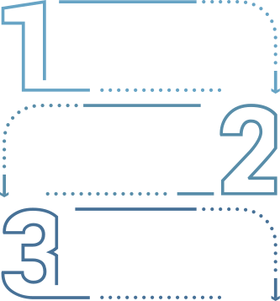
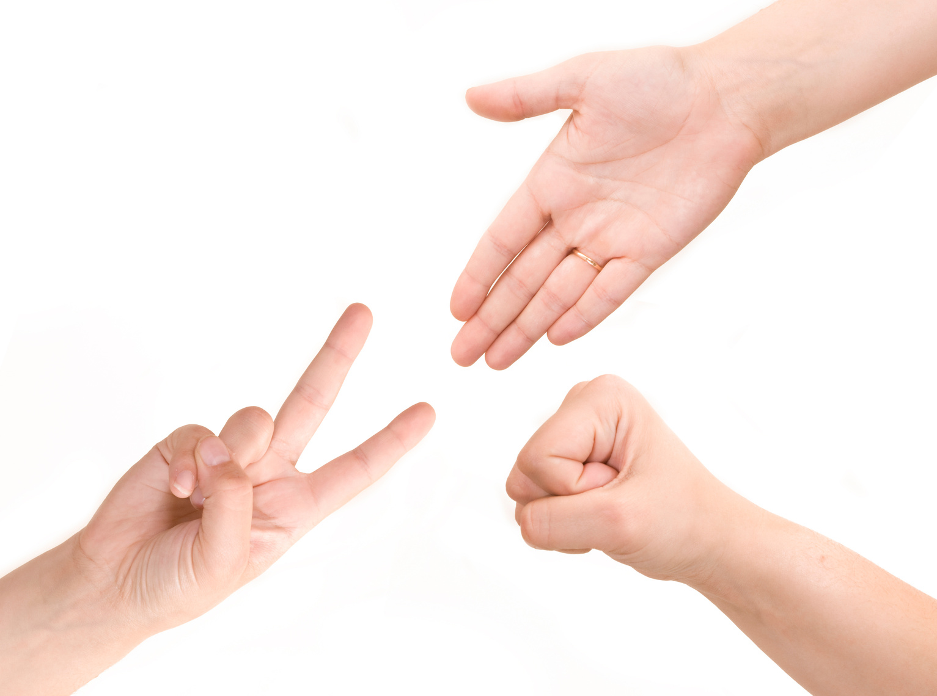
The Triad of Negotiation...
Step One: Initiate a dialogue that flows in both directions.
“
Dialog, either positive or negative, as long as vital information is being exchanged.,.”
Step Two: Determine the individual's specific needs.
Once you have reached Step Two, you then have no hope of solving the issue by Negotiation.
If you initiate a Power Struggle, it will prevent you from reaching Step Two, and therefore, there will be no hope of solving the issue.
Step Three: Support the individual's Needs.
Negotiate a mutually acceptable and safe support plan.
Address the needs in a manner that is within your scope of resources.
Don’t overpromise and underdeliver,
Be patient, negotiations take time...

Slide 14

Creating a WIN/ WIN...
People’s positions are rarely as opposed as they may initially appear, and the other person may have very different goals from the ones you expect! So, keep an open mind and be flexible in your thinking.
A win-win situation is creating a mutual compromise between two adversaries, resulting in a beneficial outcome for both parties.
Keep this in mind for EVERY customer contact you encounter.
www.MABPRO.com

Slide 15
We do our best...
“The responder will always be the one with the highest professional responsibility to navigate and resolve conflicts, but it is the patient who decides if resolution is possible.”
www.MABPRO.com

Slide 16
Management of Assaultive Behavior (MAB)
Workplace Violence Prevention Course...
Thank You!
www.MABPRO.com

