Slide 1








Management of Assaultive Behavior (MAB)
Workplace Violence Prevention Course...
M1 Basic MAB - Book Three: To Serve & Support
GET STARTED
www.MABPRO.com

Slide 2


M1 Basic MAB: Book Three - Student Guide
www.MABPRO.com

Slide 3


Lessons...
1.
2.
3.
4.
Negotiation for Success
Team Dynamics in Workplace Violence Prevention
Fundamental Reasons People Lose Control
The MAB Crisis Intervention Scale
www.MABPRO.com

Slide 4
Lessons continued...
6. 7.
8.
9.
Understanding & Assessing Risk
Perception of Threat
Defining & Working with Stress
The 10 MAB Response Principles
www.MABPRO.com

Slide 5
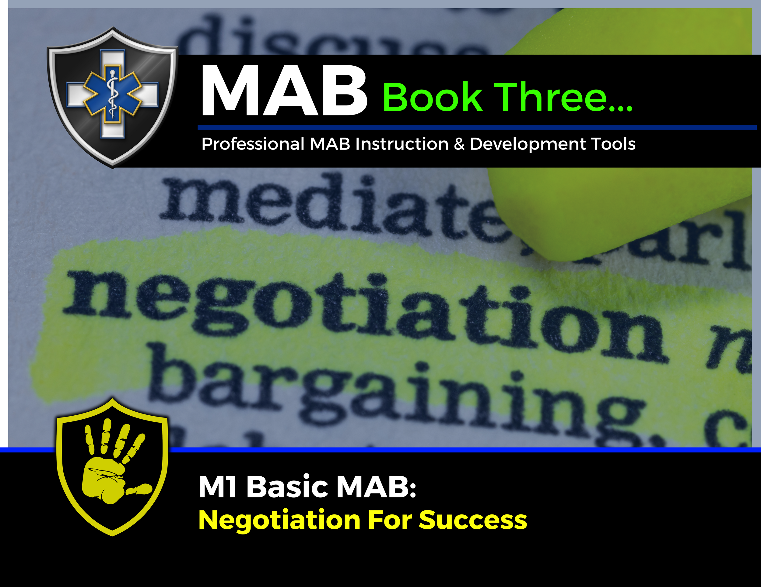

Topic Handouts
www.MABPRO.com

Slide 6


Negotiation for Success...
Welcome. In this training, we will go over the process for negotiating for success. Understanding the basic principles of negotiation will help the responder navigate and compromise to reach an agreement that avoids argument and dispute...
Negotiation is a method by which people settle differences. It is a process by which a compromise or agreement is reached while avoiding argument and dispute.
The principles of fairness, mutual benefit, and relationship maintenance are key to a successful outcome.
We pair our efforts to negotiate with the least restrictive response. The concept of "least restrictive" in crisis response is all about balancing safety with autonomy. It’s a guiding principle that encourages responders to use the minimum level of intervention necessary to stabilize a person in crisis—while preserving their dignity, freedom, and rights.
www.MABPRO.com

Slide 7
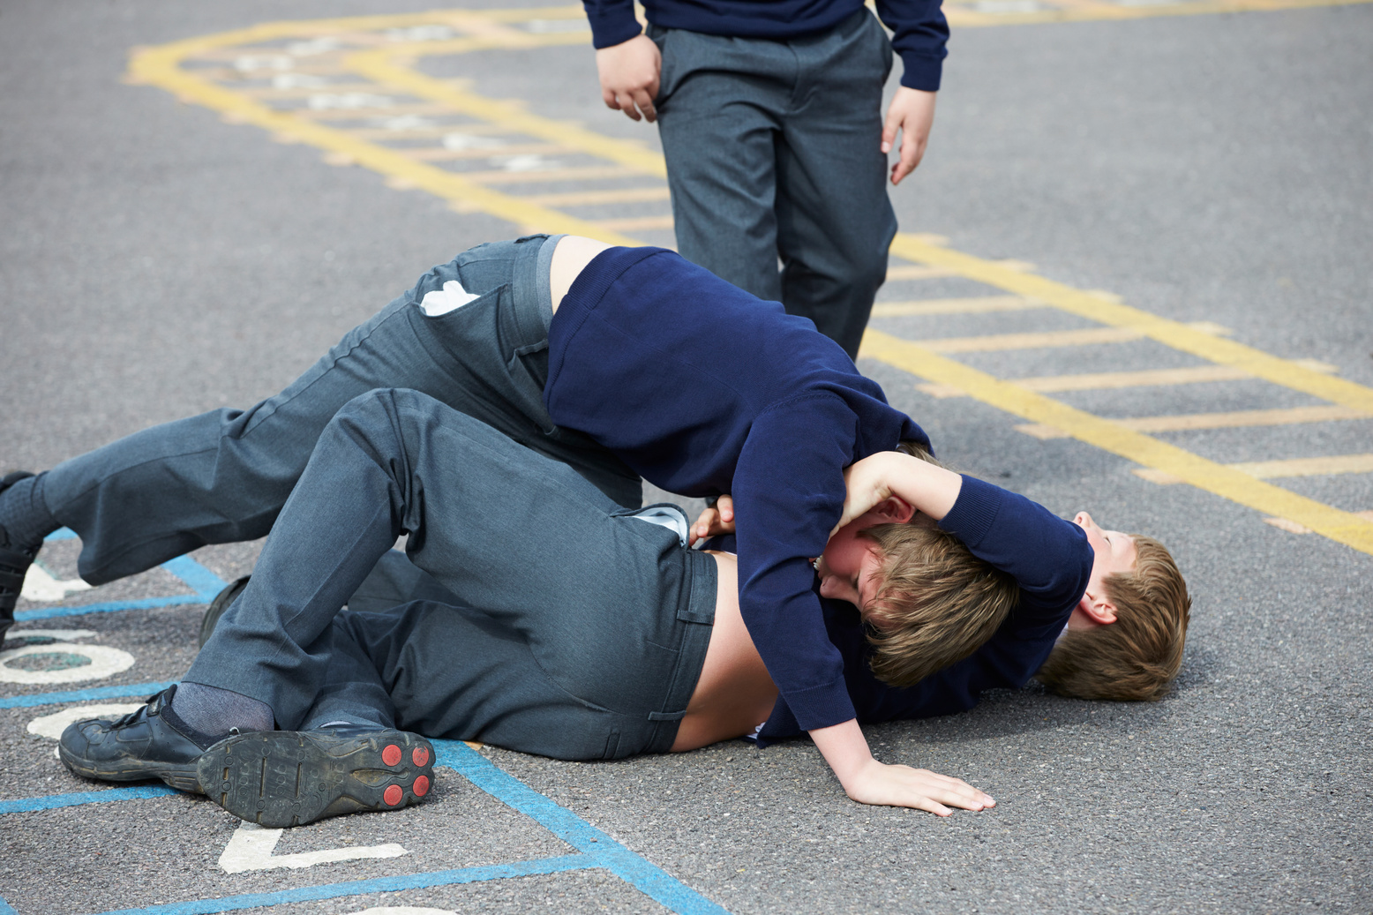
Always alert throughout the Negotiation Process...
When you are negotiating, always keep in mind the level of escalation, the potential for greater risk or danger, & a keen understanding of when additional safety resources are to be needed.
Don’t be caught off guard by encapsulating the wrong perspective or by being blindsided by the volatile capabilities of a person in crisis.
A sucker punch always comes from the angle you are not paying attention to and are least prepared for. An accidental trigger word can fuel escalation, and ultimately, we must be mindful that reality does not always care to support our best intentions.
www.MABPRO.com

Slide 8
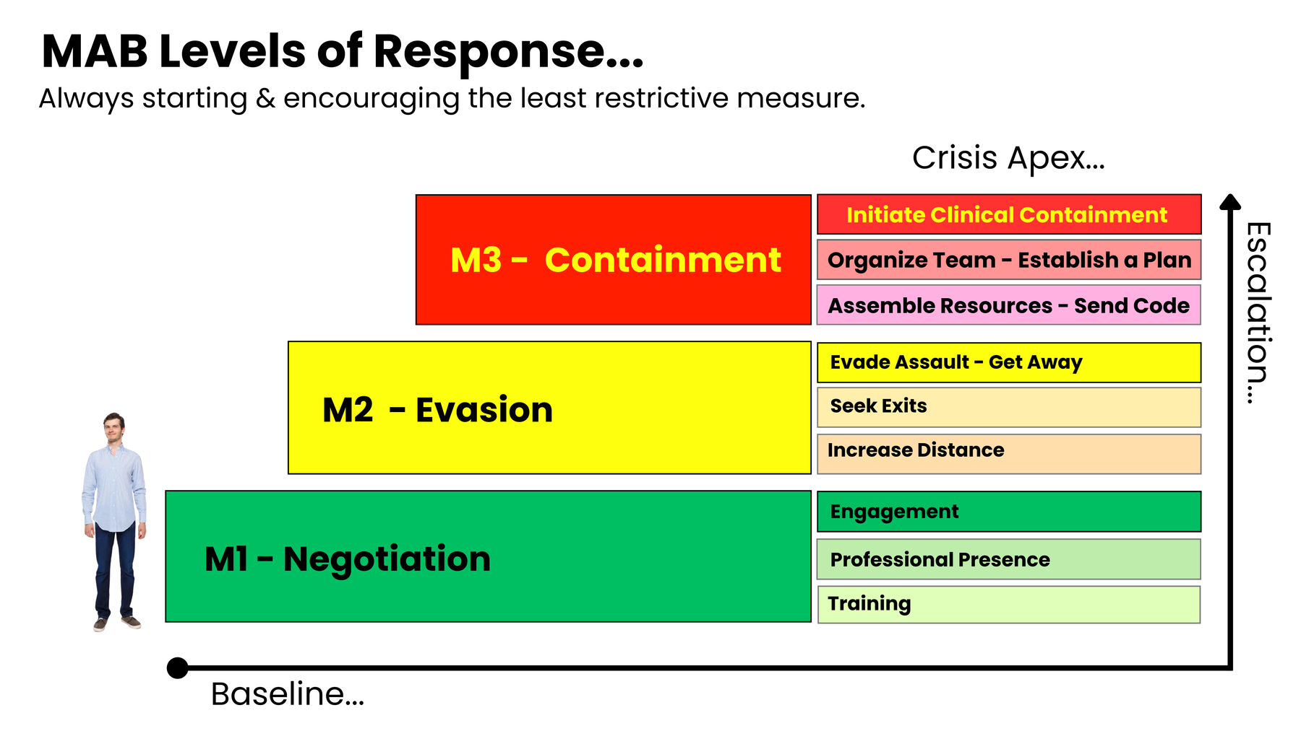
Training at the level of acuity is resourced...
The level of acuity, combined with the observable risk of imminent danger, defines the response & resources needed.
As the situation escalates, so does the need for more resources.
The negotiation process utilizes many of the skills outlined in the M1 Basic MAB course.
On occasion, conflict moments can become difficult to navigate, leading to escalation. If the Individual in conflict attacks the responder, then an elevation of response to evade is used to seek help. The M2 Advanced MAB course instructs singular maneuvers to help the responder evade the assault and get away.
There are those agencies that are required by mandate to secure violent individuals through clinical containment. This high level of acuity demands a large amount of resources trained in the ability to mitigate harm. Crisis Response Teams are trained through M3 Clinical MAB to help coordinate this team approach.

Slide 9
Understanding your mandate...
Understanding your mandate to respond in crisis situations means recognizing the responsibility, authority, and ethical framework that guides your actions as a trained professional.
In MAB (Managing Aggressive Behavior) training, this mandate is rooted in the principle of least restrictive intervention—you are empowered to act, but obligated to do so in a way that prioritizes safety, dignity, and autonomy.
Each Student is required to know their mandate at the facilities where they work. Some facilities will only authorize M1 or M2 level MAB response and draw the line at clinical containment. Facility polices should provide guidance on employee mandates.
A mandate is what you are required to do; your modality (MAB) is how you do it.

Slide 10
The Choice to Respond...
“A mandate is what you are required to do; your modality (MAB) is how you do it.”
www.MABPRO.com

Slide 11

Defining Negotiation...
Negotiation - Negotiation is part logic, part empathy, and part strategy. In Negotiation, you’re dealing with a whirlwind of impulses, curiosity, and boundary-testing. But yes, even in crisis you can negotiate… if you redefine what negotiation means....
www.MABPRO.com

Slide 12



The 3 Dynamics of Beginning a Negotiation help identify the path and set measurements for conflict resolution.
Try to understand as much about the Individual or Situation you are faced with:
Although you may have just met this patient and do not know them well, you can take a proactive approach to preparation by learning in advance about the diagnoses your patients may encounter, available demographics, histrionic dynamics, current presenting information, or observable conditions.
Try to understand your reaction to the individual or situation you are faced with.
Being self-aware during those crisis moments helps you to minimize the influence of your own emotions as you seek to help someone stabilize their own.
Try to understand how to attempt to solve the issue you are faced with.
Developing and consistently assessing that inward plan of approach is a crucial element of negotiation. Know what you are going to say before you say it. Develop a plan of procedure that is safe and utilizes the resources available in a responsive and measured manner.
www.MABPRO.com

Slide 13
Don’t lose focus...
"Adjust the plan if necessary, but stay committed to the goal."
www.MABPRO.com

Slide 14


The Key Steps to
Starting a Negotiation...
Step One: Initiate a dialogue that flows in both directions.
“
  Dialog, either positive or negative, as long as vital information is being exchanged.,.”
Step Two: Determine the individual's specific needs.
  Once you have reached Step Two, you then have no hope of solving the issue by Negotiation.
  If you initiate a Power Struggle, it will prevent you from reaching Step Two, and therefore, there will be no hope of solving the issue.
Step Three: Support the individual's Needs.
  Negotiate a mutually acceptable and safe support plan.
  Address the needs in a manner that is within your scope of resources.
  Don’t overpromise and underdeliver,
  Be patient, negotiations take time...

Slide 15

Creating a WIN/ WIN...
People’s positions are rarely as opposed as they may initially appear, and the other person may have very different goals from the ones you expect! So, keep an open mind and be flexible in your thinking.
A win-win situation is creating a mutual compromise between two adversaries, resulting in a beneficial outcome for both parties.
Keep this in mind for EVERY customer contact you encounter.
www.MABPRO.com

Slide 16
We do our best...
“The responder will always be the one with the highest professional responsibility to navigate and resolve conflicts, but it is the patient who decides if resolution is possible.”
www.MABPRO.com

Slide 17
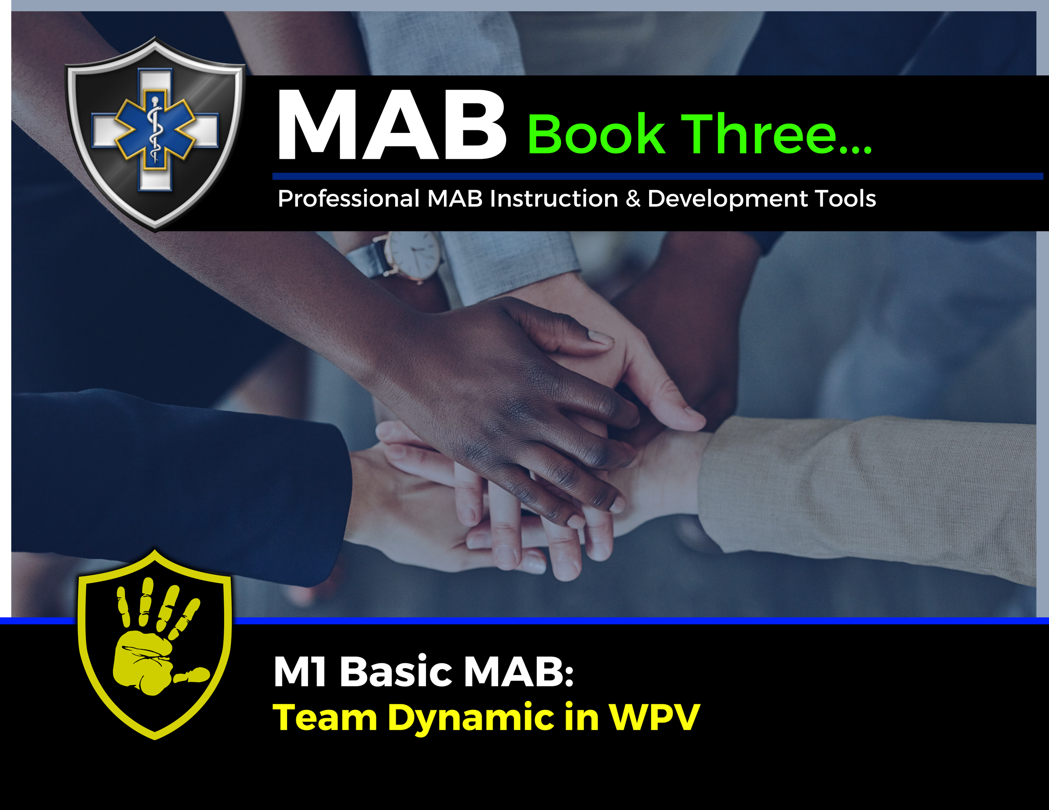
Topic Handouts
www.MABPRO.com

Slide 18
Team Dynamics in WPV Prevention...
In this Lesson, we will review how to develop and maintain a positive team dynamic. One thing is for certain: the care professions need the contributions of every team member to meet the needs of our patients. The following skills help us to continuously improve our responder teams.
www.MABPRO.com

Slide 19



To truly understand our team dynamic, we need
to consider a few key elements...
We need to build strong working relationships both internally and with other stakeholders to support our environment and mission.
  Fosters trust and collaboration among team members.
  Improves communication, reducing misunderstandings during high-pressure situations.
  Encourages mutual support, which is vital for responder well-being.
  Strengthens team cohesion, leading to more effective and unified responses
Each member must have a deep understanding of the Crisis Support Team's mission.
It ensures that:
  Everyone is aligned on the purpose and goals of the team.
  Decisions and actions are guided by a shared set of values and objectives.
  Communication is clear and consistent, both internally and with those seeking support.
  Trust and accountability are strengthened within the team and with the community they serve.
We must recognize and leverage the diverse personalities within the team.
  Different strengths: Some team members may excel in calming others, while others are great at problem-solving or logistics.
  Broader perspectives: Diverse personalities bring varied viewpoints, which can lead to more creative and effective solutions.
  Better communication: Understanding personality differences helps tailor communication styles for better collaborations.
www.MABPRO.com

Slide 20

Adjusting to meet the need...
One of the challenges is that strategies that work for one group may not work for another.
Flexibility in approach is key in understanding the strengths and weaknesses of the individuals on the team.
Strong leadership seeks to encourage the strengths and train up the weaknesses of the team. Everyone has a role to play in successful responder teams.
www.MABPRO.com

Slide 21
It’s why we are there...
“The phrase “The Patient is ALWAYS on the team!” highlights a vital philosophy in crisis response and healthcare: the individual receiving care is not just a subject of treatment, but an active and valued member of the support team.”
www.MABPRO.com

Slide 22

The value of teamwork in crisis response...
When team members feel valued, their morale and confidence increase, leading to greater commitment.
  Proactive teams experience less conflict, and leaders who recognize and enhance individual strengths foster a cohesive environment.
www.MABPRO.com

Slide 23

The value of teamwork in crisis response...
Leadership reinforces the importance of making each team member feel valued.
  When a team member feels valued by the Captain and other team members, their morale and confidence go up!
www.MABPRO.com

Slide 24

The value of teamwork in crisis response...
Leaders who understand and leverage the strengths of their team members enable cohesive functioning.
  Creating an environment where employees can thrive without conflict requires a continuous focus on improving the group dynamic.
www.MABPRO.com

Slide 25

The value of teamwork in crisis response...
To develop better team response traits, we must be technically competent, remember our work ethic supports those we serve, and maintain flexibility.
We also need to support conflict management through patience, enhance team dynamics, develop problem-solving skills, and maintain loyalty to patient rights.
www.MABPRO.com

Slide 26
One of the most powerful tools in crisis negotiation:
“One of the most powerful tools in crisis negotiation: creating psychological safety through inclusion. When someone in crisis feels like they’re part of a team, they’re more likely to trust, cooperate, and move toward resolution. Good negotiators don’t just talk to someone in crisis—they talk with them, as allies.”
www.MABPRO.com

Slide 27
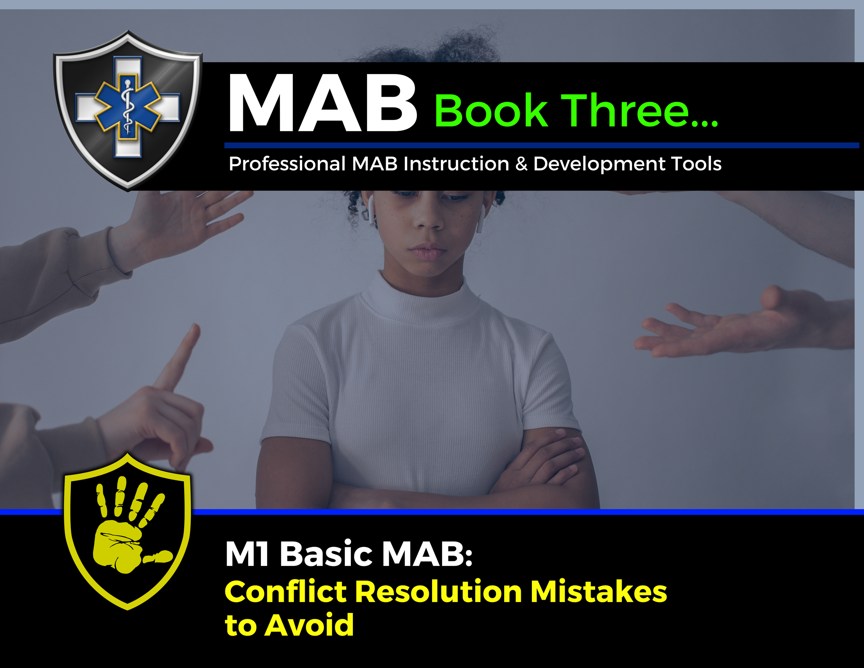
Topic Handouts
www.MABPRO.com

Slide 28

Conflict resolution mistakes to AVOID...
Welcome. In this module, we will review some common conflict resolution mistakes and discuss how to avoid them.
Conflict resolution mistakes can turn a manageable disagreement into a full-blown breakdown in trust, communication, and collaboration. Whether in personal relationships, workplaces, or crisis situations, effective communication is crucial.
Missteps in resolving conflict can intensify tension, damage relationships, and shut down progress.
www.MABPRO.com

Slide 29




Conflict resolution mistakes to AVOID...
Avoiding Conflict
Avoid Being Defensive
Avoid Overgeneralization.
  Utilizing Overgeneralizations can increase the drama when you’re resolving an argument.
  Avoid starting sentences with “you always” and “you never,” as in, “You always come home late!” or “You never do what I want to do!”
Some people avoid discussing building frustrations calmly and respectfully, waiting to say anything until they’re ready to explode. This may seem less stressful, but it usually causes more stress to both parties. It’s much healthier to address and resolve conflict.
  Defensive people steadfastly deny any wrongdoing and work hard to avoid looking at the possibility that they could be contributing to a problem.
  This creates long-term problems for people who don’t feel listened to and unresolved conflicts continue to grow

Slide 30



Conflict resolution mistakes to AVOID...
Avoid the "Need" to be Right
Avoid Psychoanalyzing.
Avoid Interrupting
The need to be “right” can prolong and intensify conflicts.
It’s damaging to decide that there’s a “right” and a “wrong” way to look at things.
Look for a compromise or agree to disagree, and remember that there’s not always a “right” or a “wrong” and that two points of view can be valid.
  Try not to “Psychoanalyze” or Mind-Read.
  “Psychoanalyzing” the other person is something to avoid in a conflict. This creates hostility and misunderstandings.
  Don't assume information. Where possible, always try to trust but verify.
  This signals disrespect and shuts down dialogue. It prevents you from hearing the full story and escalates frustration.

Slide 31



Conflict resolution mistakes to AVOID...
Avoid Forgetting to Listen
Avoid Using sarcasm
Failing to validate emotions
  This prevents you from seeing their viewpoint and makes your partner less likely to see yours.
  You can not effectively speak and listen at the same time. Actively listen to the views and points others are trying to make.
Ignoring or minimizing someone’s feelings—especially in crisis—can make them feel dismissed or unsafe.
  Validation doesn’t mean agreement; it means acknowledgment.
These tactics undermine trust and clarity. They may feel like indirect expressions of emotion, but they often confuse or provoke the other person.

Slide 32


Conflict resolution mistakes to AVOID...
Avoid Rushing the Resolution
Trying to “fix” things too quickly can feel dismissive. Some conflicts require time, space, and layered negotiation. Pacing matters.
We resolve at the pace that they can cope...

Slide 33
We eventually learn...
“Peace is not the absence of conflict, but the ability to cope with it.”
  - Mahatma Gandhi
www.MABPRO.com

Slide 34
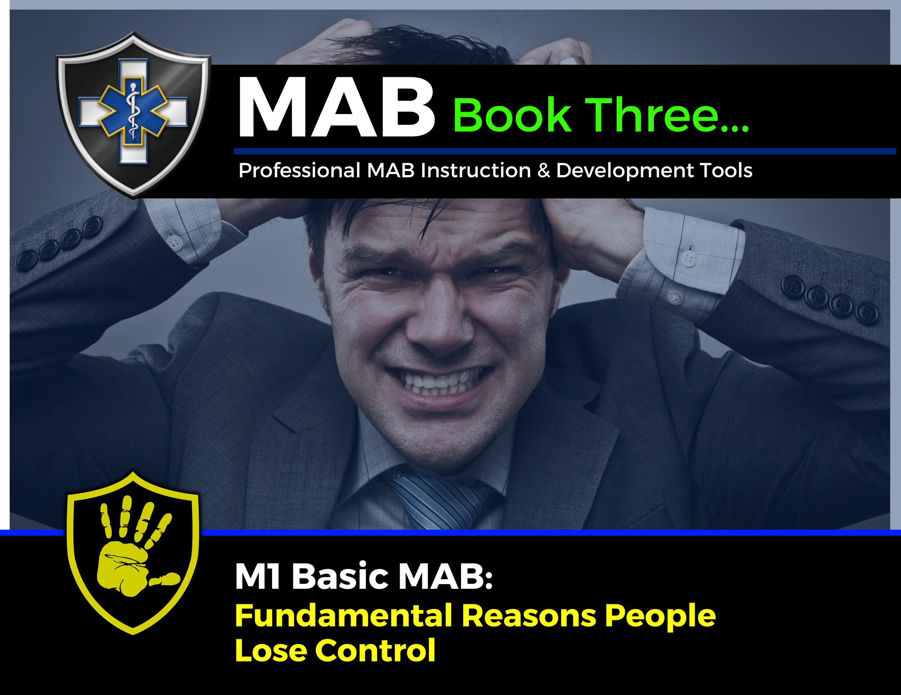
Topic Handouts
www.MABPRO.com

Slide 35

The fundamental reasons why people lose control...
Welcome to this training on the two fundamental reasons why people lose control. Here we will learn how to recognize what is leading the escalation moments of conflict...
www.MABPRO.com

Slide 36

Losing Control - When Anger Becomes Rage:
Anger isn’t always destructive. Like all other emotions, anger serves a purpose. However, a very fine line divides managed anger from rage.
It is this second, more negative facet that we will discuss below: this is when we reveal the darkest side of ourselves. In this sense, when we get angry, we exhibit a voluntary reaction – and as such, an avoidable one – in response to extreme provocation.
www.MABPRO.com

Slide 37

Losing Control - When Anger Becomes Rage:
Anger becomes negative when it becomes toxic due to a lack of control we can exercise over it.
When you stop having control and give this over to anger, the problems start: this feeling invades us and clouds our reason.
www.MABPRO.com

Slide 38
A choice we make...
“Anybody can become angry — that is easy, but to be angry with the right person and to the right degree and at the right time and for the right purpose, and in the right way — that is not within everybody's power and is not easy.”
- Aristotle
www.MABPRO.com

Slide 39
The Many Reasons We Give for Losing Control...
There are numerous reasons why people lose control...
  The staff member looks like someone the client hates or fears
  The client is being held against their will and wants to leave.
  The client does not want to leave or be discharged from the facility.
  The client is experiencing psychosis, hallucinations, or delusions.
  Demand for compliance.
  Making unreasonable demands of clients.
  Sarcasm during interactions between staff and clients.
  Rude and hostile treatment of clients.
www.MABPRO.com

Slide 40
There are so many sparks that lead to rage...
The list of reasons people lose control can be vast and unique. What concerns some does not concern all. There are even more examples like...
  Rude and hostile treatment of clients.
  Failure to provide confidentiality.
  Touching or getting too close to clients who have physical issues
  Individual or group punishments, especially in public.
  Giving double messages, Inconsistencies, and violations of the established routines.
  Favoritism.
www.MABPRO.com

Slide 41
The list continues...
How do we help redirect or distract from conflict when there are so many reasons a person can be upset?
  Being too punitive or parental with clients.
  Arguing with a client.
  Interrupting while a client speaks.
  Failing to be attentive to the client while they are speaking.
  Poorly timed confrontations.
  The lack of respect or rejection of the client.
www.MABPRO.com

Slide 42
It can seem like a list with no end....
The reality of knowing why people lose control can be tricky. Because each person is unique, and the variables they are coping with are unique, as such, we risk never seeing the end of the list of reasons why someone loses control.
Patients don’t always come into care environments with detailed histories, and we often meet them for the very first time. We sometimes find ourselves supporting someone in crisis, despite knowing nothing about them.
When this happens, we must adjust our response to read the information presented in real-time and plan action that best supports the crisis.
www.MABPRO.com

Slide 43



What if we could break it down into 2 fundamental reasons people lose control?
Communication...
They cannot communicate effectively or develop the coping skills necessary for the communication process. Alternatively, they have learned poorly and behave in the only way they know to get attention or achieve their desires.
Symptom of their illness...
Drunk, on drugs, psychotic, low functioning, autistic, reaction to medications, dementia...something having to do with illness that would cause them to become aggressive or strike out because of it.
www.MABPRO.com

Slide 44

We are Always Communicating...
  Communication is often at the root of the conflict and the end result of success.
  Communication is irreversible.
  Communication is as much nonverbal as verbal.
  Communication is a step-by-step process.
  Effective Communication must be thought through.
  The most common obstacle to the success of any work is the need for more communication.
www.MABPRO.com

Slide 45
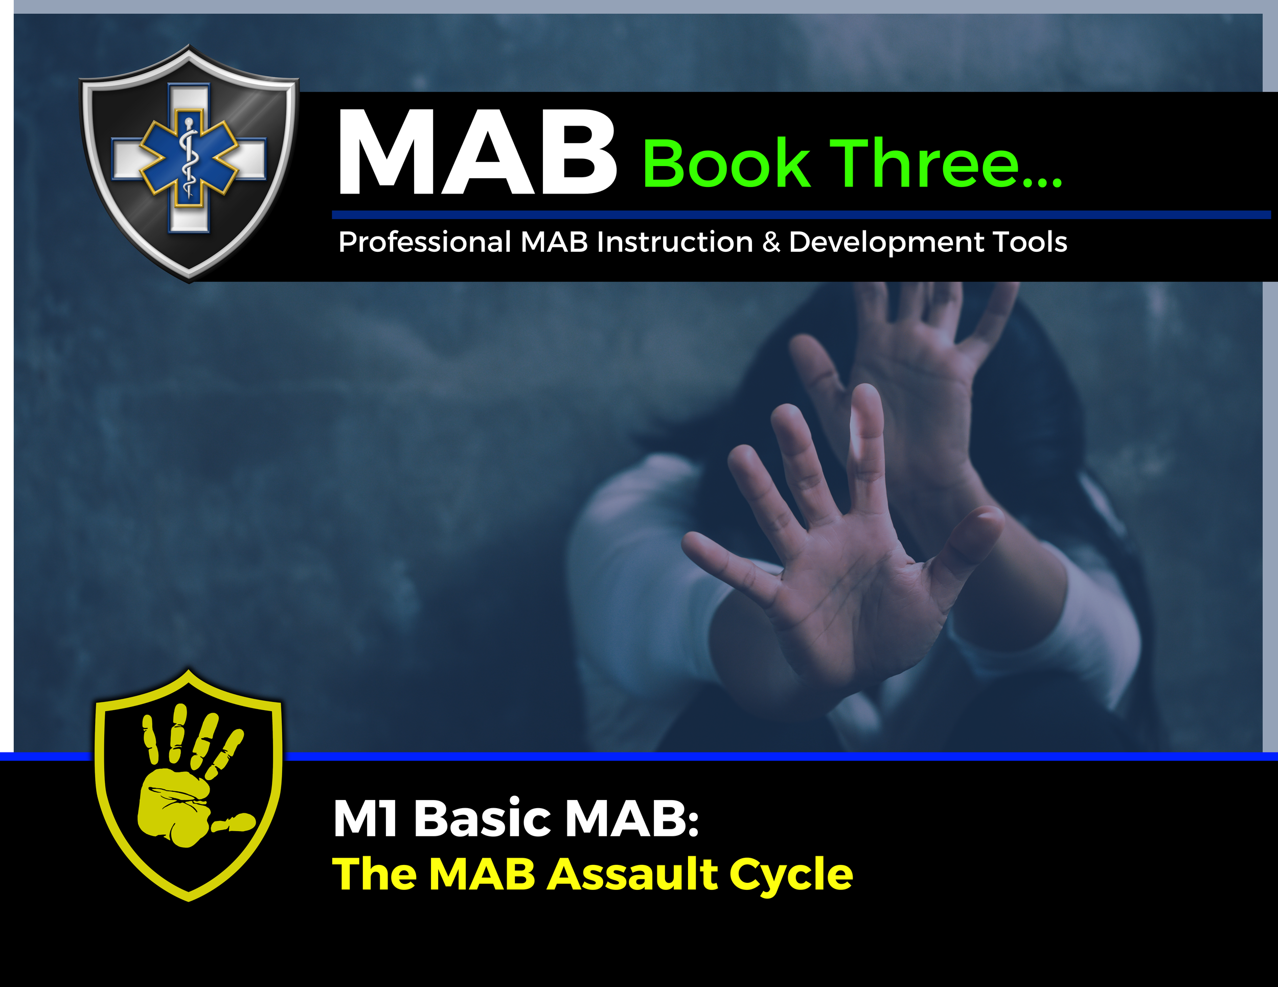
Topic Handouts
www.MABPRO.com

Slide 46
The MAB Crisis Intervention Scale ( The Assault Cycle)...
In this lesson, we will seek an understanding of the assault cycle, a critical component of our Workplace Violence Prevention Program. This model helps us recognize and potentially de-escalate situations before they escalate.
The assault cycle is rooted in the idea that everyone has a baseline behavior. By understanding this baseline, we can identify deviations that might signal the beginning of a potential crisis.
We approach crisis situations through our experience and training, considering and evaluating the variables.
www.MABPRO.com

Slide 47
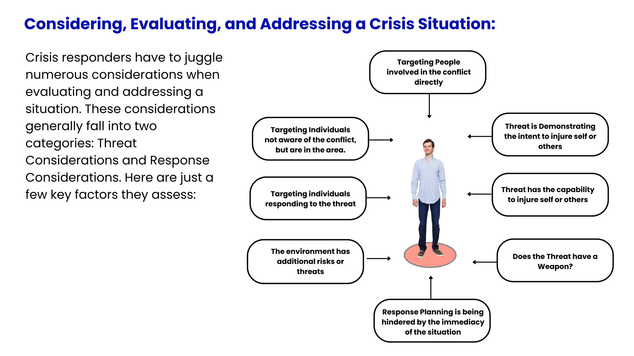
Considering, Evaluating, and Addressing a Crisis Situation:
Crisis responders have to juggle numerous considerations when evaluating and addressing a situation. These considerations generally fall into two categories: Threat Considerations and Response Considerations.
As we evaluate the crisis variables, we begin to define and identify the threat, which helps us determine how to respond. All of this is happening very rapidly as the responder seeks to calm and de-escalate the situation.
www.MABPRO.com

Slide 48
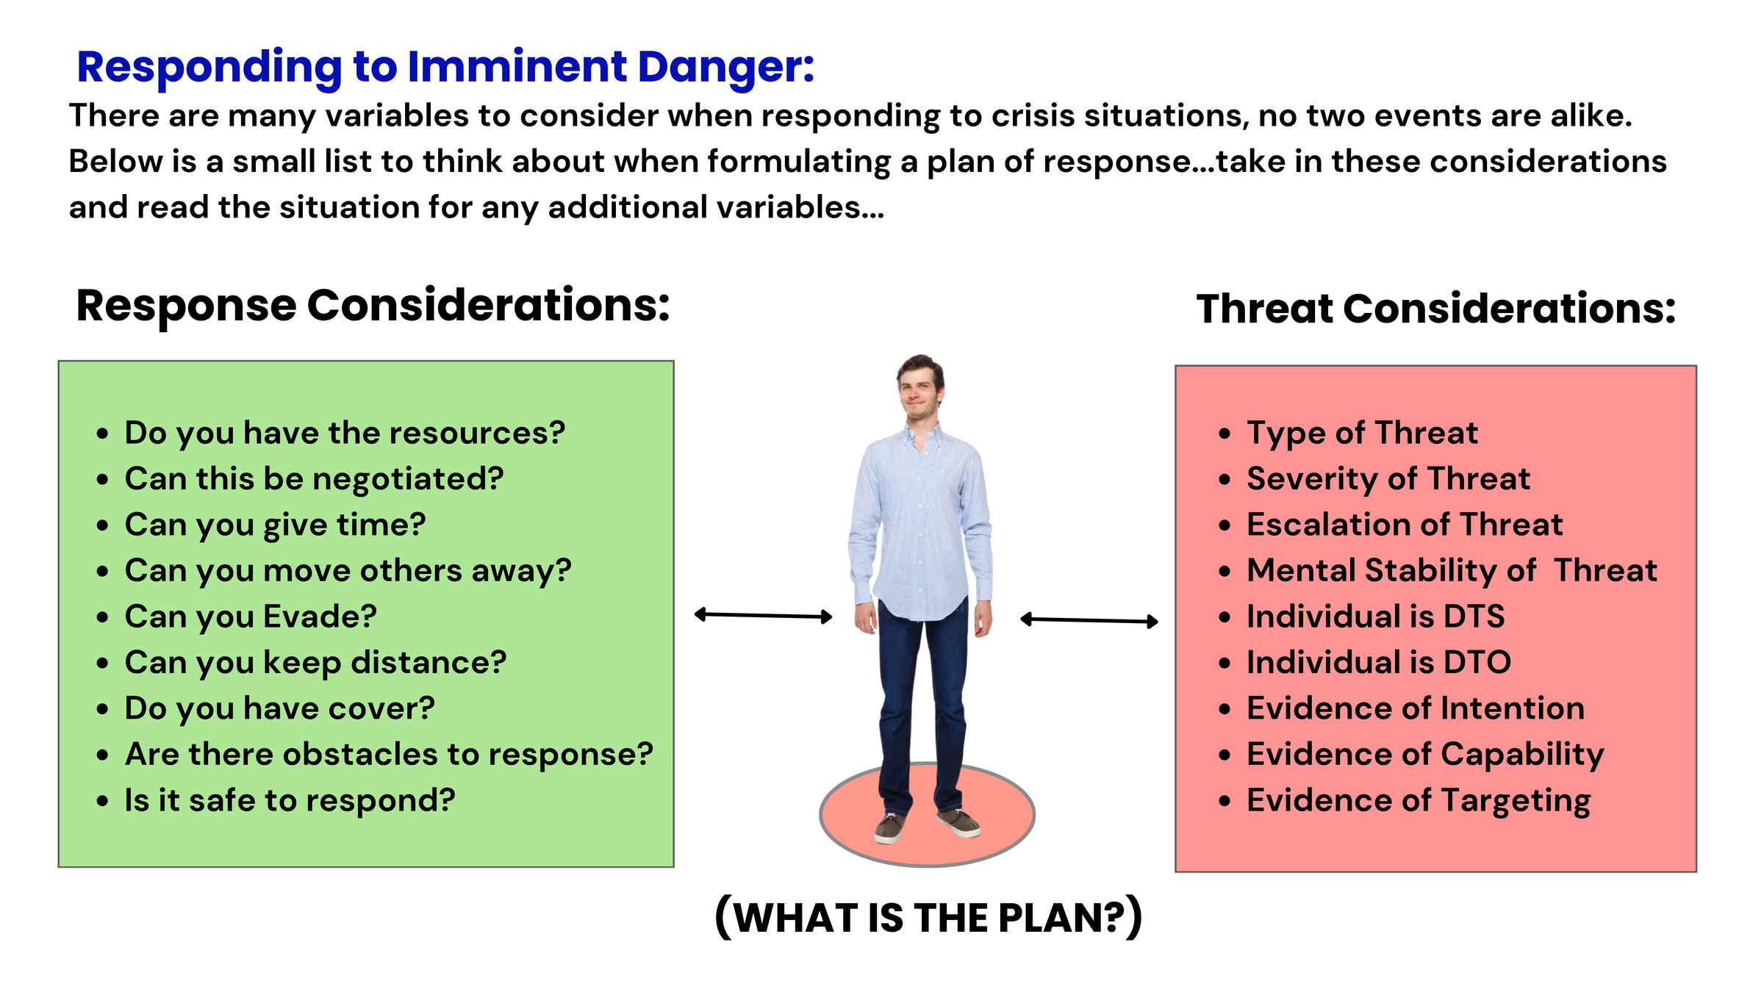
Defining Imminent Danger:
There are many variables to consider when responding to crisis situations; no two events are alike. Below is a small list to consider when formulating a response plan. Take these into account and read the situation for any additional variables.
www.MABPRO.com

Slide 49

The MAB Crisis Intervention Scale ( The Assault Cycle)...
Understanding the assault cycle is a valuable tool in crisis response. It helps us evaluate and consider how to help, identify existing threat levels, & in developing a way forward.
Understanding the assault cycle is like having a map through the storm. It helps crisis responders recognize where someone is emotionally and behaviorally, so they can intervene with the right tools at the right time.
“Remember...No two events are alike,
find the variables!”
www.MABPRO.com

Slide 50
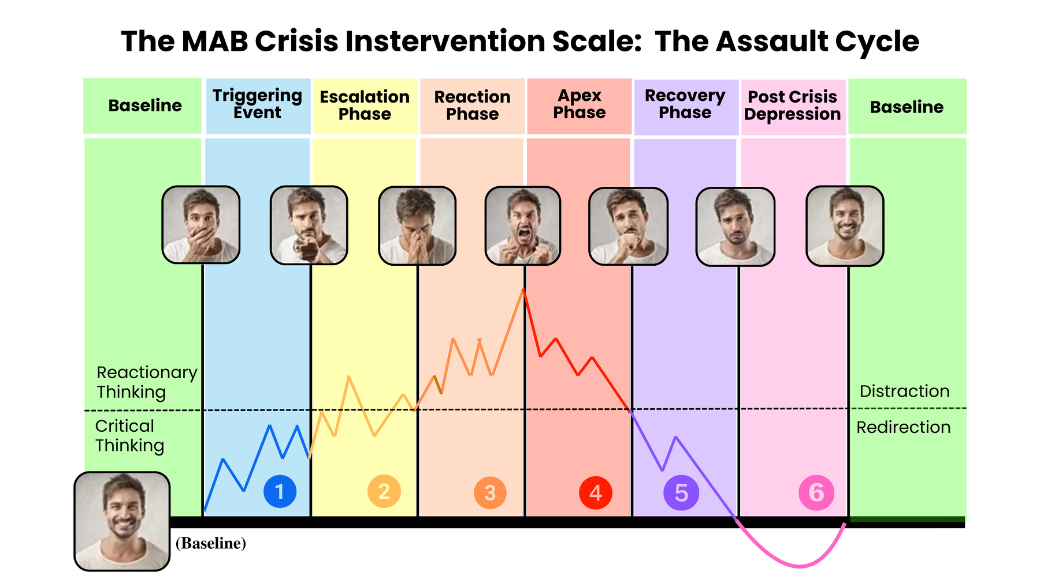
What is it?
The assault cycle is a behavioral model that helps crisis responders understand and anticipate aggressive or violent behavior.
It breaks down the progression of aggression into five distinct phases, each with its own emotional and behavioral markers.
Recognizing these phases allows for timely intervention and safer outcomes.
www.MABPRO.com

Slide 51
  Predictability in chaos. The cycle outlines five observable phases—Triggering, Escalation, Crisis, Recovery, and Post-Crisis Depression. Knowing these helps responders spot early warning signs and act before aggression peaks
  Enhances safety by identifying where someone is in the cycle, allowing responders to tailor their approach and reduce risk for themselves, the individual in crisis, and bystanders.
  Improves communication. Understanding the emotional state tied to each phase allows for more empathetic, effective dialogue. For example, during escalation, setting calm boundaries is more useful than reasoning or confrontation.
Why It Matters in Crisis Response:
www.MABPRO.com

Slide 52
Why It Matters in Crisis Response: (cont.)
  Supports de-escalation strategies. The cycle helps responders choose the right tools—whether it’s grounding techniques, verbal redirection, or offering space—based on the person’s current phase.
  Builds team coordination. In institutional settings like hospitals or schools, the cycle helps teams stay aligned in their response, reducing confusion and conflicting messages.
  Facilitates post-crisis reflection. After the crisis, the model encourages reflection and support during the Post-Crisis Depression phase, which is often overlooked but critical for healing and preventing recurrence.
“In short, the assault cycle transforms unpredictable behavior into something understandable—and that’s a game-changer in crisis work.”
www.MABPRO.com

Slide 53
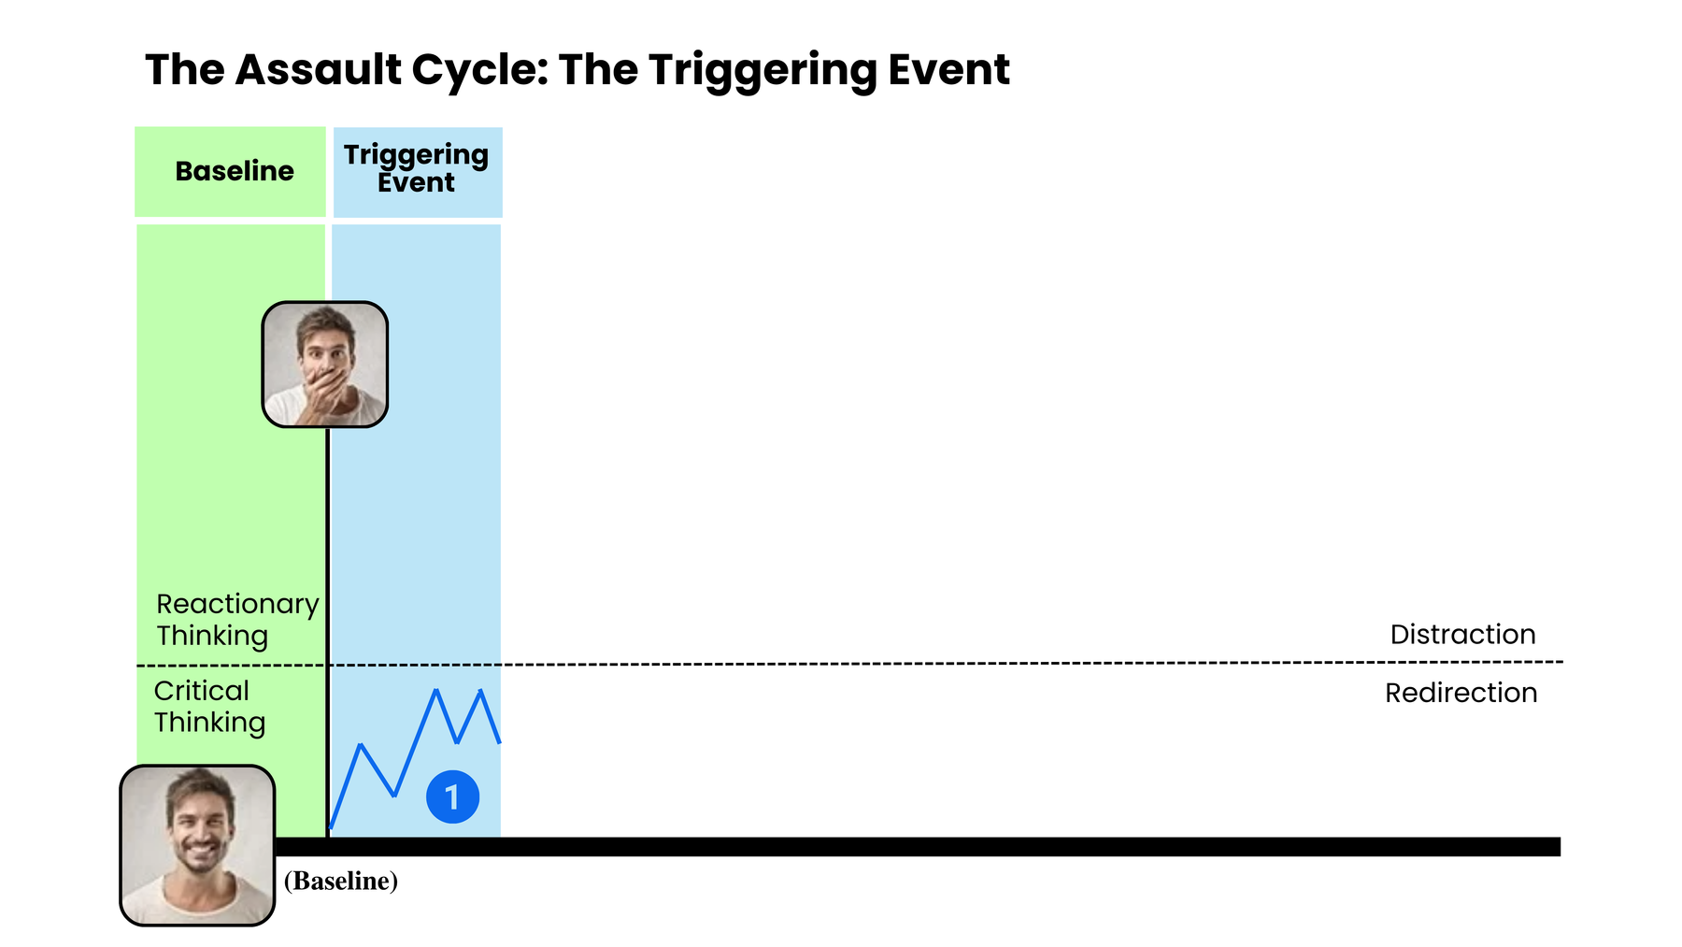
The Assault Cycle: The Triggering Event...
The assault cycle begins with the Triggering Phase, which is set in motion by an event the individual perceives as threatening, frustrating, or deeply upsetting—even if others wouldn’t see it that way.
  It's a change in behavior where the individual perceives a significant threat – emotionally, mentally, or physically. This perception sets off a chain reaction.
  The Body's physiological systems begin preparation to meet and deal with the threat.
www.MABPRO.com

Slide 54
Triggers typically fall into two categories:
  Fear-Inducing Events: These make the person feel unsafe or at risk of losing something important. Examples include being yelled at, sudden changes, and perceived abandonment.
  Frustrating Circumstances These make the person feel powerless or unheard. Examples include unmet needs, blocked goals, and feeling ignored or disrespected.
www.MABPRO.com

Slide 55
Why Triggers Matter:
  They activate the fight-or-flight response, flooding the body with stress hormones.
  The person may begin to show signs of agitation, anxiety, or withdrawal.
  If not addressed early, the cycle can escalate toward aggression or violence.
“Understanding what triggers someone—and how they interpret those events—is key to early intervention. It’s not just about what happened, but how it was experienced.”
www.MABPRO.com

Slide 56
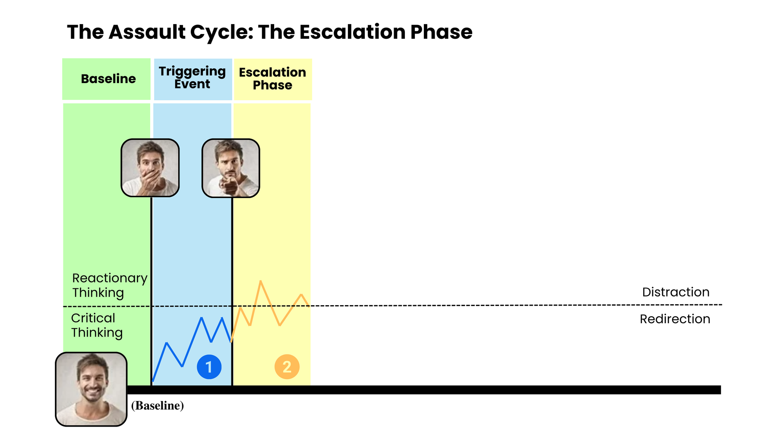
The Escalation Phase...
The Escalation Phase is the second stage of the assault cycle, and it’s where tension and agitation begin to build—both emotionally and physically.
Think of it as the moment when the internal storm gathers force but hasn’t yet broken.
www.MABPRO.com

Slide 57
  Physiological arousal increases: Heart rate rises, breathing quickens, muscles tense. The body is preparing for a possible “fight.”
  Behavior becomes more confrontational: The person may raise their voice, use aggressive language, or challenge authority.
  Cognitive narrowing: Rational thinking starts to fade. The person may misinterpret neutral actions as threats.
  Control begins to slip: They may taunt, threaten, or lash out verbally—but haven’t yet reached physical aggression.
What Happens During Escalation?
www.MABPRO.com

Slide 58

Elements of fear response begin to affect the body...
  Fear triggers a cascade of physiological responses.
  Our bodies react, impacting everything from our vision and motor skills to our heart rate and cognitive processing.
www.MABPRO.com

Slide 59
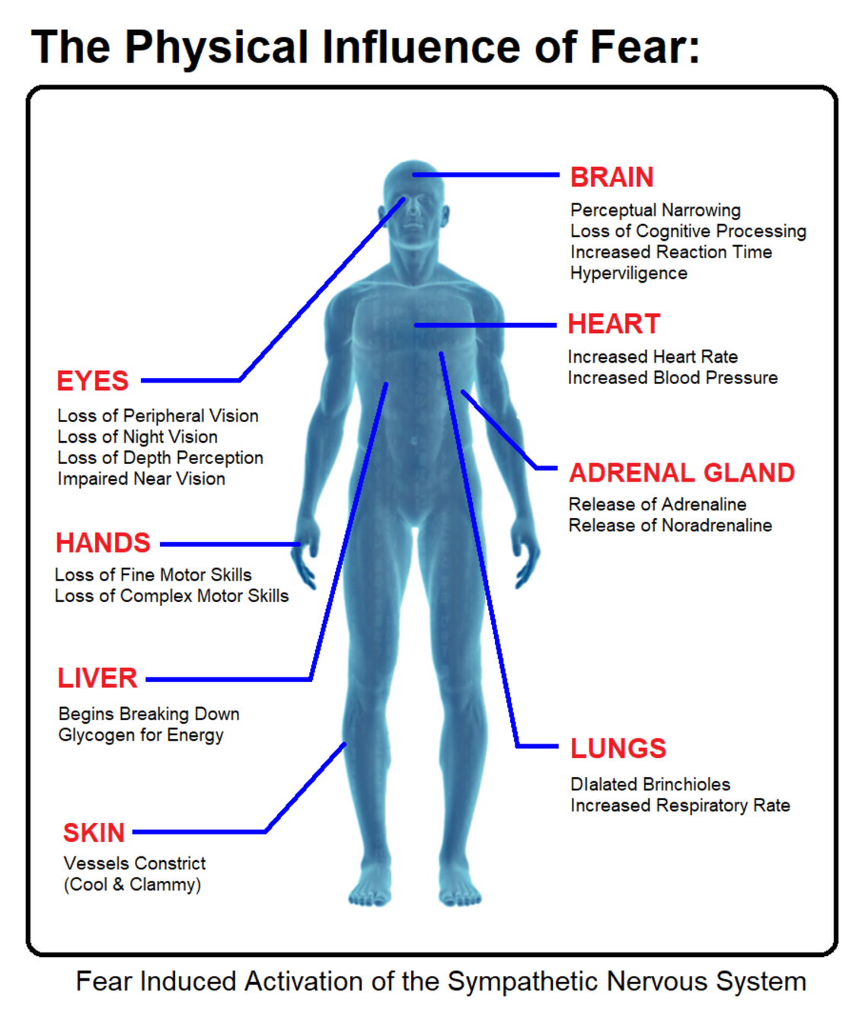
Key Physiological Responses Triggered by Fear:
  Increased heart rate and blood pressure. To pump more oxygen and nutrients to muscles, the body prepares itself to run or fight.
  Rapid breathing (hyperventilation) supplies more oxygen to the bloodstream and helps fuel quick reactions.
  Dilated pupils enhance vision to better detect threats in the environment.
  Muscle tension: Muscles tighten and prepare for action—this can lead to trembling or clenched fists.
  Sweating helps cool the body and improve grip (think clammy hands).
  Goosebumps (piloerection) is A leftover evolutionary trait that makes animals appear larger when threatened.
  Redirected blood flow: Blood is shunted away from the skin and digestive system toward vital organs and muscles
www.MABPRO.com

Slide 60
Key Physiological Responses Triggered by Fear:
  Redirected blood flow: Blood is shunted away from the skin and digestive system toward vital organs and muscles
  Release of stress hormones, Adrenaline (epinephrine) and noradrenaline, floods the system, increasing alertness and energy.
  Spiked blood glucose levels provide a quick energy source for muscles in case of physical exertion.
  Suppressed digestion and immune response. Non-essential systems are temporarily downregulated to conserve energy for survival.
“These changes happen in seconds, often before you're consciously aware of the fear.”
www.MABPRO.com

Slide 61
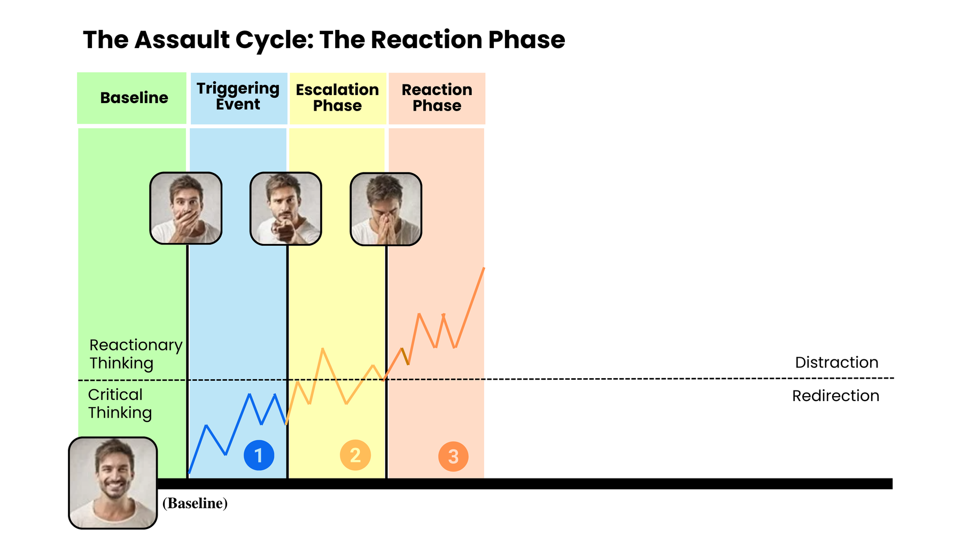
The Reaction Phase...
  The Reaction Phase is a crucial opportunity. When coping skills are exhausted, individuals often seek help and are more receptive to being redirected away from the crisis.
  Our pre-existing relationship with the individual is vital during this phase. A strong, positive connection can significantly improve the chances of successful redirection.
www.MABPRO.com

Slide 62
  When people in crisis reach out for help, it’s often a brave and vulnerable act—a signal that their internal coping systems are overwhelmed and they need connection, support, or intervention. Whether the crisis involves mental health, trauma, substance use, or emotional distress, that moment of reaching out is a critical turning point.
  It’s a chance to interrupt the assault cycle before it reaches crisis.
  It builds trust and connection, which are protective factors against long-term harm.
  It can be the first step toward healing, especially if the person has felt isolated or misunderstood.
Why this moment is so important...
www.MABPRO.com

Slide 63
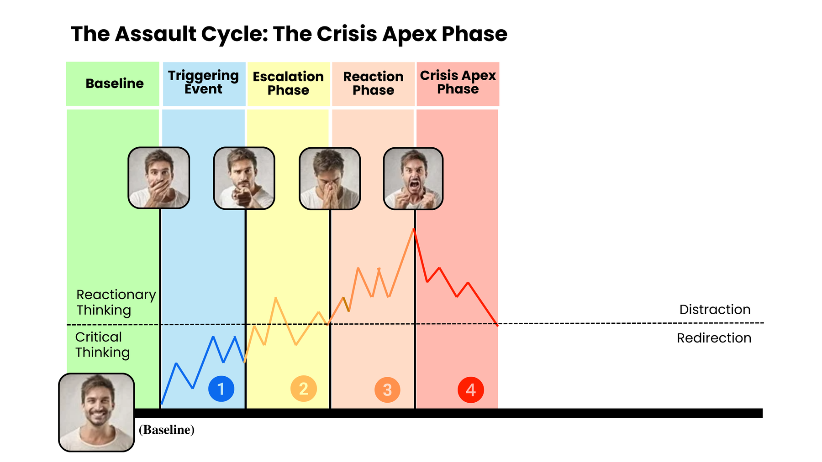
During the Crisis Apex...
  During the Crisis Apex, survival instincts take over. It's essential to communicate with simple, direct, and non-provoking statements.
  Recognizing when you're approaching the crisis point is key. If possible, create distance. The individual is experiencing heightened physical, emotional, and psychological arousal.
  Control over aggressive impulses decreases, and direct aggression is a possibility.
www.MABPRO.com

Slide 64
During the Crisis Apex...(Cont.)
  The aggressor erupts into violent acts against the perceived threat.
  The behavioral pattern explodes into one or more physical assaults on the perceived source of the threat. The individual will threaten injury, hit, kick, or throw objects at people, among other actions. An individual cannot sustain this level of energy forever
  The acuity proved too much to bear is offloaded in a vented manner (violence, property destruction, & possible self-harm).
www.MABPRO.com

Slide 65
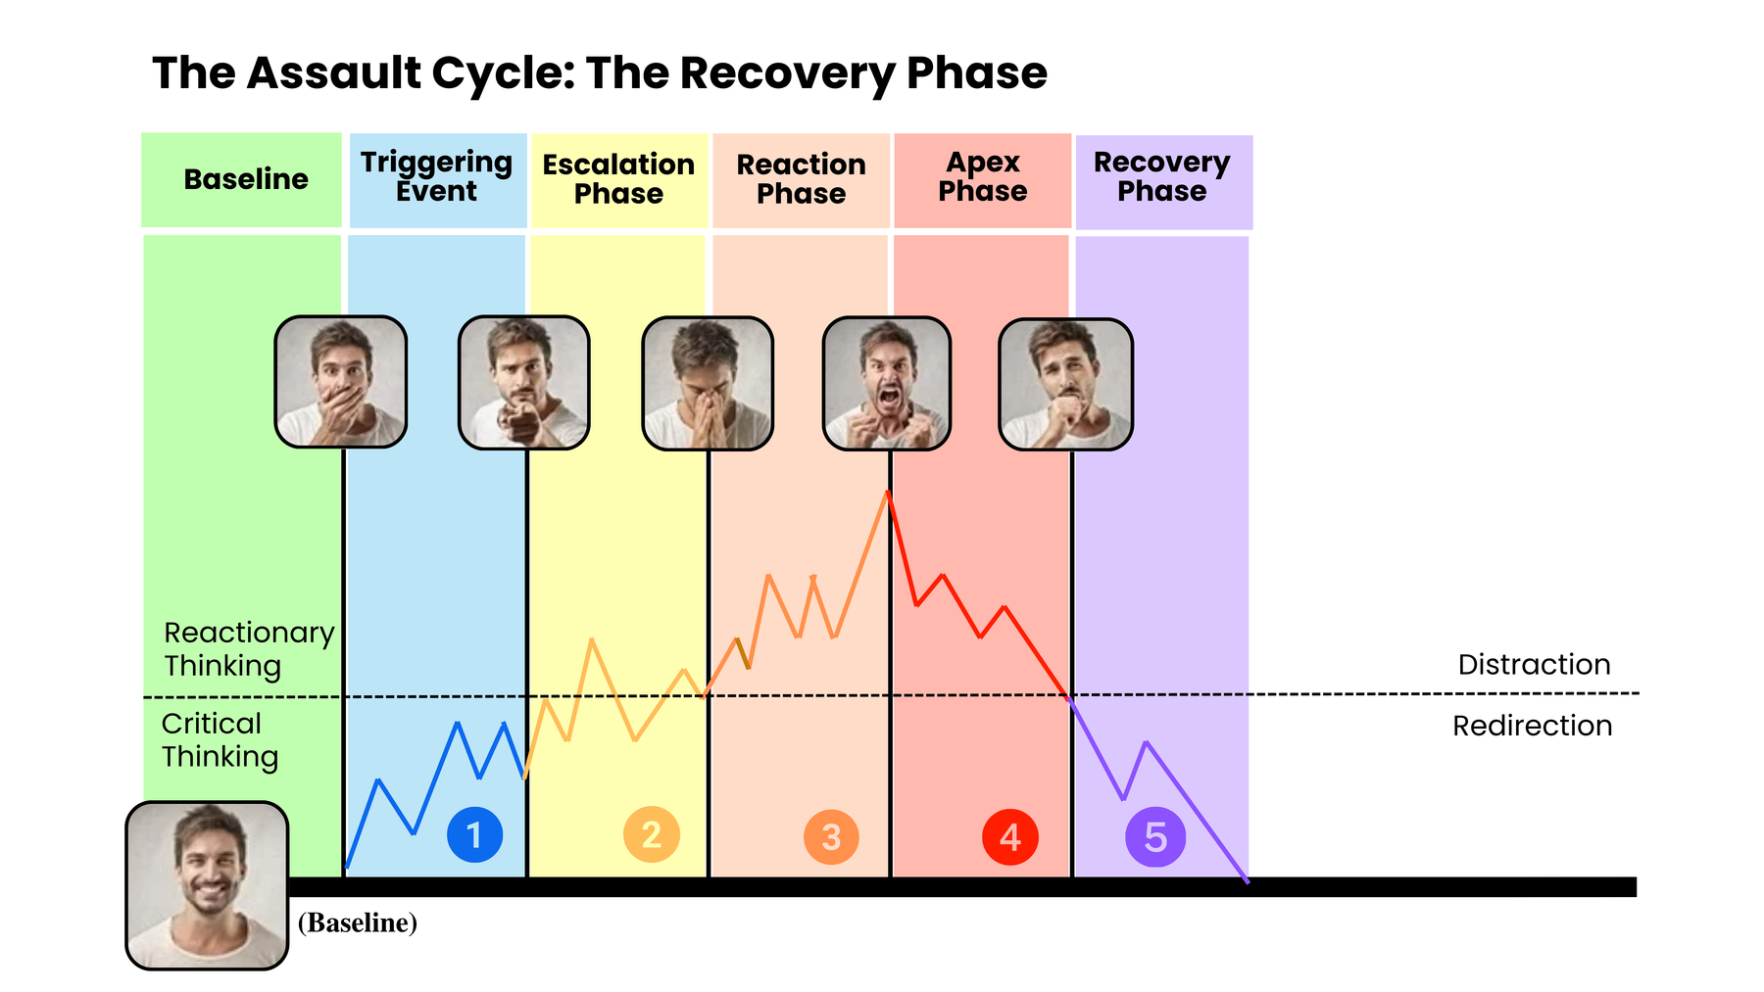
In the Recovery Phase...
  In the Recovery Phase, the Patient slowly returns to their baseline behavior. The service user’s heightened state of physical and psychological arousal can remain a threat for up to ninety minutes due to the level of adrenaline in the bloodstream.
  The aggressor’s body relaxes, and the mind decreases its vigilance. The confrontation appears to be over, even if temporarily.
www.MABPRO.com

Slide 66
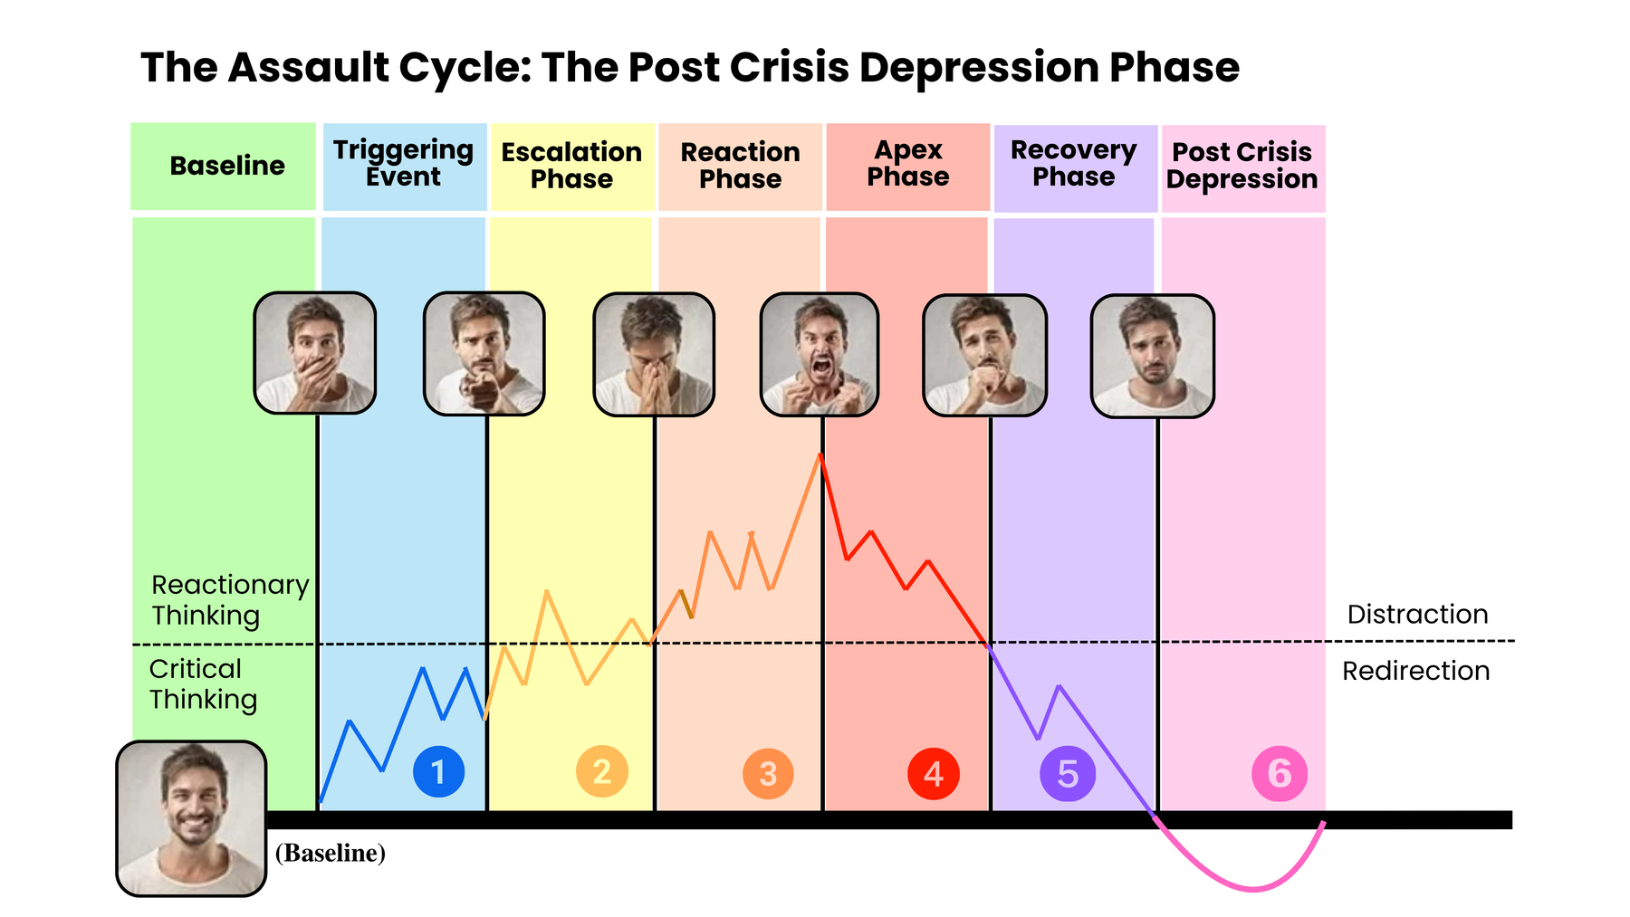
The Post-Crisis Depression Phase...
  The Post-Crisis Depression Phase often sees the individual dip below their baseline.
  After reaching normal physiological levels, the body enters a short period in which the heart rate slips below average to regain balance (homeostasis).
  They may experience feelings of guilt, regret, and emotional depression as they process what occurred.
www.MABPRO.com

Slide 67
The Post-Crisis Depression Phase...(Cont.)
  Finally, once some action has been taken to resolve the crisis phase, the body begins to recover from the extreme stress and energy expenditure. However, the adrenaline does not leave the bloodstream all at once, so the level of arousal tapers off until normal limits are reached.
  Quality of judgment returns to normal levels as reasoning replaces the survival response.
www.MABPRO.com

Slide 68
The Post-Crisis Depression Phase...(Cont.)
  Understanding the MAB Crisis Intervention Scale helps us to meet the patient where they are.
  The depth of each phase is unique to the individual's coping capability; some are quick to trigger & some are slow to escalate.
www.MABPRO.com

Slide 70

M1 Basic MAB: Test & Survey
www.MABPRO.com

Slide 71
Thank You!
www.MABPRO.com

