Slide 1








Management of Assaultive Behavior (MAB)
Workplace Violence Prevention Course...
M1 Basic MAB - Book One: Lesson 7 - The Perception of Threat
GET STARTED
www.MABPRO.com

Slide 2

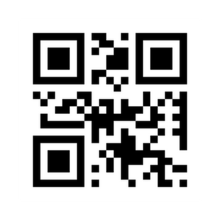
M1 Basic MAB: Book One - Student Guide
www.MABPRO.com

Slide 3



Topics...
1.
2.
3.
4.
The Perception of Threat
Influencing Factors
The Four Reasons Why...
How Perception Effects Decion Making
www.MABPRO.com

Slide 4
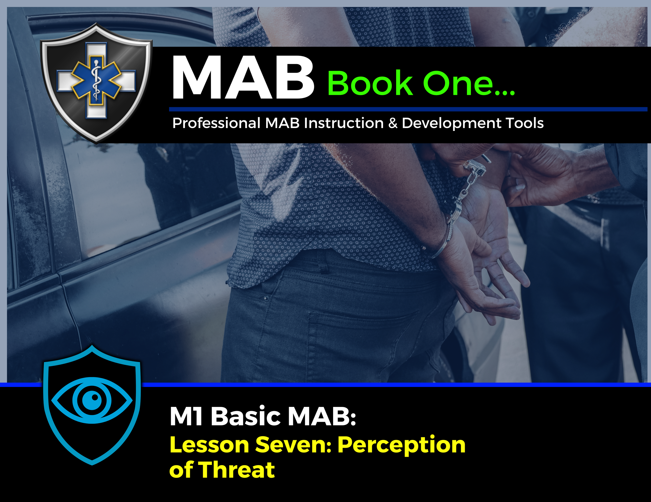

Topic Handouts
www.MABPRO.com

Slide 5

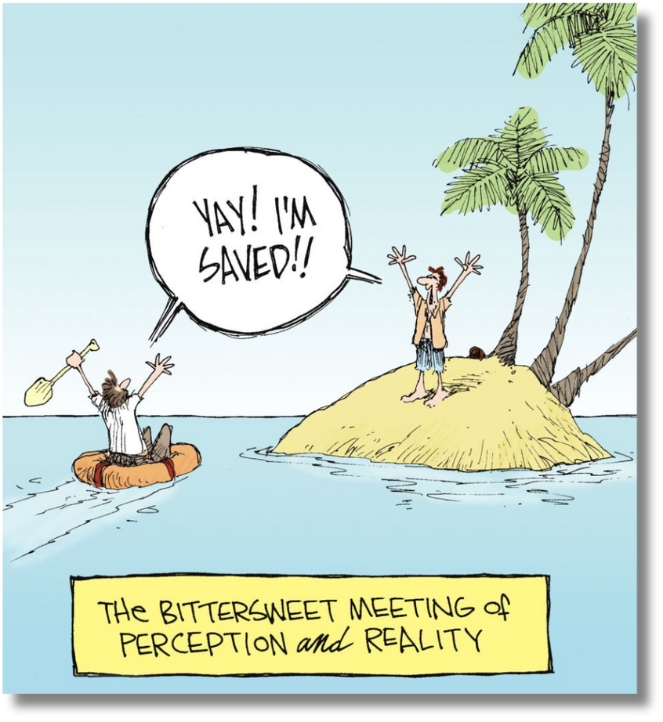
The Perception of Threat...
Understanding the perception of threat is critical for all of us. It's important to remember that our perception of a threat isn't always the same as the actual facts of the situation.
Unlike facts, perception is subjective to the individual.
www.MABPRO.com

Slide 6

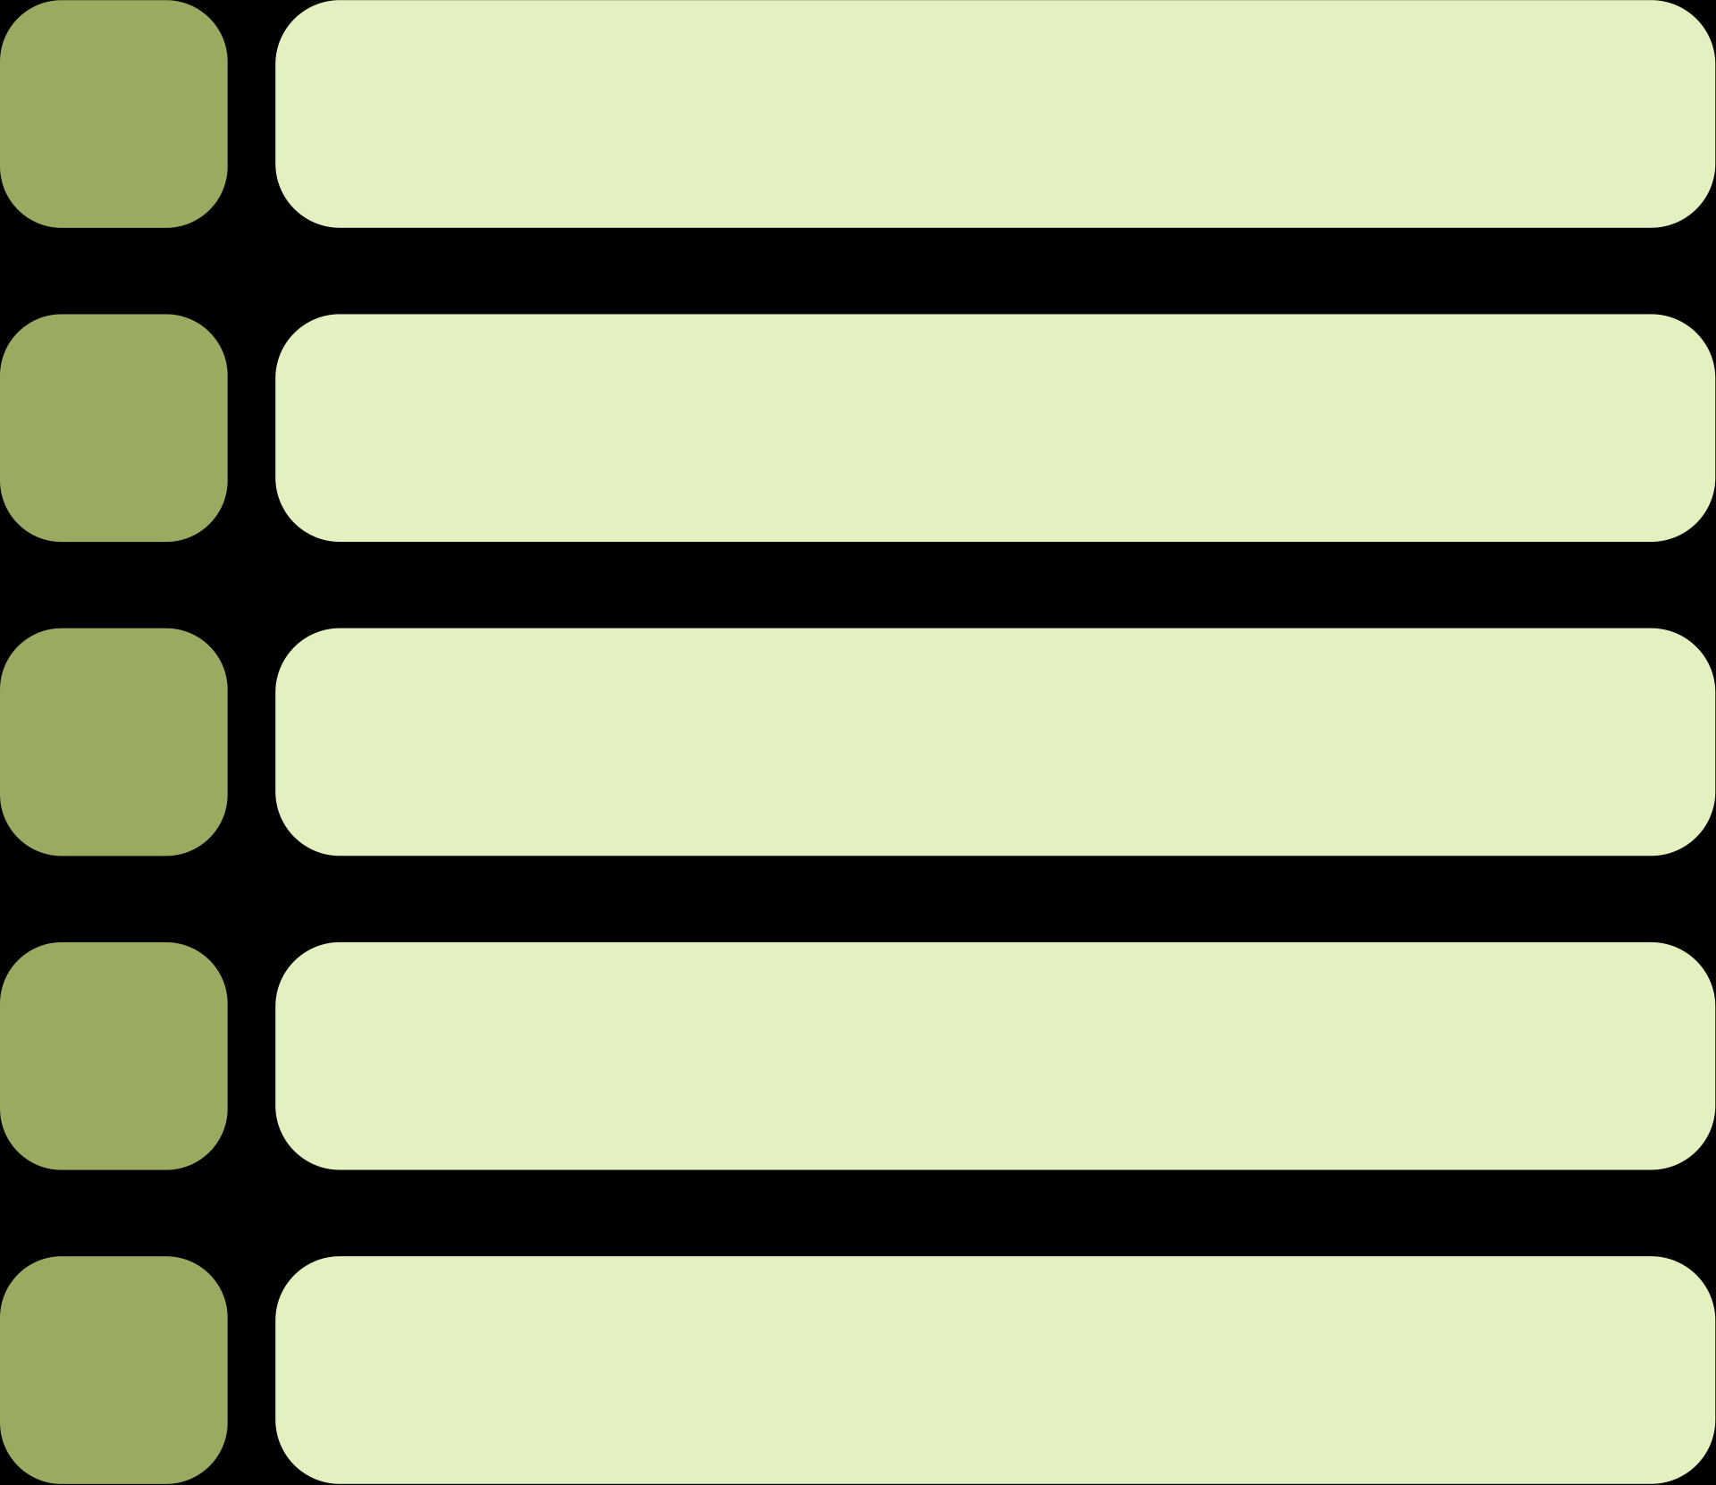
Influencing Factors...
1.
Personal Experience: Prior exposure to danger can heighten or dull perception.
2.
Media Coverage: Sensational reporting can amplify perceived risk.
3.
Cultural Beliefs: Norms and values shape what is considered risky.
4.
Trust in Institutions: Confidence in authorities can reduce perceived threat.
5.
Voluntariness: People accept higher risks when they choose them vs. imposed risks
www.MABPRO.com

Slide 7
Perception increase the negative impact of risk...
“We know that risk does not always equate to a threat, but individual perception can elevate the response to risk as if it were a threat…. and, as such, increase the negative impact of risk.”
www.MABPRO.com

Slide 8


MABPRO recognizes four key reasons why some risks are perceived as more or less serious than they truly are. Understanding these reasons is crucial for effective threat assessment.
One key aspect of threat perception is our tendency to overreact to intentional actions while underreacting to accidents or long-term threats. Moral emotions also play a significant role, often leading to heightened reactions when our values are offended.
Sometimes our emotional and cognitive biases that can influence our perception of threat.
Moral emotions also play a significant role, often leading to heightened reactions when our values are offended.
Sometimes our emotional and cognitive biases that can influence our perception of threat.
Voluntariness: People accept higher risks when they choose them vs. imposed risks
www.MABPRO.com

Slide 9


MABPRO recognizes four key reasons why some risks are perceived as more or less serious than they truly are. Understanding these reasons is crucial for effective threat assessment.
Another commonality that can lean towards negative threat perception is when Responders under-react to changes that occur slowly and over time. Employees are susceptible to bold changes in acuity, methodology, and philosophy, but if the rate of change is slow enough, then the change may go undetected. This is an element of the professional influence of apathy.
A common negative threat perception is the tendency to base the perception of threat, without the need to verify, on the prediction of the timing and location of dangers before they actually happen.
An element that can lean towards negative threat perception is when Responders under-react to changes that occur slowly and over time.
Generally, employees are susceptible to bold changes in acuity,
methodology, and philosophy, but if the rate of change is slow enough, then the change may go undetected.
This is one of the contributing elements that can lead us to fall under the professional influence of apathy.
Voluntariness: People accept higher risks when they choose them vs. imposed risks
www.MABPRO.com

Slide 10



How Perception Shapes Decision-Making...
Problem Recognition: Decisions begin with identifying a problem. If someone perceives a situation as threatening or urgent, they’re more likely to act—whether or not the threat is real.
Information Filtering: People don’t absorb all data equally. They filter based on past experiences, emotions, biases, and cultural lenses. This means two people can interpret the same facts differently.
www.MABPRO.com

Slide 11

How Perception Shapes Decision-Making...
Framing Effect: The way information is presented—positive vs. negative framing—can dramatically alter decisions. For example, “90% fat-free” sounds healthier than “10% fat,” even though they’re identical.
Biases and Shortcuts:
    Selective Perception: We notice what aligns with our beliefs and ignore the rest.
    Halo Effect: One positive trait can color our entire judgment of a person or situation.
    Contrast Effect: Recent experiences skew how we evaluate current ones.
www.MABPRO.com

Slide 12

How Perception Shapes Decision-Making...
Emotional Influence: Fear, trust, and empathy can override logic. In crisis scenarios, perception of safety or threat often drives action more than objective risk.
www.MABPRO.com

Slide 13
Management of Assaultive Behavior (MAB)
Workplace Violence Prevention Course...
Thank You!
www.MABPRO.com

