Slide 1








Management of Assaultive Behavior (MAB)
Workplace Violence Prevention Course...
M1 Basic MAB - Book One: Lesson 5 - Environmental Awareness
GET STARTED
www.MABPRO.com

Slide 2

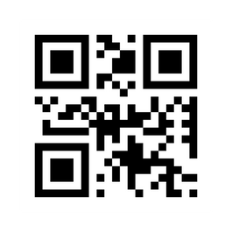
M1 Basic MAB: Book One - Student Guide
www.MABPRO.com

Slide 3



Topics...
1.
2.
3.
4.
Environmental Awarenss
How Variables Interact
How we can Improve...
Widening Our VIew
www.MABPRO.com

Slide 4
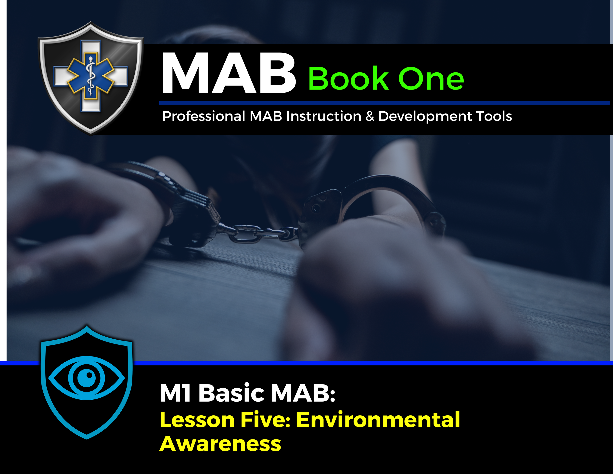

Topic Handouts
www.MABPRO.com

Slide 5


Environmental Awareness...
This Lesson will help provide a better understanding of how to develop and use environmental awareness to help keep you and clients safe.
Environmental awareness involves understanding how the people, processes, and physical place contribute to the overall environment. Stakeholders, care professionals, family, friends, and public members contribute to an environment's negative and positive variables.
Several factors contribute to a safe environment. Noise levels, ease of navigation, and the overall layout of a space can significantly impact safety. Being aware of potential escape routes and areas that could trap you is also crucial for personal safety.
www.MABPRO.com

Slide 6
How Variables Interact...
Supporting environmental awareness involves actively cultivating an understanding of how surroundings and factors like people, processes, and physical spaces interact.
www.MABPRO.com

Slide 7
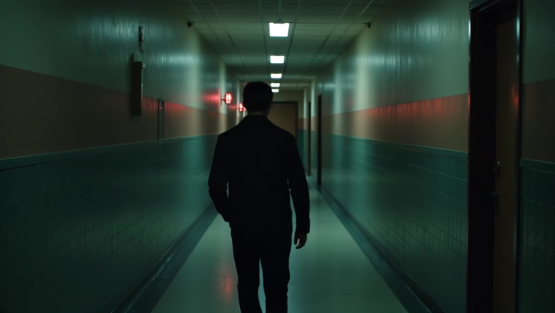
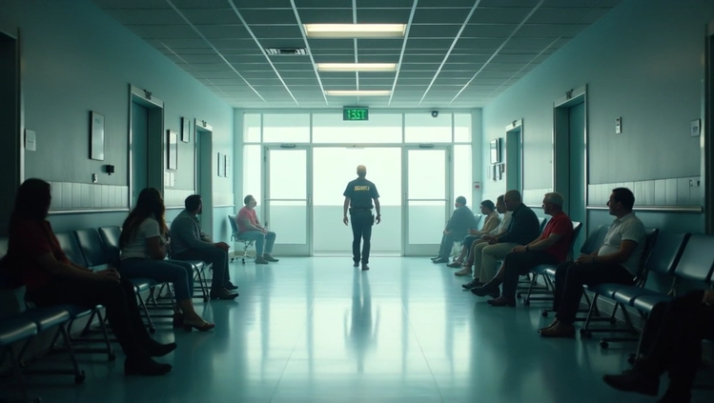
How we can improve Environmental Awareness...
Evaluate Physical Spaces:
Observe the layout—are there clear pathways and exits for easy navigation and safety?
Note noise levels or any potential hazards, like slippery floors or obstacles.
Understand Processes:
Identify how operations or routines affect the environment—are they chaotic or smooth and efficient?
Ensure workflows are designed to promote safety and accessibility.
www.MABPRO.com

Slide 8


How we can improve Environmental Awareness...
Be Aware of People:
Recognize how individuals’ actions and emotions contribute to the environment.
Foster positive interactions to create a collaborative and safe atmosphere.
Assess Escape Plans:
Identify emergency exits or areas that could serve as safe zones in dangerous situations.
Familiarize yourself with routes to avoid becoming trapped in emergencies.
www.MABPRO.com

Slide 9


How we can improve Environmental Awareness...
Promote Feedback:
Encourage open communication and listen to concerns about environmental risks.
Act on suggestions to improve safety and efficiency.
Collaborate with others:
Involve stakeholders, colleagues, or family members to address environmental risks.
Share responsibilities to maintain a secure and supportive space.
www.MABPRO.com

Slide 10
Widening our view...
Your work already emphasizes how people, processes, and physical spaces interact. Expanding that lens to include environmental factors—like air quality, noise pollution, or resource scarcity—deepens learners’ situational awareness
www.MABPRO.com

Slide 11
Management of Assaultive Behavior (MAB)
Workplace Violence Prevention Course...
Thank You!
www.MABPRO.com

