Slide 1








Management of Assaultive Behavior (MAB)
Workplace Violence Prevention Course...
M1 Basic MAB - Book One: Lesson 2 - Understanding the ACS Process...
GET STARTED
www.MABPRO.com

Slide 2

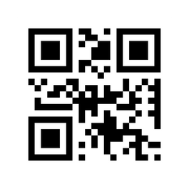
M1 Basic MAB: Book Two - Student Guide
www.MABPRO.com

Slide 3



Topics...
1.
2.
3.
4.
5.
Understanding the ACS Process...
Assessment...
Communication...
To Serve & Support...
The MAB Levels of Awareness...
www.MABPRO.com

Slide 4
Topics continued...
6.
The MAB Levels of Awareness:
www.MABPRO.com

Slide 5
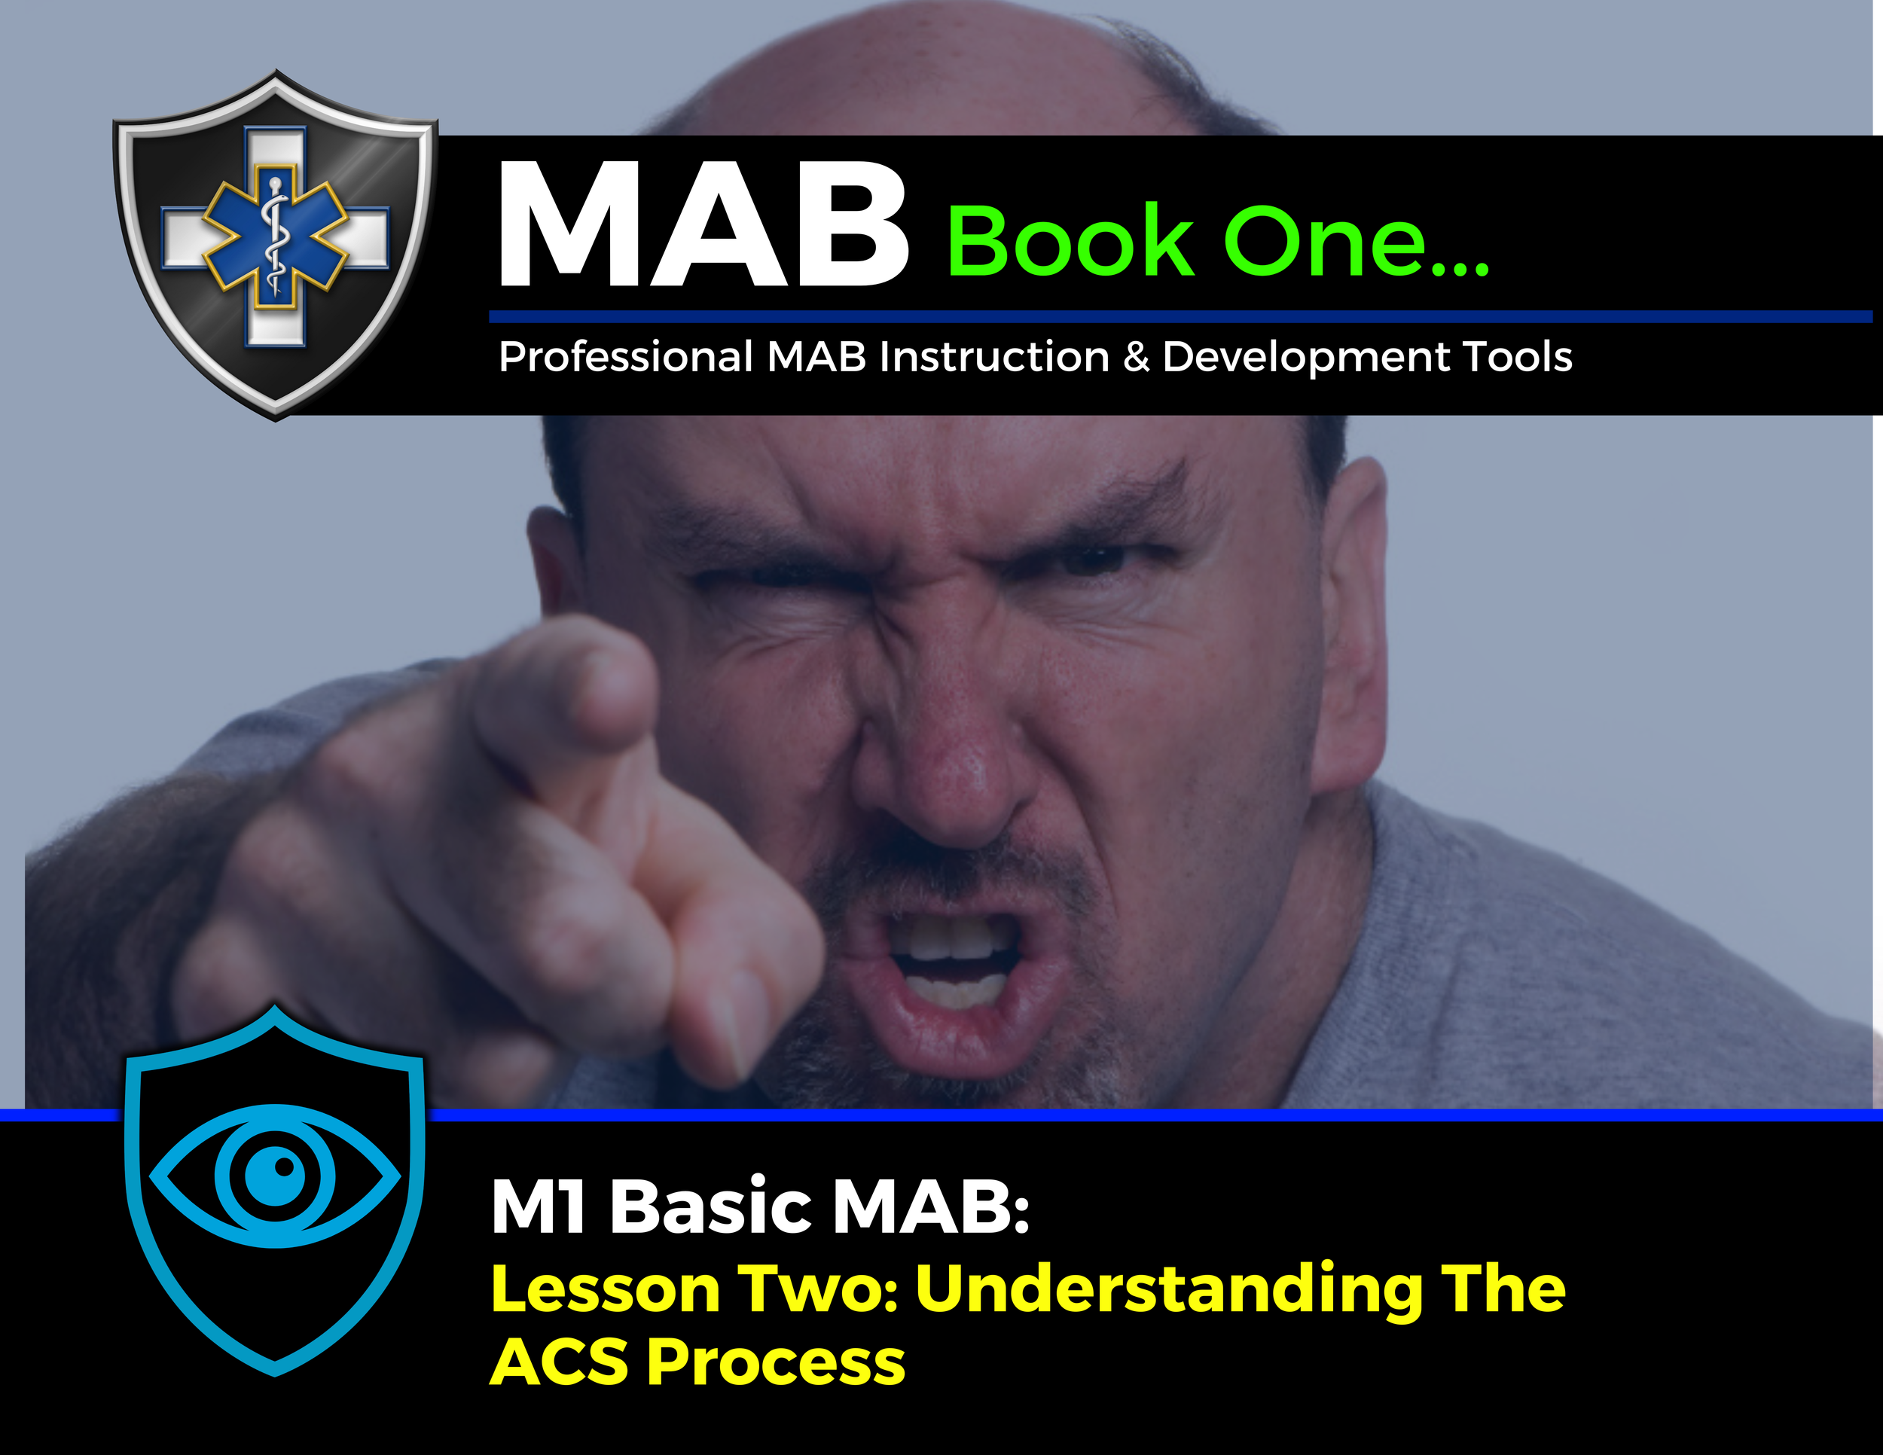

Topic Handouts
www.MABPRO.com

Slide 6




Understanding the ACS Process...
Understanding the ACS Process helps us in developing a comprehensive ability to maintain situational and environmental awareness. Today, we’ll explore the ACS Process—Assess, Communicate, and how to Serve and Support. This framework empowers you to assess situations accurately, quickly, communicate effectively, and provide the necessary support to ensure optimal care. Let’s explore how these elements can enhance your response to dynamic and challenging care environments.
Assessment
Communication
To Serve & Support
www.MABPRO.com

Slide 7




The ACS Process...
To effectively manage assaultive behavior in any setting—professionals rely on several types of assessments that help predict, prevent, and respond to aggression. These assessments are designed to identify risk factors, monitor behavior, and guide intervention strategies.
Individual trying to cope and communicate needs while dealing with conflict variables...
The Response Team is Assessing the Situation
The Response Team is engaging in Communication/ gathering and confirming information
The Response Team Create a plan of response and then implements it...
www.MABPRO.com

Slide 8
Assess + Communicate = To Serve and Support
“The ACS Process continues until the Response Team can discover and deliver the resources needed to meet the needs of the Individual and de-escalation occurs. If the Responders cannot meet the needs of the individual, then there is little hope for the process of negotiation to succeed.”
www.MABPRO.com

Slide 9
Assessment...
Assessment...
Here's a breakdown of the key types:
Violence Risk Assessments:
Violence Risk Assessments:
  These tools help evaluate an individual's potential for violent behavior.
    Triage Tool: Assesses immediate risk to self or others, often used in emergency or psychiatric settings.
    Danger Assessment Scale: Rates risk levels (e.g., low, medium, high) based on history and current behavior.
    Indicators for Violent Behavior: Quick checklist of observable behaviors like agitation, clenched fists, or pacing.
Behavioral Assessments:
Behavioral Assessments:
  These focus on patterns of behavior and triggers.
    Functional Behavior Assessment (FBA): Identifies the purpose behind aggressive behavior (e.g., attention-seeking, escape, sensory needs).
    Behavioral Observation Tools: Track frequency, intensity, and duration of assaultive incidents to spot trends.
www.MABPRO.com

Slide 10
Assessment...
Assessment...
Here's a breakdown of the key types:
Threat Assessments:
Threat Assessments:
  Used to evaluate the seriousness and immediacy of a threat.
  Structured Professional Judgment (SPJ): Combines clinical judgment with standardized criteria.
  Behavioral Threat Assessment Teams (BTAT): Multidisciplinary teams that assess and manage threats in institutions.
Environmental and Situational Assessments:
Environmental and Situational Assessments:
  These examine external factors that may contribute to assaultive behavior.
  Workplace Violence Risk Audits: Evaluate physical layout, staffing patterns, and policies that may increase risk.
  Situational Awareness Tools: Help staff recognize escalating situations before they become violent.
www.MABPRO.com

Slide 11
Assessment...
Assessment...
Here's a breakdown of the key types:
Psychological and Psychiatric Evaluations:
Psychological and Psychiatric Evaluations:
  Used when underlying mental health conditions may be contributing to aggression.
  Clinical Interviews and Psychometric Tests: Assess for disorders like schizophrenia, PTSD, or impulse control issues.
  Crisis Intervention Assessments: Determine immediate needs during acute episodes.
Assessment & the conflict of time...
Assessment & the conflict of time...
  Time is the most precious—and pressured—resource in a crisis. When response teams face an unfolding emergency, every second counts. Each crisis presenting the Need for Immediate but Accurate Assessment
  Tools like behavioral checklists or risk scales exist but applying them in real time requires training and experience.
  Mobile Crisis Teams, for example, aim to assess and stabilize individuals in non-clinical settings, but even they face time pressure when balancing safety and care
www.MABPRO.com

Slide 12
Communication...
Communication...
Responder communication during a crisis isn’t just helpful—it’s life-saving. Whether it’s a natural disaster, violent incident, or medical emergency, the way responders communicate can shape the outcome for everyone involved.
Establishes Safety and Control:
Establishes Safety and Control:
  Clear, calm communication helps reduce panic and confusion.
  It reassures victims and bystanders that help is present and organized.
  Responders who explain what’s happening and what to expect create a sense of stability in chaos.
Builds Trust and Cooperation:
Builds Trust and Cooperation:
  People are more likely to follow instructions when they feel heard and respected.
  Empathy, active listening, and validating emotions foster trust—even in high-stress situations.
  Trust can be built in the first 30 seconds of interaction, making initial communication critical.
www.MABPRO.com

Slide 13
Communication...
Communication...
Responder communication during a crisis isn’t just helpful—it’s life-saving. Whether it’s a natural disaster, violent incident, or medical emergency, the way responders communicate can shape the outcome for everyone involved.
Improves Decision-Making:
Improves Decision-Making:
  Accurate, timely information allows responders to assess risks and prioritize actions.
  Miscommunication can lead to delays, duplicated efforts, or dangerous errors.
  Effective communication ensures that everyone—from dispatch to field teams—is aligned.
Guides the Public to Safety:
Guides the Public to Safety:
  Instructions about evacuation, shelter, or medical aid must be clear and consistent.
  Misinformation or vague messaging can cause panic or lead people into danger.
  Communication tools like social media, radio, and public alerts amplify reach and impact.
www.MABPRO.com

Slide 14
Communication...
Communication...
Responder communication during a crisis isn’t just helpful—it’s life-saving. Whether it’s a natural disaster, violent incident, or medical emergency, the way responders communicate can shape the outcome for everyone involved.
Supports Emotional and Psychological Recovery:
Supports Emotional and Psychological Recovery:
  Words matter—especially in trauma. Calm, compassionate communication can reduce anxiety and fear.
  Explaining procedures, offering reassurance, and simply being present can help victims feel less alone.
  Even unconscious individuals may respond to tone and presence, making non-verbal cues just as important.
Strengthens Team Coordination:
Strengthens Team Coordination:
  Responders rely on each other—firefighters, EMTs, police, mental health professionals.
  Communication ensures that roles are clear, resources are shared, and efforts are synchronized.
  Regular training and drills reinforce these skills so that response feels instinctive when real crises hit.
www.MABPRO.com

Slide 15
To Serve & Support...
To Serve & Support...
The Serve and Support portion of the ACS Process in Management of Assaultive Behavior (MAB) is a foundational mindset that reframes intervention from control to care. It’s not just a technique—it’s a philosophy that aligns beautifully with your trauma-informed, culturally responsive approach to training.
What is Serve & Support?
What is Serve & Support?
  At its core, Serve and Support means responding to escalating behavior with empathy, structure, and purpose. It emphasizes:
  Serving the individual’s needs—not just reacting to their behavior.
  Supporting safety for everyone—staff, clients, and bystanders.
  Maintaining dignity—even in high-stress or volatile situations.
What is the plan? What are we going to do? What am I going to do?
What is the plan? What are we going to do? What am I going to do?
www.MABPRO.com

Slide 16
To Serve & Support...
To Serve & Support...
This approach is especially vital in environments like healthcare, social services, and military contexts, where behavioral escalation may stem from trauma, confusion, or unmet needs.
  As the response team seeks to serve and support, gathered information is then shaped into a response plan. The response team organizes and first makes an inward plan before putting it into outward Action (Think before you do).
  2. As the plan is implemented the ACS Process begins to move again and the individual is reassessed after encountering the response plan.
  3. As new variables are encountered through team efforts to communicate a new follow up plan is developed to assist.
  4. This new adjusted plan is implemented, and the ACS Process cycles again until the response team can implement supports to address the needs of the individual and de-escalation occurs.
  5. During high acuity crisis situations, the ACS Process can cycle quickly and frequently based on the priority of risk and the potential for violence.
  6. Not every situation can be de-escalated through negotiation, sometimes the plan of support may include law enforcement to defuse the imminent danger of the situation. The ACS Process will help well trained responders to make the determination of what level or type of support is required. All responders should include self and staff safety as part of their capability to serve and support.
www.MABPRO.com

Slide 17

The MAB Levels of Awareness:
The MAB Levels of Awareness:
The Definition of Awareness is an individual or a group element that can benefit the safety of the workplace. In simpler terms it means knowing what's going on.
To use the ACS Process we need to be aware it is in motion. To do that, we need to understand the levels of awareness we generally all have in common.
Typically, people operate on FOUR distinct levels of awareness:
Typically, people operate on FOUR distinct levels of awareness:
  Level One - Apathy Influenced,
  Level Two - Relaxed Presence,
  Level Three - Task Focused,
  Level Four - High Alert - this level consumes allot of energy and can be difficult to maintain for long periods of time.
“Altogether These levels represent the differing degrees of attention
that individuals practice in daily life.”
“Altogether These levels represent the differing degrees of attention
that individuals practice in daily life.”
www.MABPRO.com

Slide 18

The MAB Levels of Awareness:
The MAB Levels of Awareness:
Level One - Apathy Influenced...
Level One - Apathy Influenced...
  It is similar to when you are driving in a familiar environment, engrossed in thought, a daydream, or a song on the radio.
  This Professional influence is not a negative thing, in the right environment under the right timing it can help reduce stress and provide the ability to relax.
www.MABPRO.com

Slide 19

The MAB Levels of Awareness:
The MAB Levels of Awareness:
Level Two - Relaxed Presence...
Level Two - Relaxed Presence...
  Increasingly, routine access to cell phone calls and texting are also causing people to slip into the professional influence of apathy as they drive.
  "Take a look at your daily routines and evaluate your risk for falling under the professional influence of apathy at work."
www.MABPRO.com

Slide 20

The MAB Levels of Awareness:
The MAB Levels of Awareness:
Level Three - Task Focused...
Level Three - Task Focused...
  The Third level of awareness is like driving in hazardous road conditions.
  You don't dare take your eyes off the road or let your attention wander. Being task focused demands a high level of total concentration on precise details.
  This is what happens when a car that you are watching does not stop at the intersection ahead and you narrowly miss them by hitting your brakes and keeping the car under control.
  Both awareness levels three and four are exhausting and consume tremendous amounts of energy and can be very difficult and stressful to maintain for long periods of time.
www.MABPRO.com

Slide 21

The MAB Levels of Awareness:
The MAB Levels of Awareness:
Level Four: High Alert!
Level Four: High Alert!
The Fourth level of awareness is like driving in hazardous road conditions. Other drivers scare you with their poor skills and the weather is not helping. This level of awareness can induce a adrenaline rush, a prayer, and a gasp of air at the same time.
www.MABPRO.com

Slide 22
Always at the ready...
“We all need down time, a time to replenish and rest. We also have times of the day where we must be highly attentive. Our levels of awareness and how we control them helps us stay balanced and ready for the challenges ahead...”
www.MABPRO.com

Slide 23
Management of Assaultive Behavior (MAB)
Workplace Violence Prevention Course...
Thank You!
www.MABPRO.com

