Slide 1








Management of Assaultive Behavior (MAB)
Workplace Violence Prevention Course...
M1 Basic MAB - Book One: Lesson One: Why MAB?
GET STARTED
www.MABPRO.com

Slide 2


M1 Basic MAB: Book One - Student Guide
www.MABPRO.com

Slide 3



Topics...
1.
2.
3.
4.
5.
Defining Workplace Violence
What can be done to prevent Workplace Violence?
Factors that Contribute to Workplace Violence Risk...
The 5 Categories of Workplace Violence
The Importance of Taking Action...
www.MABPRO.com

Slide 4



Topic Handouts
www.MABPRO.com

Slide 5

Why is it so important to train on Management of Assaultive Behavior?
Let's address a fundamental question: Why is training in the Management of Assaultive Behavior (MAB) so vital? The answer is simple: our safety and well-being are paramount. Equipping ourselves with the right skills and knowledge allows us to respond effectively and protect ourselves and our clients.
Defining Workplace Violence...
“Workplace violence encompasses a wide range of behaviors, from verbal threats and harassment to physical assaults. It's any act that creates a threatening or disruptive environment at our workplace. Remember, it can involve anyone – employees, clients, or even visitors.”
www.MABPRO.com

Slide 6
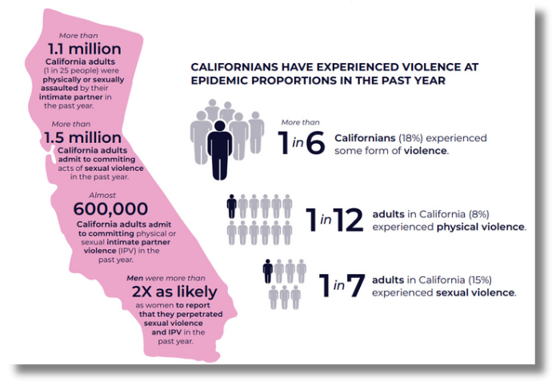
Workplace Violence (WPV) Continues to Grow in frequency and intensity...
Unfortunately, workplace violence is at epidemic levels across various professions.
As you have seen, this includes hospitals, mental health agencies, social services, and even public environments. The tension is high and often the acuity levels can be extreme.
Just a few of the Professions affected...
Hospitals - Emergency Rooms
Security Firms
Mental Health Agencies
Governmental Agencies
Social Services
Law Enforcement
Schools
Public Events
Retail Establishment
Entertainment Events
www.MABPRO.com

Slide 7
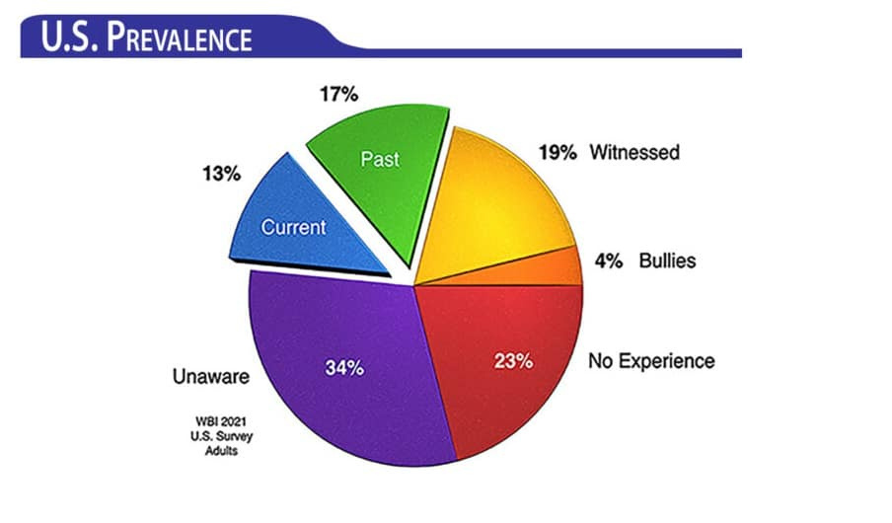
Workplace Violence (WPV) Continues to Grow in frequency and intensity...
Unfortunately, workplace violence is at epidemic levels across various professions.
As you have seen, this includes hospitals, mental health agencies, social services, and even public environments. The tension is high and often the acuity levels can be extreme.
Surveying the reality of the field...
Surveying 1000 care professionals the numbers were clear...over 75% indicated they have at one point or an other been exposed to workplace violence.
www.MABPRO.com

Slide 8
What can be done to prevent Workplace Violence?
“First, we must accept that we are ALL Responders! Through that we increase training, vigilance, Team Focused Response, and Focused Resources - Through this we can make a difference! It comes down to increasing the knowledge of what we can do and then doing what we can as safe as possible."
www.MABPRO.com

Slide 9

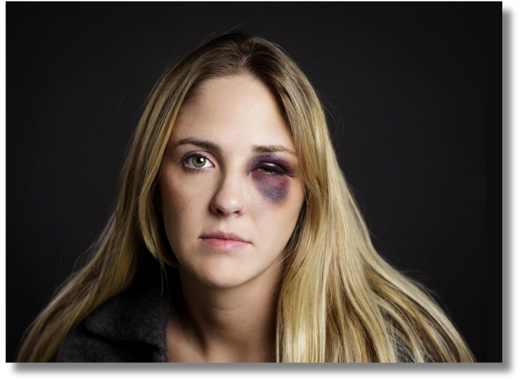

Factors that Contribute to Workplace Violence Risk...
1. Working Alone...
Certain factors can increase the risk of workplace violence.
Those working alone or in isolated areas are at a greater risk for workplace violence. Arriving at locations alone or in isolated environments, not familiar with.
2. Working where alcohol is being served...
Employees who provide services or care while working where alcohol is served are at risk of violence.
www.MABPRO.com

Slide 10


Factors that Contribute to Workplace Violence Risk...
3. Working at Night...
Working at night, or in areas with high crime rates puts employees at risk.
4. High Acuity Work Environments....
Working in environments where the acuity of the people is inherently high due to the nature of services provided.
www.MABPRO.com

Slide 11






The 5 Categories of Workplace Violence
1. Criminal Intent (Category I)
Perpetrator: Has no legitimate relationship with the workplace.
Motivation: Usually, theft or other criminal activity.
High-risk roles: Cash handlers, late-night workers, isolated staff.
2. Customer/Client (Category II)
Perpetrator: A client, patient, or customer of the organization.
Motivation: Frustration, unmet expectations, emotional distress.
High-risk sectors: Healthcare, social services, retail.
3. Worker-to-Worker (Category III)
Perpetrator: A current or former employee.
Motivation: Interpersonal conflict, bullying, retaliation.
Common targets: Supervisors, peers, subordinate.
4. Domestic Violence (Category IV)
Perpetrator: A partner or family member of an employee.
Motivation: Personal relationship issues spilling into the workplace.
5. Ideological Violence (Category V)
a. Perpetrator: Driven by political, religious, or social ideology.
b. Motivation: Belief-based grievance against the organization or its people.
www.MABPRO.com

Slide 12

The Importance of Taking Action...
Workplace violence has become a pressing issue that today’s workforce faces all too often. The heightened levels of anxiety and fear prevalent in society have significantly affected individuals’ ability to exercise patience and manage stress effectively. These challenges have, in turn, contributed to strained interactions and, at times, dangerous situations within professional settings.
As we move forward, it becomes increasingly important to take collective action to address these concerns. By fostering a deeper understanding of the underlying causes and effects of workplace violence, we can work together to implement proactive measures. This involves not only identifying potential risks but also creating initiatives focused on prevention, conflict resolution, and fostering environments where employees feel safe, respected, and supported.
www.MABPRO.com

Slide 13
Management of Assaultive Behavior (MAB)
Workplace Violence Prevention Course...
Thank You!
www.MABPRO.com

