Slide 1
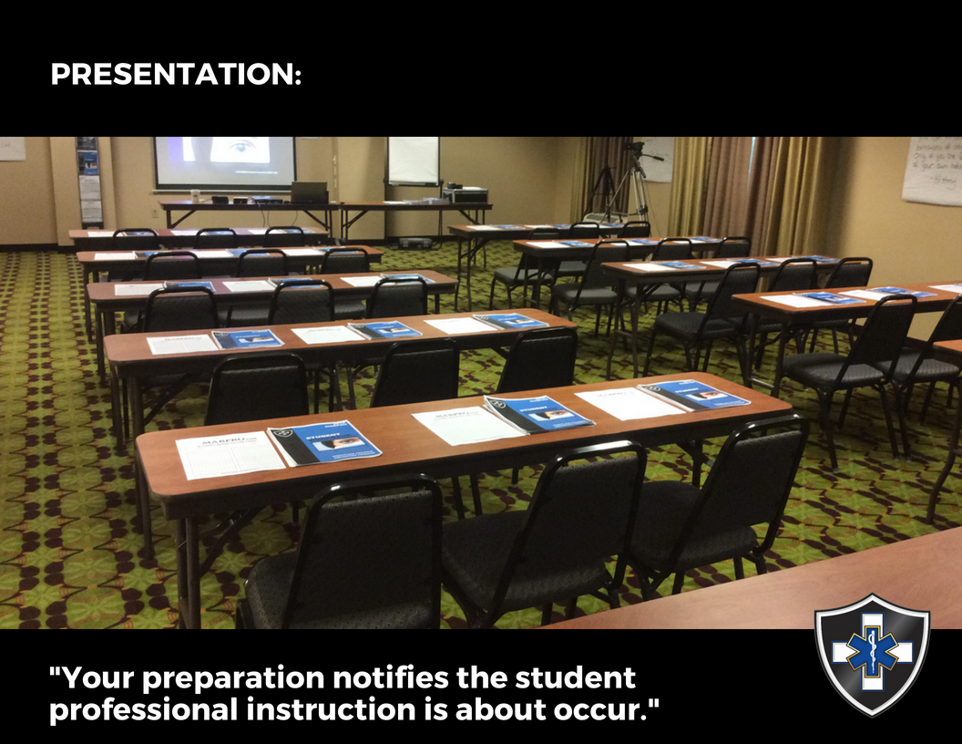

The Art of Instruction… MAB Course Operations

Slide 2
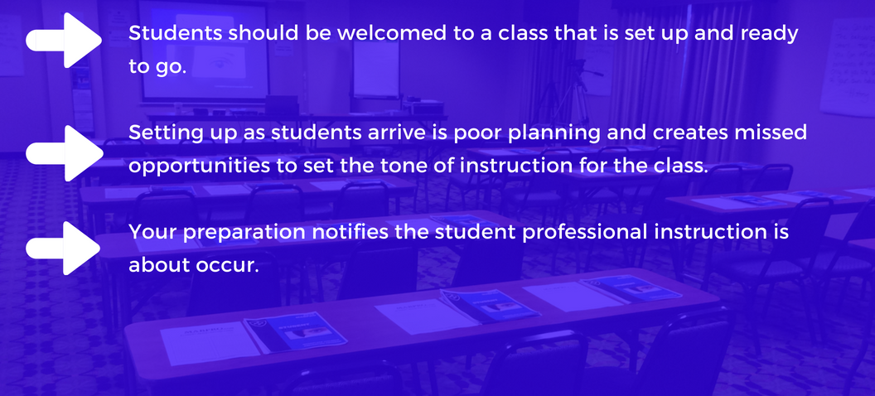
Course Presentation…

Slide 3
Your preparation notifies the student professional instruction is about to occur…

Slide 4
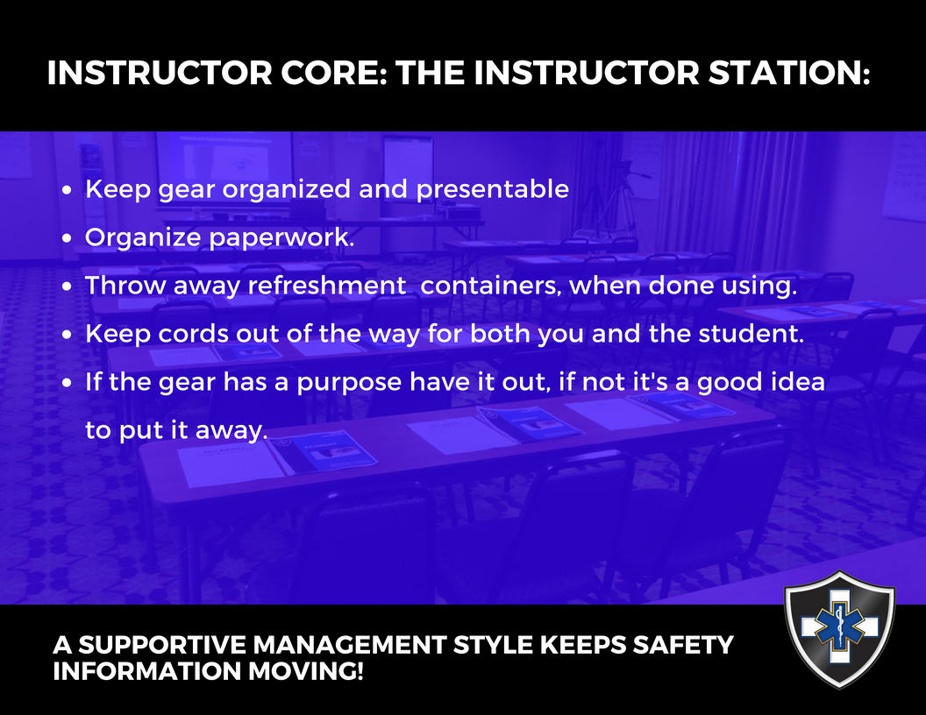
The Instructor Station…

Slide 5
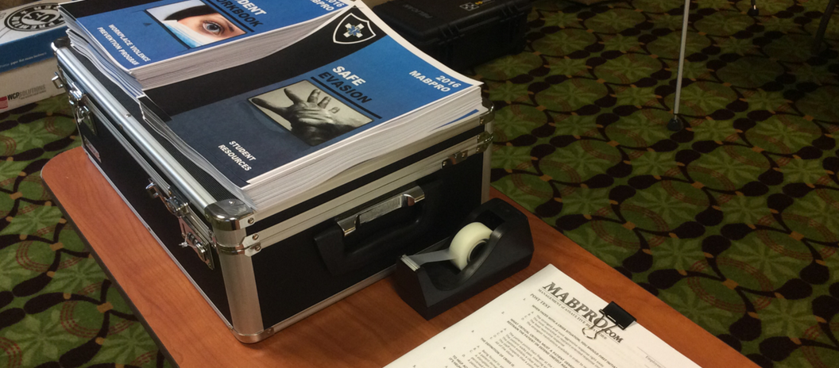
The Instructor Station… Keeping the instructor station organized helps keep the class on schedule with materials at the ready.

Slide 6
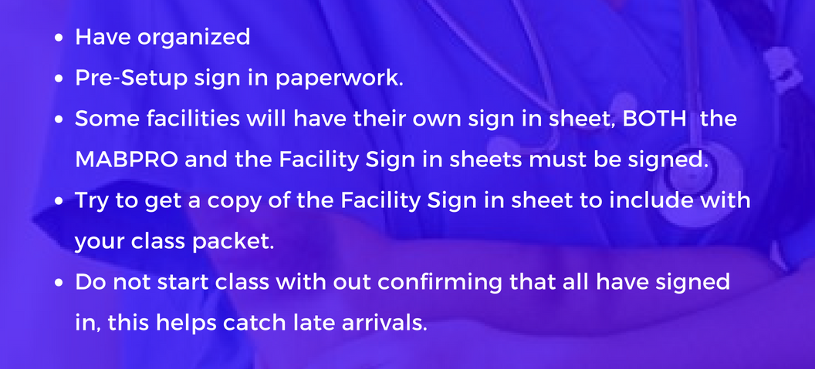
The Sign in Station… All paperwork pre-setup, ensuring student accountability.

Slide 7
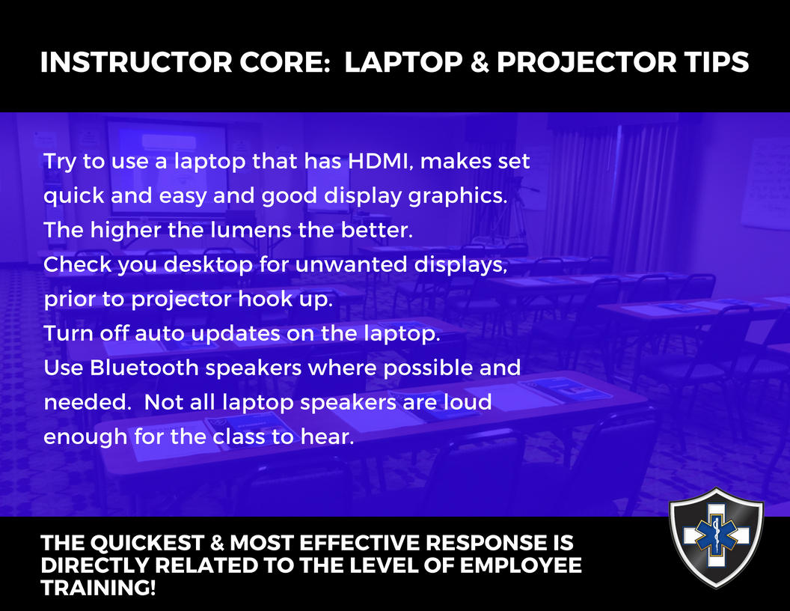
Laptop & Projector Tips… Always precheck electronic gear prior to presenting the course.

Slide 8
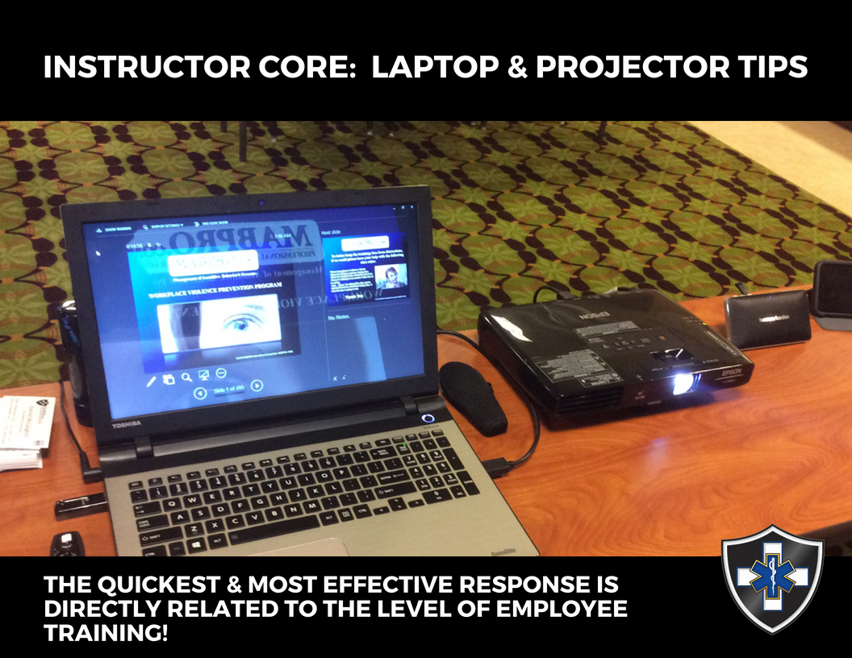
The Instructors Station… Always inventory clickers, speakers, and cords when closing the course.

Slide 9
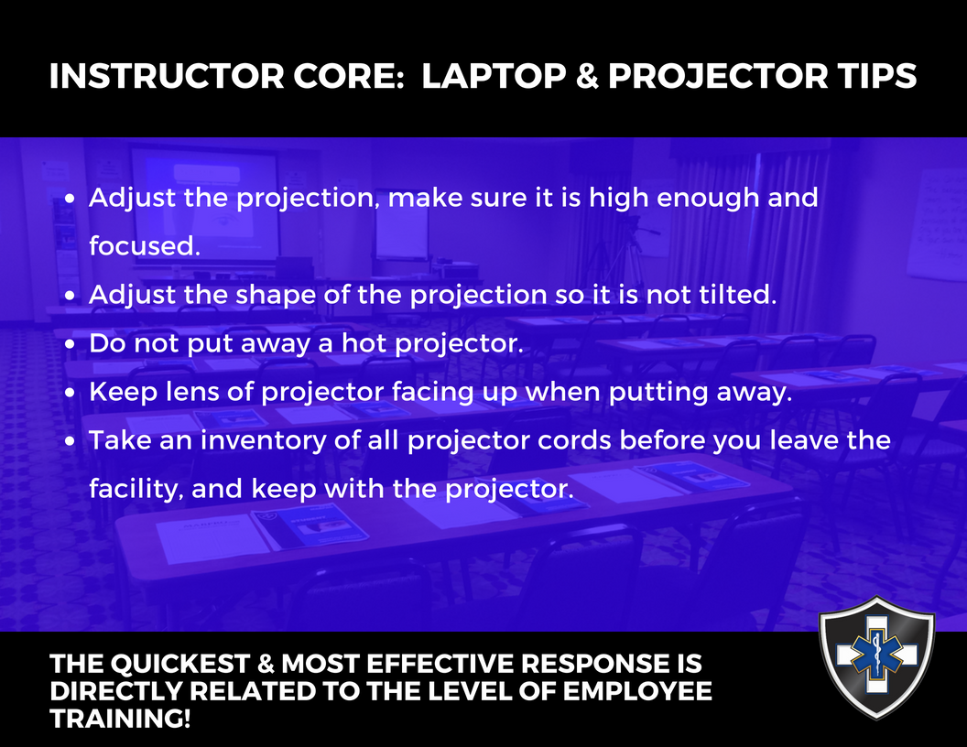
Projector Tips… Always inventory clickers, speakers, and cords when closing the course.

Slide 10
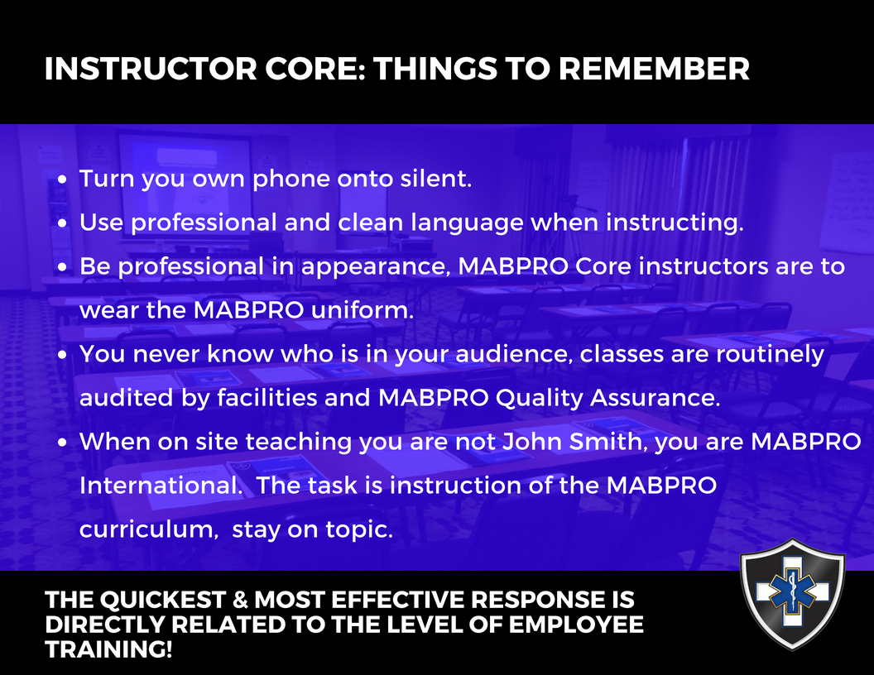
Avoid distractions… Help students focus on the material through preparation.

Slide 11
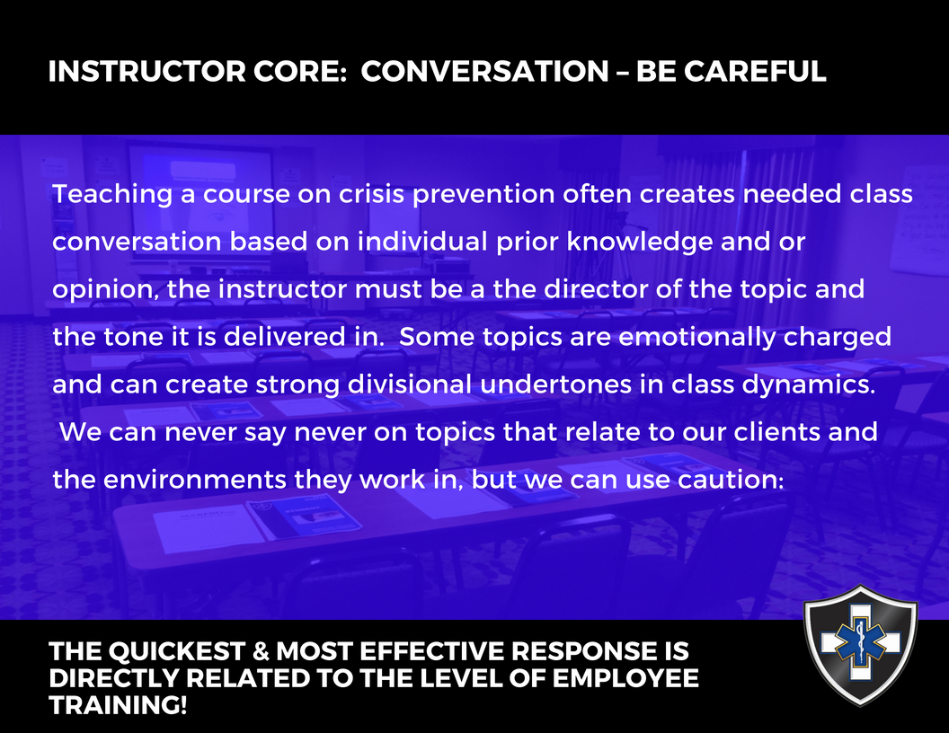
Be Careful in Conversations… MAB sometimes navigates difficult topics, be careful not to lose your way.

Slide 12
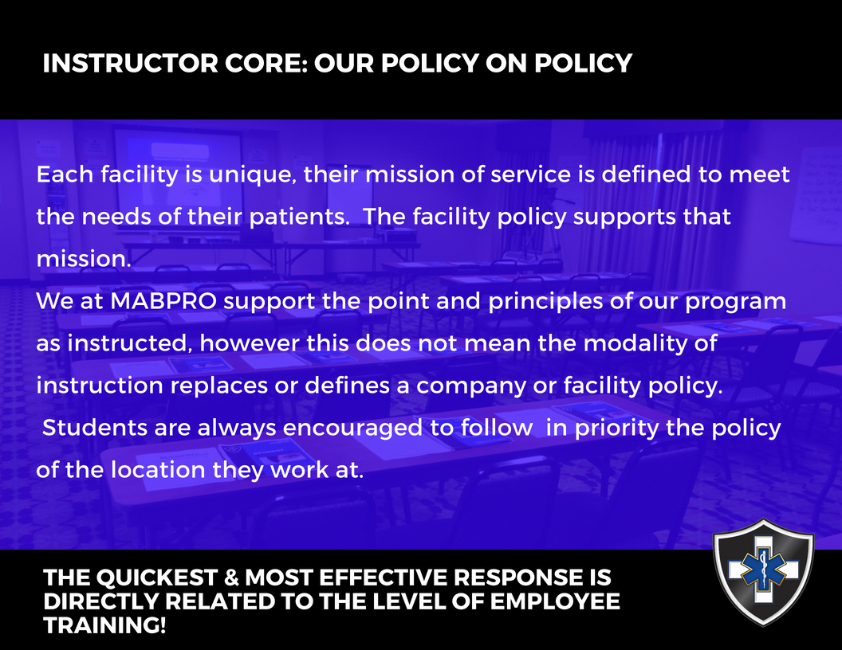
Our Policy on Policy… The MABPRO Modality does not override Company Mandate.

Slide 13
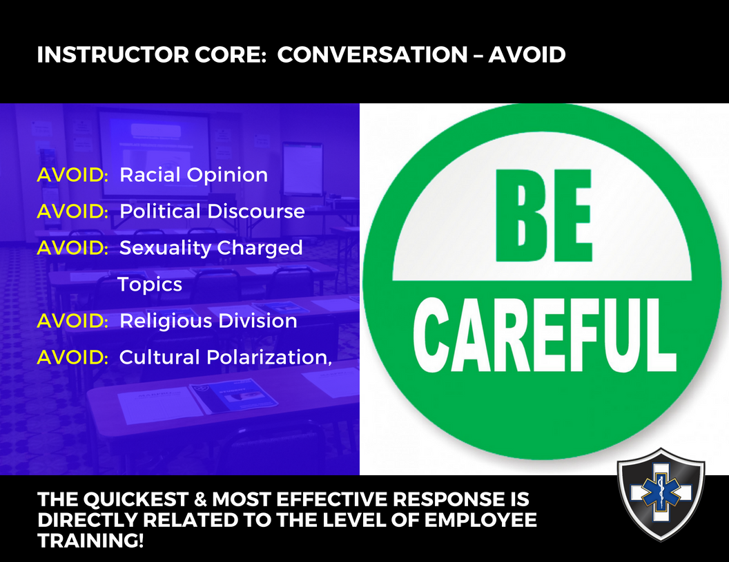

Conversations – topics to avoid… Be mindful of the risks when guiding class dialog through difficult topics.

Slide 14
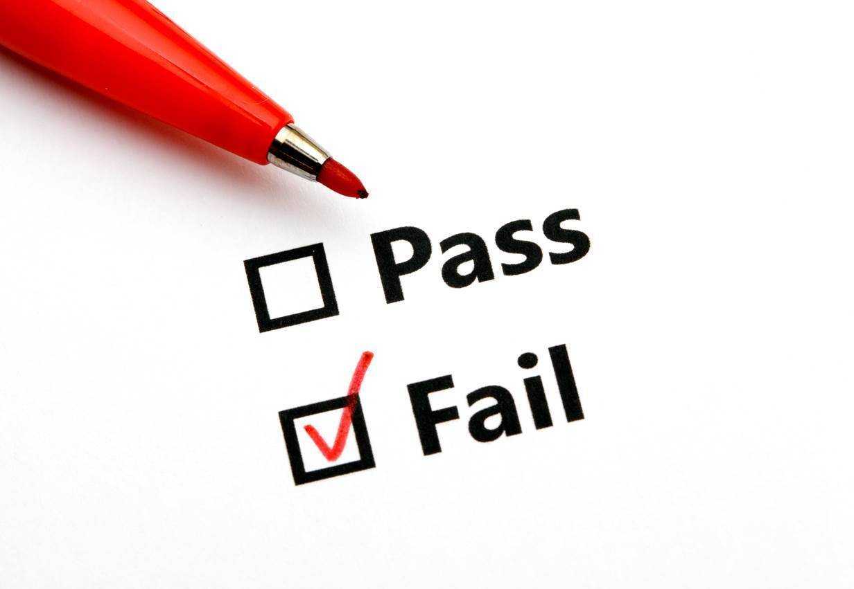
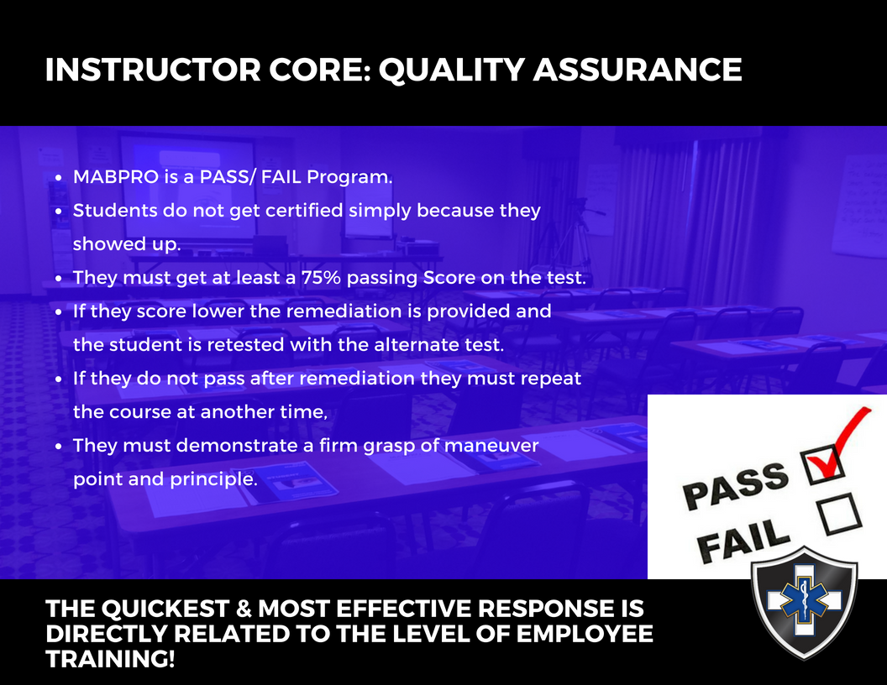
Course Quality Assurance… Attention to detail increases quality and retention.

Slide 15
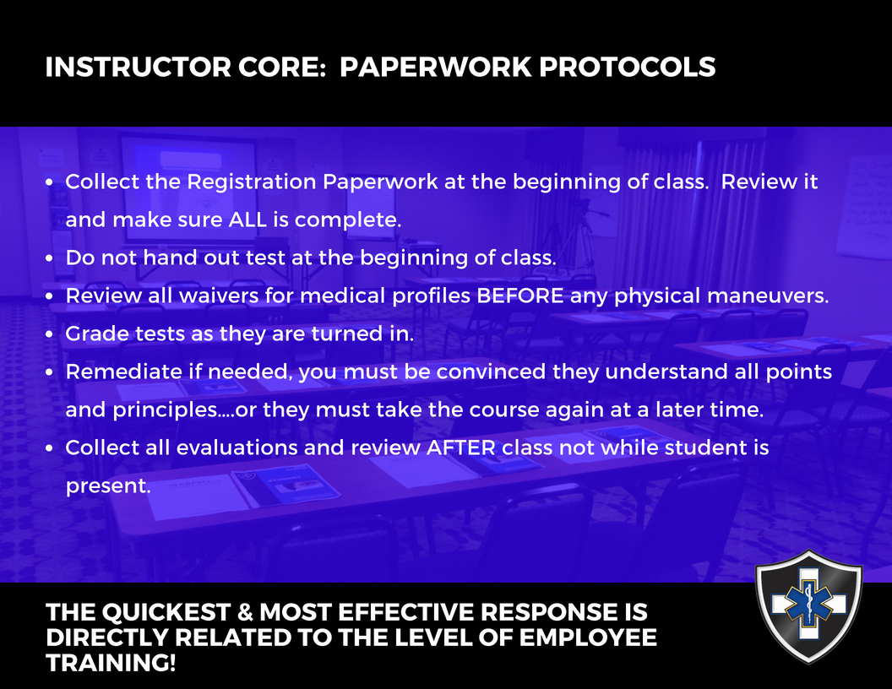
MAB Paperwork Protocols… Maintain a close watch over class packet materials.

Slide 16
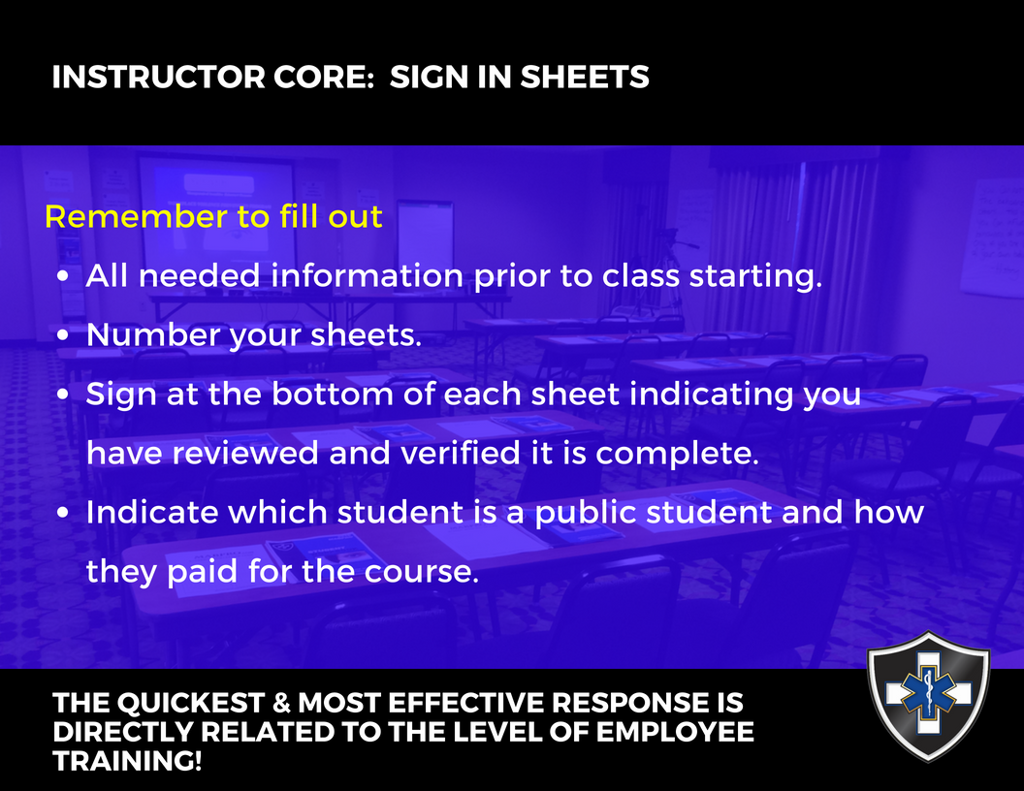
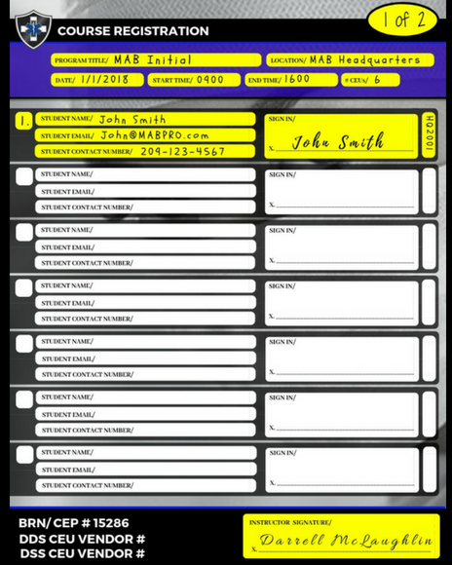
Setting up Sign in Sheets… Be complete in your review and preparation.

Slide 17
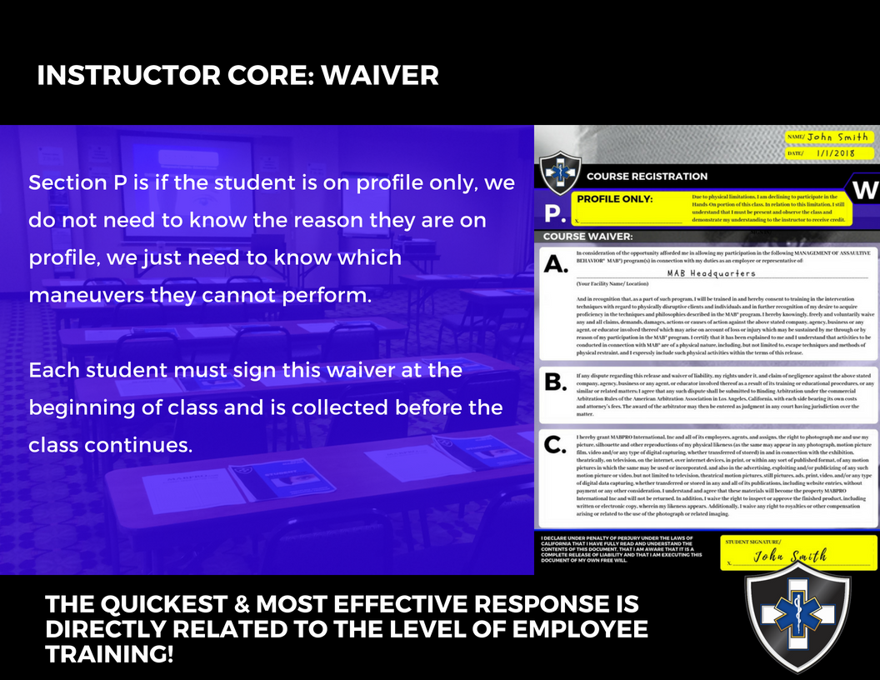
Collecting & Reviewing Course Waivers… Take note of Profiles prior to running M2 or M3 blocks of instruction.

Slide 18
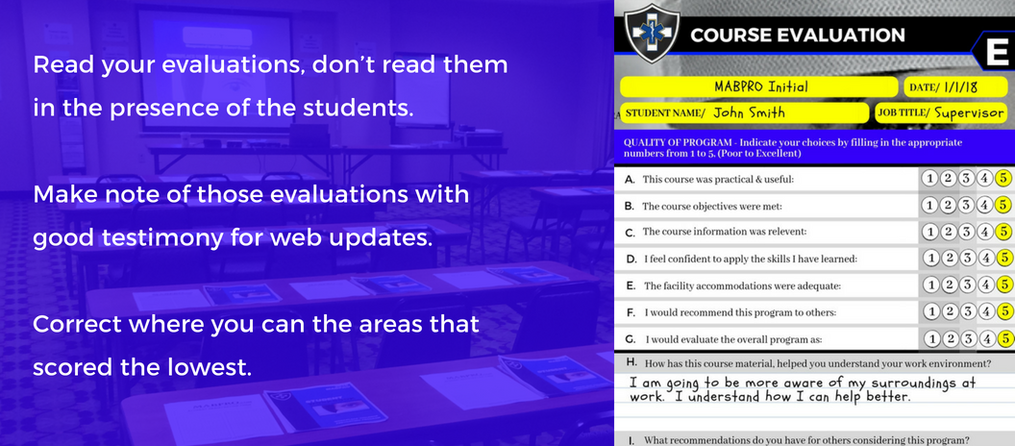
Collecting & Reviewing Course Evaluations… Evaluations are very useful tools to gauge instructor delivery.

Slide 19
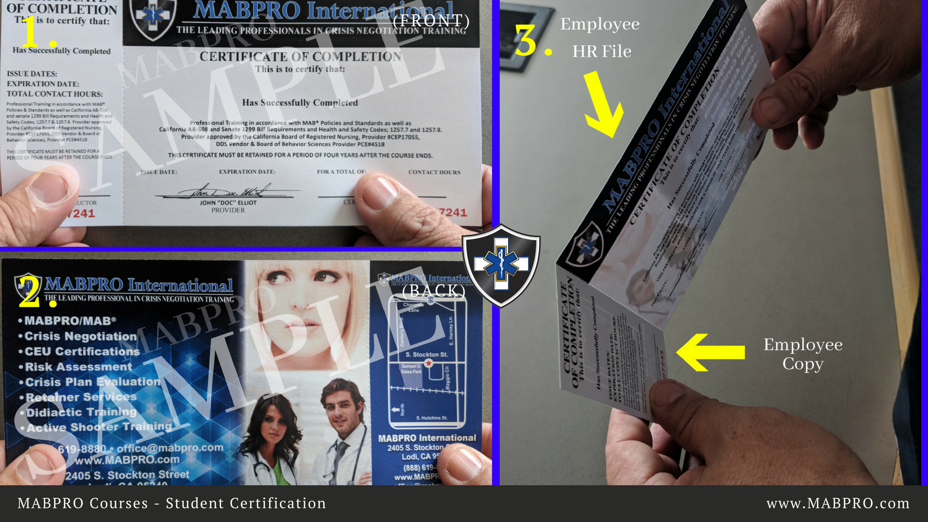
MABPRO Sample Student Certifications… Evaluations are very useful tools to gauge instructor delivery.

Slide 20

Questions?

