Slide 1
The ACS Process… Assess, Communicate, & Support
MABPRO INSTRUCTOR DEVELOPMENT

Slide 2
The Bottom Line…
In the realm of care professions, compassionate and empathetic individuals strive to enhance the quality of life through exceptional service. Our patients present complex needs, often requiring immediate attention. For some, the challenges of daily existence prove daunting, while others find it impossible to navigate. Those at the forefront of care frequently encounter a bewildered, frustrated, and sometimes angry public. The intricate interplay of developmental disabilities, mental health issues, and socio-economic struggles further compounds the situation. Individuals grappling with these stressors must reach out in a society that often lacks sufficient resources, understanding, and capability. As care professionals, we recognize that comprehensive training is essential to meet our patients’ diverse needs.

Slide 3
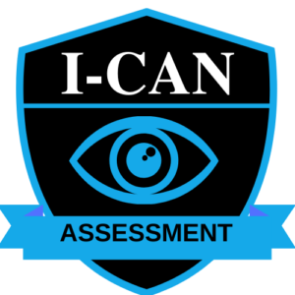
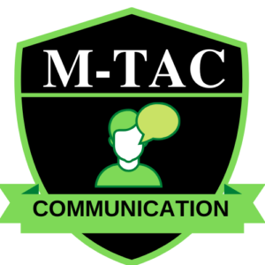
Developing a strong MAB Foundation helps the care provider todo the following…
ASSESSMENT – Plug into the skills of assessment and awareness. A keen eye for the details is essential in reading the situations that surround us.
COMMUNICATE – To recognize the types of communication, to use the most effective form of communication, and to verify when communication occurs.
SERVE & SUPPORT – Developing an inward plan of approach before committing to an outward plan of action. Developing and presenting options towards a pathway to peace, and determining which option is required, possible, and safest given the presented variables.

Slide 4
What is the ACS Process?
The ACS Process is a three-stage cycle of conflict response components that helps the Responder to have the ability to make quick, educated and safe decisions.
Stage One – ASSESSMENT
Stage Two –
COMMUNICATION
Stage Three –
SUPPORT
It starts by enhancing the skills of assessment by training the responder to look for and recognize the information required to help meet the patient’s needs.
This effort is enhanced by developing and utilizing the MAB Tactically Advanced Communication skills (M-TAC) to facilitate an understanding of needs and the delivery of capabilities to meet those needs.
Once a situation is assessed, and communication of needs has been exchanged, the responder then helps to guide the situation towards a more positive result by presenting options. Once the patient decides how he or she will respond to the options and acts on that decision, the Responder repeats the assessment and communication process steps and redevelops a new plan of approach to meet the needs.

Slide 5
Repeat the ACS Process…
“The Responder continuously loops the Stages of the ACS Process until the conflict finds resolution and the patient has his or her needs met.”

Slide 6
The Three Components of the ACS Process…

Slide 7
Initial Customer Assessment of Needs…

Slide 8
Tactically Advanced Communication

Slide 9
Support, Empathy, Recovery, & Validation…

Slide 10
The ACS Process….

Slide 11
Questions?

